Slide 1
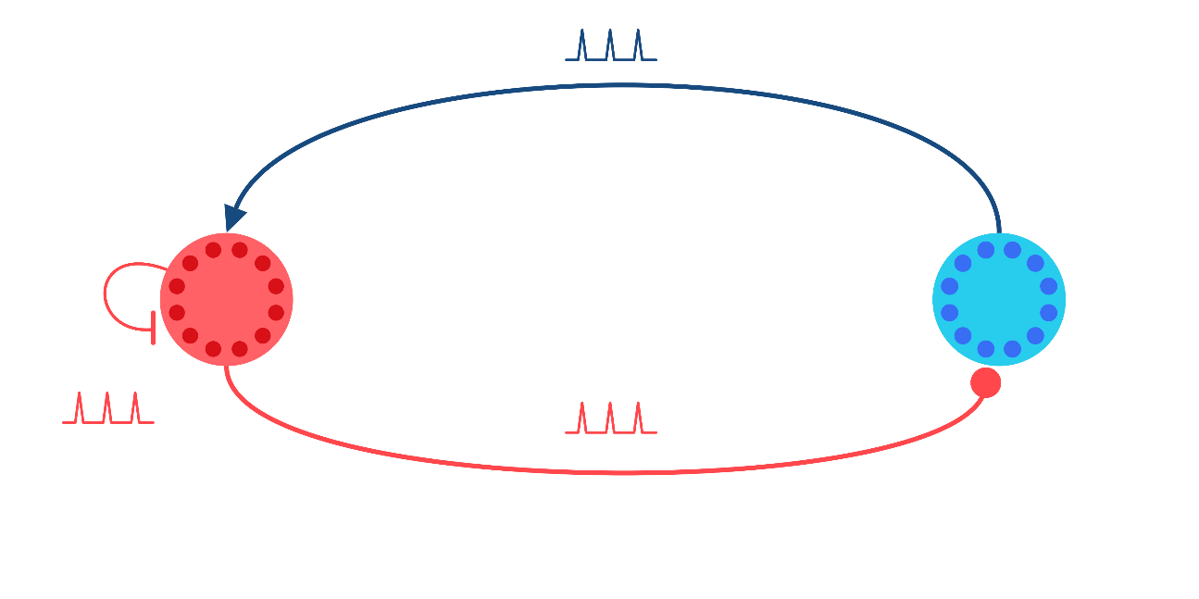




Closed-loop Control of Neural Activity Dynamics
$$+$$
Thijs Lenssen
Supervisor: Amritam Das
$$−$$
P₂
P₁
$$−$$

Slide 2
Sensing – Neural – Actuation Modeling
Single Neural Dynamics
Leaky Integrate-and-Fire (Switching)
Hodgkin Huxley Model (PDE rep)
FitzHugh-Nagumo (Simplification)
Neural Population Dynamics
Neural Mass Models (lumped)
Neural Field Models (distributed)
Dynamical Models in Neuroscience From a Closed-Loop Control Perspective, Martinez et. Al. (2023)

Slide 3
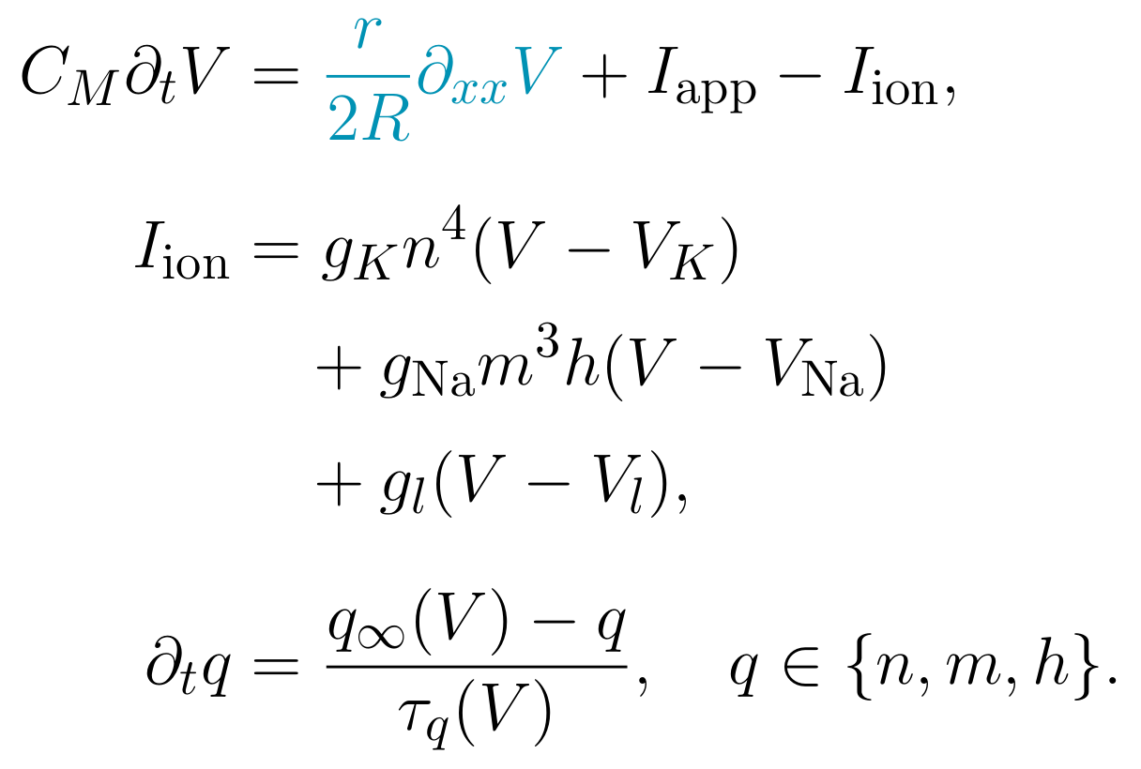
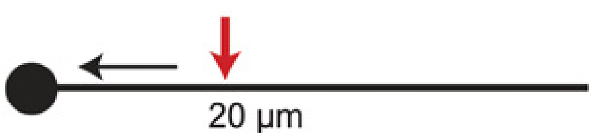
Distributed Hodgkin-Huxley model
An excitable membrane at each position along the axon
Dendrites
Voltage and local channel dynamics
I_app(x,t)
Axon
V(x,t)
Soma
x = 0
x = L
distance along the axon
The cable equation models the axon; dendrites and soma are shown for context.
Schematic: Brette (2015), Fig. 5C, adapted (CC BY). Model: Martinez et al. (2023), Eqs. (8)-(9).
Msc Defence T.M. Lenssen
Notes:
The left schematic adds dendritic branches to the soma-axon portion of Brette (2015), Figure 5C. The original current direction marker and distance label are covered; the red current injection arrow is retained. These labels illustrate the distributed HH model rather than the quantitative experiment of that original panel.
Schematic source: Romain Brette (2015), What Is the Most Realistic Single-Compartment Model of Spike Initiation?, PLoS Computational Biology 11:e1004114, Figure 5C; CC BY. https://doi.org/10.1371/journal.pcbi.1004114. That figure adapts Brette (2013), https://doi.org/10.1371/journal.pcbi.1003338.
Model source: Martinez et al. (2023), Dynamical Models in Neuroscience From a Closed-Loop Control Perspective, p. 708, Eqs. (8)-(9). https://doi.org/10.1109/RBME.2022.3180559.
The voltage PDE is for a uniform unmyelinated axon. V, n, m and h are functions of x and t. q is shorthand for each of n, m, h; therefore the displayed q equation denotes three local gating equations. n is K activation; m is Na activation; h is Na inactivation. The sodium, potassium and leak currents are explicitly expanded.
Dendrites and soma provide anatomical context. They require a branched cable/compartment extension and appropriate interface conditions to model explicitly. This is an individual-neuron model, not a population-rate model. Initial/boundary conditions, kinetics and parameters must be supplied for simulation.

Slide 4
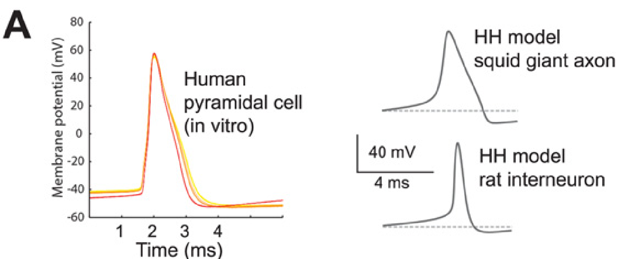
Hodgkin Huxley Model
Spike-onset comparison across different preparations; not a fit to the same cell.
Brette (2015), Fig. 3A; adapted from Testa-Silva et al. (2014) and Sengupta et al. (2010). CC BY.
Notes:
Brette (2015), What Is the Most Realistic Single-Compartment Model of Spike Initiation?, PLoS Computational Biology 11:e1004114, Figure 3A (PDF page 6). https://doi.org/10.1371/journal.pcbi.1004114
Left: recorded human pyramidal-cell action potentials in vitro. Right: single-compartment HH examples for squid giant axon and rat interneuron. These are different preparations, not a model fitted to the recorded cell. The comparison concerns spike-onset shape, not a validation of the distributed HH cable model.
Brette credits Testa-Silva et al. (2014), https://doi.org/10.1371/journal.pbio.1002007, and Sengupta et al. (2010), https://doi.org/10.1371/journal.pcbi.1000840. Figure reproduced under the article Creative Commons Attribution license. The original plotted data, labels and scale bars are retained.

