Slide 1
Course project powerpoint
Thijs van den Ende

Slide 2
Input example
Variables:
Explanatory variables: wt, hp
Dependent variable: mpg
Include interaction terms
Dependent variable can not be in the explanatory variables. After choosing variables, click submit button to generate the model.

Slide 3
Summary statistics of the generated model
term | estimate | std.error | statistic | p.value
(Intercept) | 49.80842343 | 3.60515580 | 13.815887 | 0.00000000000005005761
wt | -8.21662430 | 1.26970814 | -6.471270 | 0.00000051992872795832
hp | -0.12010209 | 0.02469835 | -4.862758 | 0.00004036243020675190
wt:hp | 0.02784815 | 0.00741958 | 3.753332 | 0.00081083073737062529

Slide 4
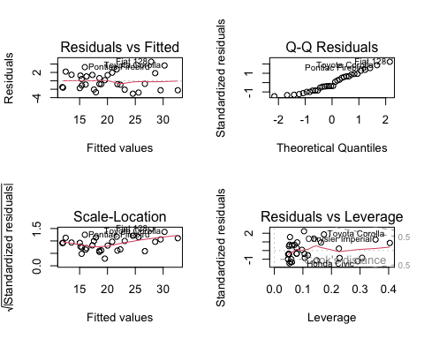
Plots of the model generated

Slide 5
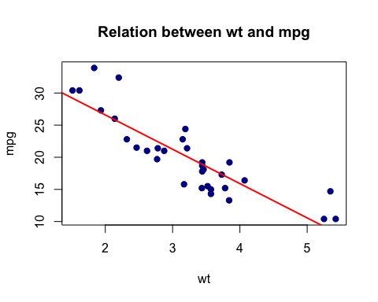
Linear relationship between two variables
This plot can only be shown with one predictor

