Slide 1
Hibernate

Slide 2
Hibernate is a Java framework that simplifies the development of Java
Application to interact with the database.
It is an open source, lightweight, ORM (Object Relational Mapping) tool.
Hibernate implements the specifications of JPA (Java Persistence API) for data persistence(The javax.persistence package contains the JPA classes and
interfaces)

Slide 3
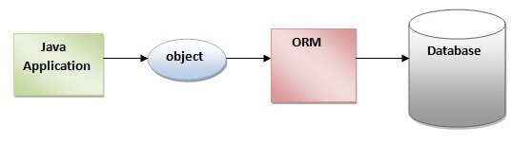
ORM Tool
An ORM tool simplifies the data creation, data manipulation and data access. It is a programming technique that maps the object to the data stored in the database.
The ORM tool internally uses the JDBC API to interact with the database.

Slide 4
JDBC and JPA
JDBC (Java Database Connectivity) provides a set of Java APIs to access the relational databases from the Java program. Java APIs enable programs to execute SQL statements and interact with any SQL database.
JDBC gives a flexible architecture to write a database-independent web application that can execute on different platforms and interact with different DBMS without any change.
Java Persistence API (JPA) is a Java specification that provides specific functionality and is a standard for ORM tools.
javax.persistence package contains the JPA classes and interfaces.

Slide 5
Mapping
The mapping of Java classes to database tables is implemented by the configuration of an XML file or by using Java Annotations
@Entity annotation marks this class as an entity.
@Table annotation specifies the table name where data of this entity is to be persisted. If you don't use @Table annotation, hibernate will use the class name as the table name by default.
@Id annotation marks the identifier for this entity.
@Column annotation specifies the details of the column for this property or field. If @Column annotation is not specified, property name will be used as the column name by default.

Slide 6
Hibernate Over JDBC
Hibernate code will work well for all databases, for ex: Oracle,MySQL, etc. where as JDBC is database specific.
No knowledge of SQL is needed because Hibernate is a set of objects and a table is treated as an object, where as to work with JDBC, one need to know SQL.

Slide 7
Session Factory vs Session
The main responsibility of a Hibernate SessionFactory is to create and manage Sessions.
The main responsibility of a Hibernate Session is to provide a CRUD interface for mapped classes, and also access to the more versitile Criteria API.

Slide 8
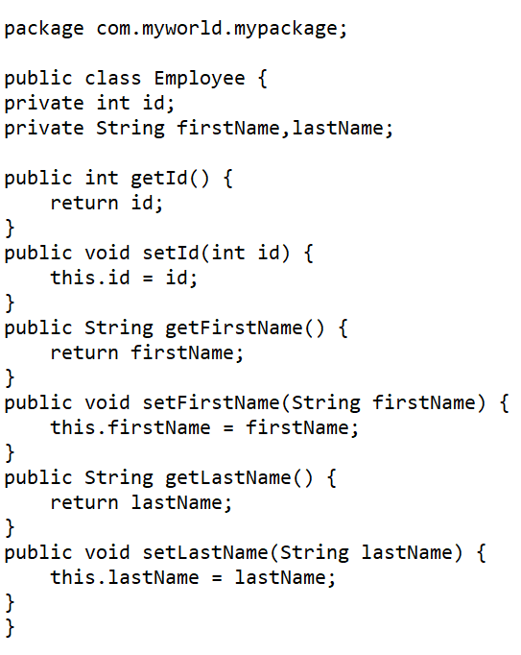
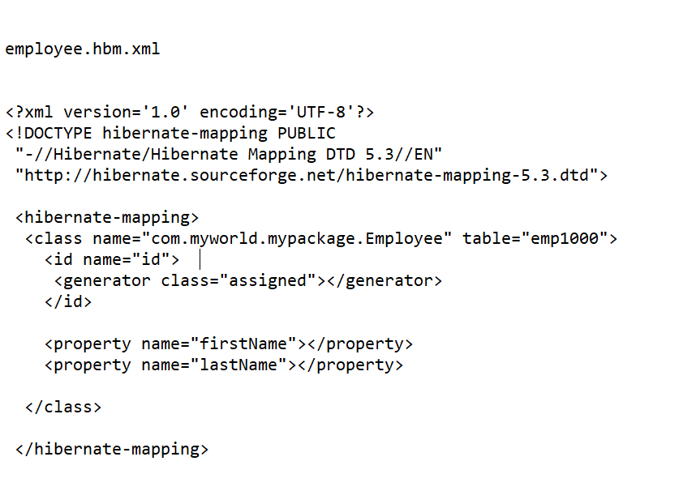
Create Persistant class Mapping file for Persistent class

Slide 9
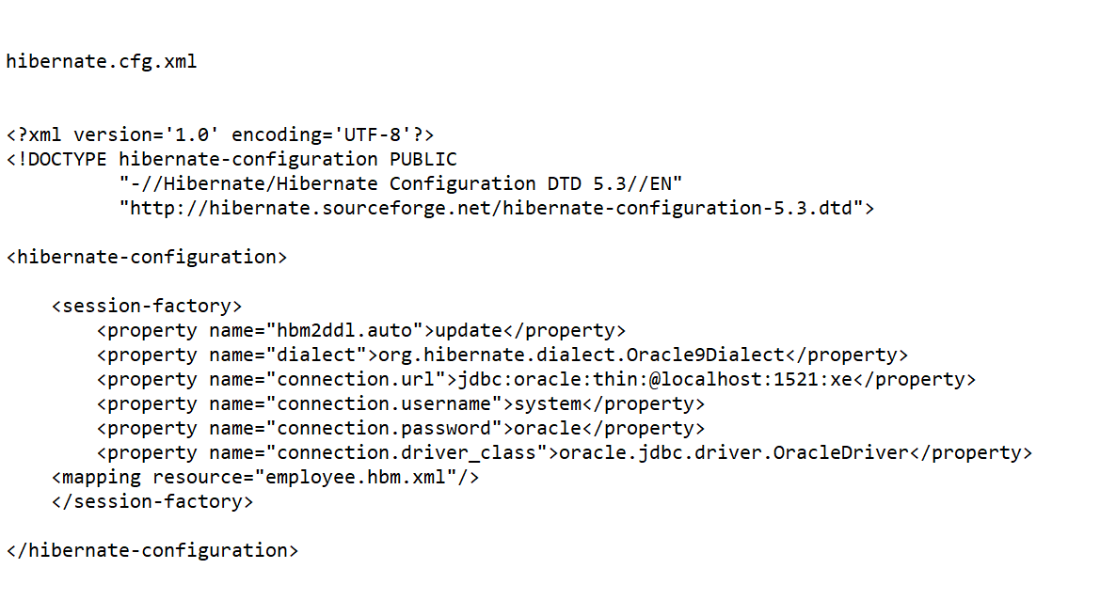
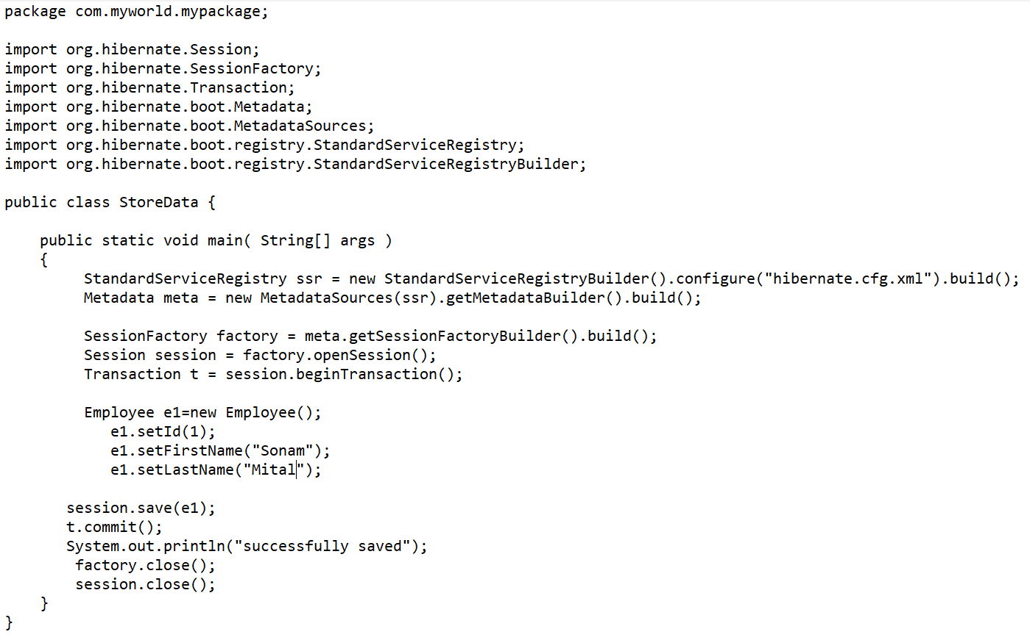
Create the Configuration file create the class that retrieves or store the persistant object

Slide 10
Conclusion
To run the hibernate application, right click on the StoreData class - Run As - Java Application.

