Slide 1
17MDC36 BUSINESS STATISTICS LAB USING R
PROJECT TITLE : Mall Customer Segmentation
Done by:
Kaaviasudhan V S 2033016
Santhosh K V 2033030
Thilak P L 2033037
GUIDE NAME:
Dr. S. Chandia
M.C.A, M.Phil, Ph.D,
Assistant Professor
Coimbatore Institute of Technology

Slide 2
INTRODUCTION
Customer Segmentation is the process of division of customer base into several groups of individuals that share a similarity in different ways that are relevant to marketing such as gender, age, interests, and miscellaneous spending habits.
customers who are individuals, attributes like age, gender, and marital status are frequently used. If these attributes are not maintained properly, the segments will be inaccurate and as a result, the information will likely be less useful. If the users do not feel comfortable with the quality of the data, they are likely not going to use the segments.

Slide 3
PROBLEM STATEMENT
It is not possible to produce products in mass scale for every segment. Market segmentation is expensive in both production and marketing. Market segmentation also creates promotional, problems and multiplies promotional difficulties. Market segmentation leads to heavy investment.

Slide 4
OBJECTIVE
To gain a deeper approach of the customer are targeting.
To be specific and should be tailored to address the requirements of each and every individual customer.
To Therefore through the data collected, companies can gain a deeper understanding of customer preferences as well as the requirements for discovering valuable segments that would reap them maximum profit.

Slide 5
DATASET USED
Dataset Name: Mall_Customer data
The Table dataset consists of following features
Customer_Id
Gender
Age
Annual Income And
Spending Score
The data consists of 200 records
Link: (GITHUB)
https://github.com/sharmaroshan/Clustering-of-Mall-Customers/blob/master/Mall_Customers.csv

Slide 6
METHODS/TECHNIQUES/TOOLS USED
Correlations and Regression Analysis – covary and equation
One way ANOVA - for commodity and suitable distribution of products
Shewhart quality control charts for variables: xbar, R and S charts – for To visualize and interpret data.
Trends Analysis – Fitting Liner, quadratic and Exponentials trends

Slide 7
INFERENCE
The Anova test the this as Null Hypothesis which states that in all group are drawn from populations with the same mean values.
The graphs are visual representations which can give information both directly and indirectly

Slide 8
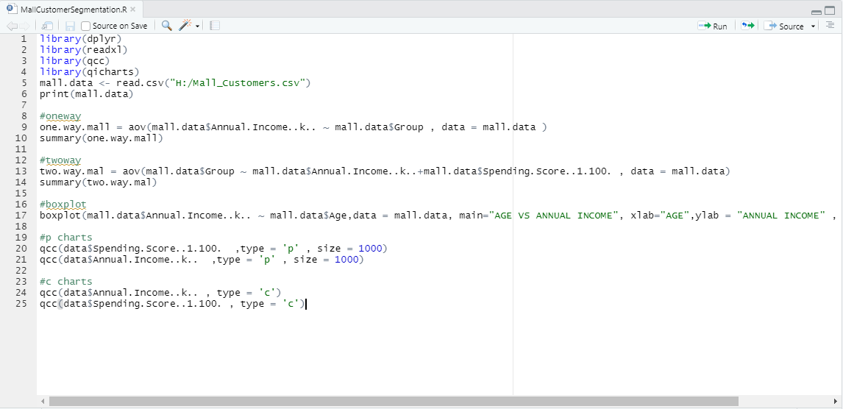
SOURCE CODE

Slide 9
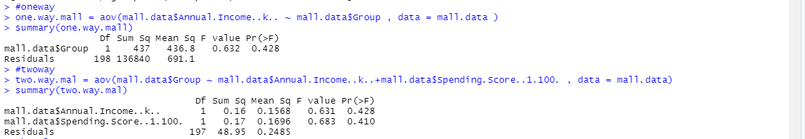
ONE WAY / TWO WAY ANOVA - OUTPUT

Slide 10
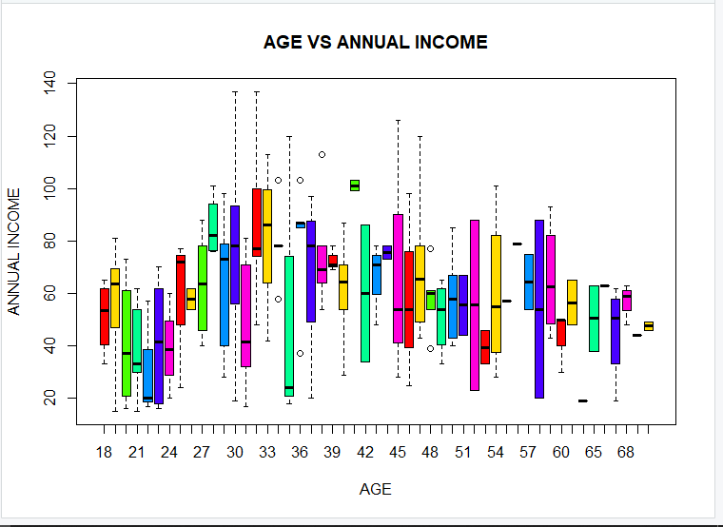
BOXPLOT CHART - OUTPUT
boxplot(mall.data$Annual.Income..k.. ~ mall.data$Age,data = mall.data, main="AGE VS ANNUAL INCOME", xlab="AGE",ylab = "ANNUAL INCOME" , col = rainbow(7))

Slide 11
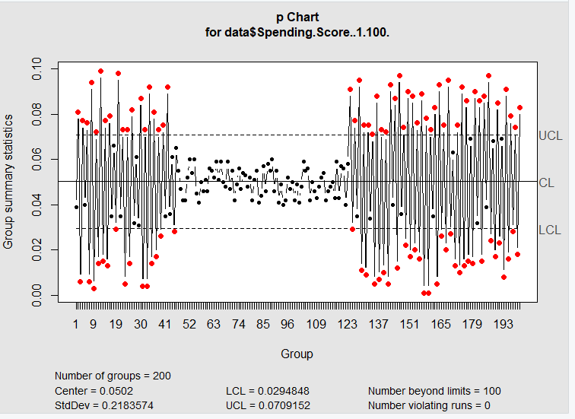
P CHART - OUTPUT
P CHART Analysis for Spending Amount

Slide 12
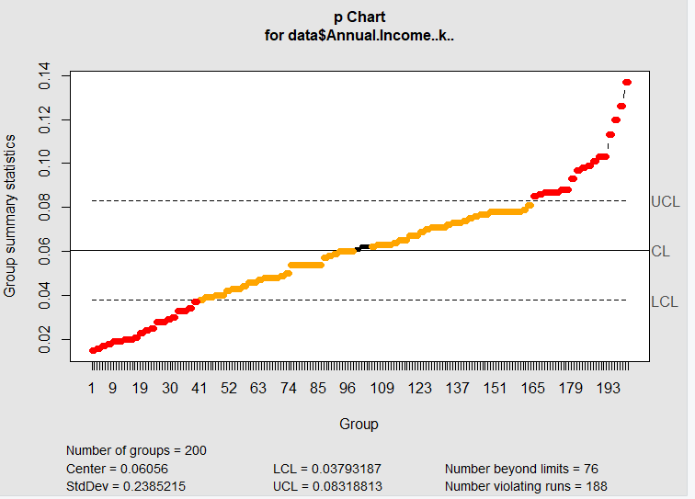
P CHART - OUTPUT
P CHART Analysis for Annual Income

Slide 13
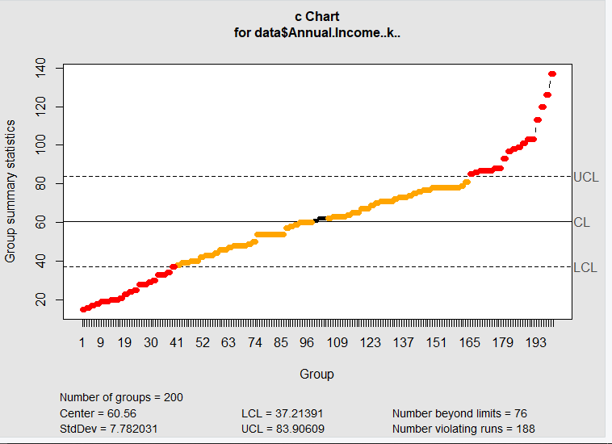
C CHART - OUTPUT
C CHART Analysis for Annual Income

Slide 14
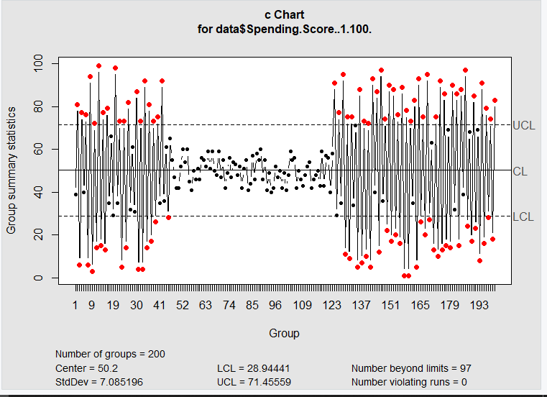
C CHART - OUTPUT
C CHART Analysis for Spending Score

Slide 15
17MDC36 BUSINESS STATISTICS LAB USING R
PROJECT TITLE : Mall Customer Segmentation
Done by:
Kaaviasudhan V S 2033016
Santhosh K V 2033030
Thilak P L 2033037
GUIDE NAME:
Dr. S. Chandia
M.C.A, M.Phil, Ph.D,
Assistant Professor
Coimbatore Institute of Technology

Slide 16
PROBLEM STATEMENT
It is not possible to produce products in mass scale for every segment. Market segmentation is expensive in both production and marketing. It also creates promotional, problems and multiplies promotional difficulties and this leads to heavy investment.

Slide 17
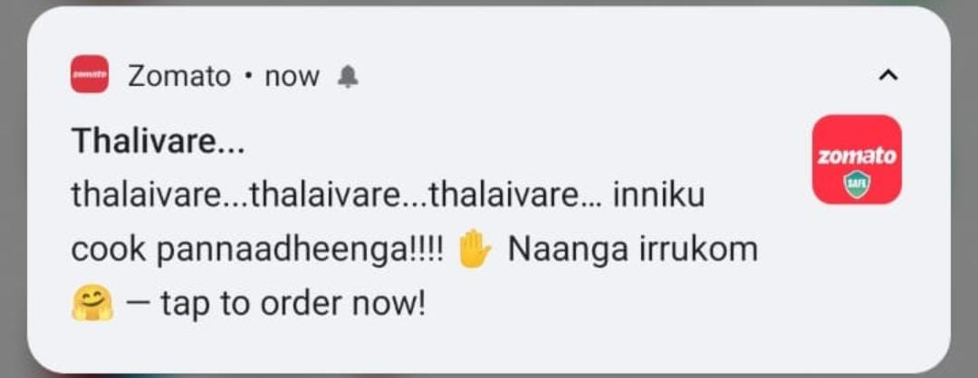
OBJECTIVE
To gain a deeper approach of the customer are targeting.
To forecast customers details.
To be specific and should be tailored to address the requirements of each and every individual customer.
To Therefore through the data collected, companies can gain a deeper understanding of customer preferences as well as the requirements for discovering valuable segments that would reap them maximum profit.

Slide 18
DATASET USED
Dataset Name: Mall_Customer data
The Table dataset consists of following features
Customer_Id
Gender
Age
Annual Income And
Spending Score
The data consists of 200 records
Link: (GITHUB)
https://github.com/sharmaroshan/Clustering-of-Mall-Customers/blob/master/Mall_Customers.csv

Slide 19
METHODS/TECHNIQUES/TOOLS USED
Correlation
Linear Regression
Time Series
Kurskal Wallis test
Cumsum
P – Chart and C – Chart
Box Plot
One Way ANOVA and Two Way ANOVA

Slide 20
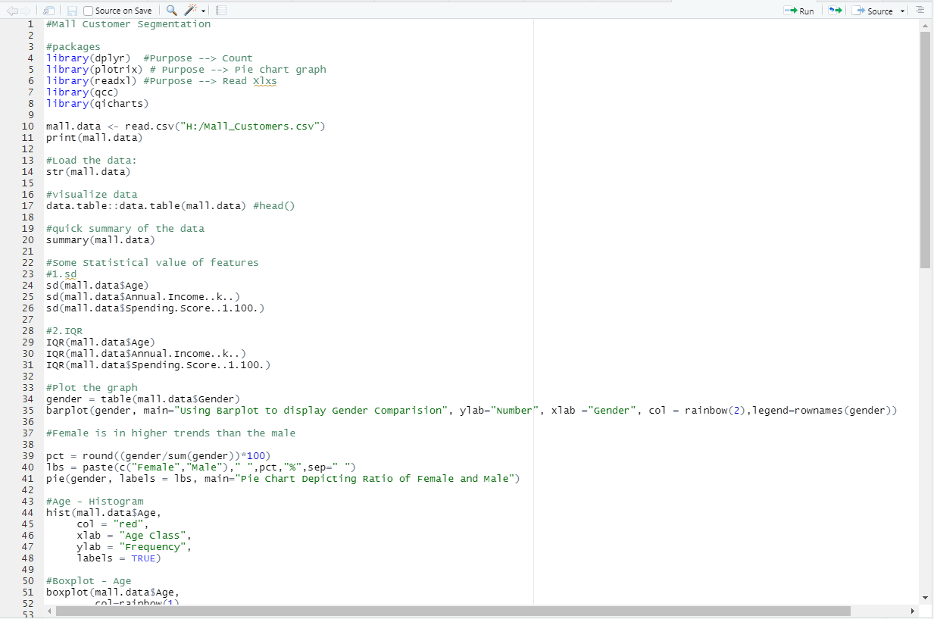
SOURCE CODE

Slide 21
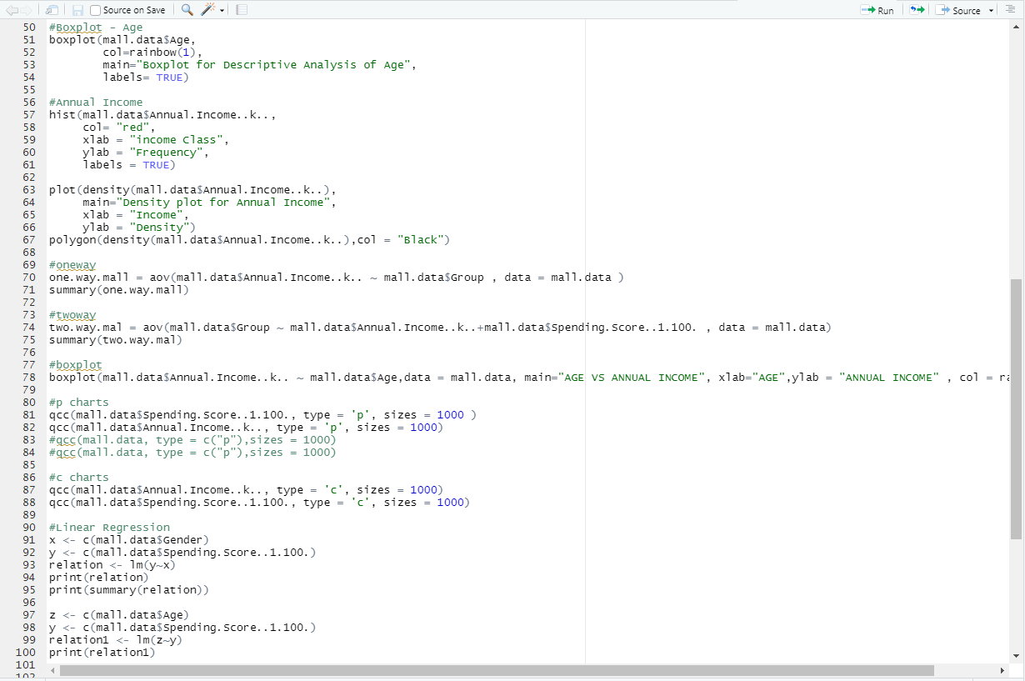
SOURCE CODE

Slide 22
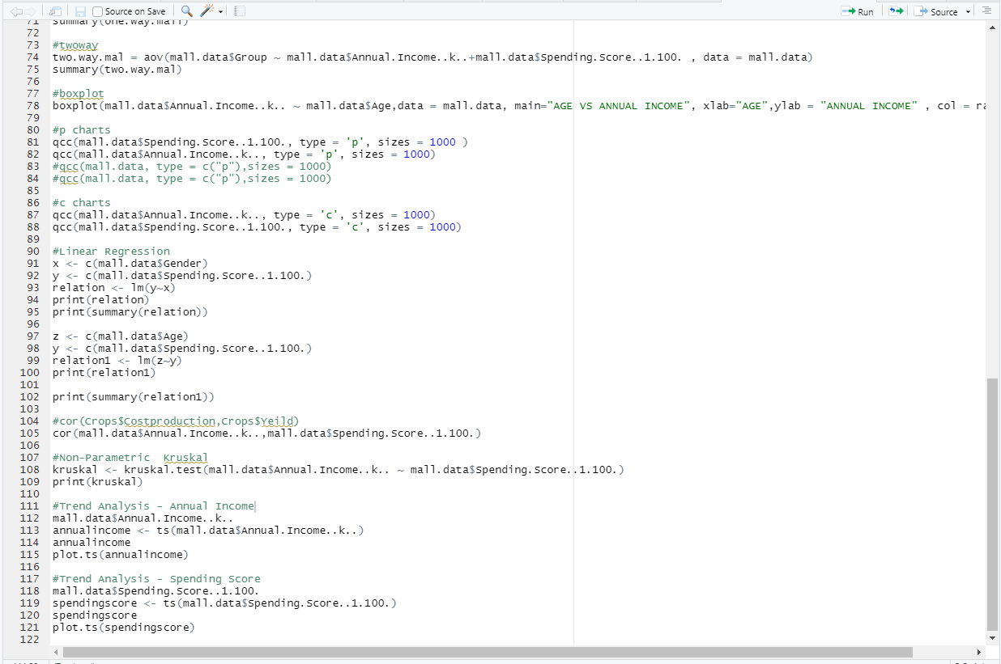
SOURCE CODE

Slide 23

Correlation
An increase in one variable leads to an increase in the other variable and vice versa.
Source Code:
#cor() – Annual Income and Spending Income
cor(mall.data$Annual.Income..k..,mall.data$Spending.Score..1.100.)
Output:
Notes:
For example, spending more time on a treadmill burns more calories. Negative correlation: A negative correlation between two variables means that the variables move in opposite directions.

Slide 24
Linear Regression
The main uses of regression analysis are forecasting, time series modeling and finding the cause and effect relationship between variables.
Source Code:
x <- c(mall.data$Gender)
y <- c(mall.data$Spending.Score..1.100.)
relation <- lm(y~x)
print(relation)
print(summary(relation))

Slide 25
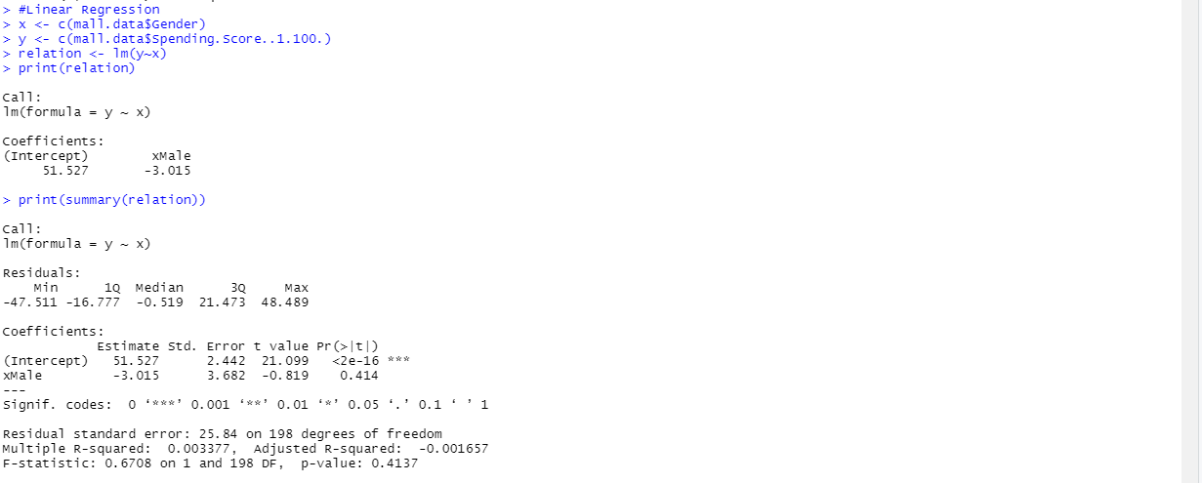
Output – Linear Regression Gender VS Spending Score

Slide 26
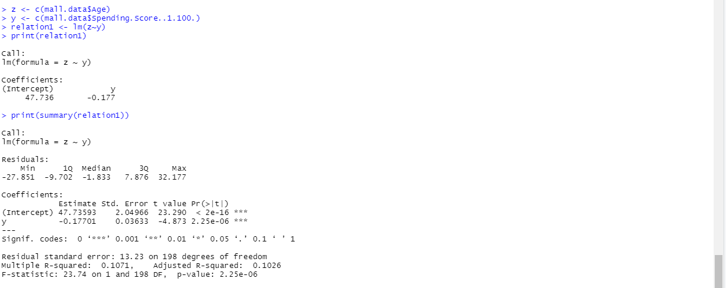
Output – Linear Regression Age VS Spending Score

Slide 27
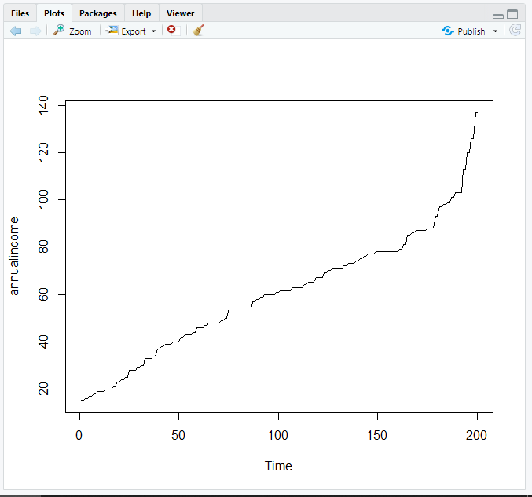
Time Series Analysis
Time series graphs can be used to visualize trends in counts or numerical values over time.

Slide 28
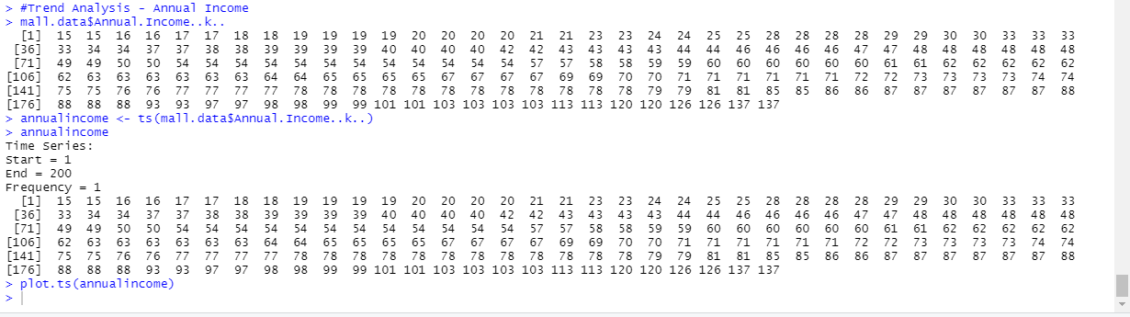
Time Series Analysis Annual Income

Slide 29
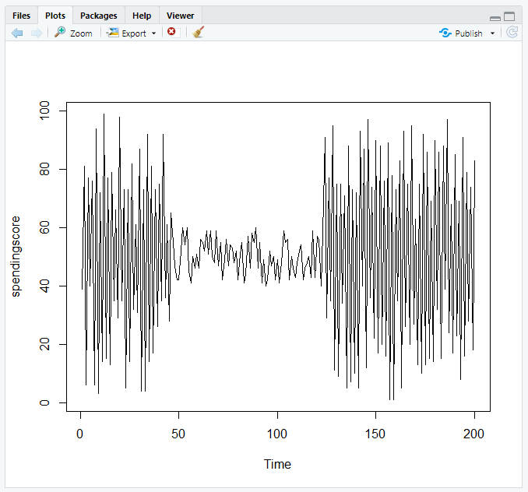
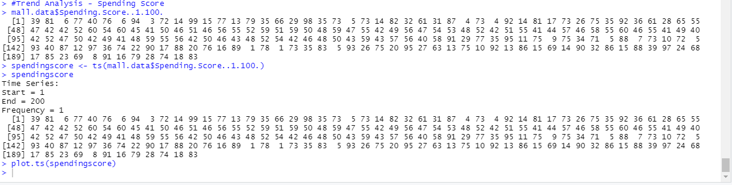
Time Series Analysis Spending Score

Slide 30
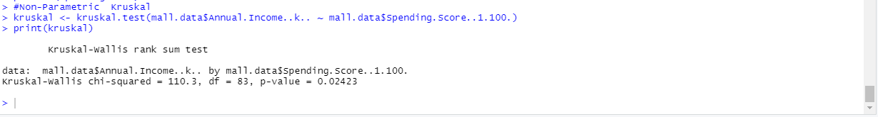
Kurskal Test
The procedure is used to compare three or more groups on a dependent variable that is measured on at least an ordinal level
Source Code:
#Non-Parametric Kruskal
kruskal <- kruskal.test(mall.data$Annual.Income..k.. ~ mall.data$Spending.Score..1.100.)
print(kruskal)
Output:

Slide 31
Cumsum Test
Cumsum - Returns a vector whose elements are the cumulative sums of the elements of the argument..
#cumsum - Annual Income
frame=data.frame(mall.data$Annual.Income..k..)
frame$cum =cumsum(mall.data$Annual.Income..k..)
plot(frame$cum, type='l', xlab='Days', ylab='Annual Income',col="blue")
#cumsum - Spending Score
frame=data.frame(mall.data$Spending.Score..1.100.)
frame$cum =cumsum(mall.data$Spending.Score..1.100.)
plot(frame$cum, type='l', xlab='Days', ylab='Spending Score',col="blue")

Slide 32
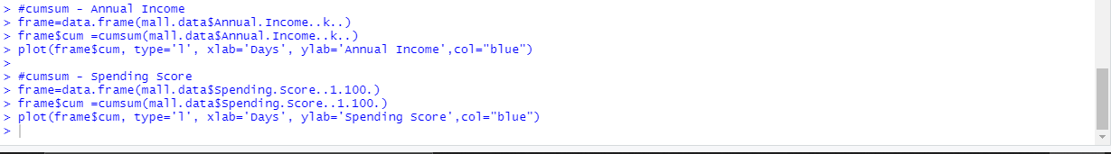
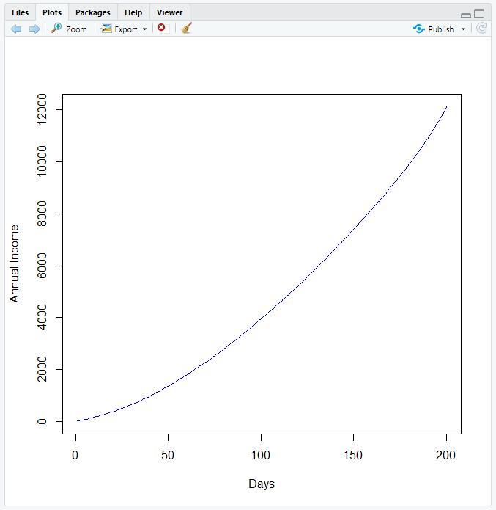
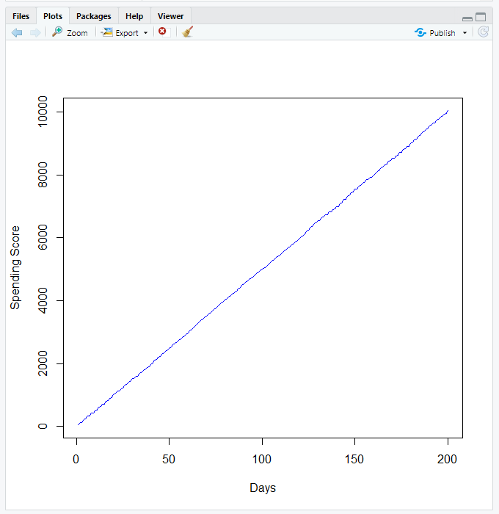
Output – Cumsum Annual Income & Spending Score

Slide 33
BOXPLOT CHART - OUTPUT
boxplot(mall.data$Annual.Income..k.. ~ mall.data$Age,data = mall.data, main="AGE VS ANNUAL INCOME", xlab="AGE",ylab = "ANNUAL INCOME" , col = rainbow(7))

Slide 34
P CHART - OUTPUT
P CHART Analysis for Spending Amount

Slide 35
P CHART - OUTPUT
P CHART Analysis for Annual Income

Slide 36
C CHART - OUTPUT
C CHART Analysis for Annual Income

Slide 37
C CHART - OUTPUT
C CHART Analysis for Spending Score

Slide 38
INFERENCE
1. The graphs are visual representations which can give information both directly and indirectly
2. Determine your customer segmentation goals.
3. Segment your customers into groups of your choice.
4. Target and reach your customer segments.
5. Run customer segmentation analysis.

Slide 39


