Slide 1
RFID BASED ATTENDANCE SYSTEM

Slide 2
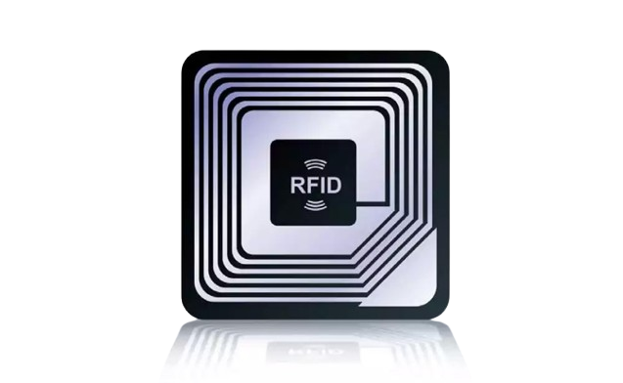
RFID ATTENDANCE
What is RFID?
RFID (Radio Frequency Identification.
RFID is a technology that enables the wireless identification and tracking of objects using radio waves.
Each RFID tag contains unique identification information, and a network of RFID readers can be deployed to detect these tags.
RFID systems utilize readers to detect RFID tags, and specialized software interprets the data collected from these tags.
Overall, RFID technology enhances efficiency and accuracy in various industries by automating the process of identification and tracking.

Slide 3
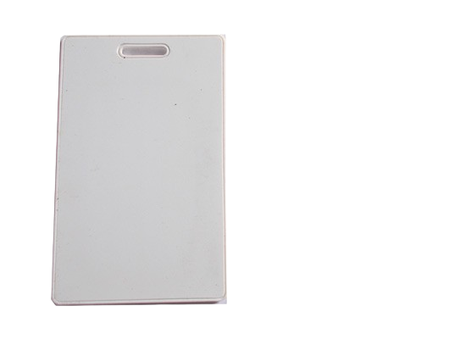
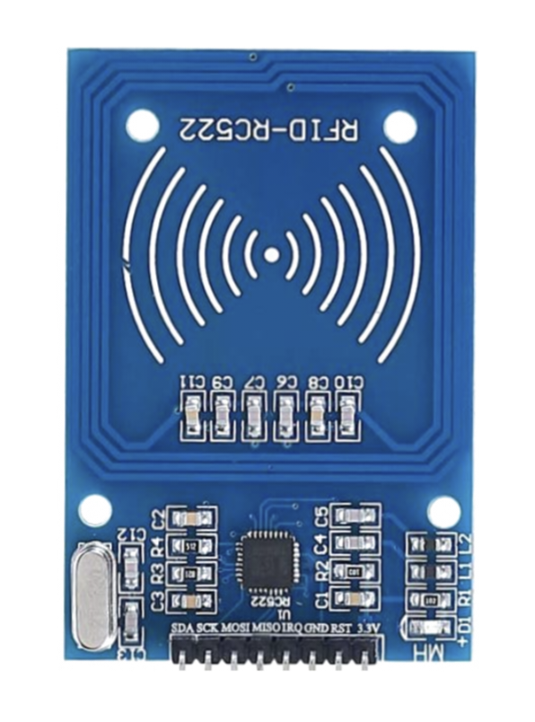
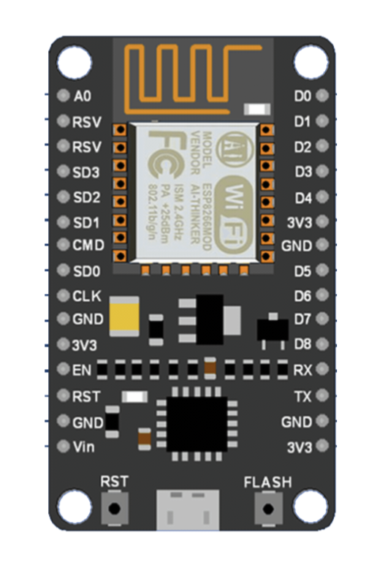
Components of RFID Attendance System
RFID TAG
RFID READER
NODEMCU-esp8266

Slide 4
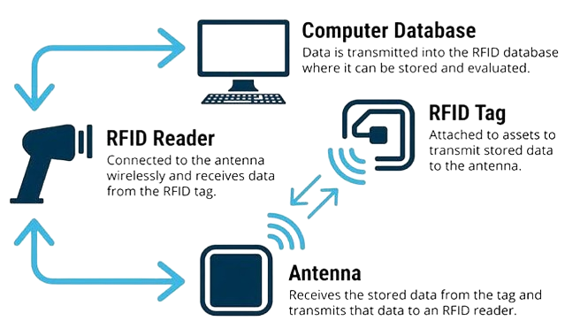
RFID ATTENDANCE
HOW DOES RFID WORKS?
Like barcode technology, RFID Scanner recognizes locations and identification of tagged items — but instead of reading laser light reflections from printed barcode labels, it leverages low-power radio frequencies to collect and store data

Slide 5
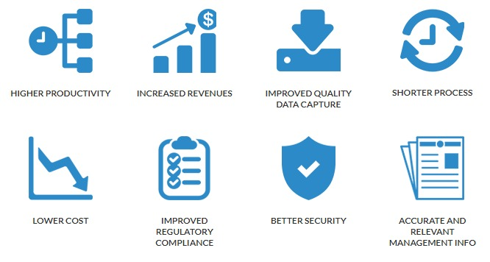
Advantages of RFID Attendance System
Accuracy: Unlike manual methods, RFID ensures accurate attendance recording.
Efficiency: Faster data capture saves time.
Automation: No need for manual roll calls.
Real-time Tracking: Monitor attendance in real-time.

Slide 6
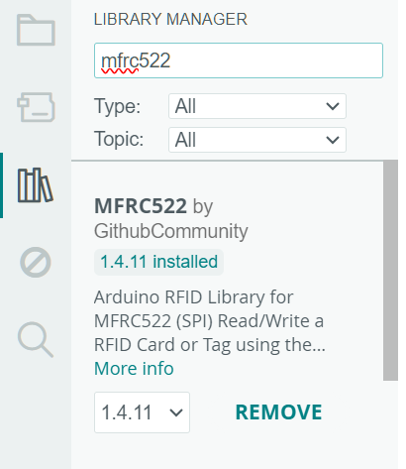
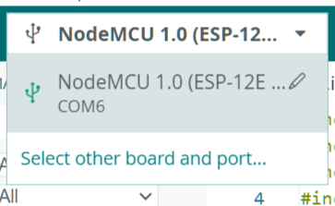
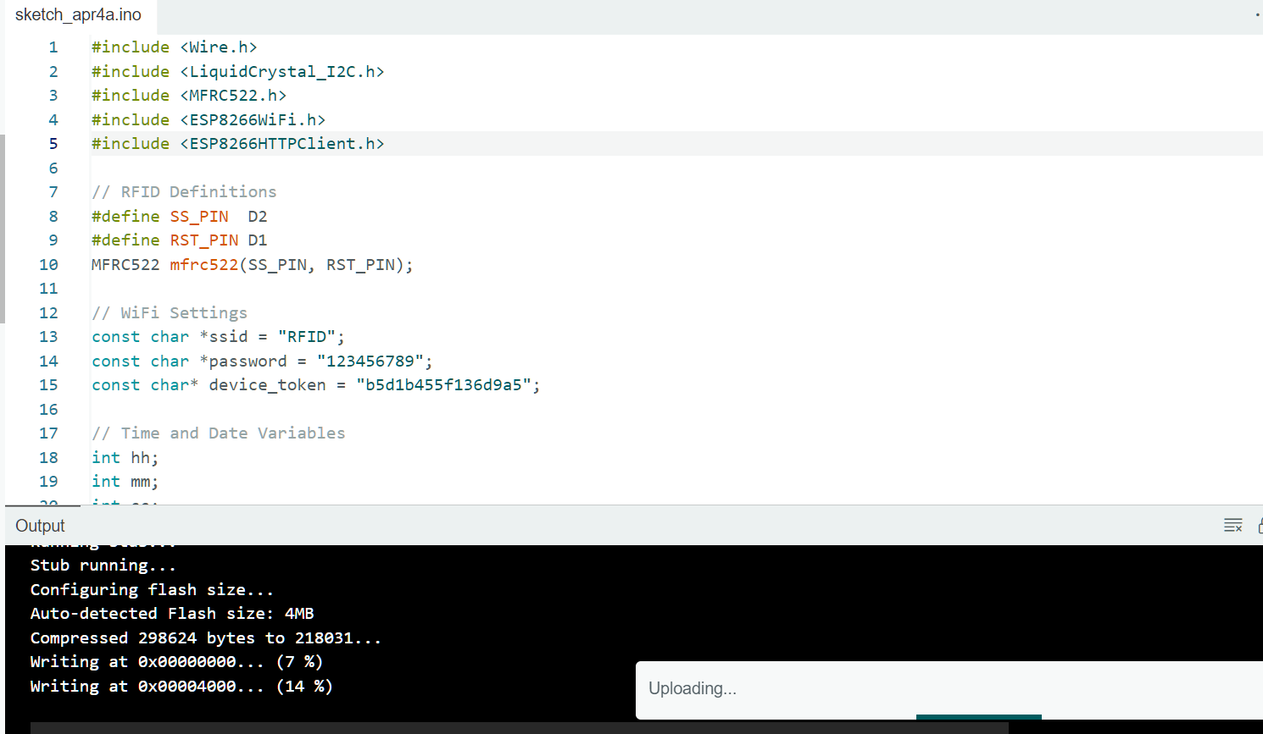
Implementation Steps:
Download the required board and library
Select the port to upload
Upload the code to the NodeMCU

Slide 7
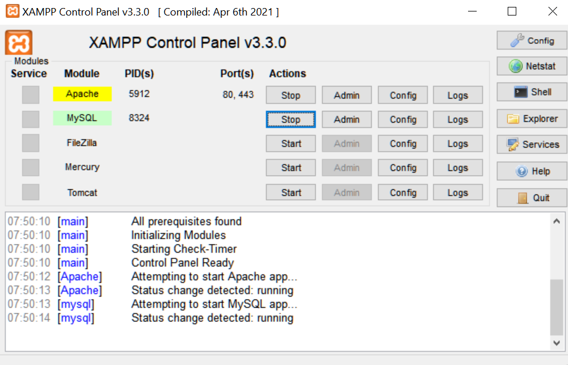

Implementation Steps:
Download XAMPP for our server
Start the XAMPP and SQL server
Connect to local host
(eg. Localhost/RFID-attendance/)

Slide 8

Important part of code
This is used to connect to our network
const char *ssid = “RFID";
const char *password = “123456789";

Slide 9
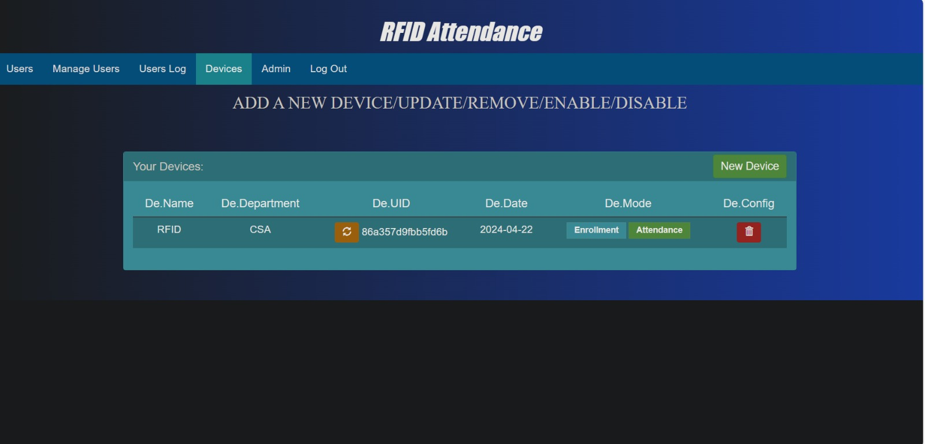
Important part of code
This defines the unique id of our RFID reader
const char* device_token = "2c4f3c61aa79d533";

Slide 10
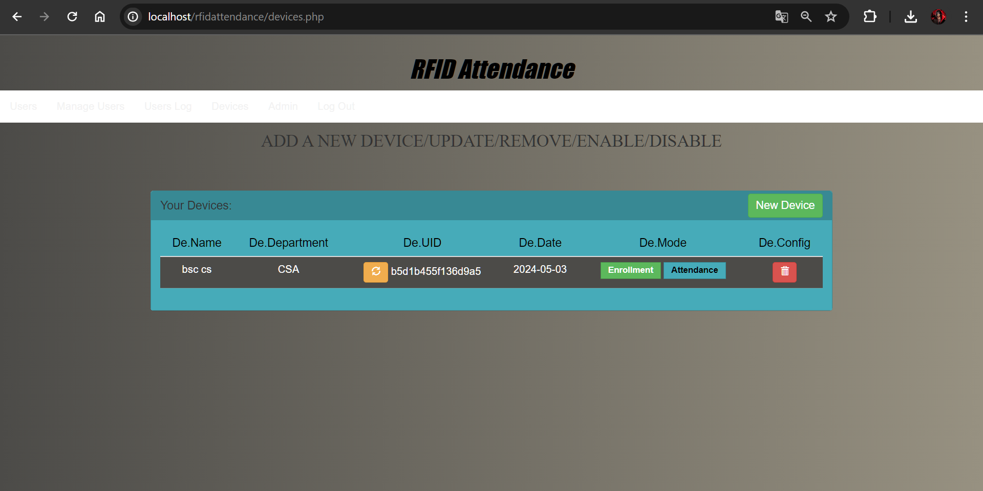
Important part of code
This specifies where the data need to be sent
String URL = "http://192.168.1.8/rfidattendance/getdata.php";
The sent data is received by our PHP file called getdata

Slide 11
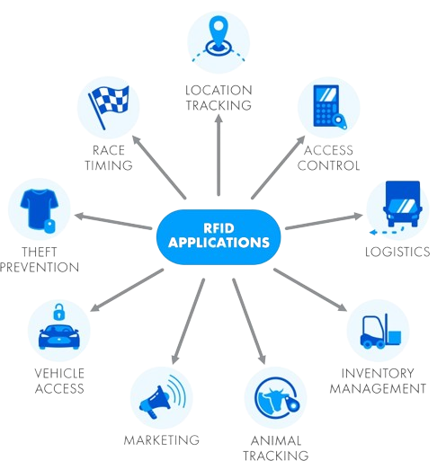
RFID ATTENDANCE
RFID applications and use cases
RFID dates back to the 1940s; however, it was used more frequently in the 1970s. As hardware costs have decreased, RFID adoption has also increased.
Some common uses for RFID applications include:
pet and livestock tracking
inventory management
equipment tracking
vehicle tracking
Shipping
tap-and-go credit card payments

Slide 12

RFID ATTENDANCE
CONCLUSION
In conclusion, an RFID-based attendance system offers several advantages, including accuracy, efficiency, and convenience. By using RFID technology, this system can track attendance with precision and eliminate the need for manual attendance marking.
Moreover, an RFID-based attendance system is a reliable and modern solution for managing attendance in various places.

Slide 13
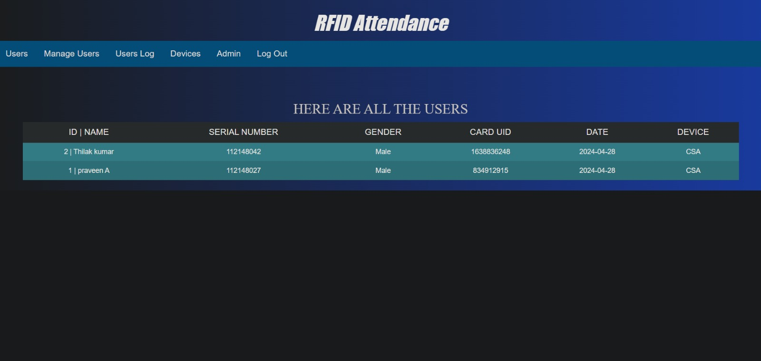

Slide 14
THANK YOU
BY:
THILAKKUMAR & PRAVEEN

