Slide 1
SMART PLANT HEALTH ASSISTANT USING CNN AND NLP FOR DISEASE DETECTION
V. SAI CHAITANYA(TEAM LEADER)
SHIKHA PANDEY
KAVYA KASAM
SAIPRASAD GENTEM
ARAV HANSHIK
THILAK KUMAR

Slide 2
OBJECTIVE
Create a smart system that assists users (farmers, botanists, and plant enthusiasts) in identifying plant diseases using image classification.
Provide detailed descriptions of diseases, symptoms, and potential remedies through natural language generation.
Offer recommendations for plant treatment and care.
Enhance user interaction through a Q&A system, multilingual support, and text-to-speech features for accessibility.
Enable real-time user interaction with a seamless, easy-to-use interface.

Slide 3
TECHNOLOGIES
CNN: For accurate plant disease image classification.
NLP (GPT): For generating disease descriptions and Q&A interactions.
GTTS (Google Text-to-Speech): Converts disease descriptions into speech.
FastAPI: Backend for handling classification, descriptions, and user queries.
Docker: Containerization for consistent deployment across environments.
Azure Services:
Custom Vision: For plant disease classification.
Blob Storage: For dataset management.
OpenAI: For generating disease descriptions.
Translator & Speech Services: For multilingual text and voice responses.
Container Registry & Container Instances: For deployment.

Slide 4
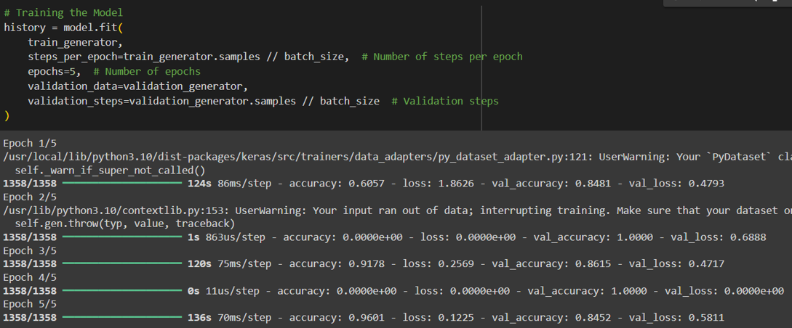
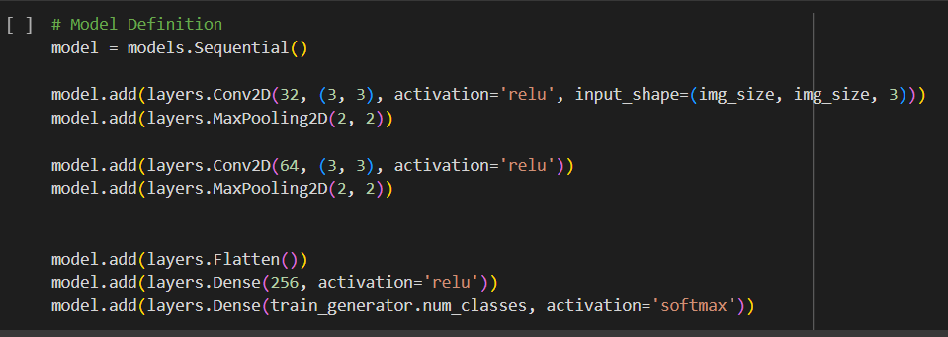
CNN FOR IMAGE CLASSIFICATION
Image Preprocessing : Applied resizing, normalization, and data augmentation to prepare plant images.
Tools: TensorFlow/Keras For building and training the CNN model.
MODEL ARCHITECTURE
EVALUATION METRICS

Slide 5
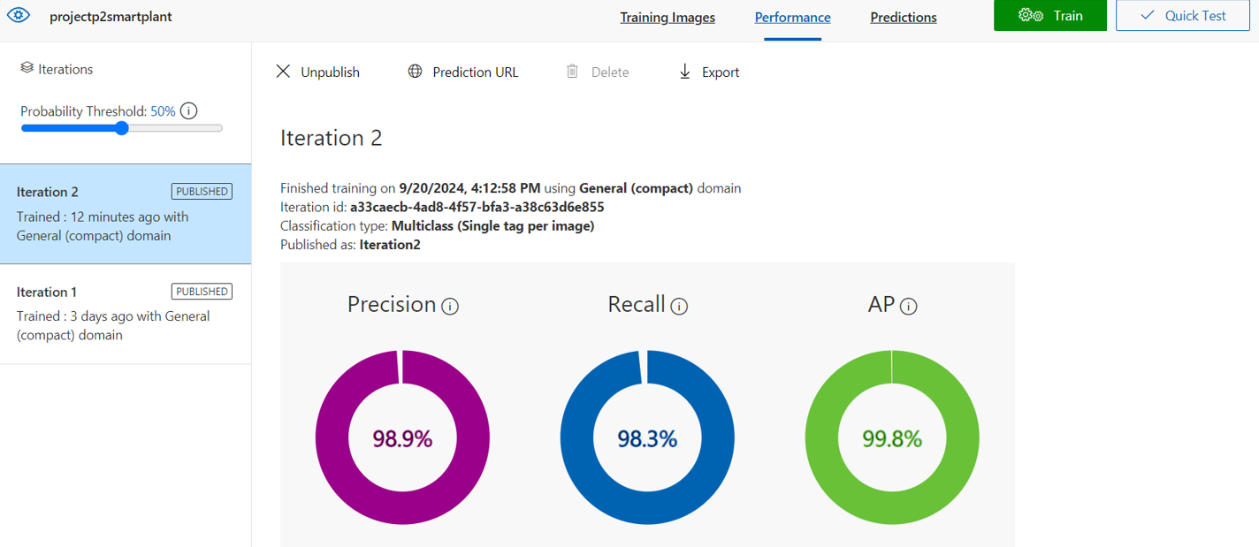
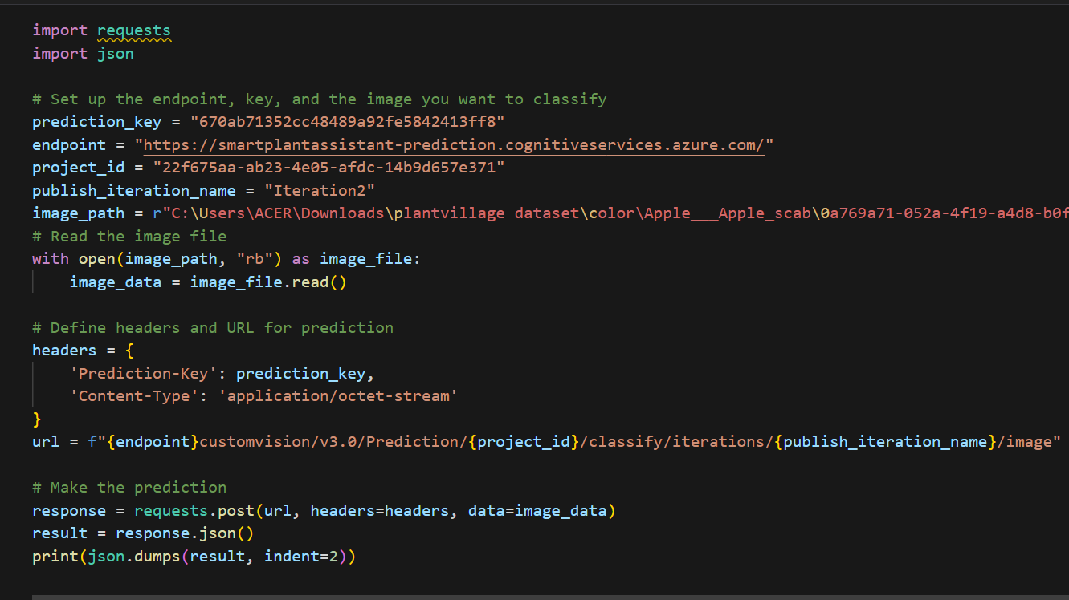
AZURE IMPLEMENTATION
Image Preprocessing: Applied in Azure Blob Storage for handling large datasets securely.
Tools:
Azure Custom Vision: For model training and deployment.
Azure Blob Storage: For dataset storage and access.
EVALUATION METRICS
WORKING MODEL

Slide 6
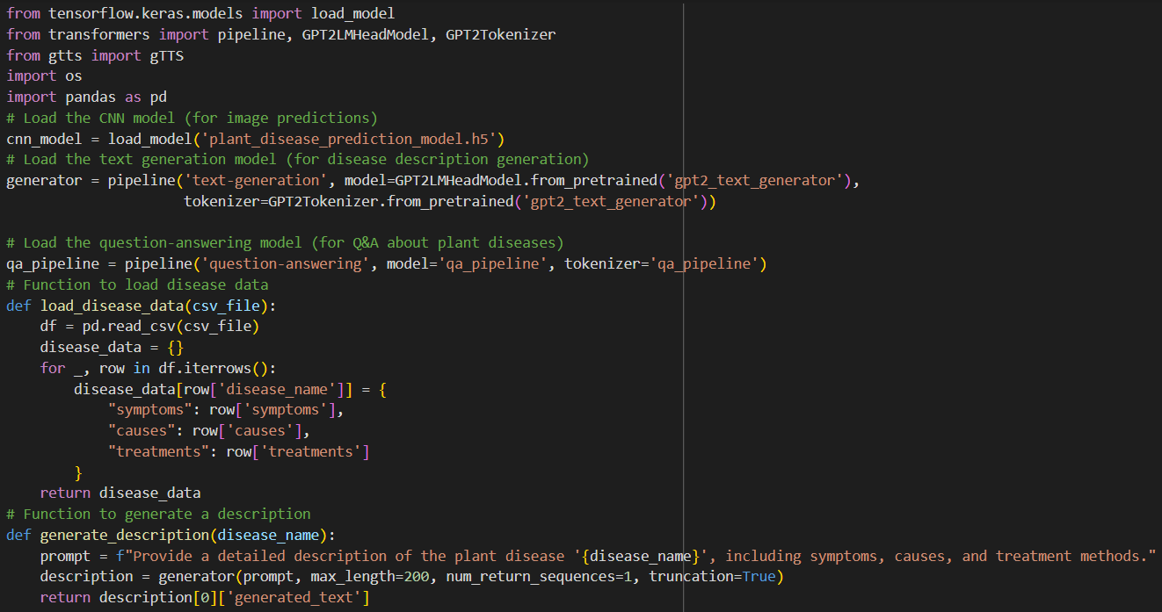
NLP FOR DISEASE DESCRIPTION & Q&A SYSTEM
GPT Model Integration: Integrated GPT model via Hugging Face API to generate detailed disease descriptions.
Symptom Explanation & Q&A System: Enabled interactive user experience by providing disease symptom explanations and a Q&A system for plant-related queries.
WORKING MODEL OF NLP

Slide 7
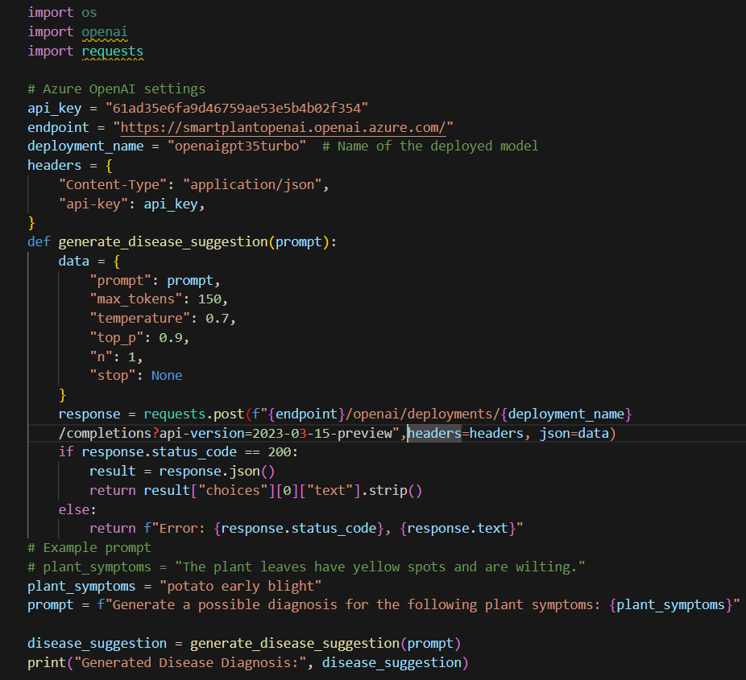
AZURE IMPLEMENTATION
GPT Model Integration: Used Azure OpenAI Service for generating detailed disease descriptions and symptom explanations.
Q&A System: Interactive Q&A for user engagement on plant diseases.
WORKING MODEL OF AZURE

Slide 8
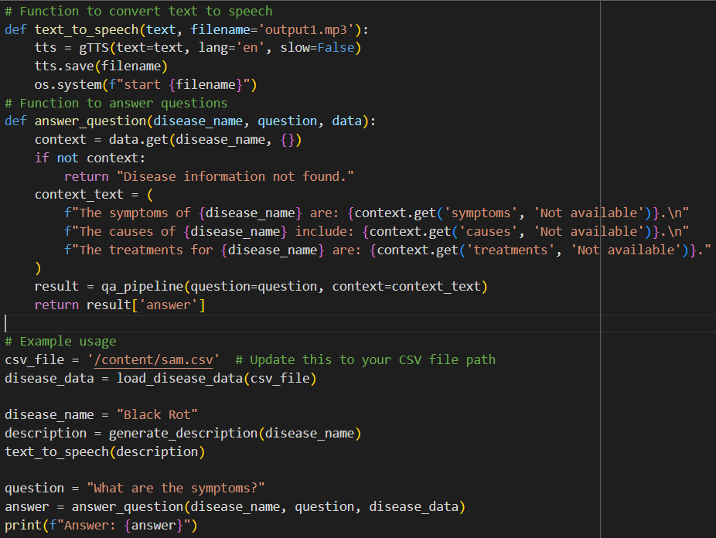
SPEECH SERVICE
Speech Conversion: Used gTTS (Google Text-to-Speech) to convert text descriptions of diseases into speech for user interaction.
WORKING MODEL OF SPEECH

Slide 9
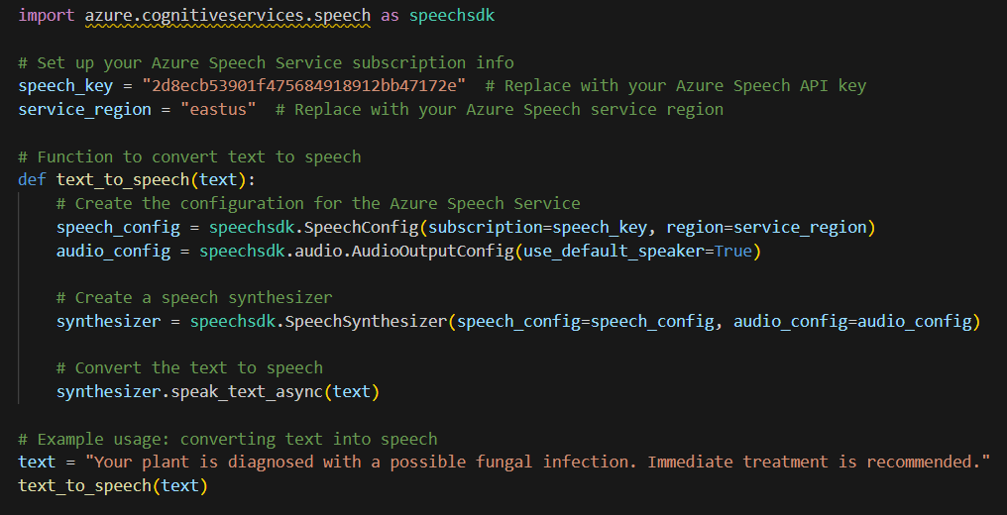
AZURE IMPLEMENTATION
Speech Conversion: Integrated Azure Speech Services to convert disease descriptions into speech for enhanced accessibility.
WORKING MODEL OF AZURE

Slide 10
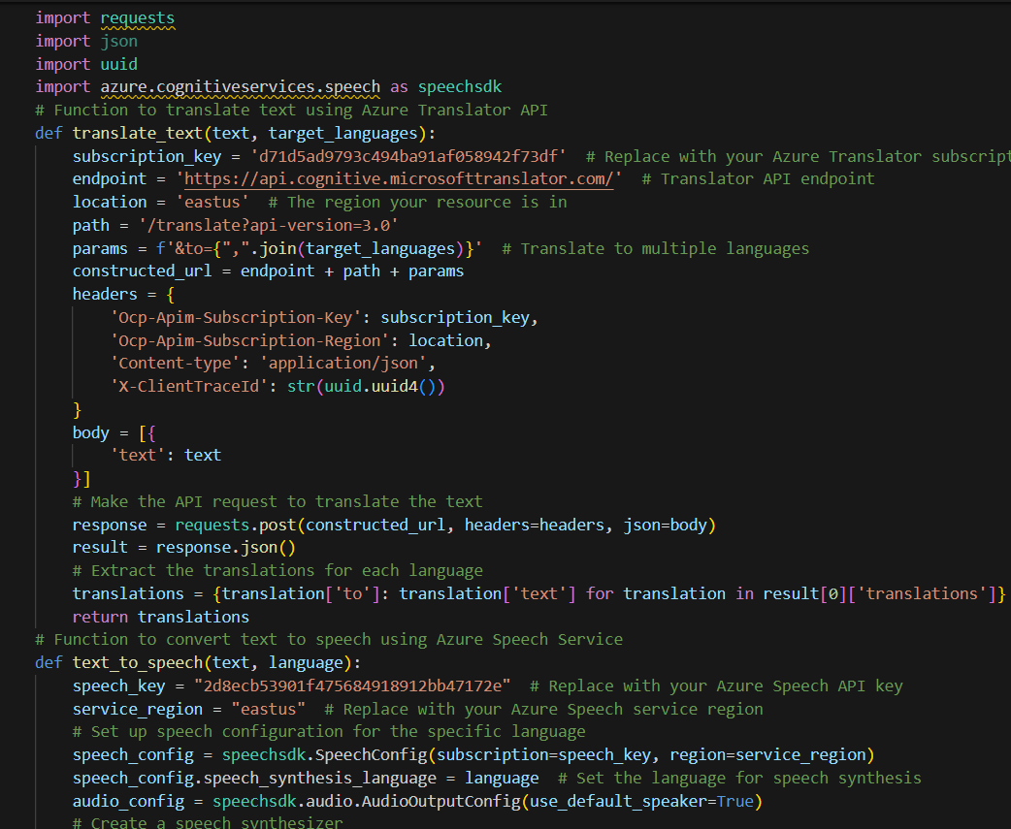
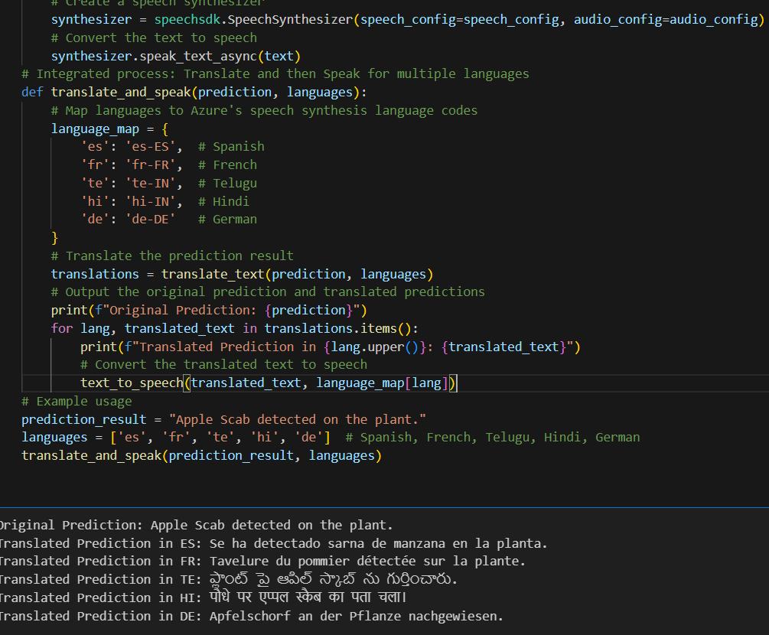
AZURE TRANSLATION SERVICE
Translation: Used Azure Translator Service to provide multilingual support by translating disease descriptions and responses into multiple languages.
WORKING MODEL OF AZURE

Slide 11
INTEGRATION WITH FASTAPI AND POSTMAN
FastAPI Integration: Combined CNN for plant disease classification and NLP for disease descriptions and Q&A into a single FastAPI backend.
API Testing: Used Postman to test the functionality, performance, and reliability of the APIs.
API Routes:
Disease Classification: For image-based plant disease identification.
http://127.0.0.1:8000/predict-disease/
Disease Description : For more detail about disease
http://127.0.0.1:8000/generate-description/{disease_name}
Q&A System: For symptom explanation and user queries.
http://127.0.0.1:8000/qa/?disease_name={disease_name}&question={question}
Speech Output: For converting text responses into speech.
http://127.0.0.1:8000/text-to-speech/{text}

Slide 12
CONTAINERIZATION WITH DOCKER
Description: Utilized Docker to containerize the application, ensuring a consistent environment for development, testing, and production. This approach simplifies deployment and scaling on Azure.
Docker:
Dockerized Application: Created a Docker image that encapsulates the entire application, including the FastAPI backend, CNN model, and NLP components.
Docker Images: Built and optimized Docker images for efficiency and reduced latency.
Docker build –t smart-plant-assistant
Docker run –p 8000:8000 smart-plant-assistant-app

Slide 13
AZURE DEPLOYMENT
Azure Container Registry: Stored Docker images securely in Azure Container Registry for easy access and management.
Deployment: Deployed the Docker container using Azure Container Instances, enabling scalable and efficient execution of the application in the cloud.
az login
az acr login --name SmartPlantconreg
docker tag samrt-plant-assistant-app:latest SmartPlantconreg.azurecr.io/samrt-plant-assistant-app:latest
docker push SmartPlantconreg.azurecr.io/samrt-plant-assistant-app:latest
az acr repository show-tags --name SmartPlantconreg --repository samrt-plant-assistant-app
http://smartplant-instance.eastus.azurecontainer.io:8000/

Slide 14
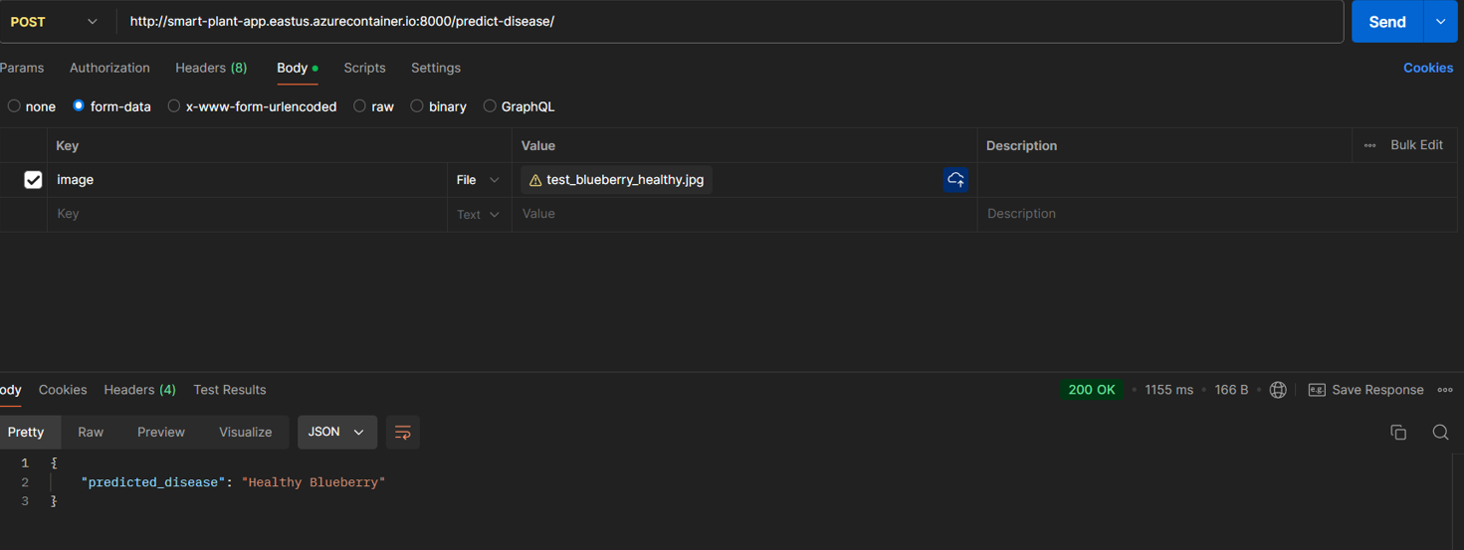
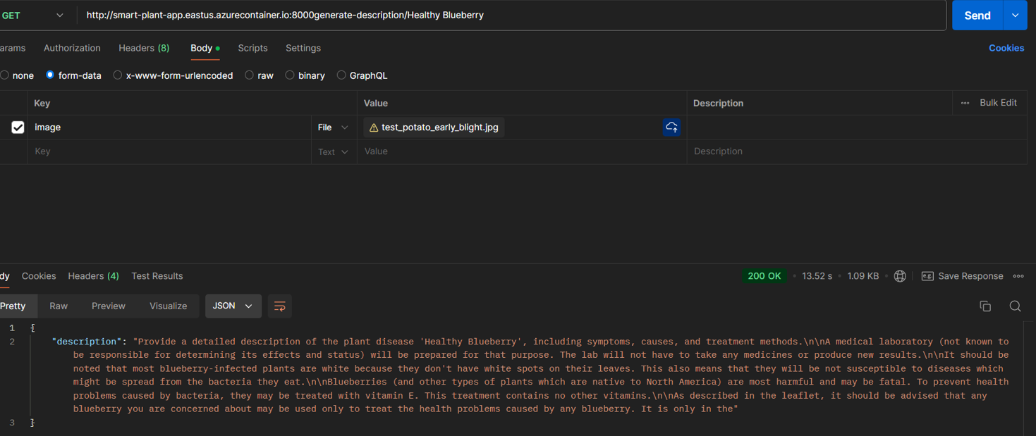
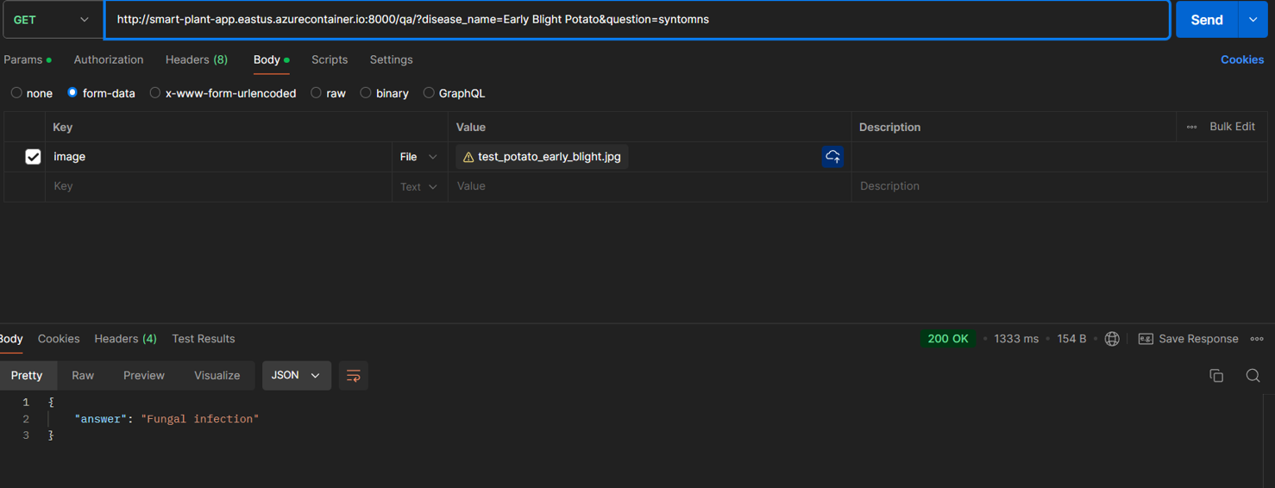
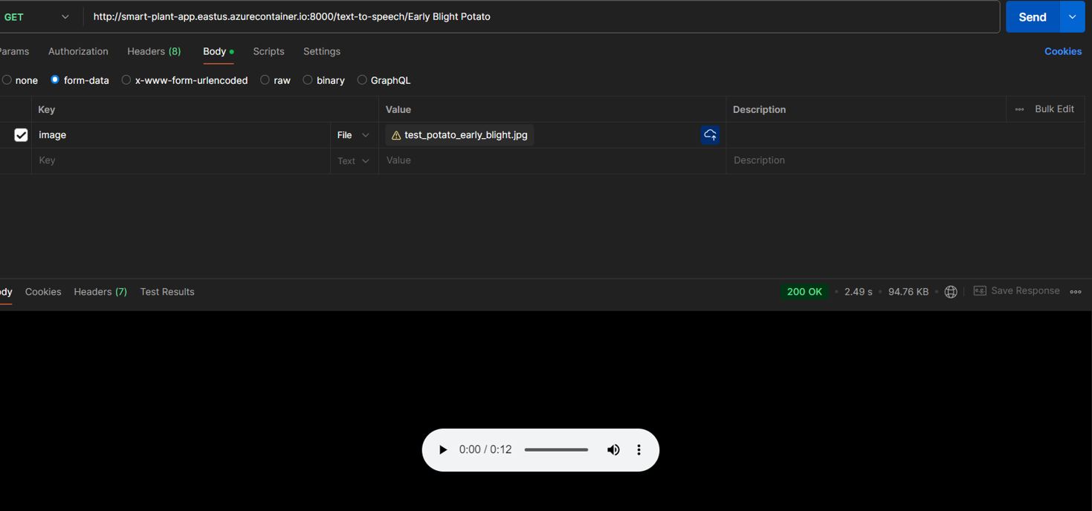
Fastapi OUTPUTS
DISEASE CLASSIFICATION
DISEASE DESCRIPTION
QnA USER INTERACTION
SPEECH

Slide 15
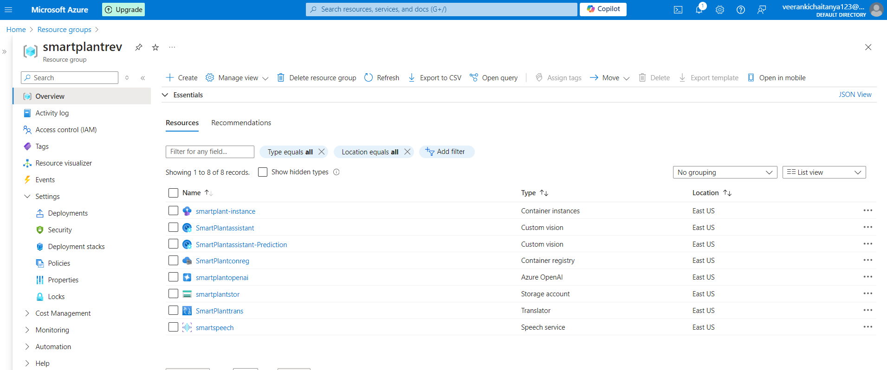
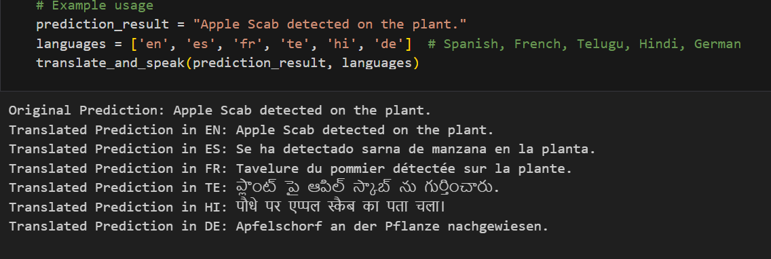
OUTPUTS
TRANSLATOR
AZURE SERVICES

Slide 16
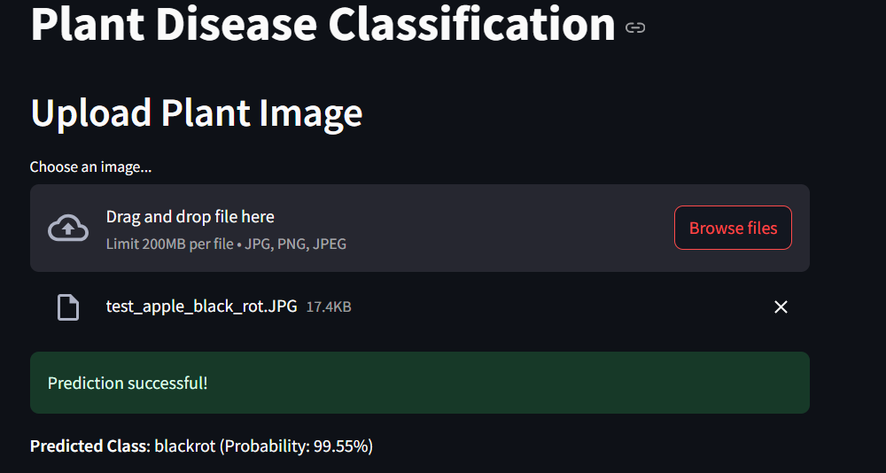
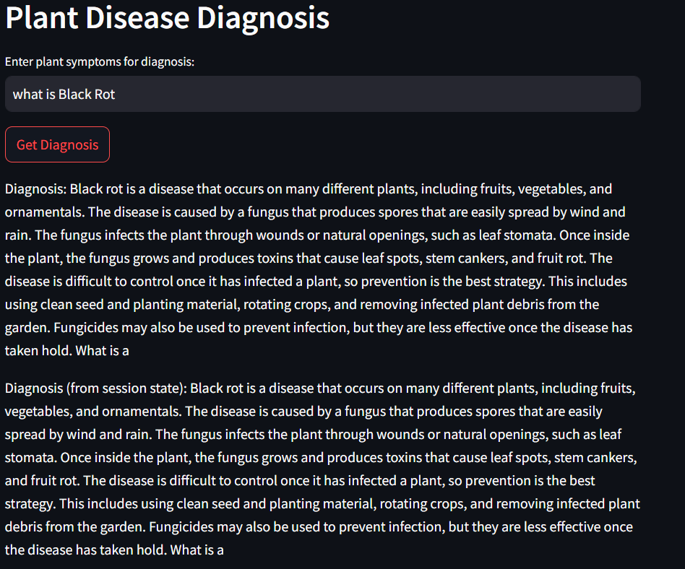
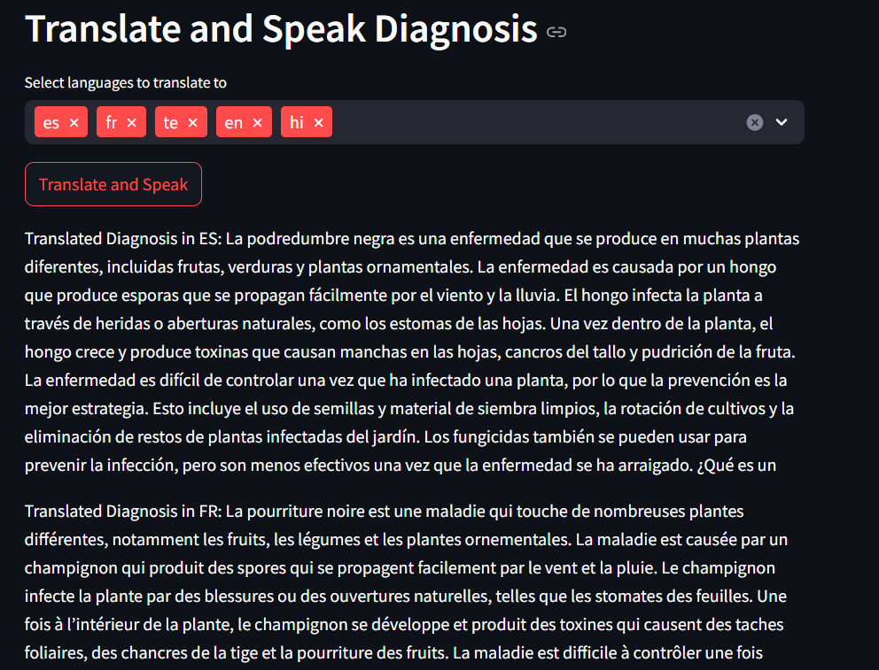
Streamlit outputs
DISEASE CLASSIFICATION
DISEASE DESCRIPTION
TRANSLATOR AND SPEECH

Slide 17
CHALLENGES & SOLUTIONS
Challenges:
Managing large datasets and ensuring fast processing times.
Ensuring accurate disease prediction across various plant types.
Providing multi-language support for global users.
Solutions:
Used Azure Blob Storage for efficient data management.
Fine-tuned the CNN and GPT models for improved accuracy.
Leveraged Azure Translator and Speech Services for multilingual support.

Slide 18
CONCLUSION
AI-Powered Solution: Combined CNN for plant disease detection and NLP (GPT) for generating detailed disease descriptions.
Azure Integration: Leveraged Azure services for scalability and efficiency:
Custom Vision: Enhanced image classification capabilities
OpenAI: Provided intelligent disease descriptions and symptom explanations
Blob Storage: Managed large datasets for plant images.
Translator & Speech: Enabled multilingual support and voice interactions.
Streamlined Deployment: Dockerized the entire application for consistent deployment across environments, using Azure Container Instances for smooth cloud execution.
Streamlit seamlessly integrates with Azure services, enabling users to utilize Cognitive Services for creating powerful data applications.

Slide 19


