Slide 1
Aurigene x Henkel
Peptide Design Proposal

Slide 2
Peptide Design - Identify a peptide that shows analogue performance to the chemical molecule of US 11566206 B2
Peptide Pool
Sequence to structural homology
Solubility prediction
Top soluble peptides
Functional role of similar proteins in related organisms. Mutational analysis "ala" or "all"
Complex Model building with Fe³⁺ and optimization
CADD and generative (AI/ML) peptide models
Sequence and phylogeny comparison
MD simulation of Peptide complex with Fe³⁺
Natural peptides
Interaction Profiling
Top ranked stable peptide prioritization
Review of literature and experimental data related to Natural peptides & patent molecule (US 11566206 B2)
Comparative analysis
Confidential

Slide 3
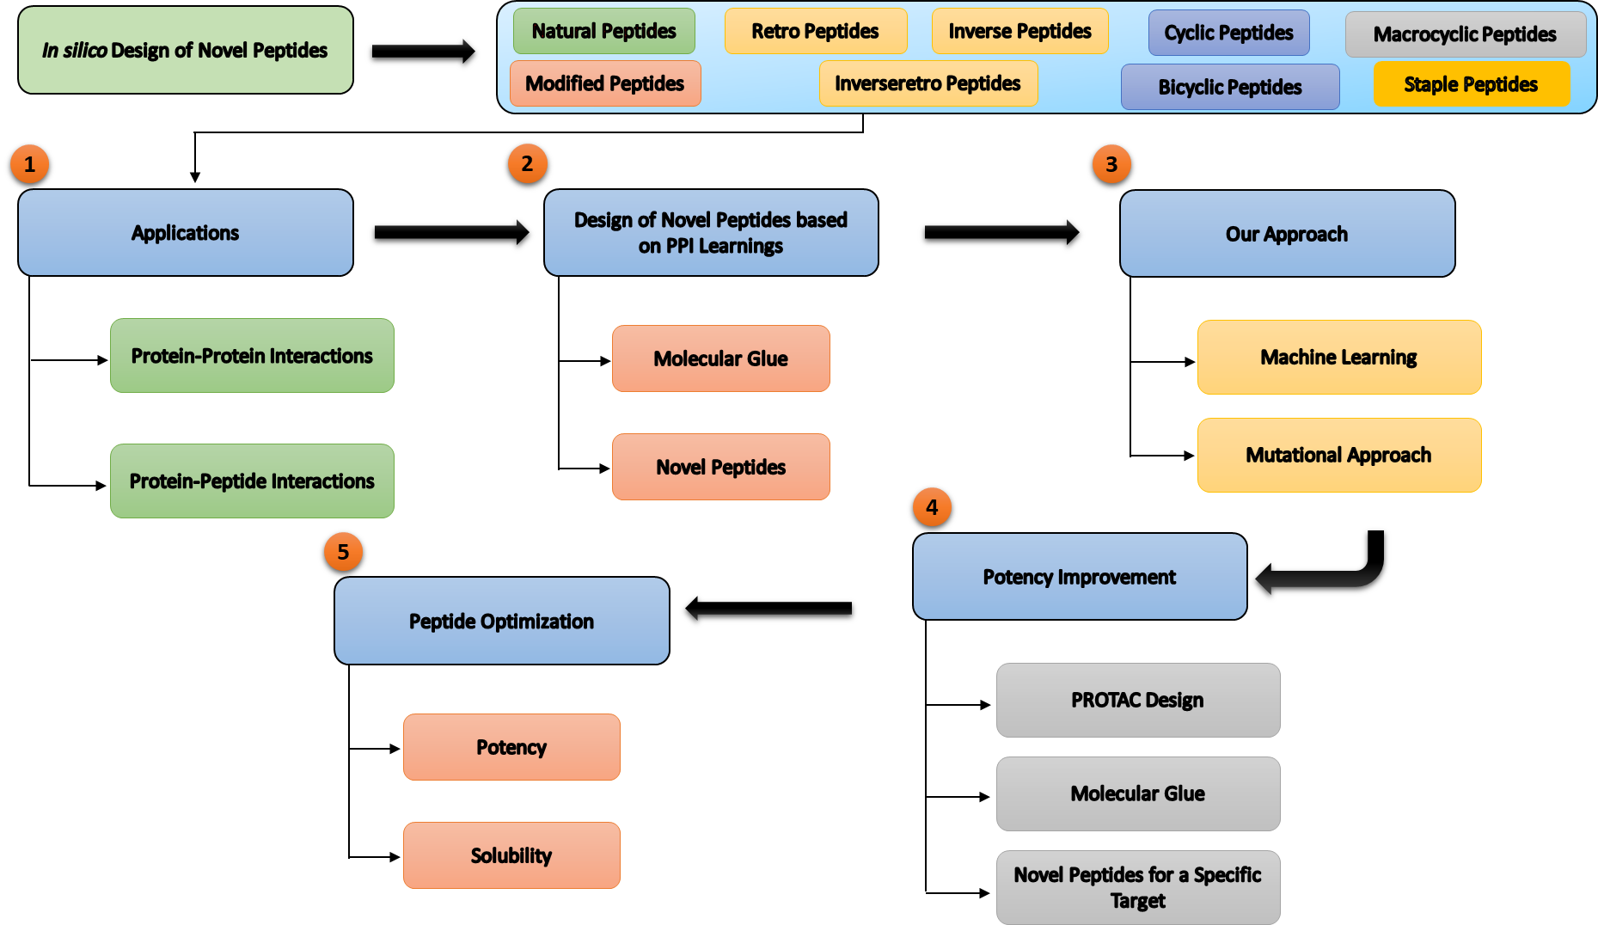
Summary - Peptide design capabilities
Confidential

Slide 4
Peptide Design Proposed Timeline – Proposal 1
S. No. | Proposal Stage | Target | Week wise Timeline
1 | Objective | Identify a peptide that shows analogue performance to the chemical molecule of US 11566206 B2 | -
2 | Understanding Mechanism | Binding of the patent molecule with Fe³⁺ along with the conformational and interaction profile | 1-3
3 | Peptide Design | Traditional and AI/ML approaches (Possibility of introducing non-standard amino acids*) | 3-4
4 | Solubility Prediction | Sequence based & ML based methods to predict the solubility of the designed peptides | 4-5
5 | Molecular Docking | Prediction and mimicking the interface for Fe³⁺ binding followed by Docking of the soluble peptides with binding site | 5-6
6 | Molecular Dynamics | MD simulation of peptides with Fe³⁺ to understand the stability | 6-10
7 | Peptide properties prediction | Calculating peptide properties such as hydrophobicity, pka and others | 10-12
8 | Iteration 1 (30 Peptides) | Deliver 30 prioritized (top-ranked) peptides | 12-14
* Can we consider having non-standard amino acids in the peptide sequences?
Confidential

Slide 5
Peptide Design Proposed Timeline – Proposal 2
S. No. | Proposal Stage | Target | Week wise Timeline
1 | Objective | Understand the data from the washing trails of 30 peptides shared by Aurigene in Phase 1 | -
2 | Understanding Mechanism | Comparative studies of 30 peptides and Fe³⁺ | 1-3
3 | Peptide Design | Traditional and AI/ML approaches (Possibility of introducing non-standard amino acids*) | 3-4
4 | Solubility Prediction | Sequence based & ML based methods to predict the solubility of the designed peptides | 4-5
5 | Molecular Docking | Prediction and mimicking the interface for Fe³⁺ binding followed by Docking of the soluble peptides with binding site | 5-6
6 | Molecular Dynamics | MD simulation of peptides with Fe³⁺ to understand the stability | 6-10
7 | Peptide properties prediction | Calculating peptide properties such as hydrophobicity, pka and others | 10-12
8 | Iteration 1 (30 Peptides) | Deliver 30 prioritized (top-ranked) peptides | 12-14
* Can we consider having non-standard amino acids in the peptide sequences?
Confidential

Slide 6
S. No. | Proposal Stage | Target | Week wise Timeline
1 | Phase 1 Data Analysis | Analysis of washing performance, solubility, and experimental feedback from 30 peptides to identify key sequence-performance relationships and optimization opportunities. | 1-2
2 | Lead Selection & Design Strategy | Selection of lead peptides (Aur_21 and Aur_24) and definition of optimization hypotheses for improving Fe³⁺ chelation, solubility, and washing efficacy. | 2-4
3 | AI/CADD-Guided Peptide Optimization | Design of peptide variants using SAR insights, AI/ML models, sequence engineering, and rational incorporation of amino acid substitutions. | 4-6
4 | Fe³⁺-Binding Modeling | Modeling peptide-Fe³⁺-colorant interactions and docking studies to evaluate binding modes, coordination geometry, and selectivity. | 6-10
5 | Molecular Dynamics | MD simulations of lead and optimized variants to assess binding stability, conformational behavior, and key interaction networks. | 10-12
6 | Peptide Property Prediction & Prioritization (30 peptides) | Assessment of solubility, hydrophobicity, aggregation propensity, pKa, stability, and manufacturability. Selection of top candidates for synthesis. | 12-14

