Slide 1

S-HOME

Slide 2

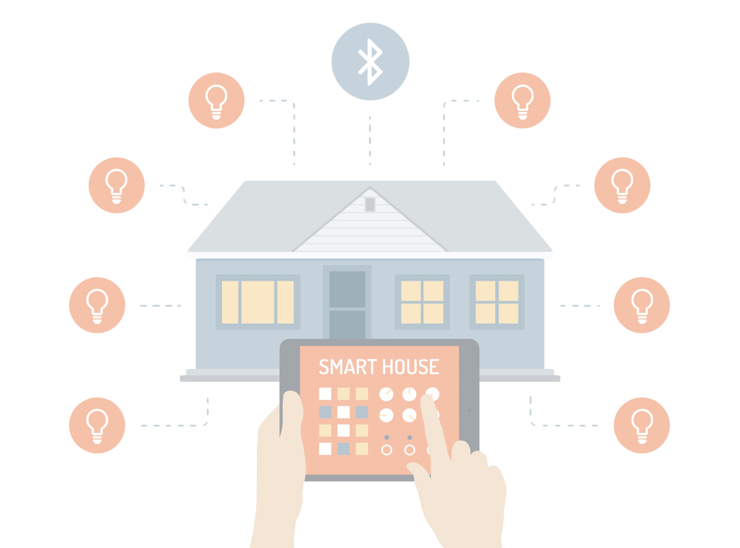
Connect your Mobile device to your house Wirelessly via Bluetooth .
Control Home Lightning system with your fingertip.

Slide 3

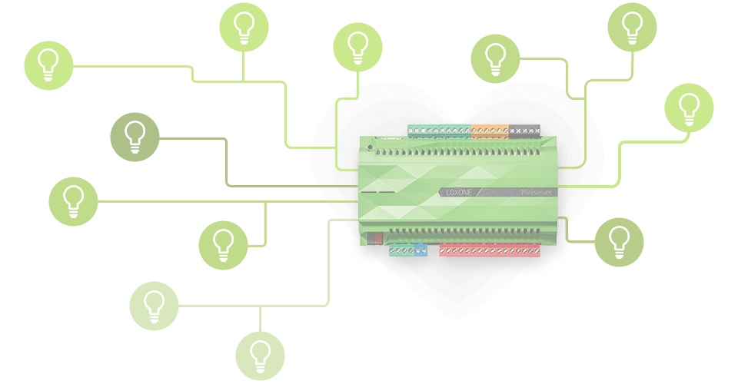
Easily configurable Microcontroller Unit.
805 Microcontroller & HC05 Bluetooth module Used.

Slide 4
Control lighting system anywhere inside your home.
Mobile
Bluetooth Module
MCU
Home Lighting System

