Slide 1

WORKERS ASSIGNMENT FOR SELECTED ASSEMBLY LINE
Group 07

Slide 2

group members
S19809 - Kasun Dhanushka
S19832 - Malith Mewanga
S19836 - Thilina Sasanka
S19845 - Hiruni Rathnaweera
S19847 - Chamuditha Rowel
S19850 - Thilini Sadarenu
S19869 - Dineth Ashen
01

Slide 3

Content
Company Overview
Problems Identified
Why we selected workers assigning
Data Collection
What is Assignment problem
Mathematical model
Implementation using Secondary data
Python Code Implementation
Solutions & Comparison
Conclusion
02

Slide 4
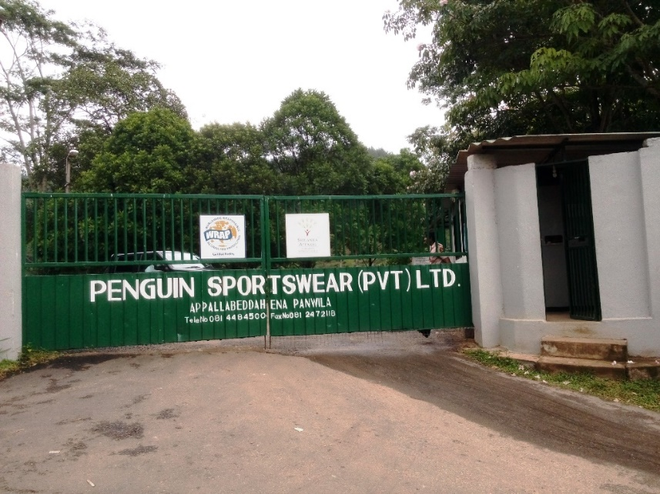

Company OVERVIEW
03

Slide 5
Ctd…
Name : Emjay international (PVT) Ltd
Products : Loungewear, underwear,
active wear, and thermal wear
Location : Panvila
Main branch: Colombo
Workers : 1200 employees
04

Slide 6

DEPARTMENTS
Storing department
Inspection area
Cutting section
Quality assurance department (overall procedure)
Sewing department
Finished goods warehouse
05

Slide 7

Problems Identified
Storage problems.
Defects generating in sewing.
Machine Downtime.
Cover the targets before deadlines.
06

Slide 8

WHY WE SELECTED WORKERS ASSIGNING
Assigning Workers to Sewing Machines for maximizing skill score taken to finish a product in the given specific line.
07

Slide 9
Data Collection
Collected skill scores for each worker (0-2 scale).
Noted worker availability.
Mapped tasks to required skill levels.
Skill variation across workers.
08

Slide 10
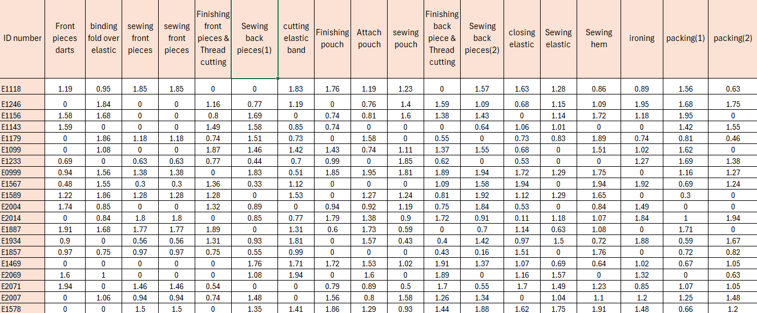
Data set
09

Slide 11
What is Assignment Problem?
10

Slide 12
ASSIGNMENT PROBLEM – FLOW DIAGRAM
c11
a - assignees
a1
1
1
t1
c12
t - tasks
a2
2
2
t2
a3
3
3
t3
a4
n
n
t4
cnn
assignees
tasks
11

Slide 13
ASSUMPTIONS
Skill score is a fixed number.
All tasks are equally importance.
One worker can do at most 2 tasks.
Additional of 2 workers.
Workers are fixed for the given line.
If the workers are less than 18, presented workers must be assigned for a task.
12

Slide 14

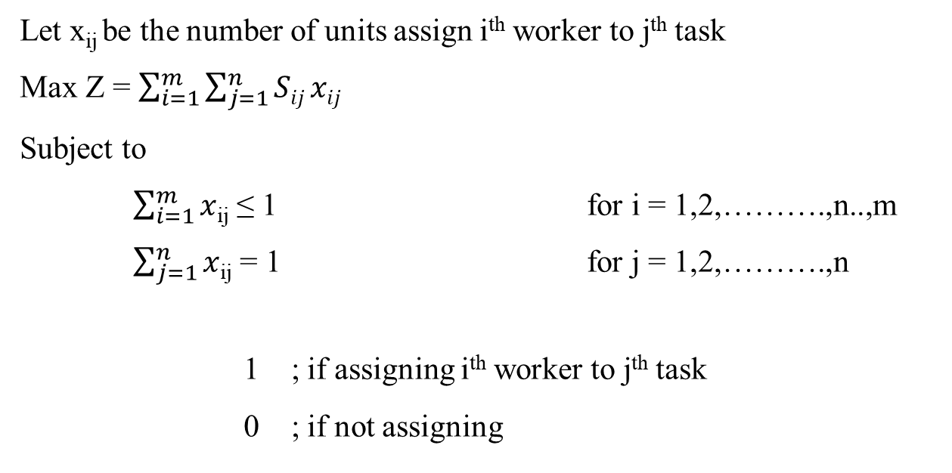
THE MATHEMATICAL MODEL
Case 01 – No. workers ≥ No. of tasks
Let x_{ij} be the number of units assign i^{th} worker to j^{th} task
Max Z = $\sum_{i=1}^{m}{\sum_{j=1}^{n}{Sij xij}}$
Subject to
$\sum_{i=1}^{m}{x}$_{ij} ≤ 1 for i = 1,2,……….,n..,m
$\sum_{j=1}^{n}{x}$_{ij} = 1 for j = 1,2,……….,n
1 ; if assigning i^{th} worker to j^{th} task
0 ; if not assigning
x_{ij} =
13

Slide 15

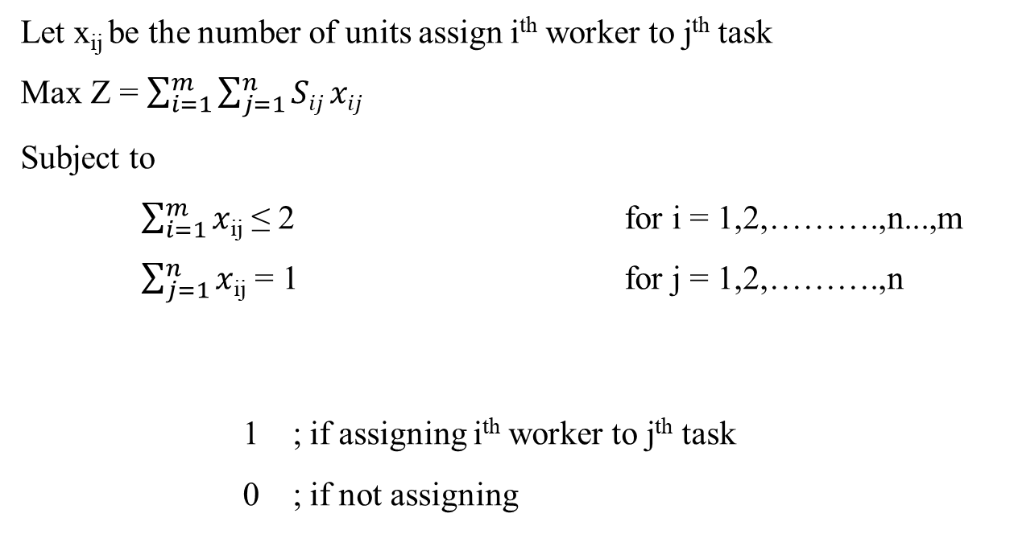
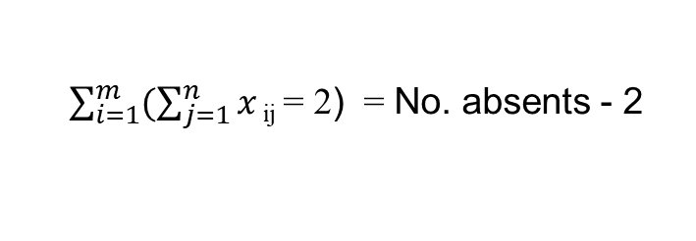
Case 02 : No. workers < No. of tasks
Let x_{ij} be the number of units assign i^{th} worker to j^{th} task
Max Z = $\sum_{i=1}^{m}{\sum_{j=1}^{n}{Sij xij}}$
Subject to
$\sum_{i=1}^{m}{x}$_{ij} ≤ 2 for i = 1,2,……….,n...,m
$\sum_{j=1}^{n}{x}$_{ij} = 1 for j = 1,2,……….,n
1 ; if assigning i^{th} worker to j^{th} task
0 ; if not assigning
$\sum_{i=1}^{m}{(\sum_{j=1}^{n}{x}}\text{ij} \text{= }\text{2}$) = No. absents - 2
14

Slide 16


MODEL SOLUTION SOFTWARES
Excel
Python
15

Slide 17
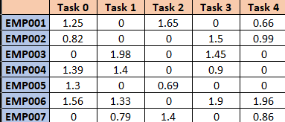
Secondary dataset
16

Slide 18
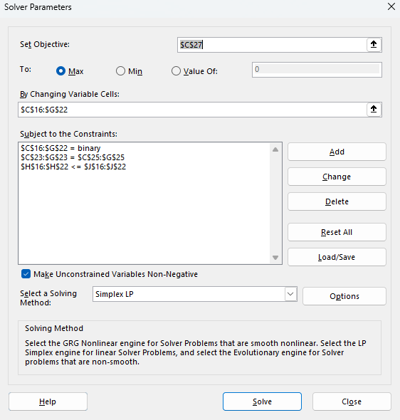
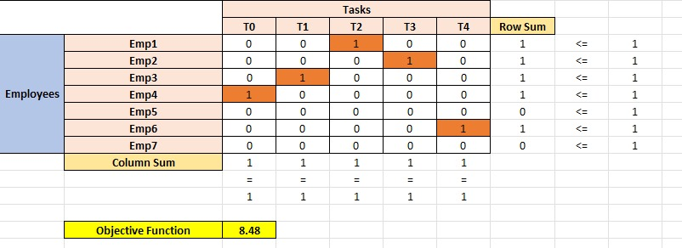
Visual Representation in Excel
17

Slide 19
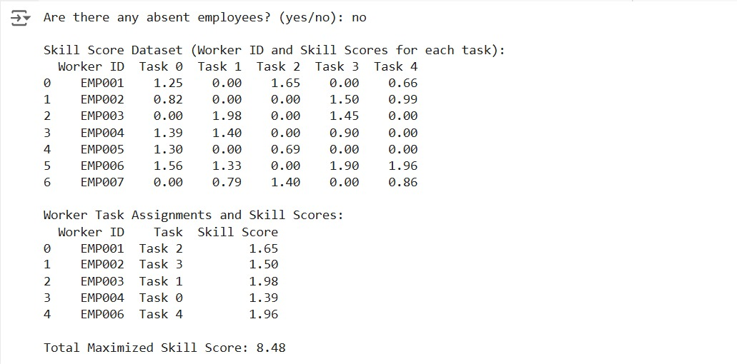
Visual Representation in python
18

Slide 20
Python Code implementation
19

Slide 21
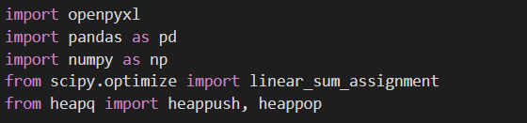
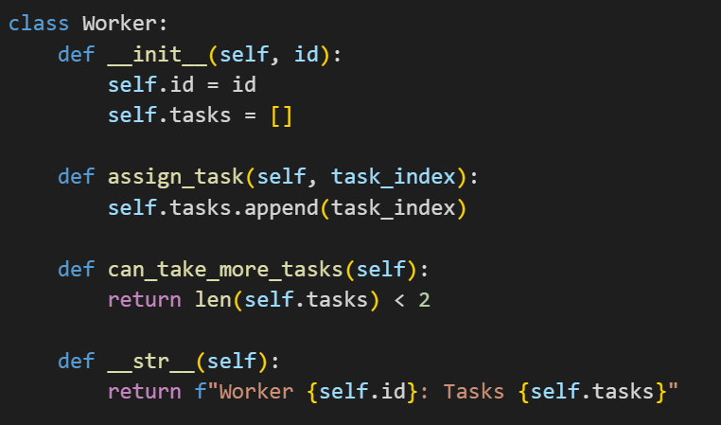
Import packages
Create Worker Class
20

Slide 22
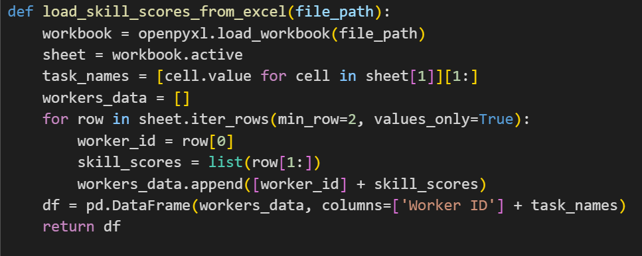
Load Skill Scores from Excel File
21

Slide 23
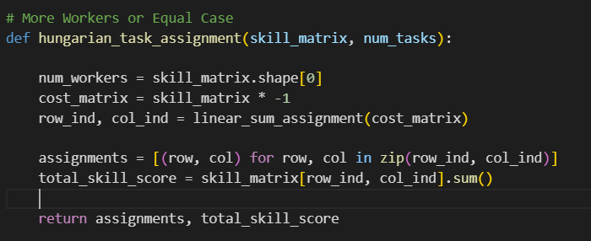
Algorithm
22

Slide 24
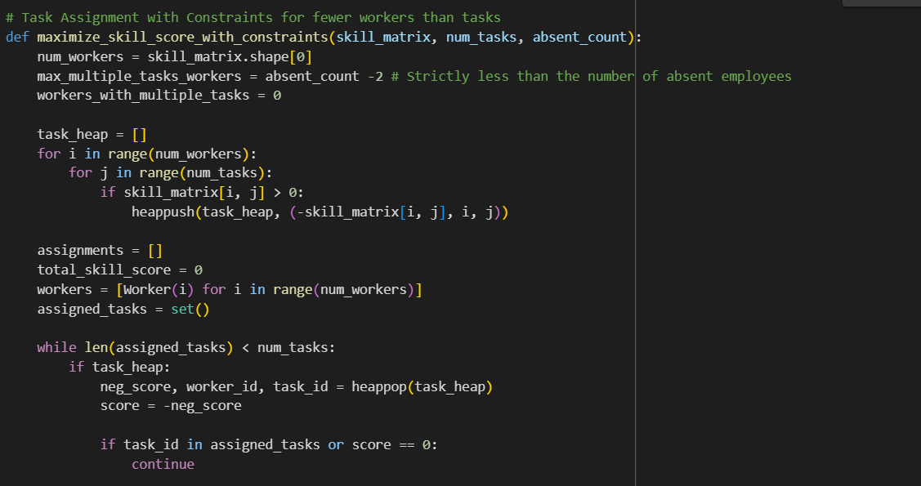
Algorithm
23

Slide 25
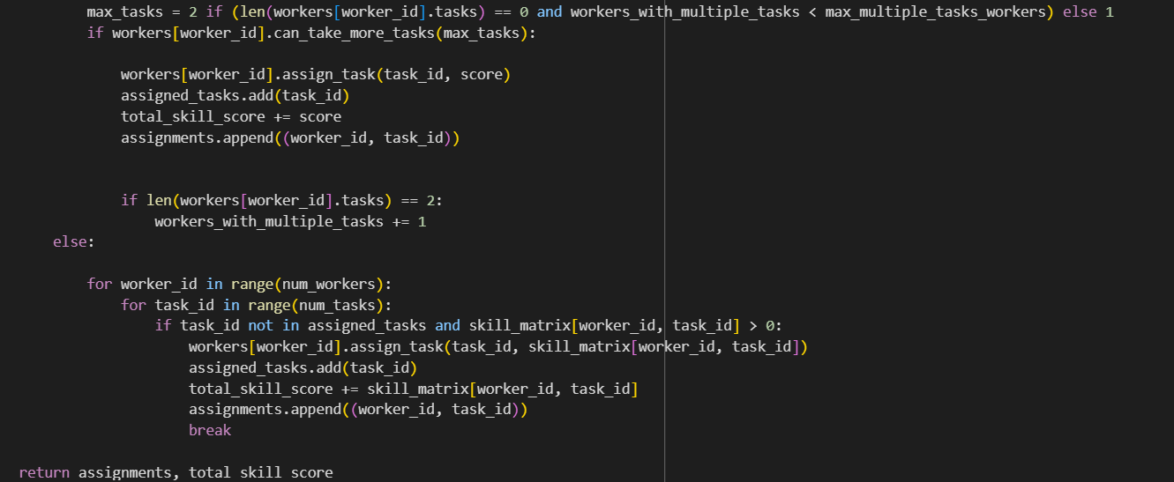
Ctd…
Algorithm
24

Slide 26
solutions
25

Slide 27
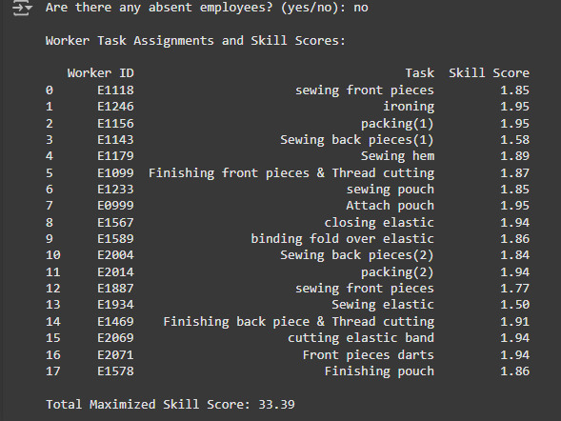
Case 01 – no. workers ≥ no. of tasks
Case A – No Absences
Optimal Skill Score
26

Slide 28
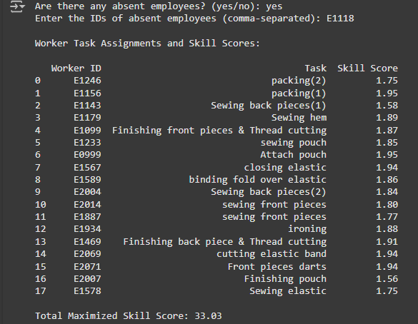
Case B – 1 worker absent
27

Slide 29
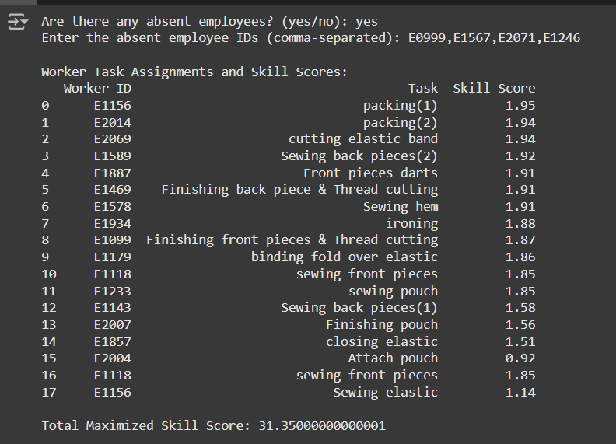
Case 02 – no. workers < no. of tasks
28

Slide 30
comparison
29

Slide 31
EMPLOEE ID | COMPANY’S ASSIGNMENT | OUR ASSIGNMENT
E1118 | 1.83 | 1.85
E1246 | 1.84 | 1.95
E1156 | 1.72 | 1.95
E1143 | 1.42 | 1.58
E1179 | 1.5 | 1.89
E1099 | 1.46 | 1.87
E1233 | 1.85 | 1.85
E0999 | 1.38 | 1.95
E1567 | 1.94 | 1.94
E1589 | 1.92 | 1.86
E2004 | 1.74 | 1.84
E2014 | 1.84 | 1.94
E1887 | 1.89 | 1.77
E1934 | 1.57 | 1.5
E1469 | 1.72 | 1.91
E2069 | 1.89 | 1.94
E2071 | 1.49 | 1.94
E1578 | 1.5 | 1.86
Total Skill Score | 30.5 | 33.39
30

Slide 32
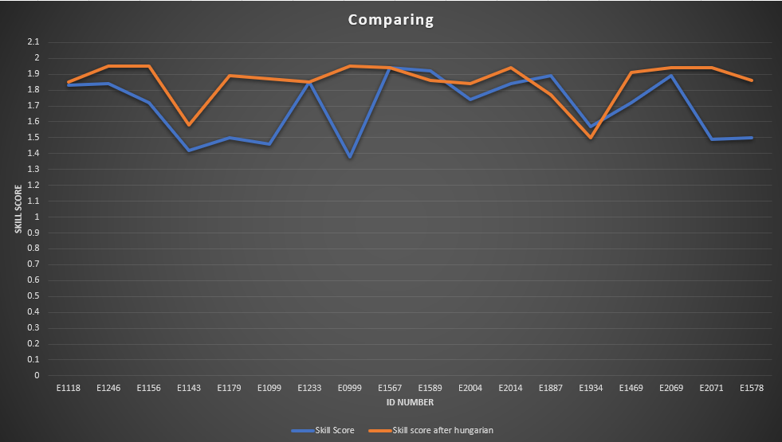
GRAPHICAL REPRESENTATION
31

Slide 33

Benefits of the Model
For the Factory:
Enhanced productivity.
Better use of skilled labor.
Reduces production time.
Reduces production costs.
For Workers:
Tasks aligned with skills.
Fair workload distribution.
32

Slide 34

Difficulties faced
Data collection challenges.
Complex constraints.
Model design.
Computational complexity.
Difficult to implement in Excel.
33

Slide 35

Conclusion
Developed a model for optimal task assignment of workers.
Reduced the effect of workers absences.
Improved efficiency and productivity at Panvila Emjay Garment Factory.
34

Slide 36
Timeline
Task | Month
 | April | May | June | July | Aug | Sep | Oct | Nov | Dec | Jan
Finding a place to continue the project
Visited Emjay international pvt(ltd)
Selected the project topic and identified the problem
Meeting 1
Data preparation
Online meeting
Analyse the skill scores and identify trends or patterns.
Design the model using hungarian method
Meeting 2
Mid presentation
Implement the algorithom in python
Test the model with using sample data in excel and python
Validate the results with actual factory scenarioes
Prepare the final presentation and final report
Meeting 3
Final presentation
35

Slide 37
References
Sri Lanka Export Development Board. (n.d.). Emjay International Pvt Ltd - Company profile. Retrieved MAY 15, 2024
Sri Lanka Export Development Board. (n.d.). Apparel. Retrieved AUGUST 29, 2024
Kanchi University. (n.d.). Course materials: Operation research. Retrieved JUNE 12, 2024
GeeksforGeeks. (n.d.). Python packages. Retrieved NOVEMBER 22 , 2024
SciPy. (n.d.). scipy.optimize.linear_sum_assignment. SciPy Documentation. Retrieved December 27, 2024
Super User. (2019). Is there a quick way to add multiple constraints in Excel Solver optimizer?. Retrieved January 2, 2025
36

Slide 38
THANK YOU
37

