Slide 1
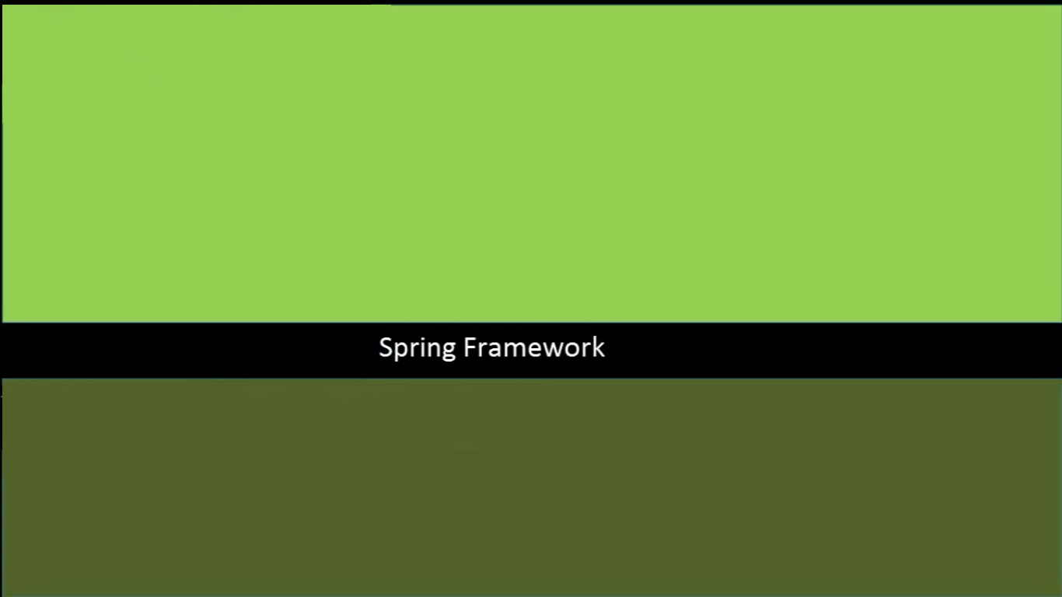

- Dependency Injection or Inversion of Control (IOP)
- Aspect-Oriented Programming Framework.
- Data access/Integration Framework.
- Model-View-Controller Framework.
- Test Framework.
Amila Iroshan Rathnayake

Slide 2
Dependency Injection or IOP – Do not create or instantiate an object inside another Java class.Instead , relly on Spring’s IOP module to create the object for you.
class AppaKade{
Tea tea=new Tea();
public void RasneBadu(){
tea.prepareTea();
}
}
class Tea{
public void prepareTea(){
// code to prepare tea
}
}
Amila Iroshan Rathnayake

Slide 3
interface TeaMaker{
public void prepareTea();
}
class AppaKade{
TeaMaker tm;
AppaKade(TeaMaker tm){
this.tm=tm;
}
public void RasneBadu(){
tm.prepareTea();
}
}
class Tea implements TeaMaker{
public void prepareTea(){
// code to prepare tea
}
}
Amila Iroshan Rathnayake

Slide 4
class AppaKade{
TeaMaker tm;
AppaKade(TeaMaker tm){
this.tm=tm;
}
}
class AppaKade{
TeaMaker tm;
public void setTeaMaker(TeaMaker tm){
this.tm=tm;
}
}
Amila Iroshan Rathnayake

Slide 5
Spring DI Framework provides two ways of DI
01. Using the Constructor Way.
02. Using the Setter method Way.
Amila Iroshan Rathnayake

Slide 6
Springs Bean Scope…..
You provide a scope of a Bean in the spring’s configuration file
using “scope” Attribute with each bean definition.
<bean id="AppaKadeObject" class="AppaKade" scope="prototype">
</bean>
<bean id="AppaKadeObject" class="AppaKade" scope=“singleton">
</bean>
Example Class
ApplicationContext context=new ClassPathXmlApplicationContext("/SpringConfig.xml");
AppaKade ob1=(AppaKade) context.getBean("AppaKadeObject");
ob1.setWelComeNote("Ob 1 is setting welcome note property...");
ob1.welComeAppakade();
AppaKade ob2=(AppaKade) context.getBean("AppaKadeObject");
ob2.welComeAppakade();
Amila Iroshan Rathnayake

Slide 7
Lazy loading and Pre-loading of a Bean…..
If you use Application Context- By default Spring Loads or Instantiate All Singleton Beans what mentioned in Spring configuration file , at the application start up time. That is the Pre-loading of a Bean
If you want , you can change Springs Default Behavior. You can instructs Spring Framework not to instantiate any singleton bean at the application start- up. It will only instantiate a singleton bean when you actually request using “getBean” Method.
Via :
<bean id="AppaKadeObject" class="ditesting_02.AppaKade" scope=“singletone" lazy-init="true"> </bean>
This is the Lazy loading of a Bean.
That is one more Interface which you may use to access Spring framework the way we
have used here ApplicationContext.That is BeanFactory Interface
BeanFactory Interface – Always perform lazy loading
Amila Iroshan Rathnayake

Slide 8
Bean Life Cycle using init-method and destroy Method attributes.
public class AppaKade {
public void init(){
System.out.println("init...");
}
public void destroy(){
System.out.println("destroy...");
}
}
<bean id="AppaKadeObject" class="ditesting_02.AppaKade"
init-method="init" destroy-method="destroy"> </bean>
((AbstractApplicationContext)context).registerShutdownHook();
Amila Iroshan Rathnayake

Slide 9
Bean Life Cycle using Annotations(PostConstruct, PreDestroy).
public class AppaKade {
@PostConstruct
public void init(){
System.out.println("init...");
}
@PreDestroy
public void destroy(){
System.out.println("destroy...");
}
}
<bean class=
"org.springframework.context.annotation.
CommonAnnotationBeanPostProcessor">
</bean>
((AbstractApplicationContext)context).registerShutdownHook();
Amila Iroshan Rathnayake

Slide 10
Bean Life Cycle By implementing methods in InitializingBean and
DisposableBean interfaces.
public class AppaKade implements InitializingBean,DisposableBean{
@Override
public void afterPropertiesSet() throws Exception {
System.out.println("Init");
}
@Override
public void destroy() throws Exception {
System.out.println("Destroy");
}
Amila Iroshan Rathnayake

Slide 11
A BeanPostProcessor in Spring
Witch Allows you to modify a Beans instance – perform any task once it is created or initialized by Spring Container.
public class DemoBeanPostProcessor implements BeanPostProcessor{
@Override
public Object postProcessBeforeInitialization(Object o, String string) throws BeansException {
System.out.println("Processing bean instance after initilization.. :"+o);
return o;
}
@Override
public Object postProcessAfterInitialization(Object o, String string) throws BeansException {
System.out.println("Processing bean instance before initilization.. :"+o);
return o;
}
}
<bean class="DemoBeanPostProcessor"></bean>
Amila Iroshan Rathnayake

