Slide 1

STRUTS 2
Interceptors
Amila Iroshan Rathnayake

Slide 2
“Automatic“ features of Struts 2
-- Param transfer to member variables.
-- Validation.
-- More…...
Who / What does this work…?
Interceptors
Amila Iroshan Rathnayake

Slide 3
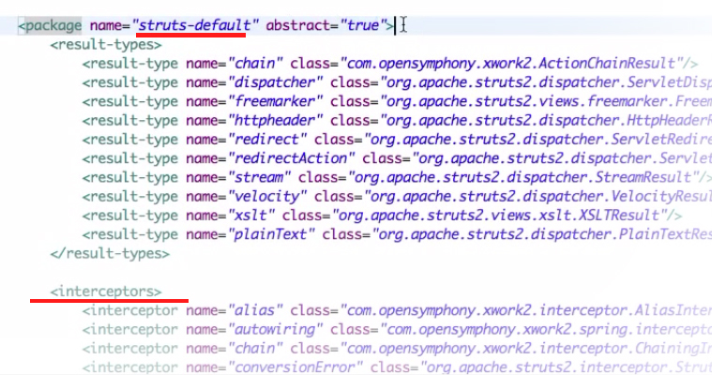
Struts_default.xml
Amila Iroshan Rathnayake

Slide 4
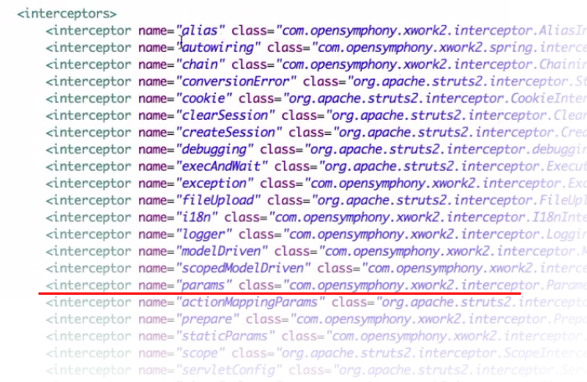
Param Interceptor.xml
Amila Iroshan Rathnayake

