Slide 1

MVC
Model - View - Controller
Amila Iroshan Rathnayake

Slide 2
HTML code embedded into JAVA Code
A Typical Servlet
JAVA code embedded into HTML Code
A Typical JSP Page
Amila Iroshan Rathnayake

Slide 3
UI Developer and Business Logic Developer Difficult to work Independently
As a result it takes more time to develop
and update such a WEB Application
Incase , something needs to be modified in
an Existing WEB Application
Otherwise , At the Later Stages , it is so Real
Big Pain…….
Amila Iroshan Rathnayake

Slide 4
M odel – Represents Data
V iew – Represents UI Part
C ontroller – Manages the application flow
Amila Iroshan Rathnayake

Slide 5
Overall Flow Works
HTML code to displaying model object
View
Model
(Java Object)
Some Business Service - producing Model (data)
Controller
Amila Iroshan Rathnayake

Slide 6




The Cake Shop
Decorate with Fruits and can write in English
Decorate with Cream and can write in Sinhala
Room having a machine preparing Chocolate cake
Room having a machine preparing Vanilla cake
Room having a machine preparing Strawberry cake
Amila Iroshan Rathnayake

Slide 7
Model = Cake without decoration (Prepared by a
specific Business Service.)
View = Each cake decorator who presents the cake in
the way customer wants.
Controller = The Shop owner is the Controller.
Amila Iroshan Rathnayake

Slide 8
Model is not just the data
it can be any logic too
which is generating data
Amila Iroshan Rathnayake

Slide 9
The Overall Workflow of
Spring MVC Framework
Amila Iroshan Rathnayake

Slide 10
It will scan the URL; and tells the exact address of the Guy who can generate data for this web page
Request.
Handler Mapping
It prepares data, creates a Java object to hold this data
Data Generator Guy
Front Controller
Browser
http://www.web-siteName/webPageName.html
Java Object for holding Data and Name of final response Builder Guy
Final Response Builder Guy
View Resolver
Amila Iroshan Rathnayake

Slide 11
Java Object for holding Data and Name of final response Builder Guy
Model
A JSP Page
Final Response Builder Guy
View
Data Generator Guy
Controller
Front Controller
Dispatcher Servlet
Amila Iroshan Rathnayake

Slide 12
For Mapping the Urls (As Handler
Mapping/Url Mapping)
- SimpleUrlHandlerMapping
- BeanNameUrlHandlerMapping
- ControllerClassNameHandlerMapping
Amila Iroshan Rathnayake

Slide 13
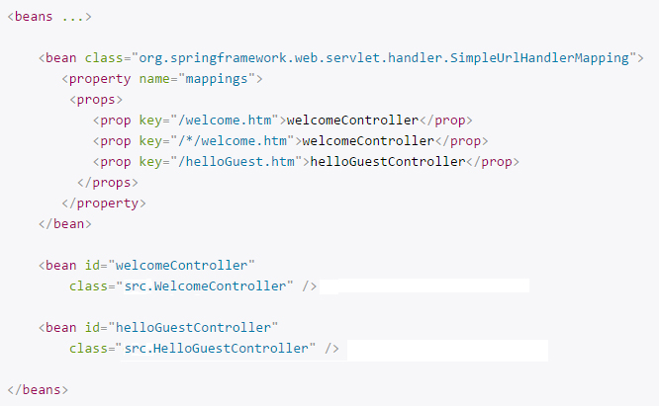
SimpleUrlHandlerMapping
Amila Iroshan Rathnayake

Slide 14
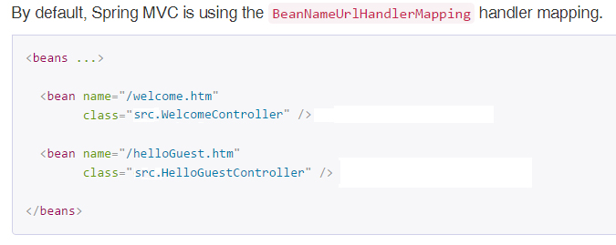
BeanNameUrlHandlerMapping
Amila Iroshan Rathnayake

Slide 15
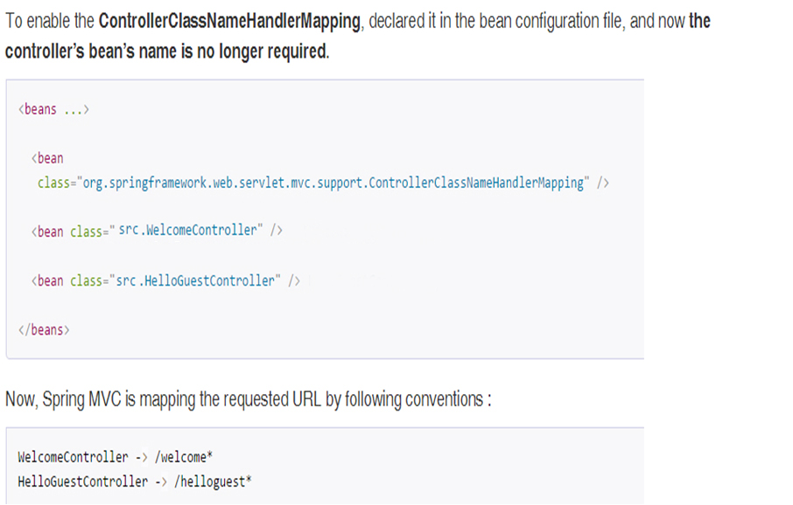
ControllerClassNameHandlerMapping
Amila Iroshan Rathnayake

