Slide 1

STRUTS 2
Model View Controller
Amila Iroshan Rathnayake

Slide 2
Popular Java WEB MVC Frameworks
-- Struts
-- Struts2
-- Spring MVC
-- Play -- JSF
-- Wicket
etc……..
Amila Iroshan Rathnayake

Slide 3
Framework vs Pattern
- Pattern is the way you can architect your application.
- Framework provides foundation classes and libraries and Gets us started quickly.
Amila Iroshan Rathnayake

Slide 4
MVC
Business Services
Servlets
Model
Client
Controller
JSPs
View
Amila Iroshan Rathnayake

Slide 5
- Controller Talks to the Model.
- View is for Rendering Outputs.
It’s Consumable by the Client
Amila Iroshan Rathnayake

Slide 6
Struts2 MVC Framework
Business Service classes
Model
Business Service classes
Handle Input Parameters
Route using XML config
Action class
Client
Business Service classes
Interceptors
Struts XML
Tag Libraries
JSP
View
Tag Libraries
Tag Libraries
Amila Iroshan Rathnayake

Slide 7
Interceptors
Is the Gate way , Ones the client makes a Request , it goes through the STRUTS2 Interceptors.So Interceptor takes care of getting the user requested parameters.
Struts XML
It configured all the Introduction like URL Mappings.
Tag Libraries
Simplifies the Lot of Efforts.
Action Class
Provide the MODEL with appropriate Business Service
Amila Iroshan Rathnayake

Slide 8
How Servlets work
Servlet
JSP
Member Variables
Thread 01
Thread 01
Servlets – Not Thread Safe
Http Obj 01
Http Obj 01
Session
Session
Req 01
Req 02
Amila Iroshan Rathnayake

Slide 9
Servlets & JSPs
-- We are given objects to use , but we will need to do the “push” and “pull” of data ourselves
-- Servlet places the business data into the Session or Request object , and the JSP accesses it.
-- This has to be done for every servlet-to-JSP flow that needs data to be communicated.
Amila Iroshan Rathnayake

Slide 10
How is Struts2 Actions Different
Action class
JSP
Encapsulated Member Variables
Struts2 Actions do not have a Threaded Model
Amila Iroshan Rathnayake

Slide 11
Ho Actions are Different
-- New Action objects are created for each request!
Action Instance 01
Action Instance 01
Action Instance 01
Action Instance 01
Member Variables
Member Variables
Member Variables
Member Variables
Req 01
Req 02
Req 01
Req 02
Amila Iroshan Rathnayake

Slide 12
How does the data , actually access in the JSPs
Value Stack
Action Instance
JSP
Member Variables
Value Stack
Amila Iroshan Rathnayake

Slide 13
Value Stack
-- One of a Important Object in Struts2
-- Not Really a Stack in Traditional Sense that we use
in Data Structures.
-- Use to Save Lot of Important Objects.
Action Instance
JSP
Member Variables
Value Stack
Amila Iroshan Rathnayake

Slide 14
Value Stack – Act as a Virtual Object
Value Stack
Value Stack
Object
Object
Member Variables
Member Variables
Object
Object
Member Variables
Member Variables
Object
Object
Member Variables
Member Variables
Isolate the Member Variables
Amila Iroshan Rathnayake

Slide 15
Value Stack
It’s not really a stack in the traditional Sense.
It does stack up objects.
Behaves like a virtual object.
Makes it easy to refer to member variables.
Amila Iroshan Rathnayake

Slide 16
Conflicts?
Value Stack
Int count:
String fileName;
Object
Object
Int count:
Object
String fileName;
Int listSize;
Amila Iroshan Rathnayake

Slide 17
Input Params
Value Stack
Interceptors
Action Instance
Member Variables
Amila Iroshan Rathnayake

Slide 18
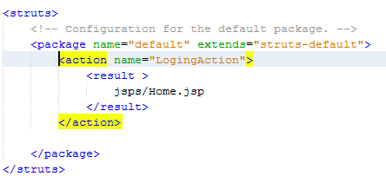
We can Include Another Actions to Struts XML via “Include” Element
<include file=“login.xml”/>
Non Result and Non Action Class
Amila Iroshan Rathnayake

Slide 19


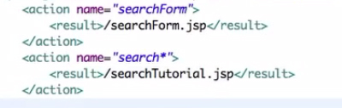

Action Wildcards
Amila Iroshan Rathnayake

Slide 20
Validation Via ActionSupport Class
-- Override the “public void validate()” method
public void validate(){
if(getU().isEmpty()){
addFieldError("u", "User ID cannot be Empty");
}
if(getP().isEmpty()){
addFieldError("p", "User Password cannot be Empty");
}
}
-- Introduce a new “result element” of your data input page in
action in struts.xml
<result name="input">
example/Login.jsp
</result>
Amila Iroshan Rathnayake

Slide 21
Login Page Sample
Use Struts TAG Lib For Crate Login Example..It Gives Special features..
<%@ taglib prefix="s" uri="/struts-tags" %>
<s:form action="LoginAction" method="post">
<s:textfield label="Username" key="u"/>
<s:password label="Password" key="p"/>
<s:submit/>
</s:form>
Amila Iroshan Rathnayake

Slide 22
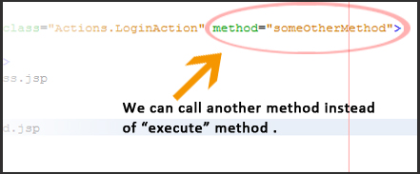
Configuring Methods in Action Mapping
By default Struts execute the
public String execute(){
return “something”
} in Action Class.
But we can change that default behavior by the
“method” Attribute.
Amila Iroshan Rathnayake

Slide 23
Using Model Objects
Model Object is………….
Is Essentially package of information that needs to be sent between different layers in the Application.
Example : - From the ViewLayer to the Business Service Layer.
From the Business Service to the Data Layer.
If you having a lot of individual elements of data , you would better to use the Model Object instead of Variables.
Amila Iroshan Rathnayake

Slide 24
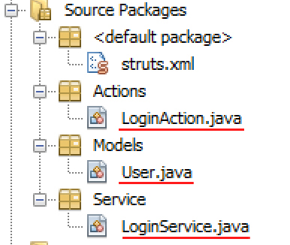
First Way – Create Entity Class as Model Ob:
Create These Three Classes….
Amila Iroshan Rathnayake

Slide 25
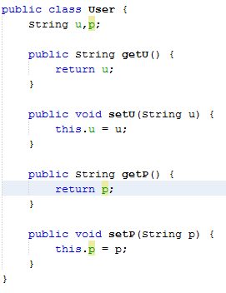
User Class ….
Amila Iroshan Rathnayake

Slide 26
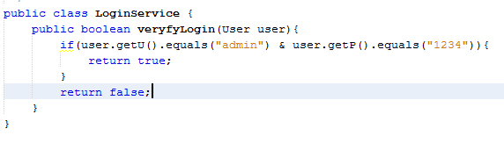
Login Service Class….
Amila Iroshan Rathnayake

Slide 27
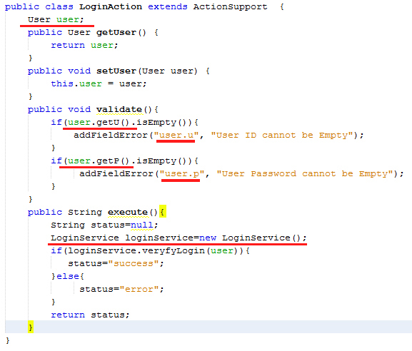
Login Action Class….
Amila Iroshan Rathnayake

Slide 28

In JSP side….
Amila Iroshan Rathnayake

Slide 29
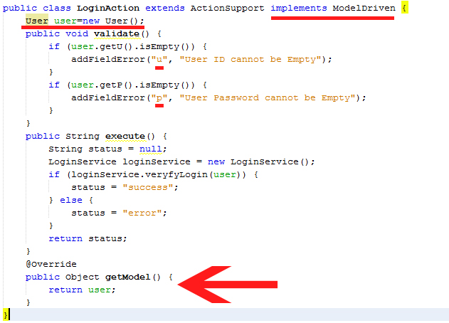
Second Way - Via Model Driven
Amila Iroshan Rathnayake

Slide 30

In JSP side…. (Via Model Driven)
Amila Iroshan Rathnayake

Slide 31


Using Session in Struts 2
Implements the SessionAware interface to the Action Class.
Override the setSession Method : -
Usage of SessionMap
In JSP Side
Amila Iroshan Rathnayake

Slide 32
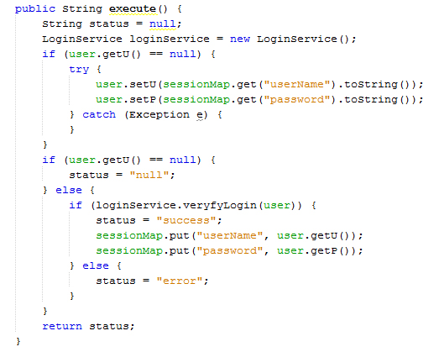
Session Validation For a Login
Amila Iroshan Rathnayake

Slide 33
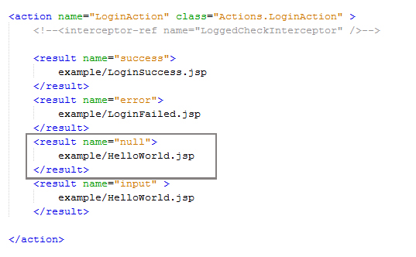
In struts.xml
Amila Iroshan Rathnayake

Slide 34
Update web.xml via…..
<filter-class> org.apache.struts2.dispatcher.ng.filter.StrutsPrepareAndExecuteFilter
</filter-class>
Amila Iroshan Rathnayake

