Slide 1
E-Commerce (ShopEZ)
Team Members
Thilochana. G
Sowmya. S. S
Nithish. G
Tejesh. J

Slide 2
ABSTRACT
ShopEZ is a dynamic and user-centric e-commerce platform designed to revolutionize the online shopping experience.
By leveraging cutting-edge technology and an intuitive interface, ShopEZ provides customers with a seamless, efficient, and personalized shopping journey.
The platform offers a wide range of products across various categories, from fashion and electronics to home goods and more, ensuring that users have access to the latest trends and top-quality items.
With features like personalized recommendations, secure payment options, and fast shipping, ShopEZ aims to enhance convenience, streamline purchases, and foster customer satisfaction.
As a result, it stands as a reliable and comprehensive solution for modern online shoppers looking for simplicity, variety, and efficiency in one place.

Slide 3
INTRODUCTION
ShopEz is an innovative and user-friendly online shopping platform designed to simplify the way consumers browse, shop, and enjoy their retail experience.
With a focus on ease of use, personalization, and seamless transactions, ShopEz brings together a wide variety of products from multiple categories, offering everything from fashion to electronics.
Whether you're a first-time visitor or a loyal customer, ShopEz ensures a smooth and enjoyable shopping journey, helping you find exactly what you need with just a few clicks.
Discover why ShopEz is quickly becoming the go-to destination for savvy shoppers worldwide.

Slide 4
EXISTING SYSTEM
Product Catalog: The platform offers a wide variety of products across multiple categories such as electronics, fashion, home goods, and more. Users can search, filter, and sort products by various attributes like price, brand, ratings, and specifications
User Accounts: Customers can create and manage accounts to save preferences, track orders, and receive personalized recommendations. The account system also supports order history, wishlist features, and secure logins.
Shopping Cart & Checkout: The system includes a shopping cart where users can add items before proceeding to checkout. The checkout process involves entering shipping details, selecting payment methods, and confirming the order.
Payment Gateway Integration: ShopEz integrates secure payment systems such as credit/debit card payments, digital wallets, and other payment gateways to ensure smooth and safe transactions.
Order Management: After a purchase is made, the system tracks orders and provides real-time updates on order status, including shipping, delivery, and return processes.
Customer Support: The platform offers customer service options, such as chat support, email assistance, and FAQs, to address any queries or issues.
Product Reviews and Ratings: Users can leave feedback on products they’ve purchased, which helps inform future buyers and promotes transparency in product quality.
Inventory Management: The system tracks product availability and stock levels in real-time, notifying customers of out-of-stock items or new stock arrivals.

Slide 5
PROPOSED SYSTEM
User Management
Registration & Login: Users can sign up and log in using email, social media accounts, or single sign-on (SSO) options like Google or Facebook.
Profile Management: Users can manage their personal information, preferences, and payment methods.
Product Management
Product Catalog: A rich product catalog with detailed product descriptions, high-quality images, specifications, and pricing.
Search and Filter: Advanced search capabilities allowing users to filter products by categories, price range, brand, ratings, etc.3.
Shopping Cart & Checkout
Shopping Cart: Users can add items to their shopping cart, view details, and modify quantities.
Discounts & Coupons: Integration of discount codes and promotions that can be applied during checkout.
Order Management & Fulfillment
Order Confirmation: Automated order confirmation emails and SMS notifications.
Shipping Integration: Integration with third-party shipping services (e.g., UPS, FedEx) for tracking and real-time updates.
Admin Dashboard
User Management: Admins can manage users, handle customer support tickets, and resolve issues.
Security & Privacy
Data Encryption: End-to-end encryption for sensitive user data, including payment and personal information.

Slide 6
FUTURE IMPLEMENTATIONS
AI & Machine Learning Integration
Augmented Reality (AR) & Virtual Reality (VR)
Enhanced Mobile & Cross-Platform Features
Sustainability and Eco-Friendly Initiatives
Data Analytics and Predictive Insights.

Slide 7
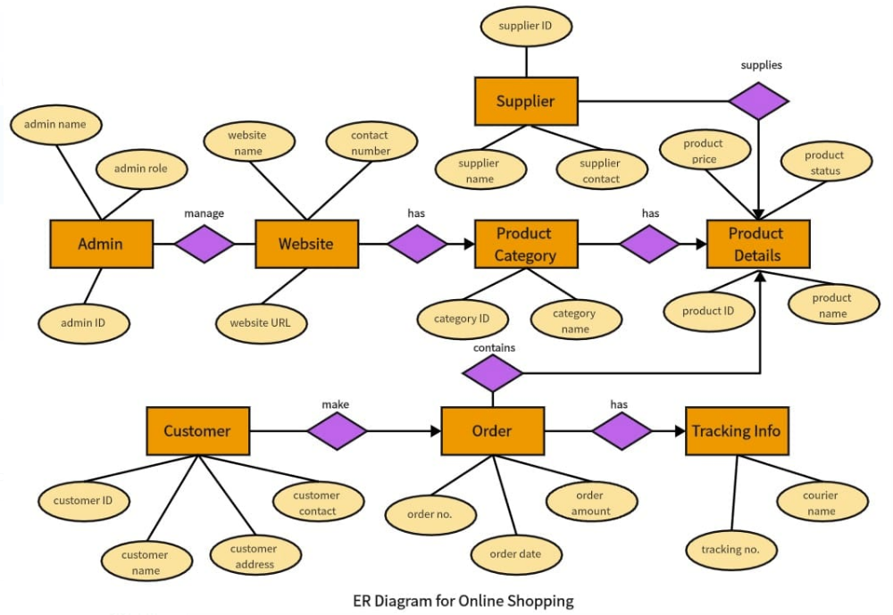
ER DIAGRAM

Slide 8
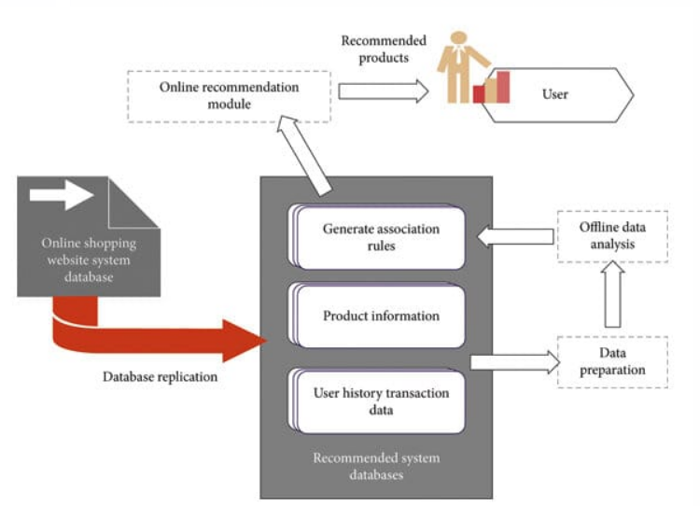
ARCHITECTURE DIAGRAM

Slide 9
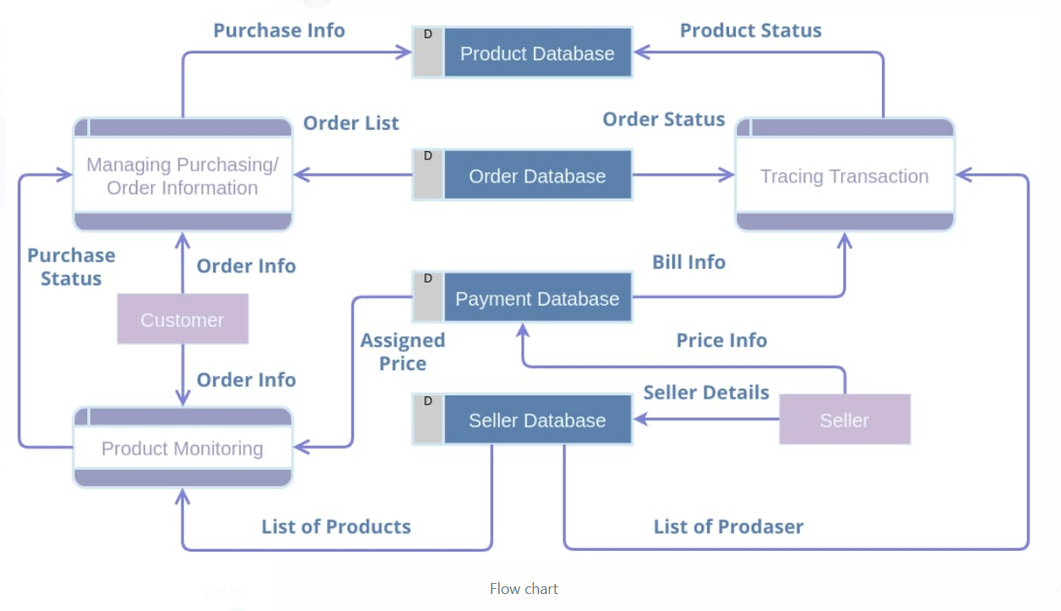
FLOW CHART

Slide 10
FRONT-END DEVELOPMENT
Technologies Used: HTML, JavaScript, Ui/Ux.
Product Catalog: Display categories, product filters, and sorting options.
Product Pages: Detail for each item, including descriptions, images, prices, and reviews.
Shopping Cart: Ability to add/remove items, view total price, and checkout.
Checkout Flow: Secure forms for billing, shipping, and payment.
User Account: Registration, login, order history, and password management.
Search Functionality: Search by name, category, and other filters.

Slide 11
BACK-END DEVELOPMENT
Tech Stack
Programming Language: Node.js (JavaScript), Python (Django/Flask), Ruby on Rails, or Java (Spring Boot) are popular choices.
Framework: Express.js for Node.js, Django for Python, or a framework suited to the chosen language.
Database: PostgreSQL or MySQL for relational databases. MongoDB if opting for a NoSQL database.
Authentication: JSON Web Tokens (JWT) or OAuth 2.0.
Caching: Redis or Memcached for caching frequently accessed data.
File Storage: Amazon S3 or Google Cloud Storage for storing product images, user avatars, etc.
Search Engine: Elasticsearch for efficient product search and filtering.
Payment Processing: Stripe, PayPal, or Square for secure payment integration.
Cloud Provider: AWS, Google Cloud Platform, or Azure.

Slide 12
BACK-END DEVELOPMENT
API Design
RESTful APIs: For most CRUD operations.
GraphQL (optional): If flexible querying is required by the frontend.
User Authentication:
POST /api/auth/signup: Register a new user.
POST /api/auth/login:User login.
POST /api/auth/logout: User logout.
POST /api/auth/refresh-token: Refresh authentication tokens.
Products:
GET /api/products: Fetch all products with filters (e.g., price, category).
GET /api/products/:id: Fetch product details by ID.
POST /api/products: Create a new product (Admin-only).
PUT /api/products/:id: Update product details (Admin-only).
DELETE /api/products/:id: Delete a product (Admin-only).

Slide 13
BACK-END DEVELOPMENT
API Design
Categories:
GET /api/categories: Fetch all categories.
POST /api/categories: Create a category (Admin-only).
PUT /api/categories/:id: Update a category (Admin-only).
DELETE /api/categories/:id: Delete a category (Admin-only).
Cart:
POST /api/cart: Add an item to the cart.
GET /api/cart: Fetch user's cart items.
PUT /api/cart/:itemId: Update item quantity in cart.
DELETE /api/cart/:itemId: Remove an item from cart.

Slide 14
BACK-END DEVELOPMENT
API Design
Orders:
POST /api/orders: Place an order.
GET /api/orders: Fetch all orders for a user.
GET /api/orders/:id: Fetch order details.
PUT /api/orders/:id/status: Update order status (Admin-only).
Payments:
POST /api/payments: Process payment.
GET /api/payments/status/:orderId: Check payment status for an order.
Reviews:
POST /api/reviews: Add a review for a product.
GET /api/reviews/:productId: Fetch all reviews for a product.

Slide 15

SHOPEZ LOGO

Slide 16
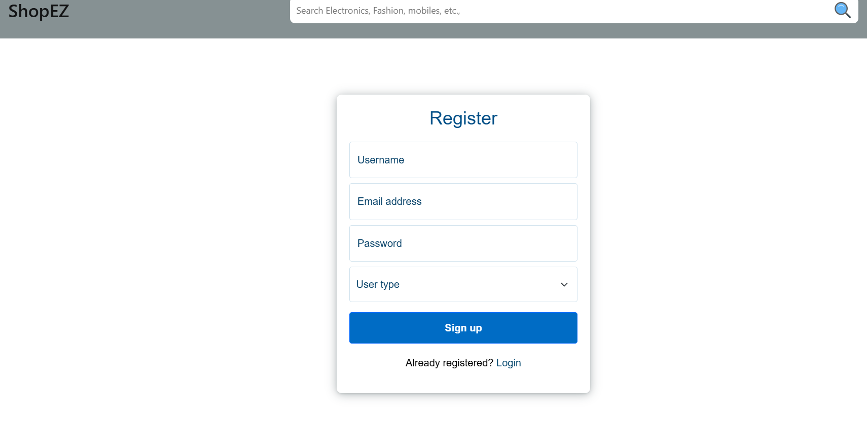
REGISTRATION PAGE

Slide 17
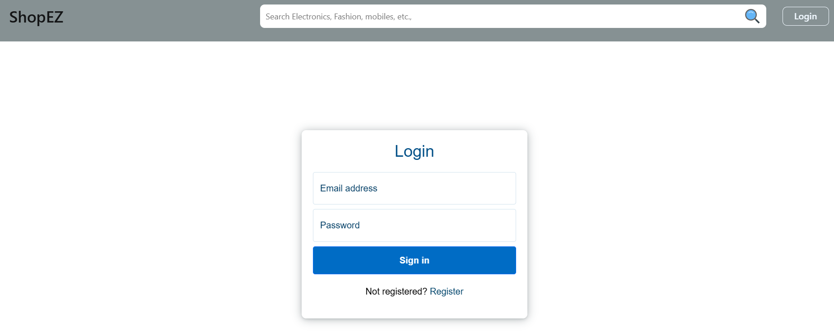
LOGIN PAGE

Slide 18
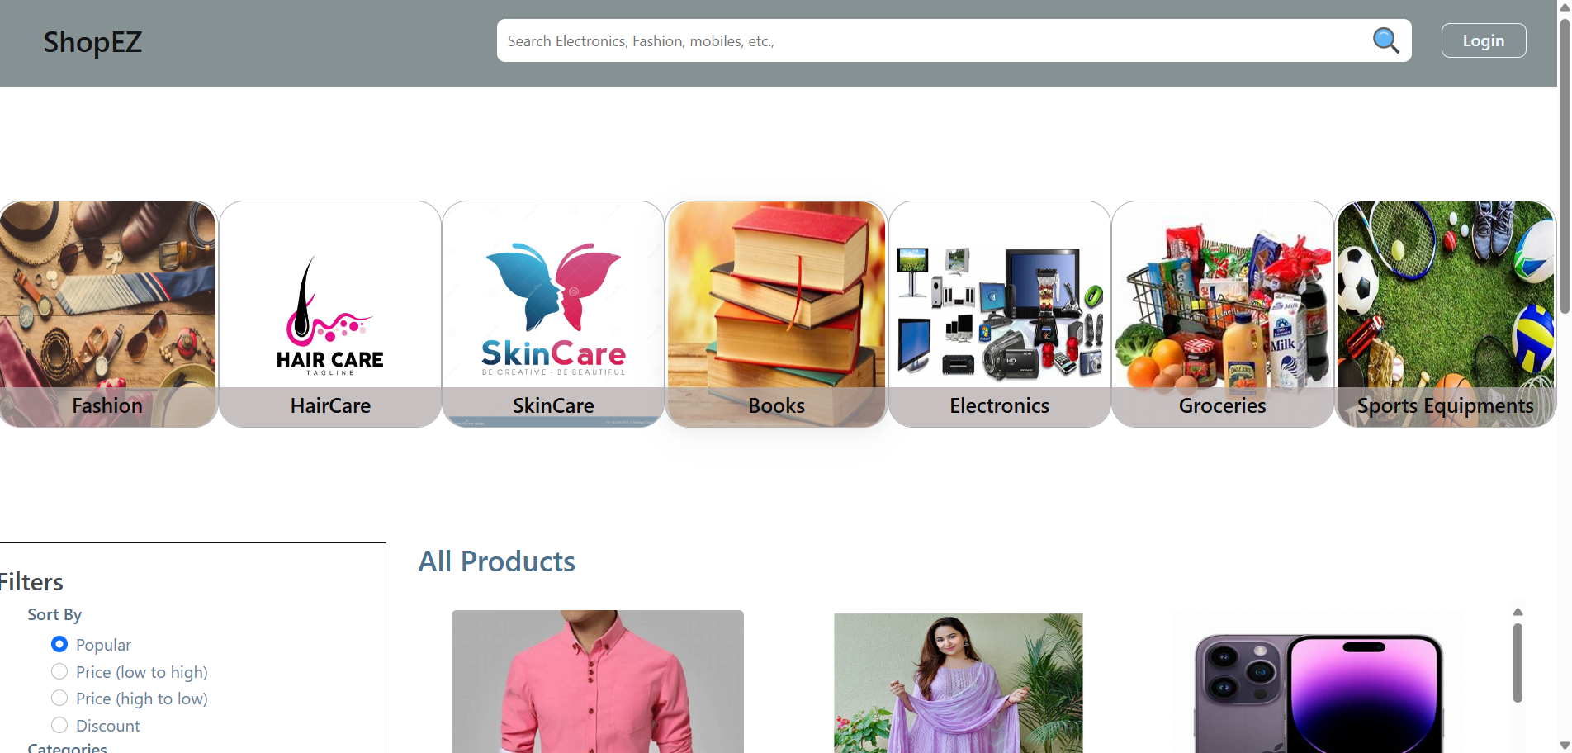
HOME PAGE

Slide 19
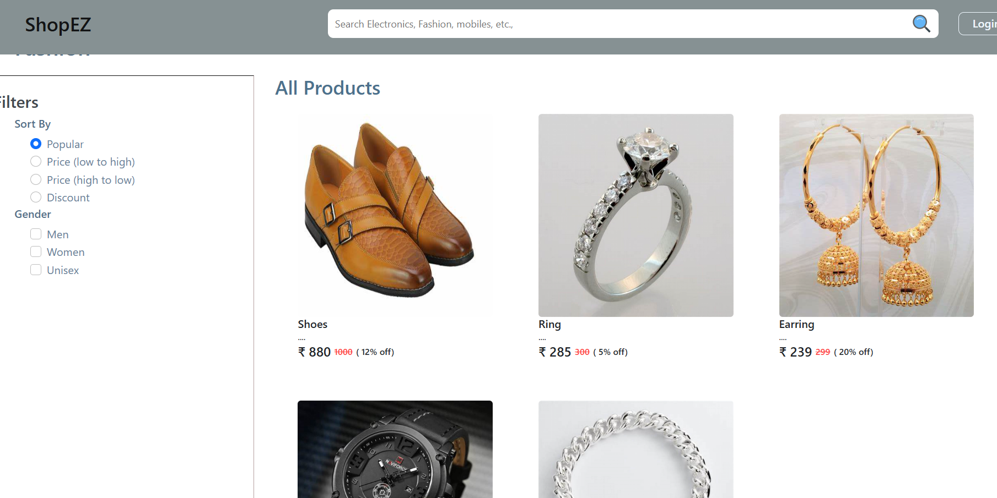
PRODUCT PAGE

Slide 20
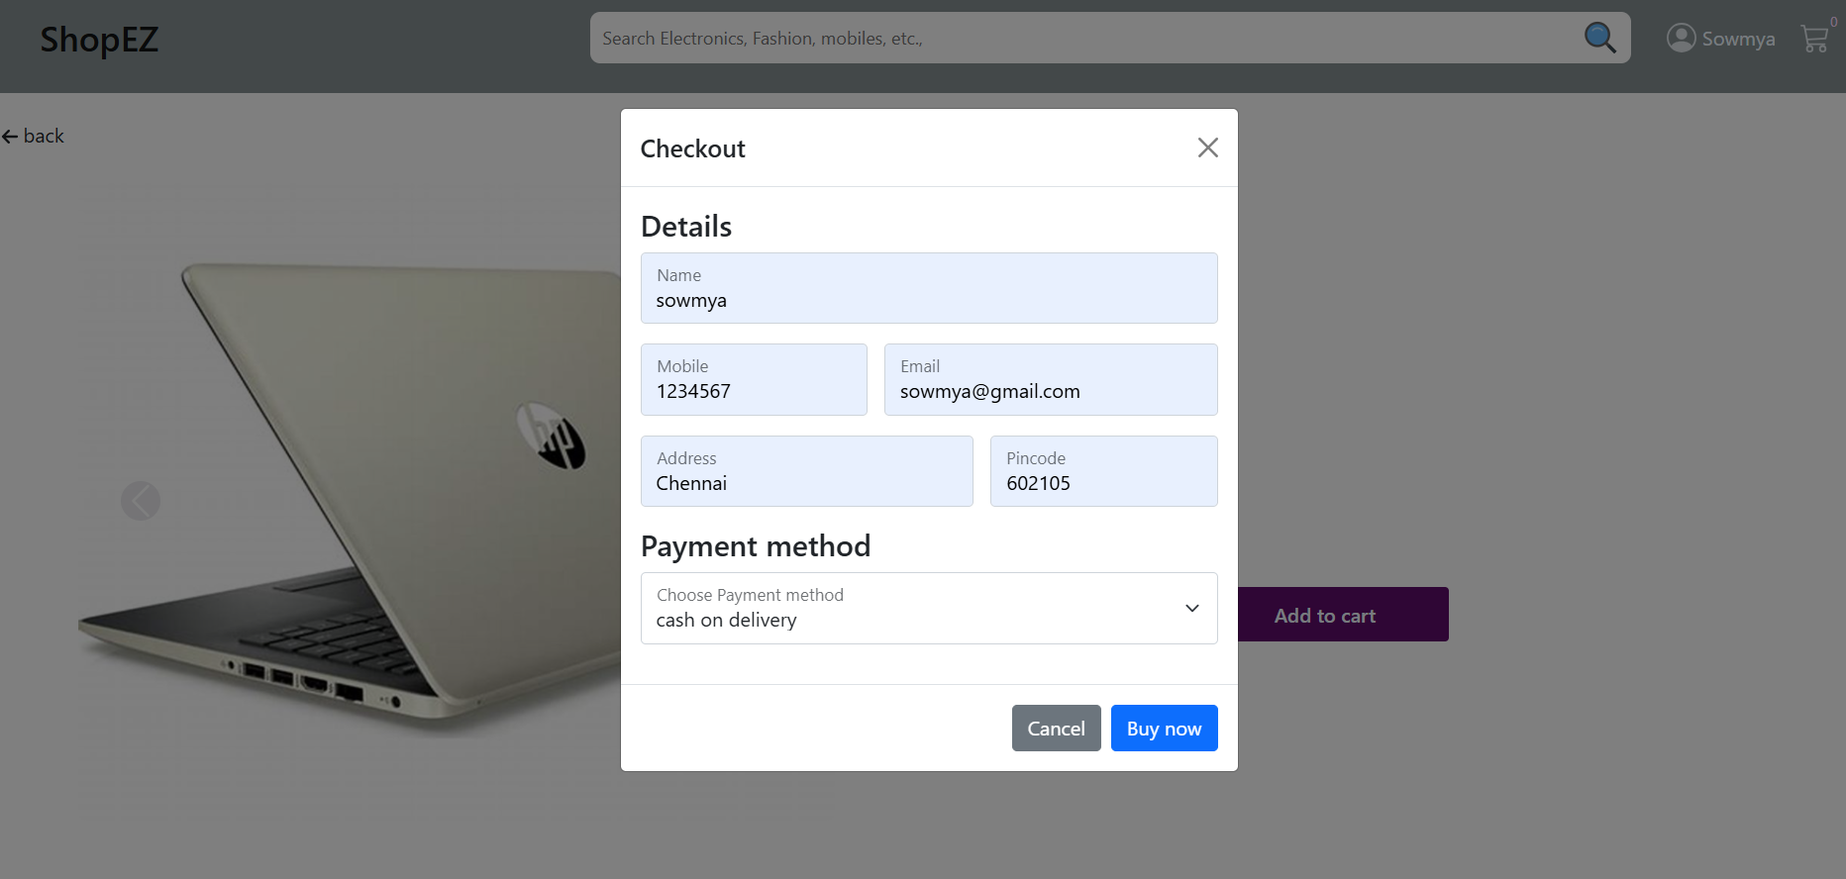
PAYMENT PAGE

Slide 21
CONCLUSION
ShopEZ stands out as a user-friendly and efficient e-commerce platform that prioritizes convenience and customer satisfaction.
With its intuitive design, wide product selection, and secure payment options, ShopEZ offers a seamless shopping experience.
Whether you're a first-time shopper or a seasoned buyer, the platform's commitment to quality and service ensures that every purchase is a hassle-free and enjoyable experience.
As e-commerce continues to evolve, ShopEZ's focus on innovation and customer-centric features positions it as a strong contender in the competitive online marketplace.

Slide 22
THANK YOU

