Slide 1
React Server Components
WR 2022
Felix Kammerlander, Alexander Kaserbacher
Notes:
Felix

Slide 2
Agenda
Welcome
Introduction
Client Server Waterfalls
React Server Components
Foundations
Further Properties of RSC
“Notes-App“ Overview
Coffee Break
Exercises Part I
Lunch
Exercises Part II
Live-Coding Exercise
Coffee Break
Frameworks & Tooling
Discussion
Notes:
Felix

Slide 3
Introduction
Notes:
Alex

Slide 4
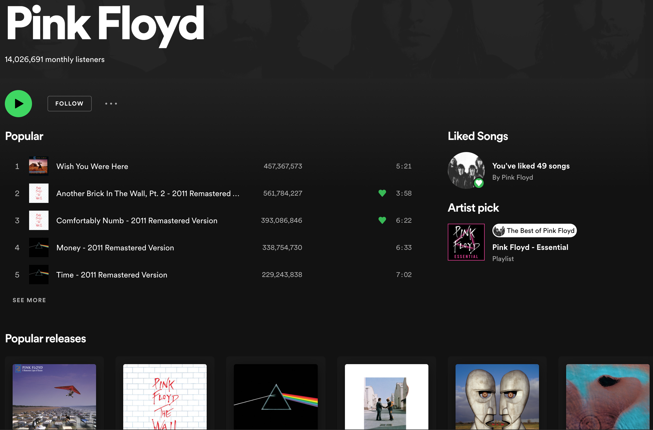
Introduction Client Server Waterfalls
Notes:
Alex

Slide 5


Introduction Client Server Waterfalls
First approach: fetch all data at once:
const data = fetch(getArtistInfoUrl(artistId));
if (data === undefined) { return <>Loading</> }
return (
<ArtistInfo artistInfo={data.info}> <TopTracks tracks={data.topTracks} /> <Discography discography={data.discography} /> </ArtistInfo>
);
User experience
Performance
Bad maintenance
Notes:
Alex

Slide 6
Introduction Client Server Waterfalls
So maybe we want our code to look more like this:
return (
<ArtistInfo artistId={id}> <TopTracks artistId={id} /> <Discography artistId={id} /> </ArtistInfo>
);
But this approach also has some issues…
Notes:
Alex
Demonstration on branch LoadingWaterfall_Demo!
Waterfall or bad user experience

Slide 7



Introduction Client Server Waterfalls
Notes:
Alex
- Visualization of the client server waterfall

Slide 8
Introduction Client Server Waterfalls
return (
<ArtistInfo artistId={id}> <TopTracks artistId={id} /> <Discography artistId={id} /> </ArtistInfo>
);
Maintenance
Bad user experience OR
Bad performance
Notes:
Alex

Slide 9
Introduction Client Server Waterfalls
Notes:
Alex
We can solve the bad user experience if we accept the waterfall. So how can we deal with the client server waterfall?
Idea: locate React components on the server.
Still a waterfall but since we are operating on the server, request times should be much shorter in general.

Slide 10
React Server Components
Notes:
Felix

Slide 11
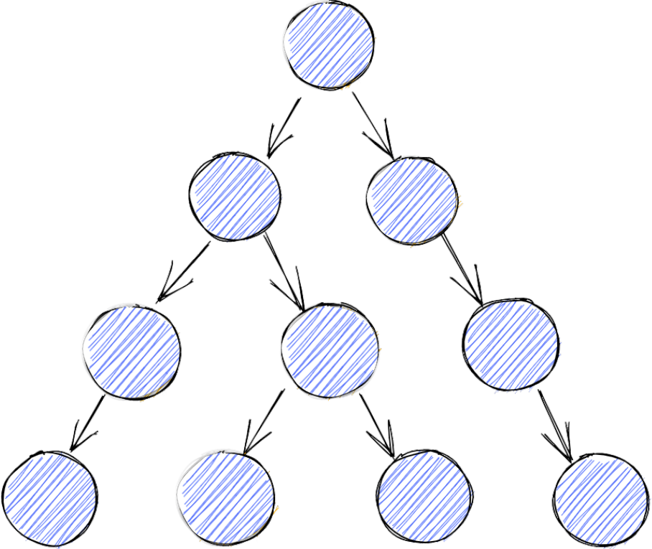
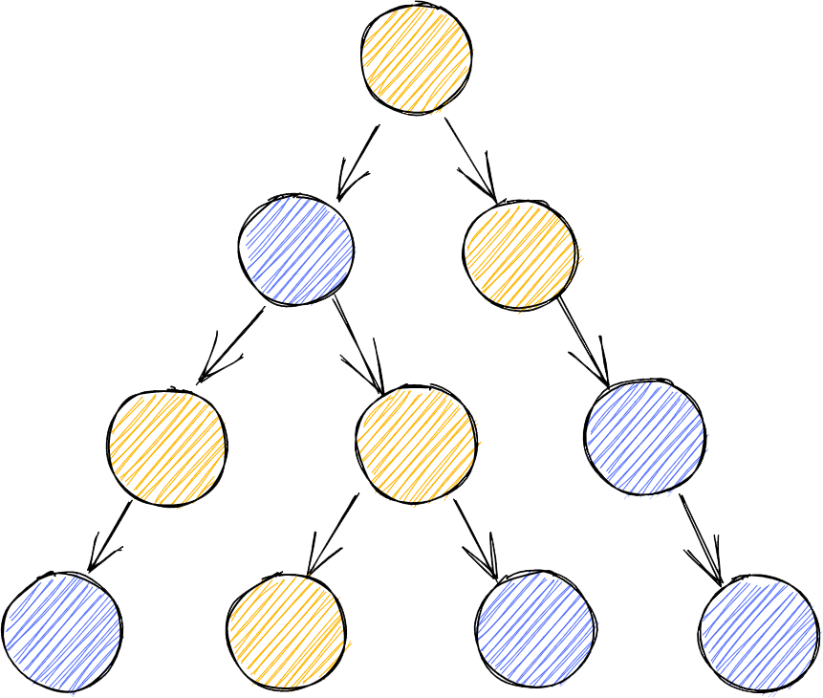
React Server Components Foundations
Server Components
*.server.tsx
Client Components
*.client.tsx
Shared Components
*.tsx
Notes:
Felix
Old: Client components only
New: Server and shared components where useful
Client components are still important: If we have a high degree of user interaction, always querying the server is a bad idea.

Slide 12
React Server Components Foundations
Server Components
*.server.tsx
Shared Components
*.tsx
Client Components
*.client.tsx
useEffect
Access to the server:
Database, files, …
Can be used on the server as well as on the client
useState
See server and client components
Use browser only APIs
Can render server components, client components, native HTML elements
Cannot render server components*
useEffect
Access to the server
useState
Use browser only APIs
Pass event handlers to client components or native elements
* Composition works, though
Notes:
Felix

Slide 13

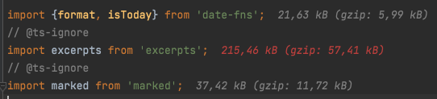
React Server Components Further Properties of React Server Components
Zero bundle Size
+ 0.0kB
Notes:
Felix
- We´ve already talked about direct server access as well as the client-server waterfall issue.
- Server components are rendered to native HTML elements or client components.

Slide 14
React Server Components Further Properties of React Server Components
Automatic Code Splitting
const NoteSkeleton = ({isEditing}) => { return isEditing ? <NoteEditorSkeleton /> : <NotePreviewSkeleton />; };
Notes:
Felix
If this is done within a server component or a shared component running on the server, the code of only one component is sent to the client.
No lazy loading required.

Slide 15
“Notes App” Introduction
Notes:
Alex
Let´s dive into the demo.
This is the Notes-App-demo by the team at Facebook, which we migrated to TypeScript.

Slide 16
“Notes App” Introduction High Level Overview
GET /
api.server.ts
Root.client.tsx
GET /react?location=
App.server.tsx
NoteList.server.tsx
native HTML / Client Components
Notes:
Alex
User navigates localhost:3000.
api.server.ts returns index.html and Root.client.tsx component is rendered.
Root.client.tsx triggers initial server component render by querying a certain URL using a location object that represents the current app state (navigation etc).
Server components get rendered on the server, native HTML and Client components are sent to the client using a certain streamable format.
Client components are rendered on the client. Updates from the server are streamed in order to update the view.

Slide 17
“Notes App” Introduction Navigation and Rerendering
const response = useServerResponse(location); return ( <LocationContext.Provider value={{location, setLocation}}> {response.readRoot()} </LocationContext.Provider> );
location context to hold and update the App state
changing the location triggers a fetch and thus a rerender of the component tree
caching is used in order to prevent too many rerenders
Notes:
Alex
The whole component tree gets rerendered
Client state is *not* impacted!
readRoot() is a function provided by a webpack plugin (react-server-dom-webpack). It is able to parse the streamable format and trigger React rendering on the client side.
Question: Any idea, why caching was implemented at that point?

Slide 18
“Notes App” Introduction Walkthrough
Walkthrough
Notes:
Felix
Lets go through some parts of the app
App.server.tsx
NoteList.server.tsx
SidebarNote.tsx
SidebarNote.client.tsx
Demonstrate what happens with slow internet!
Don´t forget to say something about useTransition()
Note.server.tsx
NoteEditor.client.tsx
Saving a note, invalidating the cache, rerender the app, navigate to update app state

Slide 19
Exercise I – Statistics Page
Branch: ex01

Slide 20
Exercise II – Favourites
Branch: ex02
Please run npm run seed once again!

Slide 21
Exercise III – Improving the App

Slide 22
Exercise III – Improving the App

Slide 23
Discussion
What would we need for production usage?
What are current limits?
What are current use-cases?
What are patterns and architectural considerations?
Notes:
Alex

Slide 24
References
Introducing Zero-Bundle-Size React Server Components
by Dan Abramov, Lauren Tan, Joseph Savona, Sebastian Markbåge
https://reactjs.org/blog/2020/12/21/data-fetching-with-react-server-components.html
RFC: React Server Components
by Dan Abramov, Joseph Savona
https://github.com/josephsavona/rfcs/blob/server-components/text/0000-server-components.md
server-components-demo
by Andrew Clark, Dan Abramov, Joseph Savona, Lauren Tan, Sebastian Markbåge, Tate Strickland
https://github.com/reactjs/server-components-demo
How React server components work: an in-depth guide
by Chung Wu
https://blog.plasmic.app/posts/how-react-server-components-work/#the-server-client-component-divide
React component image
https://www.pngaaa.com/detail/2507930

