Slide 1
Continuous Delivery Platform @GTS
ITaaS, Puppet & co
C1
RESG/GTS/MKT
DATE 10/03/2015

Slide 2
CHAPTER 01
How did we get here?
C1 | PRESENTATION TITLE
DATE 00/00/2011
P.<number>

Slide 3
“Standing on the shoulders of giants”
SFSQ
DeployIT
Agile @ ITEC
ERM
Study/POC Cloud
Pilote Cloud
Cloud for Dev
Continuous Delivery
IaC
Before 2013
2013
2014
C1 | PRESENTATION TITLE
DATE 00/00/2011
P.<number>

Slide 4
The Cloud PaaS Pilot
Cloud PaaS pilot scope was composed of 16 applications
Infrastructure blueprints of the applications were coded in AppDirector
« VMware® vCloud™ Application Director is a model-based application provisioning solution (…) Application architects can use a graphic-based canvas with a drag-and-drop interface to model application deployment topologies called application blueprints
But PaaS pilot was non successful
  Low level of blueprint factorization: 15 blueprints for 16 applications
  Market study showed that PaaS was not mature enough: no emerging standards, too many different approachs
AppDir was decommissionned in Sept 2014
C1 | PRESENTATION TITLE
DATE 00/00/2011
P.<number>

Slide 5
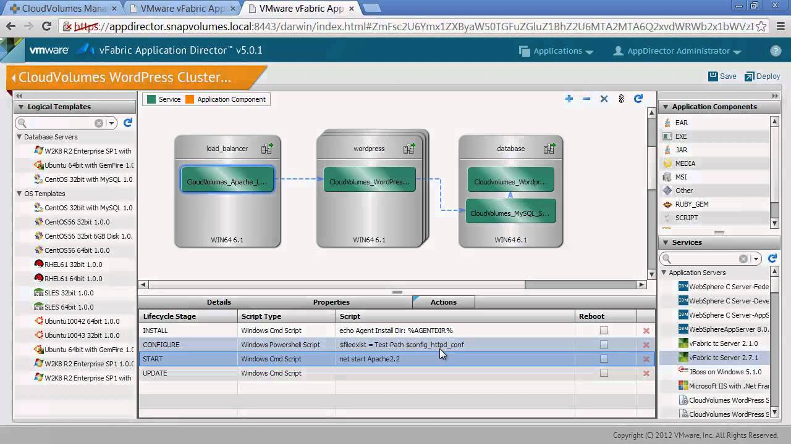
vCloud Application Director
C1 | PRESENTATION TITLE
DATE 00/00/2011
P.<number>

Slide 6
Infrastructure as Code
Continuous Delivery program promoted another approach:
API-centric
Infrastructure is code : versioned, tested, released
Use a standard configuration manager, which will be shared between ITEC & GTS
GTS should provide unitary components and let ITEC do the orchestration
A dedicated stream was started in Continuous Delivery program, with GTS/MKT accountability
Within this stream, we built the « ITaaS »
C1 | PRESENTATION TITLE
DATE 00/00/2011
P.<number>

Slide 7
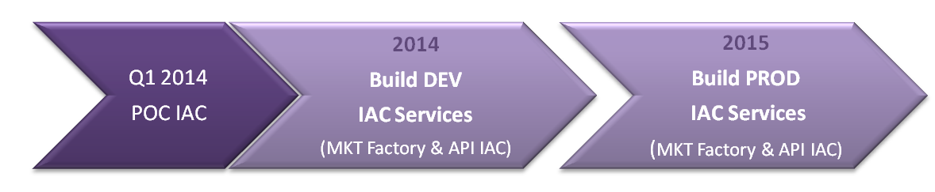
INFRA AS CODE: MAIN MILESTONES & DELIVERABLES
22/10 : Extend perimeter to 32 CD APP
More APIs (APACHE, IIS, PKIAAS)
IAC Platform Robustness & Resilience
IAC Authorisation management V1
BILLING
API Documentation : migration in MIND
15/04 : POC WITH 2 APP
Minimal IAC Platform
5 PROVISIONING API
Sept : PILOTE with 10 APP
APIs improvement
Dynamic usage DASHBOARD
Path to AGILE Method : JIRA tool; REL every 3 weeks
GTS Training
30/06 : PILOTE with 7 APP
IAC & DATALAKE Platform setup
27 API (PROVISIONING & DB REFRESH)
Authentication V1 & Traceability

Slide 8
CHAPTER 02
To the point, man, to the point:
“How does it work?”
C1 | PRESENTATION TITLE
DATE 00/00/2011
P.<number>

Slide 9
The ITaaS
ITaaS role is to
  Expose a set of APIs for provisioning and operating the infrastructure
  Manage the security around these APIs : Authentication + Authorization
  Handle asynchronicity
  Measure API consumption
We needed a configuration manager
  After a quick study, we choose Puppet as configuration manager (more on this later)
We choose to develop in Ruby
  High-level language
  Puppet is (was) written in Ruby
  Other contendants were Python, Java
Chosen API format was REST/JSON
  De facto web standard
C1 | PRESENTATION TITLE
DATE 00/00/2011
P.<number>

Slide 10
REST/Jwhat??
REST (Representational state transfer) is an architecture pattern
  Client-server
  Stateless
  Cacheable
  Layered system
JSON (JavaScript Object Notation) is a format designed to transmit data using key/value pairs
Network protocol is HTTP(S)
{"employees":[
{"firstName":"John", "lastName":"Doe"},
{"firstName":"Anna", "lastName":"Smith"},
{"firstName":"Peter", "lastName":"Jones"}
]}
C1 | PRESENTATION TITLE
P.<number>

Slide 11
ITaaS High Level Design
ITaaS
Directory
(AD)
API Frontend
(Apache + Passenger)
VCS
(SGithub)
Datalake
(ELK)
Job Handler
(Rundeck)*
Cfg. Manager
(Puppet)
SG Cloud
(vCAC)
Other Backends
(DBA Bastion, OSM server)
C1 | PRESENTATION TITLE
DATE 00/00/2011
P.<number>

Slide 12
The ecosystem
Kibana
ITaaS
Elastic Search
PuppetDB
Logstash
Hiera
PKIaaS
ENC
Puppet Dashboard
GitHub
Puppet Master
API call
GDAT
Bin Repo
ITAAS
Rundeck
Puppet agent
DBA Bastion
SVCtools
vCac VCO
ESX
VM
Compkit
sshkit
SVCmon
AD
Centrify
HOSTmon
UNX Bastion
Netmap
unxprdmas
DNSmap
Group Membership
Marley
DNS
C1 | IaC Awareness APIs for Linux Servers
28/11/2014

Slide 13
Configuration Manager choice
We choose Puppet as a Configuration Manager (against Chef, SaltStack & Ansible)
Puppet canonical use cases:
  OS post-install and configuration
  Install and configure infrastructure components (Middlewares, Databases)
  Apply a desired state to a server
  Compliance checks
Puppet is not meant for:
  Deploying applications (code, .war)
  Configuring non-server equipments, controlling clouds
  More globally, doing any action outside the node it is running on
C1 | Project Name
P.<number>

Slide 14
Puppet Principles
« Destinations, Not Journeys »
  You don’t write scripts: you define the desired state of a node and puppet ensures that the node configuration complies with its state.
  It is done by providing manifests to puppet. Here’s a example:
  # /root/examples/file-1.pp
    file {'testfile':
    path => '/tmp/testfile',
    ensure => present,
    mode => 0640,
    content => "I'm a test file.",
    }
  Puppet will ensure that the testfile will be present, with the right permissions. If the file is not present, it will create it
Idempotence
  Successive runs of puppet yield the same results. This is very important to bear in mind when writing manifests.
  As a consequence, « check » and « fix » are both done with the same code (you can always run puppet with the « no-op » parameter for simulating what it would have done)
C1 | Project Name
P.<number>

Slide 15
Puppet Principles
Manifests can be bundled in « modules »
  There are a lot of modules in the community for configuring all kind of software. Some are officially supported by Puppetlabs (support comes with the Enterprise Edition)
  See : https://forge.puppetlabs.com/
The puppet language is a Ruby DSL (Domain-Specific Language)
  Ruby skills are not necessary, but may come handy for tricky situations: e.g.: complex substitution in a configuration file
C1 | Project Name
P.<number>

Slide 16
Serverless mode:« Puppet Apply »
In its simplest implementation, Puppet is just a binary to be run on the server.
  # puppet apply /root/examples/file-1.pp
It can be run in privileged or in non-privileged mode, but will fail if it has insufficient permissions
Manifest synchronization across all nodes must be done manually
Not really adapted to big-scale deployments
It can be daemonized for scheduled runs
C1 | Project Name
P.<number>

Slide 17
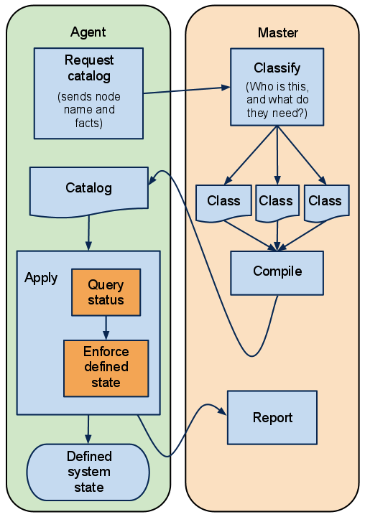
Server mode: « Puppetmaster »
For large-scale deployment, it is recommanded to setup « Puppetmasters ».
These masters accepts connections from agents, compile the catalog (the configuration that must be applied to that node) and act as central management node
The masters are stateless, enabling a scale-out infrastructure…
… except for one particular master acting as CA for all puppet nodes. This master stores a CRL
Agents can be loadbalanced across the puppetmasters
Only manifests must be synchronized on the masters
C1 | Project Name
P.<number>

Slide 18
Roles and node-specific configurations
How does a puppetmaster knows what configuration should be applied to each node?
Simplest way: use the node hostname to deduce its role -> not applicable here
Advanced method: use an ENC (External Node Classifier)
  An ENC is a component that puppet will query to know which role and configuration is assigned to each node.
  Technically it is a arbitrary binary that return a YAML file describing the server
  There are off-the-shelf ENC implementations (Hiera)
C1 | Project Name
P.<number>

Slide 19
Apache HTTPd +
Phusion Passenger
API - Front
AD
Auth
DB
mySQL
Core
API - Tech
ENC
Rundeck (JRE)
Puppet Master
Puppet
Refresh
DB
Unregister
GDAT
vCAC
ITaaS
Sync
Git
Scripts DB
GDAT
SG Cloud
Puppet
Agent
Software Factory

Slide 20




So all is well?
Well..
… we had a major incident last week because Rundeck froze.
… security model is not satisfactory for prod usage
… Puppet cannot be used right now without the ITaaS
… Puppet Console was part of Puppet Enterprise, we had to drop it
C1 | PRESENTATION TITLE
DATE 00/00/2011
P.<number>

Slide 21
What I didn’t talk about
Hiera
HieraGPG
Facter
R10k
All the tools in the ITaaS Software Factory
  Serverspec
  rspec-puppet
  Jenkins
  Rake
  ….
PuppetDB
Puppet Dashboard
C1 | PRESENTATION TITLE
DATE 00/00/2011
P.<number>

Slide 22
What’s next
Decouple Puppet from ITaaS
Better reporting on Puppet runs
Multi puppet masters (with geo-affinity)
Compliance with Puppet
Better monitoring
Performance assessment
New APIs & services
Integrate with WAM
Integrate with a secrets vault
C1 | PRESENTATION TITLE
DATE 00/00/2011
P.<number>

