Slide 1
JS Objects
Storing related data & behavior.

Slide 2
Learning Objectives
When to use objects
How to use objects
How to create objects (object literals or new)
Recognize objects in the wild
Understand the basic theory behind object-oriented programming

Slide 3
What is an object?
An object is a collection of related data and/or functionality
For example, an object can store several variables and functions
The variables are called properties when they are inside objects
The functions are called methods when they are inside objects

Slide 4
Create Objects – Literal Notation
A simple solution for simple use cases
A comma separated list of key: value pairs
Key names can contain characters like spaces if enclosed in quotes
Let’s talk about the other ways to create objects later

Slide 5


Using An Object’s Data
Dot notation
Bracket notation

Slide 6
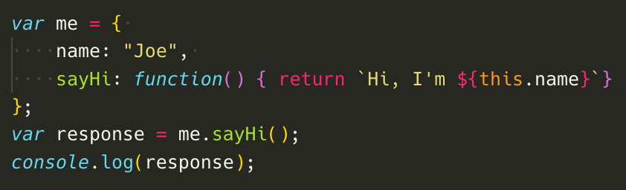
Using Object’s Behavior
Reference the object’s method followed by parenthesis to call an object method

Slide 7
Objects and “this”
You are probably wondering what "this" is. The this keyword refers to the current object the code is being written inside^{[1]}
The importance of “this” is more obvious when you have several objects or more complex behavior.
We’ll come back to “this” with constructors

Slide 8
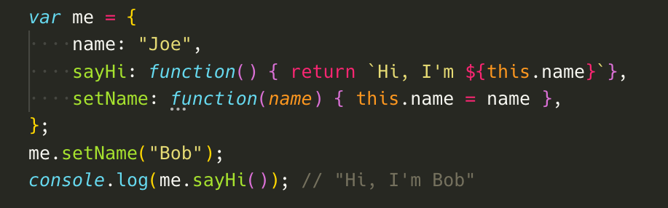
Behavior, Acting Upon Itself
Object store values, the ideal use of object behavior is to use those values and/or modify those values.

Slide 9
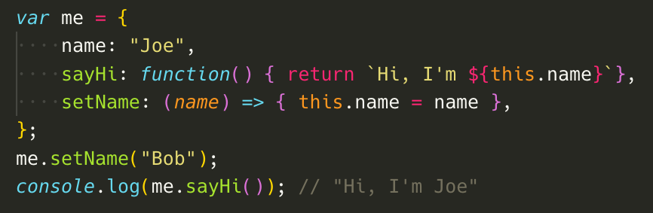
Challenge - Spot the bug
Be aware – arrow functions do not bind/inject their own “this” variable

Slide 10
Behavior, Avoid Side Effects
Try to avoid methods that affect state outside the object, unless adding side effects truly simplifies your code
Example, if you are modeling a store product, avoid methods on the store object that display itself in the DOM. Instead, have a function elsewhere that accepts a product argument and displays it.
The reason is that; relationships between data are a) really hard to model and b) really hard to read in code

Slide 11
Objects You Already Know
Objects are everywhere in Javascript
Creating an array is actually creating an object whose behavior/methods are tailored to working with a series of values indexed by integers, but it’s still an object

Slide 12
Aside – Learning Style
Do you approach learning this material with much curiosity?
Stop to investigate how code works
Slow down when you get an error and try to understand what did happen and why
Take the time to explain out loud what you think is happening^{[3]}

Slide 13
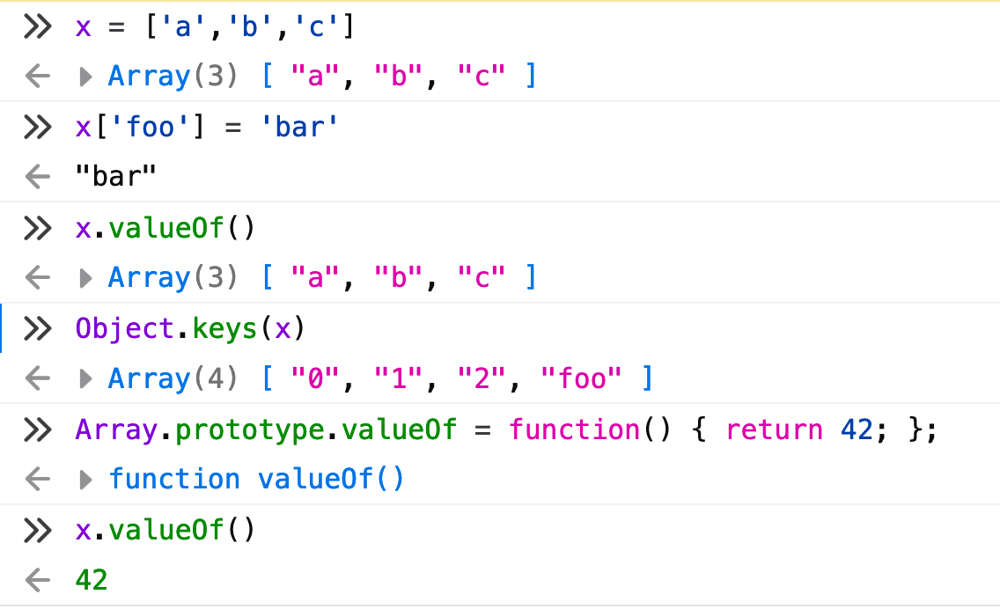
Array Object - Investigate
Its methods seem to ignore non-integer property names
It isn’t really special, you can override its behavior if you wanted (don’t), it’s just a normal object

Slide 14
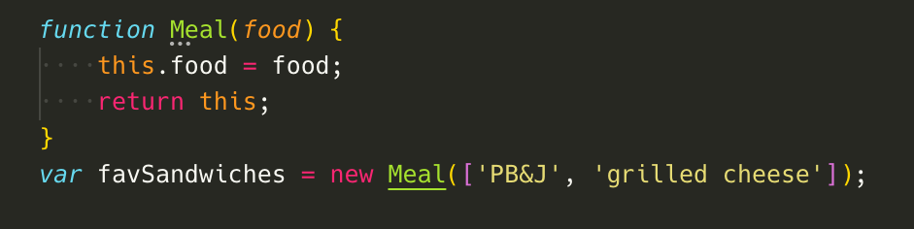
Create Objects – Constructor
A better solution for important, complex, or long-lived objects
Constructor function syntax - define a function returning special variable, “this” (implied)

Slide 15
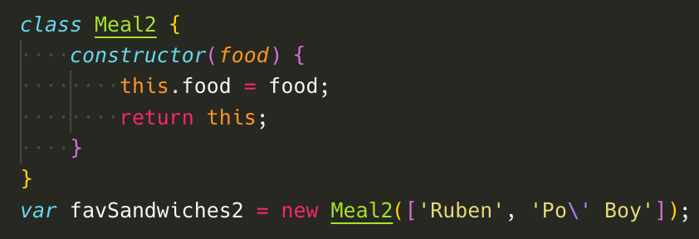
Create Objects – Class
Similar to constructor function but with simpler syntax
Define a class with a constructor method that returns the special variable, “this” (implied)

Slide 16
Resources
MDN Guide - Javascript Object Basics
https://developer.mozilla.org/en-US/docs/Learn/JavaScript/Objects/Basics
Bouncing ball challenge from the above guide
https://developer.mozilla.org/en-US/docs/Learn/JavaScript/Objects/Object_building_practice
Rubber ducky prototyping
https://en.wikipedia.org/wiki/Rubber_duck_debugging
Primitive Wrappers Docs
https://developer.mozilla.org/en-US/docs/Glossary/Primitive#Primitive_wrapper_objects_in_JavaScript

