Slide 1
Events Checkpoint

Slide 2
Events Checkpoint
Give two examples of an HTML Event.
Show an example of an Event Handler added to an HTML Button
This handler should be calling the function randomNumber()

Slide 3
Events
Event Handlers

Slide 4
Objectives
Understand when an event occurs
Know when to use an event handler
Familiarize methods used to work with events

Slide 5
What is an Event?
Things that happen to HTML elements
Caused by either the browser or user

Slide 6
How Do You Work with Events?
Adding Event Handlers
Manages what happens during/after event
Through HTML or JavaScript

Slide 7
HTML Event Handler

Slide 8
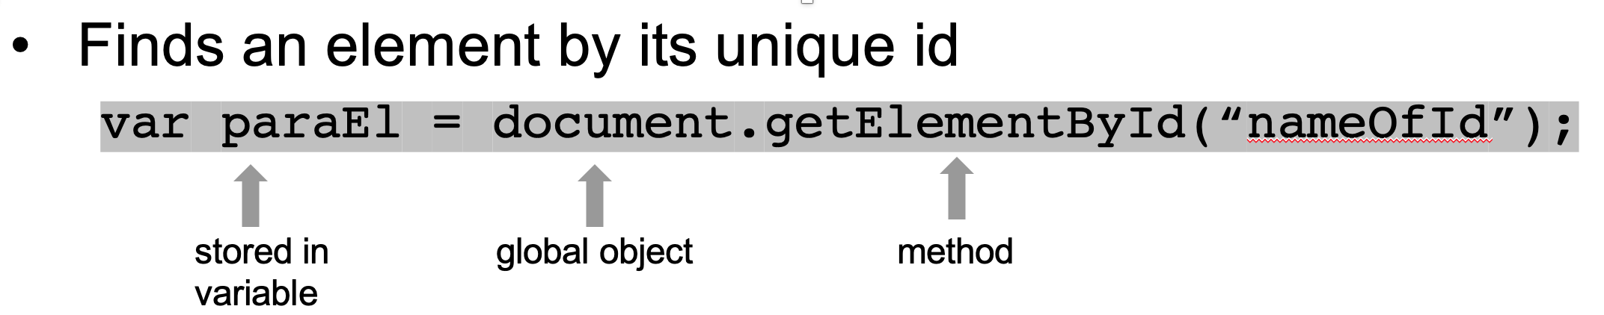
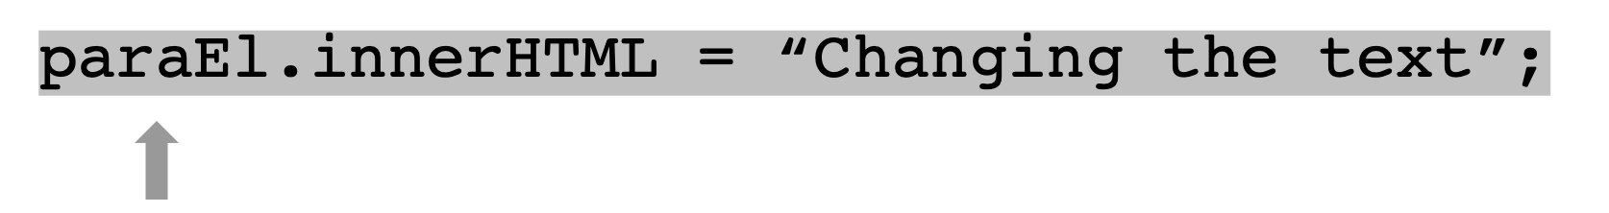
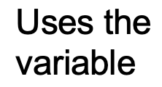
getElementById

Slide 9
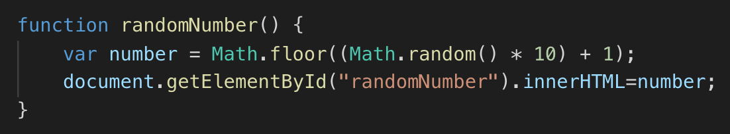
JS Event Handler

Slide 10
Challenge Set Up
In VS Code…
Create an index.html file with a HTML skeleton
Create a script.js file
Link the script.js in the script tag located in the index.html

Slide 11
Challenge #1 Use JavaScript
Create an H1 tag with a title for your page
Create a button that says “Change the Color”
Use an Event Handler named changeColor() to change the H1’s color to your favorite color when clicked. Change the background color as well

Slide 12
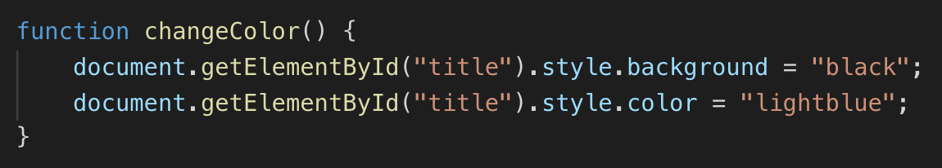
Challenge #1 Answer

Slide 13
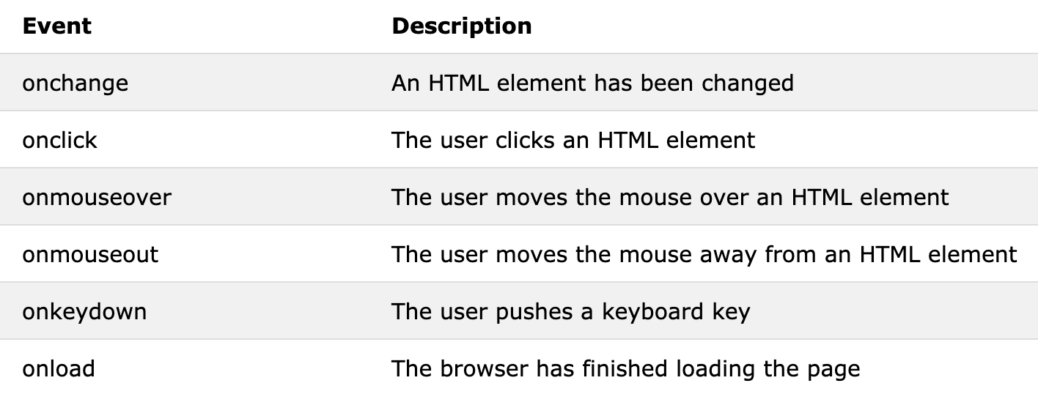
What HTML Events Can We Use?

Slide 14
Challenge #2
Find a picture of your least favorite food and add it to an image tag.
Create an onmouseover event handler with a function named beGone() to turn the opacity to 0 when your mouse moves over the image
Create an onmouseout named itsBack() that will unfortunately bring it back

Slide 15
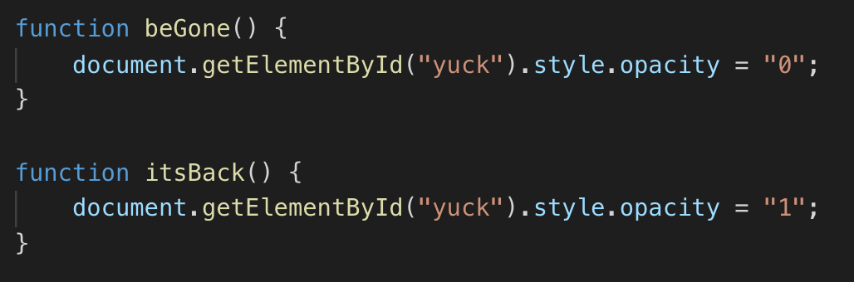
Challenge #2 Answer

Slide 16
Resources
https://www.w3schools.com/js/js_events.asp
https://developer.mozilla.org/en-US/docs/Web/Guide/Events/Event_handlers
https://idratherbewriting.com/events-and-listeners-javascript/

