Slide 1





Emotion-Aware Chatbot for Customer Support
College Code & Name : 3135 - Panimalar Engineering College Chennai City Campus
Subject Code & Name : NM1090 - Natural Language Processing (NLP) Techniques
Year and Semester : III Year - VI Semester
Project Created by : 1. THINESH KUMAAR K (313522104166)
2. CHETAN VM (313522104168)
3. THIRUPPATHI BALAJI E (313522104167)
4. SUDARSAN S (313522104164)

Slide 2
Abstraction
This project presents an Emotion-Aware Chatbot designed to enhance user experience in digital communication, particularly in customer support. It utilizes a fine-tuned DistilRoBERTa transformer model for emotion classification, detecting emotions like joy, sadness, anger, and fear from text.
NLP techniques such as tokenization, stop word removal, and lemmatization improve emotion detection accuracy. The chatbot is trained on a custom dataset and evaluated based on classification accuracy.
It generates empathetic, context-aware responses for more human-like interactions. Challenges like ambiguous text and context retention are addressed, with future improvements suggested through better context tracking and reinforcement learning.
Notes:
Abstraction
This project presents an Emotion-Aware Chatbot designed to enhance user experience in digital communication, particularly in customer support. It utilizes a fine-tuned DistilRoBERTa transformer model for emotion classification, detecting emotions like joy, sadness, anger, and fear from text. NLP techniques such as tokenization, stop word removal, and lemmatization improve emotion detection accuracy. The chatbot is trained on a custom dataset and evaluated based on classification accuracy. It generates empathetic, context-aware responses for more human-like interactions. Challenges like ambiguous text and context retention are addressed, with future improvements suggested through better context tracking and reinforcement learning.

Slide 3
Technologies Used
• Programming Languages: Python for development.
• Libraries: PyTorch for deep learning, Hugging Face Transformers for model handling,
NLTK for text processing, and Pandas for data manipulation.
• Pre-trained Model: DistilRoBERTa (Hugging Face) for emotion classification.
Project Implementation
• Data Collection: A CSV dataset of text samples labeled with emotions (joy, sadness, anger, fear) is used.
• Text Processing: Text is preprocessed using tokenization, stopword removal, and
lemmatization for better emotion detection.
• Model Fine-Tuning: A pre-trained DistilRoBERTa model is fine-tuned on the emotion
dataset using the Hugging Face Trainer API (3 epochs, batch size 8).
• Chatbot Logic: The chatbot detects user emotions, recognizes greetings, handles work
related stress, and generates empathetic, context-aware responses.

Slide 4
Coding
#import necessary libraries.
import torch
import os
import sys
from transformers import AutoTokenizer, AutoModelForSequenceClassification, pipeline, Trainer, TrainingArguments
from torch.utils.data import Dataset, DataLoader
import pandas as pd
import nltk
from nltk.corpus import stopwords
from nltk.stem import WordNetLemmatizer
# Download necessary NLTK resources
nltk.download('punkt')
nltk.download('stopwords')
nltk.download('wordnet')
# Initialize lemmatizer and stopwords
lemmatizer = WordNetLemmatizer()
stop_words = set(stopwords.words('english'))

Slide 5
Coding
#Function to process text using basic NLP with nltk
def process_text(text):
tokens = nltk.word_tokenize(text)
filtered_tokens = [lemmatizer.lemmatize(word.lower()) for word in tokens if word.isalpha() and word.lower() not in stop_words]5
return ' '.join(filtered_tokens)
class EmotionDataset(Dataset):
def __init__(self, file_path='emotion_dataset.csv', tokenizer=None, max_length=128):
if not os.path.exists(file_path):
raise FileNotFoundError(f"Dataset file {file_path} not found.")
self.data = pd.read_csv(file_path)
self.tokenizer = tokenizer
self.max_length = max_length
def __len__(self):
return len(self.data)

Slide 6
Coding
def __getitem__(self, idx):
text = self.data.iloc[idx]['text']
label = self.data.iloc[idx]['label']
processed_text = process_text(text) # Use NLP process without spaCy
inputs = self.tokenizer(processed_text, truncation=True, padding='max_length',
max_length=self.max_length)
inputs['label'] = int(label)
return {key: torch.tensor(val) for key, val in inputs.items()}6
class EmotionAwareChatbot:
def __init__(self, model_name='j-hartmann/emotion-english-distilroberta-base',
dataset_file='emotion_dataset.csv'):
self.tokenizer = AutoTokenizer.from_pretrained(model_name)
self.model = AutoModelForSequenceClassification.from_pretrained(model_name)
if dataset_file and os.path.exists(dataset_file):
self.finetune_model(dataset_file)

Slide 7
Coding
def respond(self, text):
# Handle greetings explicitly
greetings = ['hi', 'hello', 'hey', 'good morning', 'good afternoon', 'good evening']
if any(greeting in text.lower() for greeting in greetings):
return "Hello! How can I assist you today?"
# Handle specific complaints like work-related frustration
work_related_phrases = ['work was so hard', 'work is exhausting', 'I’m stressed at work', 'I had a tough day at work']
if any(phrase in text.lower() for phrase in work_related_phrases):
self.last_emotion = 'work-related stress' # Track that the last emotion was work-related stress
return "It sounds like you had a challenging day at work. I'm really sorry to hear that. How can I help you feel better?“
# If the user previously mentioned work-related stress, continue the conversation
if self.last_emotion == 'work-related stress':
if 'yes' in text.lower():
return "I'm glad you're open to discussing it. How about telling me what specifically made
your day hard? I'm here to help."

Slide 8
Coding
#Handle emotions based on text input
emotion, score = self.classify_emotion(text)
if emotion == 'anger' or emotion == 'frustration':
response = "I'm really sorry you're feeling this way. Let's work together to resolve this issue.”
elif emotion == 'joy':
response = "That's awesome! I'm glad you're having a great time. How can I make your day
even better?"8
# Example usage with continuous interaction
chatbot = EmotionAwareChatbot(dataset_file='emotion_dataset.csv')
print("Chatbot is ready to chat! Type 'exit' to end the conversation.")
while True:
user_input = input("You: ")
if user_input.lower() in ['exit', 'quit', 'bye']:
print("Chatbot: Goodbye! Have a great day!")
break
response = chatbot.respond(user_input)
print("Chatbot: ", response)

Slide 9
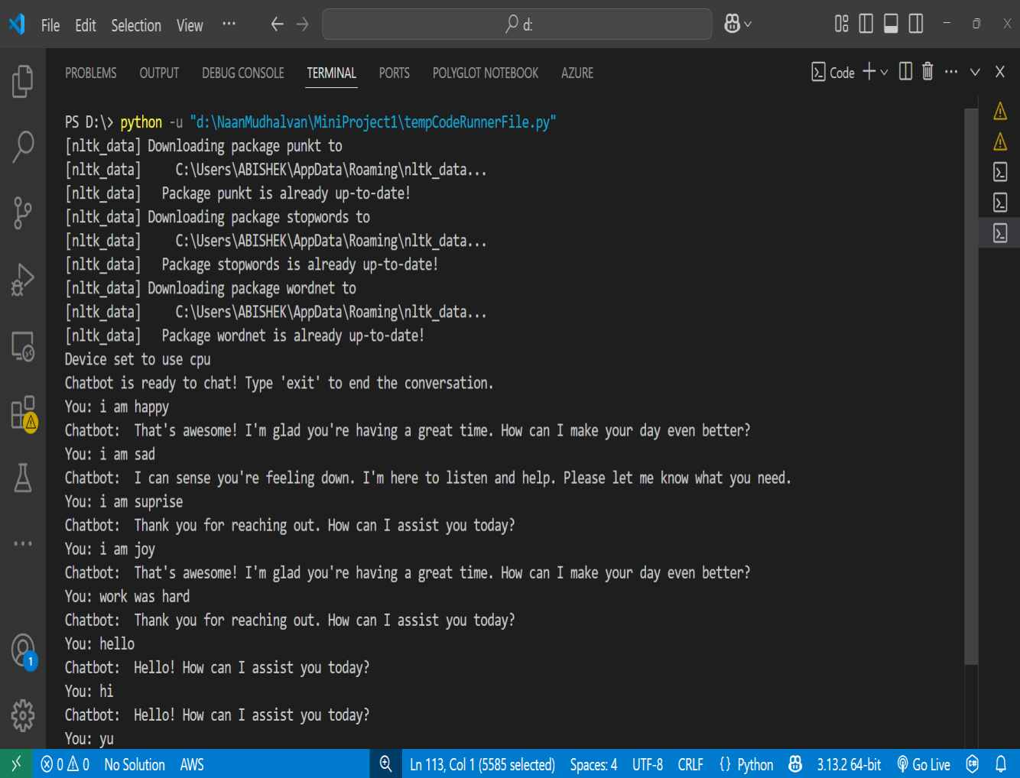
Output

Slide 10
THANK YOU

