Slide 1
ZeaStellar
By pheripheralplutarch

Slide 2
MISSION TO CREATE AN AGE FILLED WITH SUNSHINE

Slide 3
ABOUT
Zeastellar is developed to find the current profitability of the user's location. The Zeastellar finds whether the solar energy is suitable for that particular location or not. With its advanced ML model Zeastellar finds the cost of installation and profitability of the installation(Here profitability means Total cost of the electricity / cost of Solar UNit x 100). We have collected various data to evaluate the profitability. The data includes Total area of Installation, Solar Irradiation, Performance Ratio and ENergy Yield of the unit. With this Datas and some more algorithm, Zeastellar postulates a accuracy of 65%.

Slide 4
PRINCIPLES
Every location on Earth receives sunlight at least part of the year. The amount of solar radiation that reaches any one spot on the Earth's surface varies according to:
Geographic location
Time of day
Season
Local landscape
Local weather.

Slide 5
MEASUREMENT
Scientists measure the amount of sunlight falling on specific locations at different times of the year. They then estimate the amount of sunlight falling on regions at the same latitude with similar climates. Measurements of solar energy are typically expressed as total radiation on a horizontal surface,or as total radiation on a surface tracking the sun.
Radiation data for solar electric (photovoltaic) systems are often represented as kilowatt-hours per square meter (kWh/m²). Direct estimates of solar energy may also be expressed as watts per square meter (W/m²).
Radiation data for solar water heating and space heating systems are usually represented in British thermal units per square foot (Btu/ft²).

Slide 6
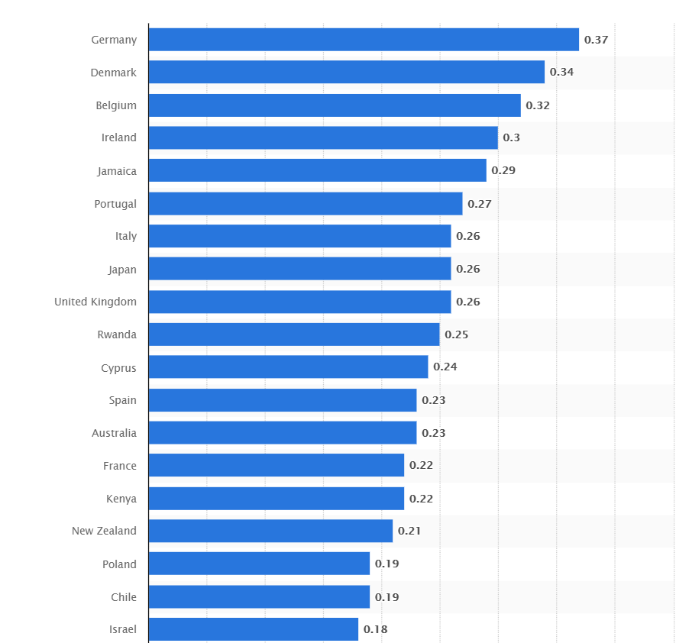
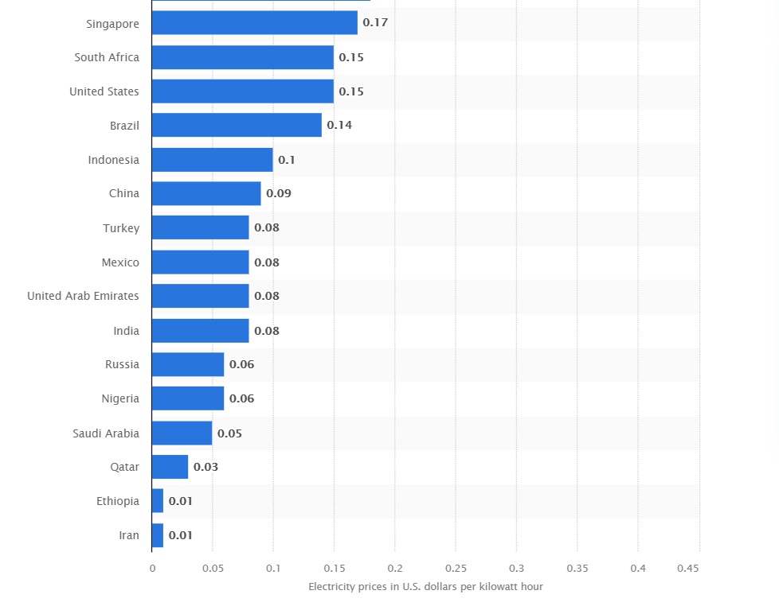
ELECTRICITY PRICE STATS

Slide 7
ZeaStellar neural network
BLOCK 1(INPUT NODES)
Profitability
Cost
BLOCK 2(REFERRAL NODES)
Panel type
Irradiation
Season
BLOCK3(OUTPUT NODES)
Area
Profitability
Cost
Efficiency
2 min Video: https://youtu.be/8y6E3DxF3z0
30 sec Video: https://youtu.be/TFlp-VeB4CI

Slide 8
TOOLS USED
Python-flask
HTML,CSS
Tensorflow
DATA SET
datascope-ast-datasets-nov29 - Electricity Bill
midcdmz.nrel.gov/apps/plot.pl?site=BMS; - Global Radiation(Live Data)
sciencedirect.com/science/article/pii/S2352340917301476 - Panel Types & efficiency
https://power.larc.nasa.gov/ - Power Project (Irradiation)

