Slide 1
DC Nano grid based on open source renewable energy electronics
Martin Jäger
Berlin, 20.01.2018

Slide 2



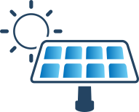
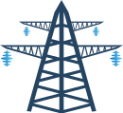




Current uni-directional electricity grid
Notes:
Dezentral klappt schon ganz gut in Deutschland. Allerdings hauptsächlich für Eigenheimbesitzer.
Strom fließt hauptsächlich in eine Richtung: Vom (regenerativen) Kraftwerk zum Verbraucher
Insbesondere das System im Haus ist nicht dafür ausgelegt, auch einzuspeisen → komplizierter Anschluss mit separatem Zähler für Dach-PV-Anlage. Grauzone: Guerilla-PV

Slide 3
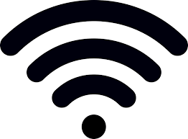



DC nano-grid with Open Source Hardware
Gateway
Safe (Voltage < 60V)
Easy (Plug & Play)
Reliable (multiple energy storage devices possible)
Open Source Hardware und Communication Protocol
~
=
DC load
=
=
=
=
DC nano-grid
~
=
=
Communication bus (CAN)
=

Slide 4
Device 1
Device 2
Host computer or display
Gateway
Device 3
Network link
Host computer or display
Direct link
Device
Communication channel

Slide 5
Network Layer (3) |  |  | Transport Layer (4) | ThingSet Protocol (Layer 5-7)
Network Header | Source Address/ID | Destination Address/ID | Transport Header | Payload byte 1 | … | Payload byte n

Slide 6
Battery-dominated low voltage DC grid
AC grid
230 V
LVDC bus
Battery defines bus voltage
Voltage limits (charge profiles) need to be communicated to all energy sources
AC
DC
Load 1
…
Solar
DC
DC
Load n
Wind
AC
DC
DC
DC
Second battery
Main battery

Slide 7
Low voltage DC grid with bus signaling
AC grid
230 V
LVDC bus
Independent DC bus voltage
DC bus voltage defines system state (→ basic communication)
Load prioritization via different disconnect set-points possible
AC
DC
Load 1
…
Solar
DC
DC
Load n
Wind
AC
DC
DC
DC
Additional energy storage
Battery
DC
DC

Slide 8
DC bus signaling example for 48 V
Energy Storage
Sources
Loads
54 V
52 V
50 V
48 V
46 V
44 V
42 V
40 V
High priority load
Low priority load
Renewable Energy Source
Electric heater / dump load
Bat 100% SOC
Bat 50% SOC
Bat 0% SOC
AC grid tied
Diesel gen.
Producer
Consumer

