Slide 1
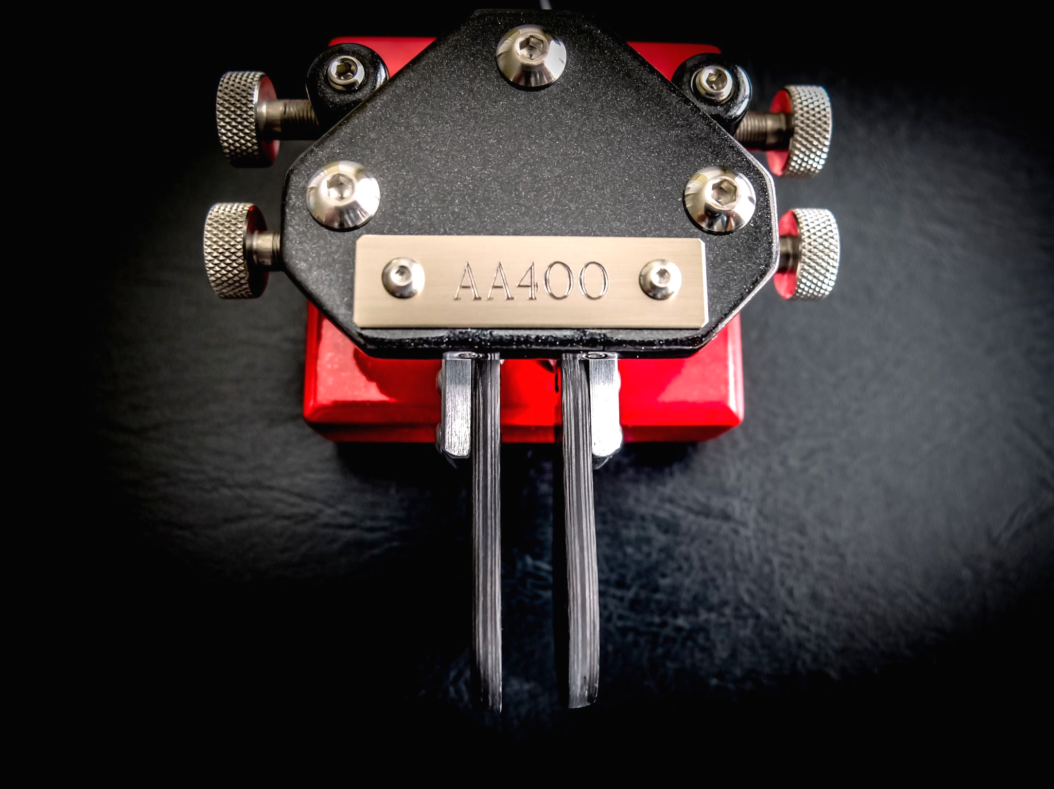
Morse Training @30 WPM
The Most Common 500 QSO Words
The 500 most common words & abbreviations used in a CW QSO

