Slide 1


CAPSTONE PROJECT
Software Project Management
of
FPT University’s Capstone Project

Slide 2

INTRODUCTION
SUPERVISOR
MEMBERS
ThinhDN
HieuNM
Mr. Tran Dinh Tri
GiangTD
LongPT

Slide 3
CONTENT
Project Overview
Software Management
System Requirement Specification
Software Design
Testing
Lessons Learned
Demo and Q&A

Slide 4
Project Overview

Slide 6
Software Management

Slide 7
TEAM ORGANIZATION STRUCTURE
SUPERVISOR
Tran Dinh Tri
TEAM LEADER
GiangTD
Documentation
Leader
LongPT
Analysis and Design
Leader
ThinhDN
Coding
Leader
GiangTD
Testing
Leader
HieuNM
GiangTD
HieuNM
LongPT
GiangTD
ThinhDN
ThinhDN
HieuNM
LongPT

Slide 8














tools and Techniques
Tools
Design Tools: Adobe Photoshop 6
Document Tools: Microsoft Word
Diagram Tools: Astah, Draw.io.
Project Management Tool: Microsoft Project 2016.
Developing tools: PHP Storm 2017.3.4, Subline Text 3 Build 3143.
Techniques
Programming languages: PHP 7.2, HTML5, CSS3, jQuery 3.3.1, JavaScript, MySQL.
Web Server: Apache 2.4.27
Framework: Bootstrap 3

Slide 9
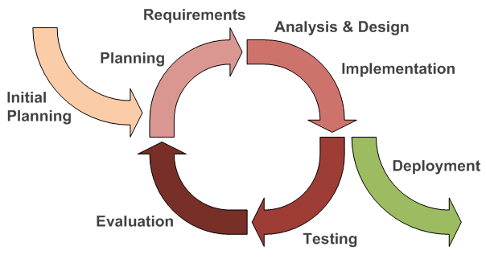
SOFTWARE PROCESS MODEL

Slide 10
MASTER SCHEDULE

Slide 11
System Requirements Specification

Slide 12
Non-Functional Requirements Specification

Slide 13
SOFTWARE DESIGN

Slide 14
Architectural Design

Slide 15
Component Diagram For Web Service Module

