Slide 1
Linux Operating System Introduction
September, 2020
Rev. 1.00 by Bui Viet Hung

Slide 2
Agenda
What is Linux Operating System ?
Design Goals.
Memory Management.
Processor Management.
Device Management.
File Management.
User Interface.

Slide 3
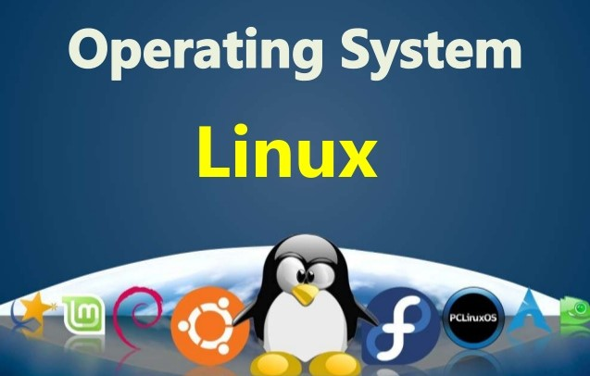
What is Linux Operating System ?
Just like Windows, iOS, and Mac OS, Linux is an operating system. In fact, one of the most popular platforms on the planet, Android, is powered by the Linux operating system. An operating system is software that manages all of the hardware resources associated with your desktop or laptop. To put it simply, the operating system manages the communication between your software and your hardware. Without the operating system (OS), the software would not function.

Slide 4
What is Linux Operating System ?
Linux is POSIX-compliant (POSIX will be discussed shortly) and portable with versions available to run cell phones, supercomputers, and most computing systems in between.
Unlike the other operating systems described in this book, its source code is freely available, allowing programmers to configure it to run any device and meet any specification. The frequent inclusion of several powerful desktop GUIs continues to attract users. It is also highly modular, allowing multiple modules to be loaded and unloaded on demand, making it a technically robust operating system.
Linux is an open source program, meaning that its source code is freely available to anyone for improvement.

Slide 5
Design Goals.
Linux has three design goals: modularity, simplicity, and portability. To achieve these goals, Linux administrators have access to numerous standard utilities, eliminating the need to write special code.
Many of these utilities can be used in combination with each other so that users can select and combine appropriate utilities to carry out specific tasks.

Slide 6
Design Goals.
Linux has three design goals: modularity, simplicity, and portability. To achieve these goals, Linux administrators have access to numerous standard utilities, eliminating the need to write special code.
Many of these utilities can be used in combination with each other so that users can select and combine appropriate utilities to carry out specific tasks.

Slide 7
Memory Management.
When Linux allocates memory space, it allocates 1GB of high-order memory to the kernel and 3GB of memory to executing processes. This 3GB address space is divided among: process code, process data, shared library data used by the process, and the stack used by the process.
Linux offers memory protection based on the type of information stored in each region belonging to the address space of a process. If a process modifies access authorization assigned to a memory region, the kernel changes the protection information assigned to the corresponding memory pages.

Slide 8
Memory Management.
When a process requests pages, Linux loads them into memory. When the kernel needs the memory space, the pages are released using a least recently used (LRU) algorithm.
To keep track of free and busy pages, Linux uses a system of page tables. With certain chip architectures, memory access is carried out using segments.
Virtual memory in Linux is managed using a multiple-level table hierarchy, which accommodates both 64- and 32-bit architectures.

Slide 9
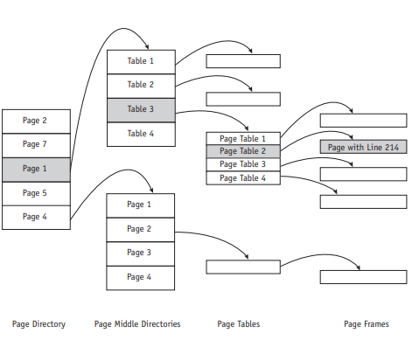
Memory Management.
Virtual memory management uses three levels of tables (Main, Middle, and Page Table Directories) to locate the page frame with the requested instruction or data within a job.

Slide 10
Processor Management.
Organization of Process Table:
Each process is referenced by a descriptor, which contains approximately 70 fields describing the process attributes together with the information needed to manage the process.
The kernel dynamically allocates these descriptors when processes begin execution.
All process descriptors are organized in a doubly linked list, and the descriptors of processes that are ready or in execution are put in another doubly linked list with fields indicating “next run” and “previously run.” There are several macro instructions used by the scheduler to manage and update these process descriptor lists as needed.

Slide 11
Processor Management.
Process Synchronization:
Linux provides wait queues and semaphores to allow two processes to synchronize with each other. A wait queue is a linked circular list of process descriptors.
Semaphores, are used to solve the problems of mutual exclusion and the problems of producers and consumers. In Linux the semaphore structure contains three fields: the semaphore counter, the number of waiting processes, and the list of processes waiting for the semaphore.
The semaphore counter may contain only binary values, except when several units of one resource are available, and the semaphore counter then assumes the value of the number of units that are accessible concurrently.

Slide 12
Device Management.
Linux is device independent, which improves its portability from one system to another.
Device drivers supervise the transmission of data between main memory and the peripheral unit. Devices are assigned not only a name but also descriptors that further identify each device and are stored in the device directory

Slide 13
Device Management.
Device Classifications:
Linux identifies each device by a minor device number and a major device number.
The minor device number is passed to the device driver as an argument and is used to access one of several identical physical devices.
The major device number is used as an index to the array to access the appropriate code for a specific device driver.
Each class has a Configuration Table that contains an array of entry points into the device drivers. This table is the only connection between the system code and the device drivers, and it’s an important feature of the operating system because it allows the system programmers to create new device drivers quickly to accommodate differently configured systems

Slide 14
Device Management.
Device Classifications:
Linux identifies each device by a minor device number and a major device number.
The minor device number is passed to the device driver as an argument and is used to access one of several identical physical devices.
The major device number is used as an index to the array to access the appropriate code for a specific device driver.
Each class has a Configuration Table that contains an array of entry points into the device drivers. This table is the only connection between the system code and the device drivers, and it’s an important feature of the operating system because it allows the system programmers to create new device drivers quickly to accommodate differently configured systems

Slide 15
Device Management.
Device Drivers:
Linux supports the standard classes of devices introduced by UNIX. In addition, Linux allows new device classes to support new technology.
A notable feature of Linux is its ability to accept new device drivers on the fly, while the system is up and running. That means administrators can give the kernel additional functionality by loading and testing new drivers without having to reboot each time to reconfigure the kernel.

Slide 16
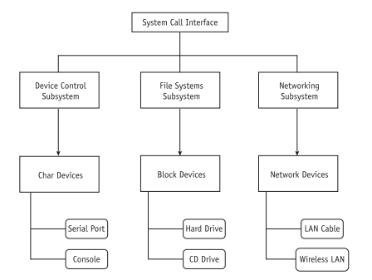
Device Management.
Device Classes:
The three standard classes of devices supported by Linux are character devices, block devices, and network devices.
This example of the three primary classes

Slide 17
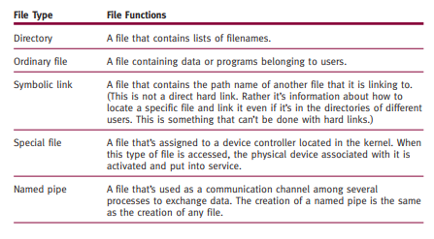
File Management.
Data Structures:
All Linux files are organized in directories that are connected to each other in a treelike structure. Linux specifies five types of files:
The file type indicates how each file is to be used.

Slide 18
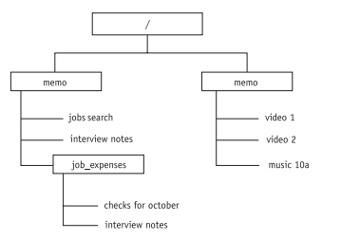
File Management.
Filename Conventions:
Filenames are case sensitive so Linux recognizes both uppercase and lowercase letters in filenames. For example, each of the following filenames are recognizable as four different files housed in a single directory: FIREWALL, firewall, FireWall, and fireWALL.
A sample file hierarchy. The forward slash ( / ) represents the root directory.

Slide 19
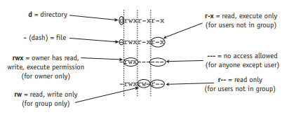
File Management.
Directory Listings :
While directory listings can be created from Terminal mode using typed commands (ls or ls -l), many Linux users find that the easiest way to list files in directories is from the GUI desktop.
Graphical depiction of a list of file and directory permissions in UNIX

Slide 20
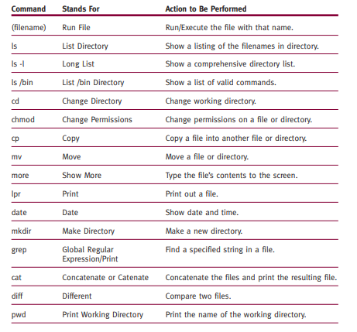
User Interface.
Early versions of Linux required typed commands and a thorough knowledge of valid commands.
Sample user commands

Slide 21
User Interface.
Command-Driven Interfaces: Commands are interpreted and executed by the shell (such as the Bash shell). The shell is technically known as the command interpreter, but it isn’t only an interactive command interpreter; it’s also the key to the coordination and combination of system programs.
Graphical User Interfaces: Most Linux operating systems are delivered with multiple graphical user interfaces (often free of charge), allowing the end users to choose the GUI that best meets their needs or those of the organization.
System Monitor: Information about the status of the system is available using the System Monitor window. which shows the immediate history of CPU, memory, and network usage. Other information available from this window includes supported file systems and information about processes currently running.

Slide 22
User Interface.
Service Settings: Depending on the Linux distribution, administrators can implement a variety of services to help manage the system, but options may vary from one system to another.
System Logs: Administrators use system logs that provide a detailed description of activity on the system. These logs are invaluable to administrators tracking the course of a system malfunction, firewall failure, disabled device, and more. These log files for some Linux operating systems can be found in the /var/log directory
Keyboard Shortcuts: To allow users to switch easily from one task to another, Linux supports keyboard shortcuts, many of which are identical to those commonly used on Windows operating systems, easing the transition from one operating system to the other. For example, CTRL-V is a quick way to issue a PASTE command in Linux, UNIX, and Windows.

Slide 23
Thank you

