Slide 1

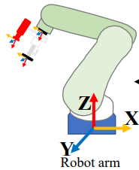
Visual prompt
3D CAD Model
Vision-language model
ROI Funsion
ICP Matching
Object Pose estimation
Grasp planning
Depth Any thing

