Slide 1
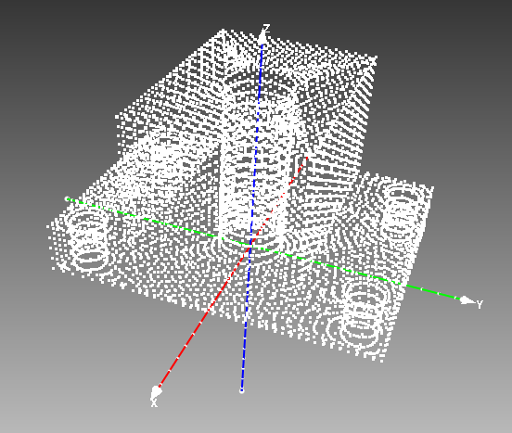
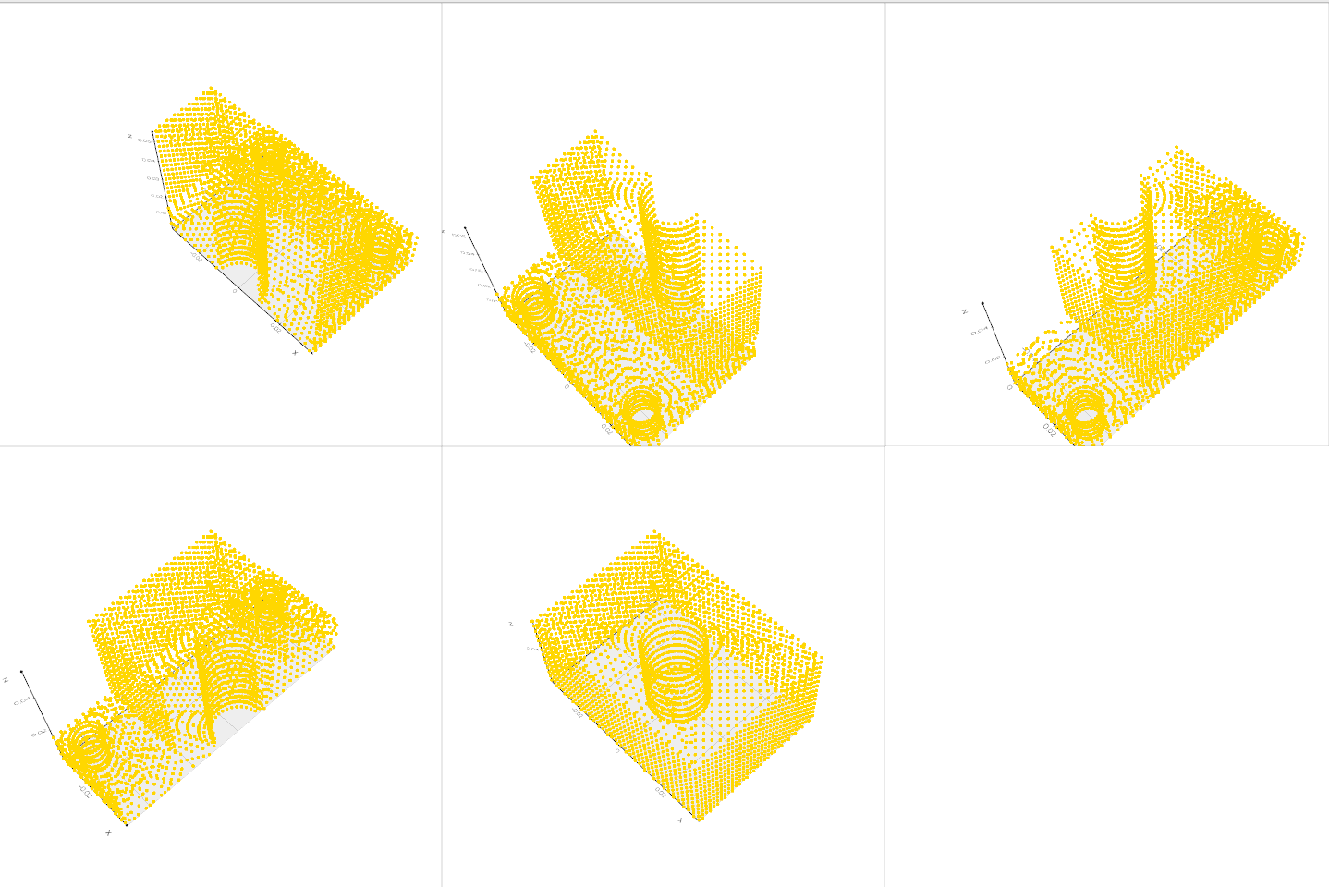

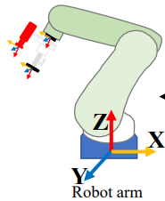
3D CAD Model
Visual prompt
Blender
Partial point clouds
Seeing Anything
ROI Fusion
Similarity checking
Pair wise point feature
Depth Anything
ICP refining
Object Pose estimation
Grasp planning

