Slide 1
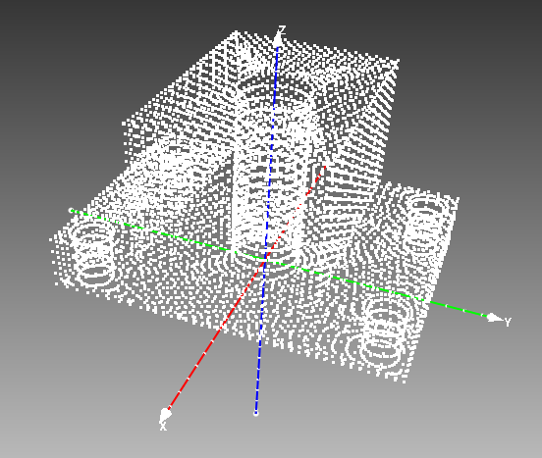
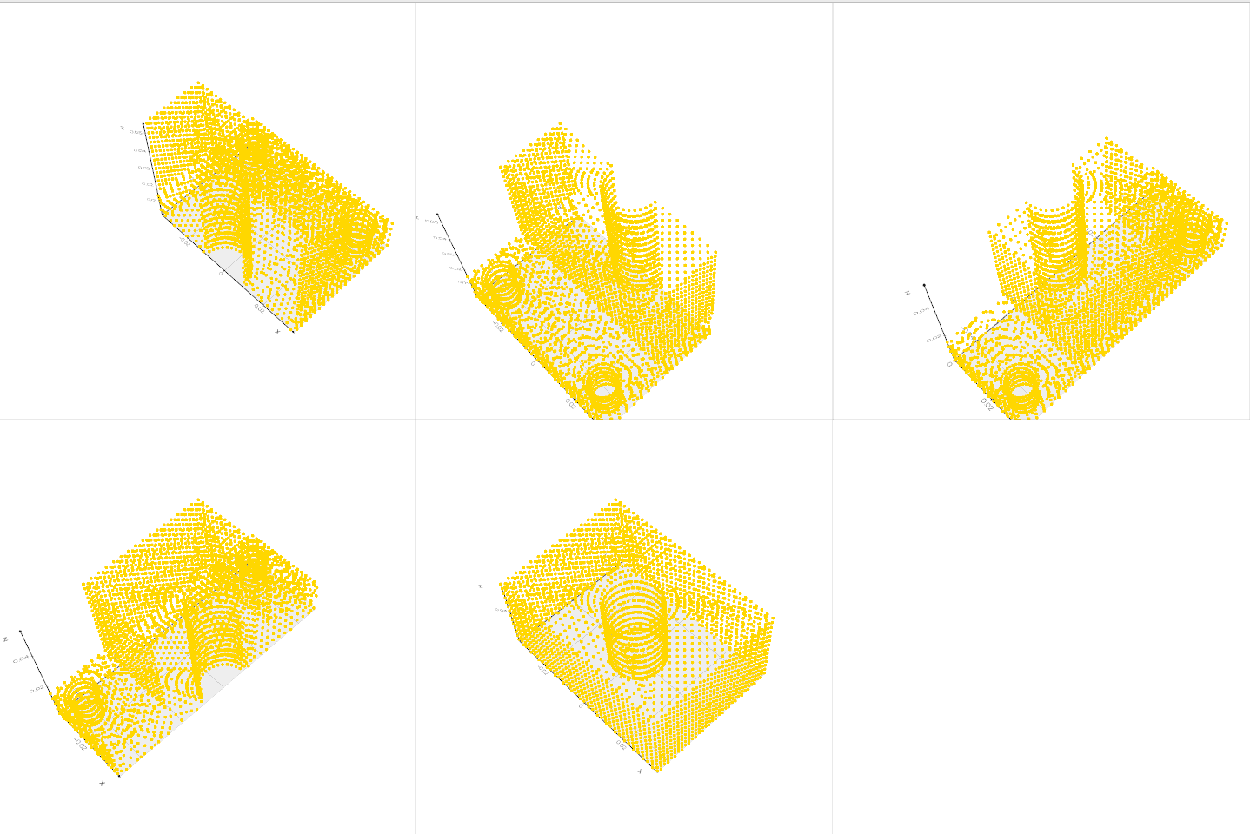

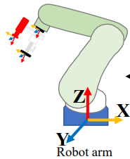
Version 1
3D CAD Model
Visual prompt
Blender
Partial point clouds
Seeing Anything
ROI Fusion
Similarity checking
Pair wise point feature
Depth Anything
ICP refinement
Object Pose estimation
Grasp planning

Slide 2
Version 2
3D CAD Model
Visual prompt
Render
Partial point clouds
Seeing Anything
ROI Fusion
Cosine similarity
Pair wise point feature
DEFOM
Stereo
ICP refinement
Object Pose estimation
Grasp planning

