Slide 1
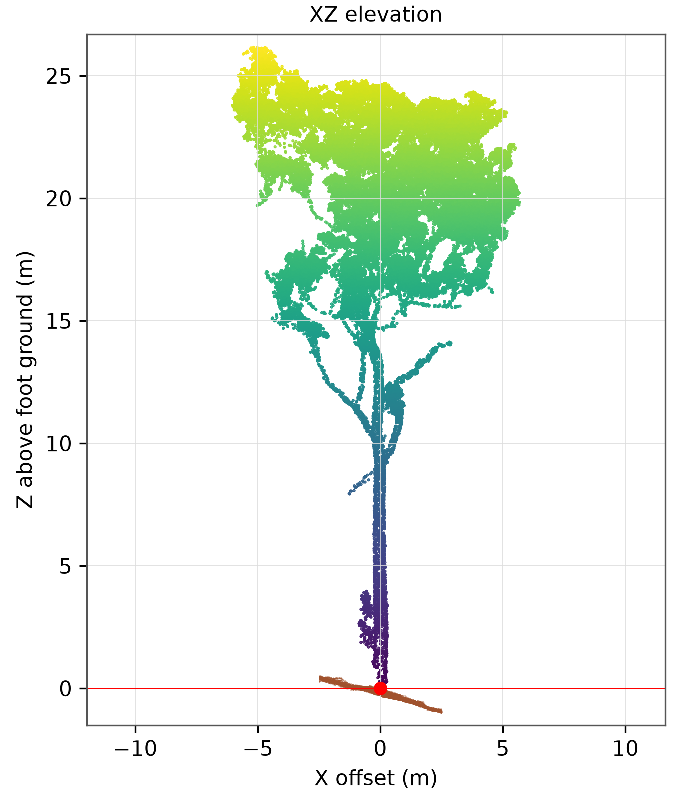

Semi-Automated Individual-Tree Segmentation of Blue Mountains TLS Point Clouds: From Automated Extraction and Manual Refinement to Tree Measurements
Hoang Truong Thinh Nguyen (Thomas) · 22083142
Supervisors: Prof. Brendan Choat, Dr. Chng Wei Lau · In collaboration with Erick Calderon-Morales
INFO6003 Postgraduate Research Project · School of Computer, Data and Mathematical Sciences
Western Sydney University · Spring 2026
Notes:
[0:15]
SAY: Good morning. I'm Thomas. My project applies a semi-automated workflow to a laser scan of a Blue Mountains forest plot, turning it into individual trees and tree measurements, and asks how far each step can be trusted.

Slide 2
Tree measurements need every point assigned to the right tree — and that is hard to automate
Point cloud
TLS points on stems, branches, crowns
Separated trees
one cloud per tree
Measurements
height · DBH · crown
TLS = terrestrial laser scanning. DBH = stem diameter at 1.3 m.
Merged crown
one tree inflated, one tree lost
TLS captures stems, branches and crowns.
Segmentation is the hardest step to automate where eucalypt crowns overlap.
No published benchmark covers temperate eucalypt forest.
Semi-Automated Tree Segmentation of Blue Mountains TLS Data · Thomas Nguyen
2/13
Notes:
[1:00]
SAY: Terrestrial laser scanning, or TLS, records millions of points on stems, branches and crowns. That lets us measure things that are impractical in the field. But every tree-level measurement needs each point assigned to the right tree. If two crowns are merged, one tree is inflated and the other disappears. This segmentation step is the hardest to automate. A 2026 benchmark by Cherlet and colleagues compared five methods. Rayextract, which I use, scored best on three of four plots, but every method struggled in dense forest, and the authors expect manual checking to remain. None of their plots is eucalypt forest. In the Blue Mountains, overlapping eucalypt crowns are exactly the problem, so the team agreed a semi-automated approach: automatic extraction, then manual correction.
DETAIL: Field inventories record species and DBH; TLS enables measurements impractical in the field (Calders et al., 2020). Cherlet et al. (2026) compared 5 methods on 2,983 manually segmented trees; Rayextract had the highest plot-level F1 on 3 of 4 plots (0.480-0.919); all methods did worse in dense forest and made different errors, so manual checking remains part of the workflow. Manual segmentation is most accurate but slowest (Cushman et al., 2026). The Blue Mountains team identified overlapping crowns and complex branching as the main obstacles and agreed a semi-automated approach.

Slide 3
Four questions follow the workflow from segmentation to field validation
RQ1
RQ2
RQ3
RQ4
What does automatic segmentation get wrong, and what does correction change?
How much manual effort does correction need?
How many corrected trees meet quality criteria for height, DBH and crown — and why do the others fail?
How does TLS DBH compare with the field inventory?
Contributions
C1 163-tree corrected dataset
C2 Quality-labelled measurements for every tree
C3 DBH comparison with the located field plot and tree-by-tree matching
Existing tools used unchanged. Biomass deferred (see conclusion).
DBH = stem diameter at 1.3 m
Semi-Automated Tree Segmentation of Blue Mountains TLS Data · Thomas Nguyen
3/13
Notes:
[0:45]
SAY: I asked four questions that follow the workflow. RQ1: what does automatic segmentation get wrong, and what does correction change? RQ2: how much manual effort does that take? RQ3: for how many trees can height, DBH (stem diameter at 1.3 metres) and crown size be measured to predefined quality criteria? And RQ4: how does TLS DBH compare with the field inventory? My contributions are a corrected 163-tree dataset, quality-labelled measurements for every tree, and the field comparison. I used existing tools unchanged. Biomass was in scope; I'll explain at the end why I deferred it.
DETAIL: Agreed minimum scope: one well-segmented plot or a large part of one. Prof. Choat suggested the workflow; applying it to WSF_ML2A, correcting and measuring are my own work.

Slide 4
A 0.32 ha TLS crop that contains a 30 m field inventory plot
TLS
Plot WSF_ML2A · 1 cm scan spacing
Crop 57.3 × 55.0 m
234 M points → thinned to 3 cm: 45.4 M
Field plot
30 m circle
Field inventory
30 m circle (0.071 ha) · surveyed 3 Apr 2024
26 live trees, DBH ≥ 11.2 cm
No tree coordinates, no heights · approximate site map
Schematic: crop rotated about 13°, field plot inside
Semi-Automated Tree Segmentation of Blue Mountains TLS Data · Thomas Nguyen
4/13
Notes:
[0:50]
SAY: The data is plot WSF_ML2A, scanned in May 2025 at one-centimetre resolution. I cut a 57 by 55 metre area, 0.32 hectares and 234 million points, and thinned it to three-centimetre spacing, leaving 45 million points. Inside it sits the field inventory plot: a 30-metre circle surveyed thirteen months earlier, with 26 live tagged trees. Importantly, the field data has DBH and species, but no tree coordinates and no heights, only an approximate site map. That limits what can be validated, and it shaped the matching method later.
DETAIL: Raw scan 355,462,232 points; crop 234,060,453; thinned 45,449,820. UTM zone 56S (EPSG:32756). I did not collect the scans; scanner model and scan positions not supplied. Crop outline computed from the points since no boundary file existed. Field DBH in cm; site description gives canopy 15-25 m. Diagram is a schematic, not to scale.

Slide 5
A five-stage workflow — each decision chosen for a reason
S1 Preparation
S2 Automatic segmentation
RayCloudTools
S3 Manual correction
CloudCompare
S4 Measurements
ITSMe 2.0.0
S5 Field comparison
partly done
Biomass
future work
Before/after comparison
Decision | Why
Thin to 3 cm | Manageable processing; trade-off: loses fine branches and thin stems
Rayextract + manual correction | Best benchmark F1, but automation alone is insufficient in overlapping crowns
VALID / REVIEW / N/A labels | Make quality visible instead of silently mixing good and doubtful values
Estimated DBH kept separate | Never mixed with measured DBH
IoU ≥ 0.5 before/after protocol | Same protocol as the benchmark (Cherlet et al., 2026)
Position first, DBH second for matching | Species not visible in scan (supervisor advice)
Semi-Automated Tree Segmentation of Blue Mountains TLS Data · Thomas Nguyen
5/13
Notes:
[1:15] (checkpoint: end of slide 5 = about 4:00)
SAY: The workflow has five stages: preparation, automatic segmentation with RayCloudTools, manual correction in CloudCompare, measurement with the ITSMe package, and field comparison, which is partly done. Biomass would follow. I want to highlight the decisions. I thinned to three centimetres to keep processing manageable; the trade-off is losing fine branches and thin stems. I used Rayextract because it performed best in the benchmark, but added manual correction because automation alone fails where crowns overlap. Every measurement gets a label, VALID, REVIEW or N/A, so doubtful values are visible rather than silently mixed in. For the same reason, estimated diameters stay in a separate column. I compared before and after using the benchmark's own protocol. And for field matching, position comes first and DBH second, because species can't be seen in a scan. One honest gap: the settings of the first two stages were not recorded.
DETAIL: I added the point-ownership check, the quality labels and the before/after comparison to the suggested workflow. Solid border = done; shaded = partly done; dashed = future.

Slide 6
162 → 163 trees, but correction changed the segmentation substantially
RQ1
162
automatic trees
86
identical
29
automatic trees split
25
corrected trees merged from several
163
corrected trees
0.85
F1 at IoU ≥ 0.5 (0.62 at 0.9)
8.5%
of points removed
12.6%
of points moved to another tree
36.8%
of points left unassigned by automation
IoU = overlap of shared points. F1 = combined precision and recall.
Evidence: Measures change, not accuracy — the reference was made by editing the automatic output.
Semi-Automated Tree Segmentation of Blue Mountains TLS Data · Thomas Nguyen
6/13
Notes:
[1:30] KEY SLIDE. Reveal counts first, then the split/merge tiles.
SAY: RQ1. Automation produced 162 trees; after correction there are 163. On counts alone, correction barely mattered. That's misleading. Only 86 trees are identical. 29 automatic trees were split, and 25 corrected trees combine parts of several automatic ones. Correction removed 8.5 percent of points and moved another 12.6 percent, 3.6 million points, to a different tree. Automation had also left 37 percent of points unassigned. I measured agreement with IoU, the overlap of shared points, counting a match at 0.5 or above, as the benchmark does. F1, which combines precision and recall, is 0.85, falling to 0.62 at a strict 0.9. One caution: this measures how much correction changed the output, not accuracy, because the reference was made by editing the automatic result. The takeaway: similar tree counts are no evidence of correct segmentation, because splits and merges cancel out in the count.
DETAIL: Precision = share of automatic trees that match; recall = share of corrected trees that match. Removed 2.44 M points, moved 3.61 M. Most work was moving points between trees, not deleting. File names could not be used for pairing.

Slide 7
About 106 hours — over a third spent on 18% of trees
RQ2
Trees (163)
133 trees · about 30 min each
30 trees · 50–160 min
Effort (about 106 h)
63% of effort
37% of effort
30 trees (18%) → 37% of effort
DBH VALID rate
30% (40/133)
Fisher's exact test
p = 0.01
Evidence: effort is a per-tree estimate; acceptance was by visual judgement.
7% (2/30)
Hardest 30
Other 133
Semi-Automated Tree Segmentation of Blue Mountains TLS Data · Thomas Nguyen
7/13
Notes:
[1:00] If behind schedule: say only the title and the callout, then move on.
SAY: RQ2. Correction took about 106 hours, by my per-tree estimate. Most trees took around 30 minutes over both rounds. But 30 trees, 18 percent, took 50 to 160 minutes each and consumed 37 percent of the time: full re-cleans, re-cut trunks, forks and leaning stems. The hardest, tree 079, took 160 minutes and still holds two intertwined stems. These hard trees were also hard to measure: DBH met all criteria for only 7 percent of them, against 30 percent of the rest, significant with Fisher's exact test. Two caveats: times were estimated afterwards, not logged, and acceptance was by visual judgement.
DETAIL: Correction steps: move misassigned points, split merged trees, join fragments, remove noise. Round 1 gave 199 clouds, replaced by round 2 (163). Script check proposed fixes for 4 trees; 7 trees hand-edited 22-23 Oct, 18 re-cleaned 28 Oct. Of the 30 hard trees: 18 fully re-cleaned, 7 trunks re-cut, 5 with forks/lean/missing stem/detached crown. Height VALID rates were similar (50% vs 44%). The 63% bar is simply the remainder of the 37%.

Slide 8
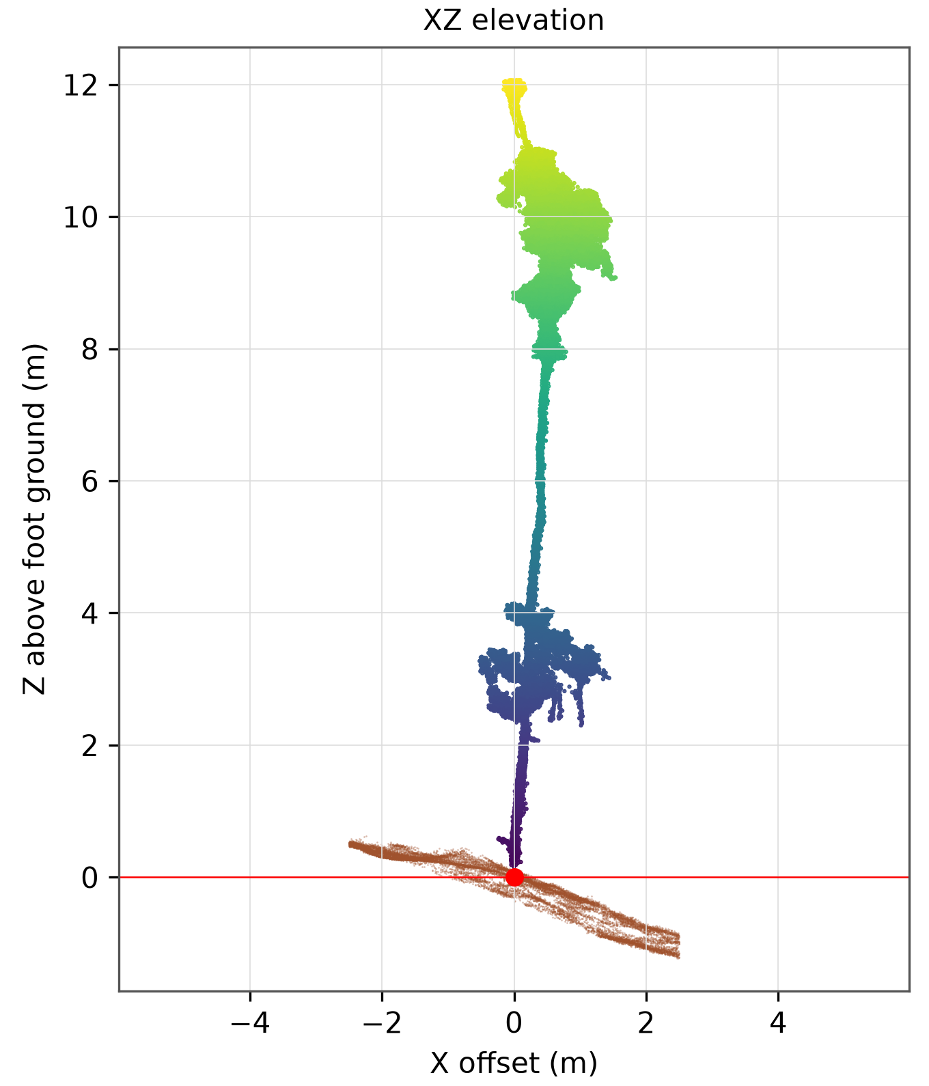
Only 16 of 163 trees meet every quality criterion
RQ3
Height
73
90
DBH
42
44
77
Crown base
156
Crown area
123
33
Envelope volume
95
61
tree_069 · 26.2 m
DBH 51.7 cm VALID
Crown area 97.6 m² REVIEW
tree_146 · 12.1 m
DBH 10.7 cm VALID
Crown area 1.9 m² REVIEW
Slice-sum volume
122
34
VALID
REVIEW
N/A
Evidence: VALID trees are not a random sample — their medians are not plot averages.
16
trees with height, DBH, crown area and crown volume all VALID
Semi-Automated Tree Segmentation of Blue Mountains TLS Data · Thomas Nguyen
8/13
Notes:
[1:45] KEY SLIDE. Reveal the "16" after the bars. (checkpoint: end of slide 8 = about 8:30)
SAY: RQ3, the central finding. Every tree has a height, but only 73 meet all criteria. DBH was measured for 86 trees and is VALID for 42; 77 have no reliable value. Crown values are the most robust. And only 16 trees, fewer than one in ten, have height, DBH, crown area and crown volume all VALID. Why? Most height REVIEWs come from uncertain ground at the stem base, or treetops cut by the crop edge. DBH fails where no stem axis is found, 21 trees, or no circle fit is good enough, 55 trees. Many stems are hard: 56 have more than one point cluster at breast height, 36 fork, 21 lean. Point density, occlusion and stem shape probably contribute, but I haven't separated those causes. The two trees here show it: both have VALID diameters but REVIEW crown areas. So a well-segmented tree is necessary but not sufficient. And VALID trees aren't a random sample, so their medians aren't plot averages.
DETAIL: Definitions: height = top minus ground at stem base; DBH = circle fit at 1.3 m on a 6 cm slice; crown volume by single envelope and by sum of 1 m slices (neither is wood volume). Medians: VALID height 15.6 m, VALID DBH 26.8 cm. 40 of the 77 N/A DBH trees have a separate estimated DBH (median 17.9 cm). Height REVIEW: 69 uncertain ground, 24 unconfirmed treetop (18 at crop edge). DBH N/A: 21 no stem axis, 55 no acceptable fit, 1 withheld. Re-checking flags found stray points that had made four heights 4.0-9.5 m too tall. Causes of DBH failure are hypotheses (14 of 55 failed fits had <10 points), not separated by the analysis.

Slide 9
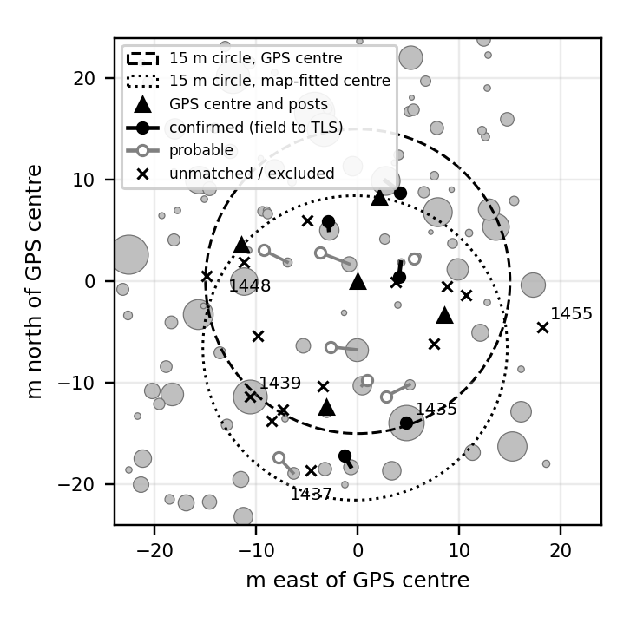
The field plot lies inside the crop, and DBH distributions are indistinguishable
RQ4
Measured TLS DBH vs field median 32.5 cm
Plot centre | n | TLS median | Difference | p
GPS centre | 28 | 30.0 cm | −7.7% | 0.62
Map-fitted centre | 20 | 28.0 cm | −13.8% | 0.48
Evidence: no significant difference (p = 0.35–0.91 across all six sets), but low power with 10–33 trees.
Survey posts lie 8.5–12.8 m from the GPS centre instead of 15 m, so GPS is off by several metres. A second, map-fitted centre was tested.
Semi-Automated Tree Segmentation of Blue Mountains TLS Data · Thomas Nguyen
9/13
Notes:
[1:15]
SAY: RQ4. DBH is the only trait with an independent field measurement. First I located the field plot by converting its GPS centre into the scan's coordinates. The survey posts sit 8.5 to 12.8 metres from the centre instead of 15, so the GPS is off by several metres. I therefore also tested a second centre fitted from the site map. Inside the circle, measured TLS DBH has a median of 28 to 30 centimetres against 32.5 in the field, and no TLS set differs significantly from the field distribution. But with 10 to 33 trees the test has low power: "no difference detected" is not "proven equal".
DETAIL: GPS centre converted to UTM; tree inside if stem base within 15 m. A second, map-fitted centre 6.6 m south was used as a sensitivity check. 39 TLS trees inside (GPS) / 30 (fitted) vs 26 field trees; TLS count includes small stems. Two-sample KS statistic with permutation test. Adding estimated DBH lowers the median because estimates are mostly for thin stems. Full six-row table in backup B4.

Slide 10
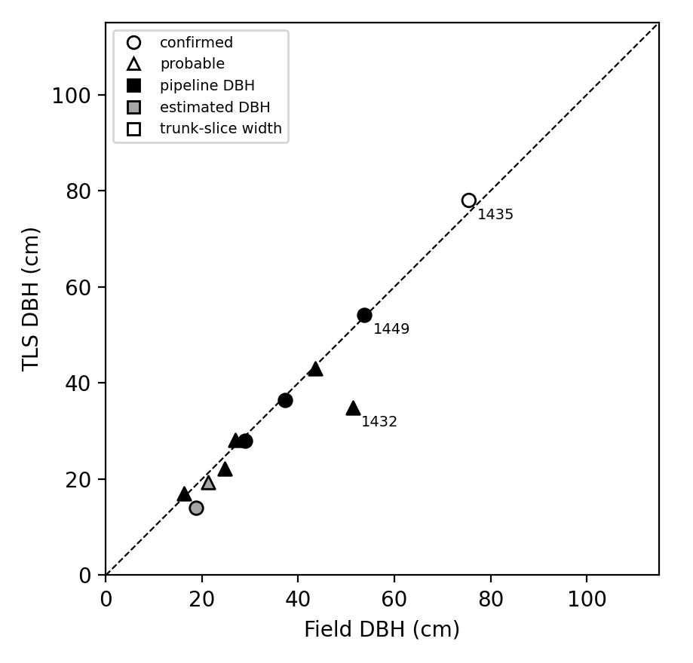
5 tagged trees matched with confidence; the largest trees reveal different failure modes
RQ4
5
confirmed
8
probable
12
unmatched
p ≈ 0.007
shuffled-DBH test
2.4 cm
confirmed RMSE
1
excluded
Largest field trees
1435 (75.5 cm): oval trunk, circle fit too low → measurement
1448 (83 cm): two intertwined trunks → segmentation
1439 (90 cm): measured 63.6 cm → unexplained
1437 (107.5 cm), 1455 (74.5 cm) → not identified
Evidence: matches required DBH within 25%, so the RMSE is optimistic. One confirmed tree is an anchor; 4 are independent.
Semi-Automated Tree Segmentation of Blue Mountains TLS Data · Thomas Nguyen
10/13
Notes:
[1:30] KEY SLIDE. (checkpoint: end of slide 10 = about 11:15)
SAY: Next, individual trees. An automatic search for the map placement failed: random stem positions matched just as many trees, because the stand is dense and the GPS imprecise. So I hand-picked two anchor trees with large, distinctive trunks whose spacing matched the map, and used them to fix the map's scale and rotation. Five tags are confirmed, eight probable, twelve unmatched. Shuffling the TLS diameters gives p about 0.007, so matching beats chance. Confirmed pairs have an RMSE of 2.4 centimetres, but that's optimistic: a match had to agree within 25 percent, and one confirmed tree is an anchor. The largest trees are most revealing. The pipeline's largest DBH is 66.6 centimetres; five field trees exceed 74. Tag 1435 is an oval trunk the circle fit underestimates. 1448 is two merged trunks. 1439 is unexplained. Two I couldn't find. Different causes, not one bias.
DETAIL: Automatic placement search: placements 13 m apart matched 16 of 26 trees within 1.5 m, and random stem positions matched 13-16, so no placement stood out (20 runs). Anchors: 1439 = tree_074, 1435 = tree_103 (15.6 m apart, bearing 100 deg), fixing map scale 1.13 and rotation -6 deg. Rules: confirmed <=2 m and DBH within 25%; probable <=2 m within 50% (or no DBH) or 2-4 m within 25%. Shuffling TLS DBH 2,000 times: mean 1.4 confirmed, >=5 in 0.7% of runs. Confirmed mean difference -0.7 cm; with probable pairs RMSE 9.2 cm (23%). tree_103 is 96 x 64 cm; area-equivalent width 78 cm. 1439 refits at nine heights gave 55-77 cm, so method does not explain it. 1437: nearest large trunk tree_163 (~85 cm, leaning 63 deg) 4-5 m away. 1455 at the crop's eastern edge in clutter. Height has no field reference.

Slide 11
Segmentation success does not guarantee usable measurements
Measurement accuracy
DBH only; small, partly selected sample
Limitations
Visual acceptance by two people
GPS errors of several metres, approximate map, two anchors
Time gap, survey to scan
Effort estimated
Some settings unrecorded
One 0.32 ha crop
Measurement success
measured: the main finding
Segmentation change
measured; no independent accuracy reference
Evidence ladder: what each result can and cannot show
Semi-Automated Tree Segmentation of Blue Mountains TLS Data · Thomas Nguyen
11/13
Notes:
[1:15]
SAY: What does it mean? I separate three levels of evidence. Segmentation change is measured, but without an independent reference I can't claim accuracy. Measurement success is measured, and it's the main finding: careful correction still left only 16 complete trees. Measurement accuracy has evidence only for DBH, from a small, partly selected sample. My internal checks, byte-identical re-runs, an independent re-implementation, the height-DBH relationship, show consistency and repeatability, not correctness. The main limitations are acceptance by the visual judgement of two people, GPS errors of metres, a 13-month gap between survey and scan, effort estimated afterwards, and a single 0.32-hectare crop.
DETAIL: 16 automatic consistency checks passed; two full re-runs byte-identical; re-implementation on 24 trees (heights within rounding; 9 DBH median diff 0.16 cm, max 2.16 cm); height-DBH rank correlation 0.84 on 25 VALID pairs; slice-thickness sensitivity <=2.9% on 8 trees; hidden-stem test median 3.8% (synthetic). tree_079 and 8 poor-source trees remain flagged. 40 estimated DBH values checked only against other fits.

Slide 12
Next: confirm matches in the field, then biomass
Done
Next
Take-home
163 corrected trees
Quality-labelled measurements for all
Field plot located
5 confirmed matches
Reproducible code
Field-check matches; locate 1437 and 1455 (12-tree sheet ready)
Per-tree accept/reject records
Refit DBH at full resolution (234 M points)
Then biomass
Tree counts and segmentation success can both hide problems — quality labels make them visible.
Use of AI: generative AI assistants (OpenAI Codex, Anthropic Claude) supported script development and report editing, declared per WSU Academic Integrity Policy. Manual segmentation, anchor checks and all analytical decisions are my own. Code: github.com/Thinhrichkidz/tls-tree-segmentation (commit 72479a1)
Semi-Automated Tree Segmentation of Blue Mountains TLS Data · Thomas Nguyen
12/13
Notes:
[1:00]
SAY: To conclude: I produced 163 corrected trees with quality-labelled measurements, located the field plot and confirmed five matches. Two lessons: similar tree counts can hide large corrections, and segmentation success does not guarantee usable measurements. Next: confirm matches in the field, where a 12-tree check sheet is ready; record per-tree accept decisions; and refit DBH at full resolution to test whether thinning caused failures. Biomass comes after that, because it depends on those inputs. I used generative AI as a support tool for scripting, report editing and preparing these slides, as declared in the report; the manual segmentation, the anchor checks and all analytical decisions are my own. (Then click to the end slide.)
DETAIL: Biomass deferred because reliable biomass needs robust segmentation and structure first, and the results show clear limits there. Scan data from the Hawkesbury Institute for the Environment via Prof. Choat; public release needs custodian permission (not confirmed).

Slide 13
Thank you — questions?
Hoang Truong Thinh Nguyen (Thomas) · 22083142
Semi-Automated Tree Segmentation of Blue Mountains TLS Data
INFO6003 Postgraduate Research Project · Western Sydney University
Notes:
[Q&A] Leave this slide up. Pause, smile, wait for the first question.
SAY: Thank you. I'm happy to take questions.
BACKUP SLIDES: six backup slides (14-19) are hidden so they cannot appear by accident. During questions, type the slide number and press Enter to jump to one, then type 13 and Enter to come back here. 14 = B1 height vs DBH, 15 = B2 before/after scores, 16 = B3 definitions, 17 = B4 DBH tests, 18 = B5 matching, 19 = B6 reproducibility. The notes of each backup slide say when to use it and give a short script.
PREPARED Q&A (answer pattern: direct answer, one number, limit or next step; 20-40 s)
- Why not an independent segmentation reference? None existed; building one means manually segmenting the plot from scratch. So before/after scores are reported as change, not accuracy.
- Why defer biomass? Biomass needs robust segmentation and structure; only 42 DBH and 16 complete trees met all criteria, so biomass now would rest on weak inputs.
- Did thinning to 3 cm cause DBH failures? Possibly - 14 of 55 failed fits had <10 points - but untested. The full-resolution crop (234 M points) is kept for exactly this refit.
- How sensitive is matching to GPS error? Very: automatic placement search matched no better than random positions. That is why two inspected anchors were used, a map-fitted centre was tested, and a permutation test (p about 0.007) was run.
- Isn't the 2.4 cm RMSE circular? Partly - confirmed pairs had to agree within 25%. That is stated; the permutation test checks that matching beats chance, not DBH accuracy.
- Why only two anchors? Only these could be identified with confidence from large, distinctive trunks whose spacing (15.6 m, bearing 100 deg) matched the map.
- How reliable is manual correction? Visual judgement of two people, no numerical test, no per-tree accept/reject record - listed as a limitation and as future work.
- What exactly did AI do? Supported writing and running the scripts and suggested report edits; I did the manual segmentation, anchor inspection and all editing and reporting decisions. Be ready to explain IoU pairing, the circle fit and the permutation test in plain words.
- Why semi-automated? Automatic left 37% of points unassigned and mis-split or merged dozens of trees; fully manual is most accurate but slowest. RQ2 quantifies the cost: about 106 h for 0.32 ha.
- Why thin to 3 cm? To keep a 234 M-point crop manageable; trade-off is losing fine branches and thin stems.
- Why IoU >= 0.5? It is the benchmark protocol; I also report 0.7 and 0.9 (F1 0.78, 0.62).
- Were heights validated? No - the field data has no heights. TLS median 16.1 m, max 27.2 m fits the 15-25 m canopy description (reasonableness check only).
- Does the 13-month gap matter? It adds unquantified uncertainty; listed as a limitation.
- Could this scale to all 36 plots? Not as is: about 106 h for 0.32 ha shows manual correction is the bottleneck. Do not claim a figure for other plots.
- What would you do differently? Log time and error type per tree while correcting, record all processing settings, and keep a per-tree accept/reject decision.

Slide 14
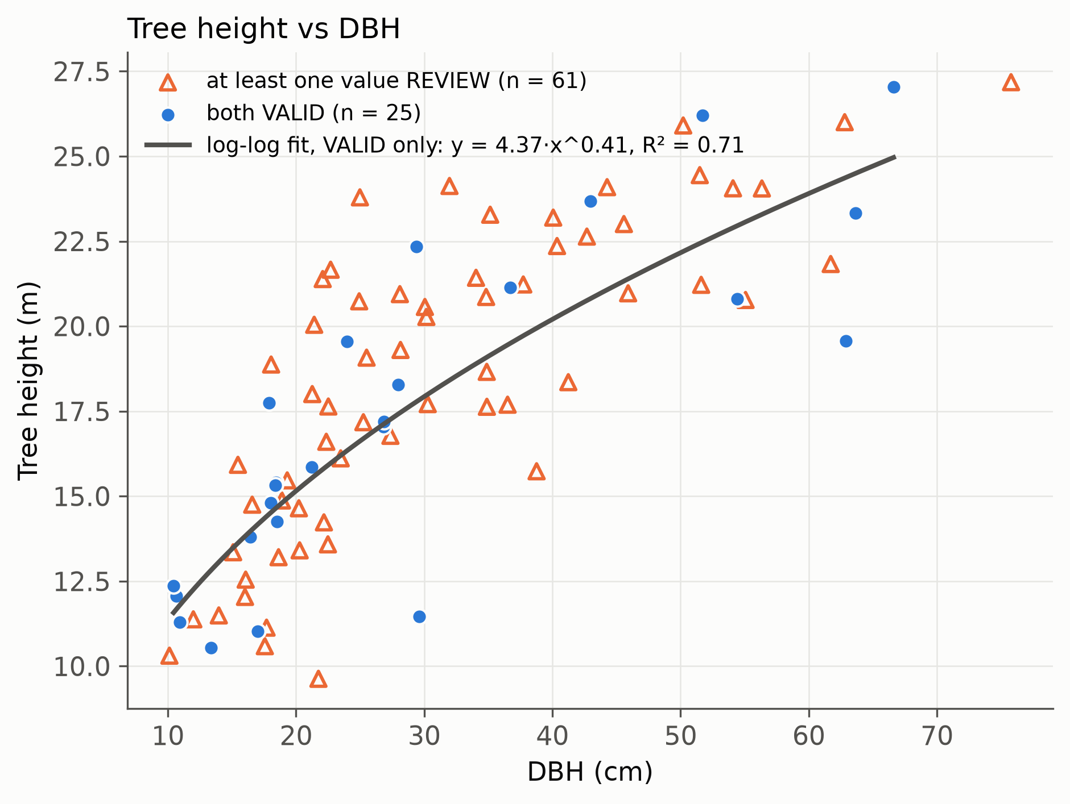
Height and DBH are consistent where both are VALID (consistency check only)
Backup B1
Rank correlation 0.84 (25 VALID pairs)
No implausible height-to-DBH ratio
TLS heights: median 16.1 m, max 27.2 m — consistent with the 15–25 m canopy description (not validation)
Semi-Automated Tree Segmentation of Blue Mountains TLS Data · Thomas Nguyen
Backup B1
Notes:
BACKUP B1 (hidden). Slide number 14.
WHAT IT IS FOR: shows that the measured heights and diameters are sensible together. Use it if someone asks "were heights validated?", "how do you know the measurements are plausible?" or "what is the relationship between height and DBH?".
SAY: This plots height against DBH for the 86 trees that have a measured DBH. The blue dots are the 25 trees where both values are VALID, with a fitted curve. The orange triangles are the 61 trees where at least one value is REVIEW. Taller trees are thicker, as expected: the rank correlation is 0.84, and no tree has an implausible height-to-diameter ratio. To be clear, this is a consistency check, not validation. The field data has no heights, so I cannot compare them with anything independent. The TLS heights have a median of 16.1 metres and a maximum of 27.2, which fits the site description of a 15 to 25 metre canopy, but that is only a reasonableness check.
NUMBERS: rank correlation 0.84 (25 VALID pairs); 86 trees plotted (25 + 61).
DO NOT SAY: that heights are validated or accurate.
BACK TO END SLIDE: type 13, Enter.

Slide 15
Before/after scores by correction round
Backup B2
Corrected set | TP / FP / FN | Precision | Recall | F1 at IoU 0.5 / 0.7 / 0.9
After round 1 (199) | 142 / 20 / 57 | 0.88 | 0.71 | 0.79 / 0.73 / 0.60
After round 2 (163) | 139 / 23 / 24 | 0.86 | 0.85 | 0.86 / 0.79 / 0.66
Final set (163) | 138 / 24 / 25 | 0.85 | 0.85 | 0.85 / 0.78 / 0.62
Evidence: F1 measures change from the automatic output, not accuracy.
Semi-Automated Tree Segmentation of Blue Mountains TLS Data · Thomas Nguyen
Backup B2
Notes:
BACKUP B2 (hidden). Slide number 15.
WHAT IT IS FOR: the full before/after scores for each correction round. Use it if someone asks "how did the scores change between rounds?", "what are TP, FP and FN?", "why IoU 0.5?" or "isn't 0.85 good?".
SAY: This is the comparison behind slide 6, for each stage of correction. Each automatic tree is paired one-to-one with a corrected tree by overlap, and a pair counts as a match at IoU 0.5 or above. TP is matched pairs; FP is automatic trees with no match; FN is corrected trees with no match. Precision is the share of automatic trees that match, recall is the share of corrected trees that match, and F1 combines them. After round 1, with 199 clouds, F1 was 0.79; recall was 0.71. After round 2, with 163 clouds, it was 0.86, and the final set gives 0.85. The columns on the right show stricter thresholds: 0.78 at IoU 0.7 and 0.62 at 0.9 for the final set. I used 0.5 because that is the benchmark's protocol.
IF ASKED "isn't 0.85 good?": These scores measure how much correction changed the automatic output, not accuracy, because the reference was made by editing the automatic result and may favour it.
NUMBERS: final set 138 / 24 / 25; precision 0.85; recall 0.85; F1 0.85 / 0.78 / 0.62.
DO NOT SAY: that F1 is the accuracy of the segmentation.
BACK TO END SLIDE: type 13, Enter.

Slide 16
Measurement definitions and when a value is REVIEW or N/A
Backup B3
Value | Definition | REVIEW or N/A when
Height (m) | Top minus ground at stem base | Ground, treetop or base uncertain; crop edge; cloud in pieces
DBH (cm) | Circle fit at 1.3 m on a 6 cm slice | Poor fit or other heights; N/A if no stem axis or no accepted fit
Crown base (m) | Start of continuous crown, or chosen manually | N/A if no live crown
Crown area (m²) | Footprint from above | Unusually small or large, or at crop edge
Crown volume (m³) | Envelope; sum of 1 m slices | As crown area; envelope also if more than 2× the slice sum
Estimated DBH: flexible fallback fit where no circle was accepted (40 trees). Hidden-stem test on 66 clean stems: median difference 3.8% (90th percentile 11.6%). Synthetic test, kept separate from measured DBH.
Semi-Automated Tree Segmentation of Blue Mountains TLS Data · Thomas Nguyen
Backup B3
Notes:
BACKUP B3 (hidden). Slide number 16.
WHAT IT IS FOR: exact definitions of each measurement and the rules for VALID, REVIEW and N/A. Use it if someone asks "how exactly was DBH or height measured?", "what does REVIEW mean?" or "what is the estimated DBH?".
SAY: VALID means the value meets all the predefined criteria. REVIEW means there is a value, but with a concern. N/A means no reliable value could be given. Height is the highest point minus the ground at the stem base; it goes to REVIEW if the ground, the treetop or the base position is uncertain, if the tree is cut by the crop edge, or if the cloud is in pieces. DBH is a circle fitted to a 6 centimetre slice at 1.3 metres; it is N/A if there is no stem axis or no accepted fit. Crown base is where the continuous crown starts, or chosen manually, and is N/A only if there is no live crown. Crown area is the footprint seen from above. Crown volume is given two ways, a single envelope and a sum of 1 metre slices. Neither is wood volume.
ESTIMATED DBH: where no circle was accepted, a more flexible fit gives an estimate for 40 trees. I kept it in a separate column. In a test where half of 66 clean stems was hidden, the estimate differed from the full fit by a median of 3.8 percent (90th percentile 11.6). That is a synthetic test, not independent validation.
DO NOT SAY: that estimated DBH is measured or validated.
BACK TO END SLIDE: type 13, Enter.

Slide 17
DBH distribution tests: no significant difference in any of six sets
Backup B4
Centre | TLS set | n | Median (cm) | Difference | p
GPS | VALID | 16 | 35.8 | +10.2% | 0.72
GPS | Measured | 28 | 30.0 | −7.7% | 0.62
GPS | Measured + estimated | 33 | 21.4 | −34.2% | 0.43
Map-fitted | VALID | 10 | 31.4 | −3.4% | 0.91
Map-fitted | Measured | 20 | 28.0 | −13.8% | 0.48
Map-fitted | Measured + estimated | 23 | 27.4 | −15.7% | 0.35
Field median 32.5 cm (26 trees). Two-sample KS statistic with permutation test. Low power with 10-33 trees: no difference detected is not proof of equality.
Semi-Automated Tree Segmentation of Blue Mountains TLS Data · Thomas Nguyen
Backup B4
Notes:
BACKUP B4 (hidden). Slide number 17.
WHAT IT IS FOR: all six DBH distribution tests behind slide 9. Use it if someone asks "what about the other sets?", "what happens with estimated DBH?" or "how significant is the difference?".
SAY: Slide 9 showed two of these six rows. Here are all of them, for the GPS centre and the map-fitted centre, with three sets of TLS trees each: VALID only, all measured, and measured plus estimated. The field median is 32.5 centimetres across 26 trees. The TLS medians range from 21 to 36, and none of the six differs significantly: p runs from 0.35 to 0.91. Adding the estimated diameters lowers the median, for example to 21.4 with the GPS centre, because the estimates are mostly for thin stems. The test is a two-sample KS statistic with a permutation test. With only 10 to 33 trees it has low power, so no difference detected is not proof of equality.
NUMBERS: field median 32.5 cm; p range 0.35 to 0.91; n from 10 to 33.
DO NOT SAY: that the distributions are proven equal.
BACK TO END SLIDE: type 13, Enter.

Slide 18
Matching rules and confirmed pairs
Backup B5
Rules
Confirmed: within 2 m and DBH within 25%
Probable: within 2 m and DBH within 50% (or no DBH), or 2–4 m and within 25%
The 50% limit was added after a 14 cm vs 85 cm pair was classed probable; it changes no confirmed match.
Pair | Difference
1435 / tree_103 | +2.5 cm (trunk-slice width 78 cm); −8.9 cm (pipeline 66.6 cm)
1449 / tree_102, 1444 / tree_089, 1436 / tree_091 | +0.3, −0.7, −0.9 cm (pipeline DBH)
1451 / tree_106 | −4.6 cm (−25%), estimated DBH
Without the anchor | 4 pairs, RMSE 2.4 cm
Probable outliers | 1439 / tree_074 (−29%), 1432 / tree_098 (−32%)
Semi-Automated Tree Segmentation of Blue Mountains TLS Data · Thomas Nguyen
Backup B5
Notes:
BACKUP B5 (hidden). Slide number 18.
WHAT IT IS FOR: the exact matching rules and the five confirmed pairs behind slide 10. Use it if someone asks "how did you match tags to trees?", "why 25 percent?", "is the 2.4 centimetre RMSE circular?" or "which pairs are confirmed?".
SAY: Each field tag was paired with the nearest unused TLS stem within 4 metres. A pair is confirmed if it is within 2 metres and the DBH differs by at most 25 percent. It is probable if it is within 2 metres and within 50 percent, or no DBH, or 2 to 4 metres away and within 25 percent. The 50 percent limit was added after a 14 centimetre field tree was paired with an 85 centimetre TLS stem; it changes no confirmed match. The five confirmed pairs are 1435 with tree 103, 1449 with 102, 1444 with 089, 1436 with 091 and 1451 with 106. Three of them use the pipeline DBH and differ by plus 0.3, minus 0.7 and minus 0.9 centimetres. 1435 uses the trunk-slice width of 78 centimetres, 2.5 above the field; its pipeline value of 66.6 is 8.9 below. 1451 uses an estimated DBH, 4.6 below. Without the anchor, the other four pairs give an RMSE of 2.4 centimetres.
IF ASKED "is it circular?": Partly. A confirmed pair had to agree within 25 percent, so the RMSE is optimistic. The shuffle test, p about 0.007, shows the matching beats chance. It does not prove the DBH values are accurate.
PROBABLE OUTLIERS: 1439 with tree 074 (minus 29 percent) and 1432 with tree 098 (minus 32 percent). A wrong pairing and a TLS error cannot be told apart.
DO NOT SAY: that the 2.4 cm RMSE shows TLS DBH is accurate.
BACK TO END SLIDE: type 13, Enter.

Slide 19
Reproducibility
Backup B6
R 4.5.2 (ITSMe 2.0.0), Python 3.13.14
16 automatic consistency checks passed
Two full re-runs on 30 Oct 2026 were byte-identical
SHA-256 hash recorded for every tree file
Code: github.com/Thinhrichkidz/tls-tree-segmentation, commit 72479a1
Semi-Automated Tree Segmentation of Blue Mountains TLS Data · Thomas Nguyen
Backup B6
Notes:
BACKUP B6 (hidden). Slide number 19.
WHAT IT IS FOR: shows the work can be repeated and where the code is. Use it if someone asks "how reproducible is this?", "can I rerun it?" or "where is the code?".
SAY: The measurement stage ran with R 4.5.2 and ITSMe 2.0.0, and Python 3.13.14. 16 automatic consistency checks passed. On 30 October 2026 I ran the whole measurement stage twice more, and the results were byte-identical. Every tree file has a SHA-256 hash recorded, so any change to an input would be detected. The code is on GitHub at commit 72479a1.
HONEST LIMIT: reproducibility covers the measurement stage. The settings of the first two stages, preparation and automatic segmentation, were not recorded. Say this if asked.
DO NOT SAY: that the whole workflow is reproducible, or that reproducible means correct.
BACK TO END SLIDE: type 13, Enter.

