Slide 1
Start
Simplify expressions to collect points.
The faster you are the more you get points.
You need to reach certain amount of total points to reach the next level.

Slide 2
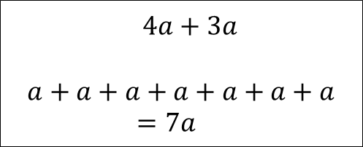
doAdding
$$4a+3a$$
$$a+a+a+a+a+a+a=7a$$

Slide 3
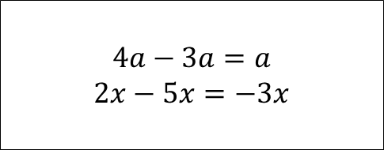
doSub
$$4a−3a=a$$
$$2x−5x=−3x$$

Slide 4
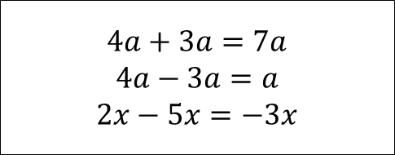
doClause
$$4a+3a=7a$$
$$4a−3a=a$$
$$2x−5x=−3x$$

Slide 5
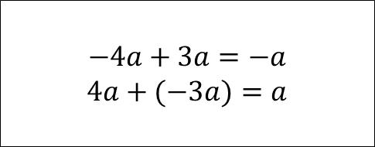
doClause1
$$−4a+3a=−a$$
$$4a+(−3a)=a$$

Slide 6
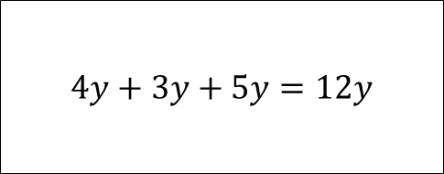
doClause2
$$4y+3y+5y=12y$$

Slide 7
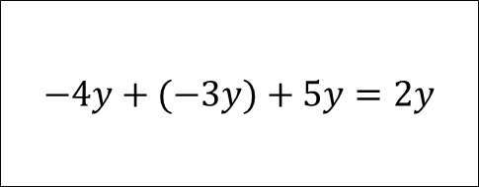
doClause3
$$−4y+(−3y)+5y=2y$$

Slide 8
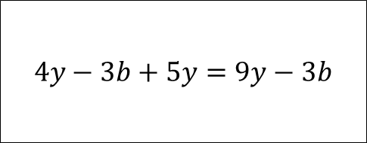
doClause4
$$4y−3b+5y=9y−3b$$

Slide 9
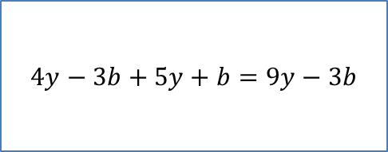
doClause5
$$4y−3b+5y+b=9y−3b$$

Slide 10
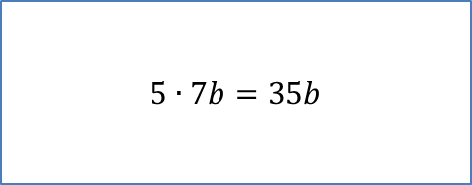
doConstXMonom
$$5∙7b=35b$$

Slide 11
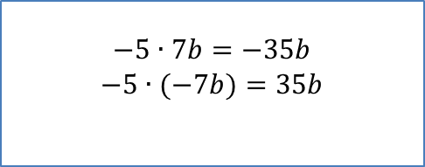
doConstXMonomNeg
$$−5∙7b=−35b$$
$$−5∙(−7b)=35b$$

Slide 12
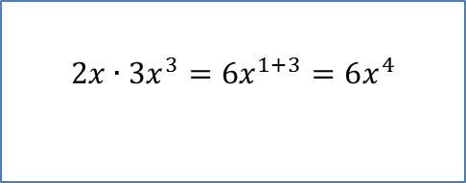
doMonomXMonom
$$2x∙3x^{3}=6x^{1+3}=6x^{4}$$

Slide 13
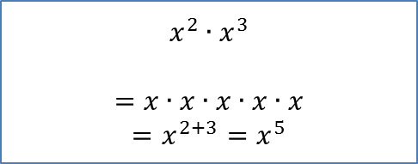
doMonomXMonom1
$$x^{2}∙x^{3}$$
$$=x∙x∙x∙x∙x$$
$$=x^{2+3}=x^{5}$$

Slide 14
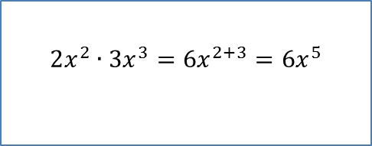
doMonomXMonom2
$$2x^{2}∙3x^{3}=6x^{2+3}=6x^{5}$$

Slide 15
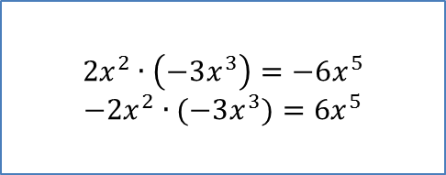
doMonomXMonomNeg
$$2x^{2}∙\left(−3x^{3}\right)=−6x^{5}$$
$$−2x^{2}∙(−3x^{3})=6x^{5}$$

Slide 16
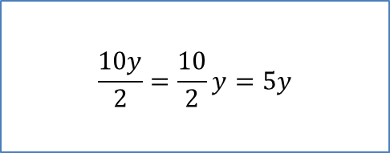
Div
$$\frac{10y}{2}=\frac{10}{2}y=5y$$

Slide 17
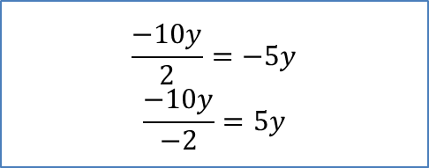
Div1
$$\frac{−10y}{2}=−5y$$
$$\frac{−10y}{−2}=5y$$

Slide 18
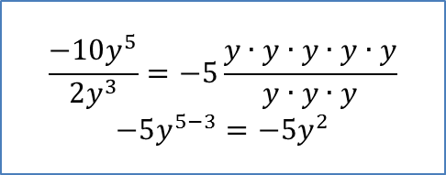
Div2
$$\frac{−10y^{5}}{2y^{3}}=−5\frac{y∙y∙y∙y∙y}{y∙y∙y}$$
$$−5y^{5−3}=−5y^{2}$$

Slide 19
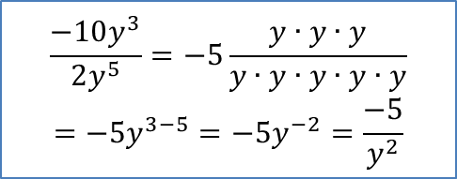
Div3
$$\frac{−10y^{3}}{2y^{5}}=−5\frac{y∙y∙y}{y∙y∙y∙y∙y}$$
$$=−5y^{3−5}=−5y^{−2}=\frac{−5}{y^{2}}$$

Slide 20
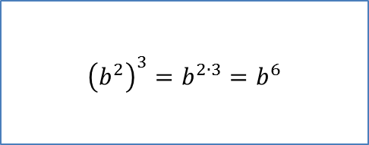
powerOfPower
$${\left(b^{2}\right)}^{3}=b^{2∙3}=b^{6}$$

Slide 21

powerOfPower1
$${\left(2b^{2}\right)}^{3}={2^{3}b}^{2∙3}=8b^{6}$$

Slide 22
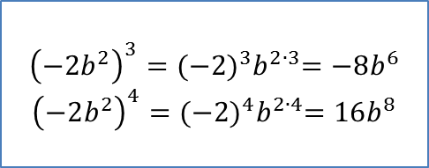
powerOfPower2
$${\left(−2b^{2}\right)}^{3}={(−{2)}^{3}b}^{2∙3}=−8b^{6}$$
$${\left(−2b^{2}\right)}^{4}={(−{2)}^{4}b}^{2∙4}=16b^{8}$$

Slide 23
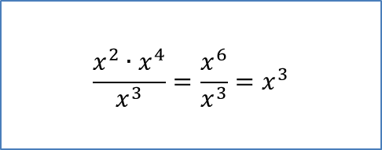
powerRules
$$\frac{x^{2}∙x^{4}}{x^{3}}=\frac{x^{6}}{x^{3}}=x^{3}$$

Slide 24
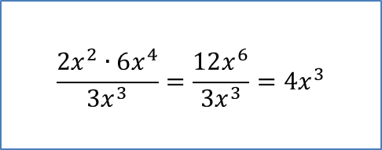
powerRules1
$$\frac{2x^{2}∙6x^{4}}{{3x}^{3}}=\frac{12x^{6}}{{3x}^{3}}={4x}^{3}$$

Slide 25

powerRules2
$$\frac{−2x^{2}∙−6x^{4}}{{−3x}^{3}}=\frac{12x^{6}}{{−3x}^{3}}=−{4x}^{3}$$

Slide 26
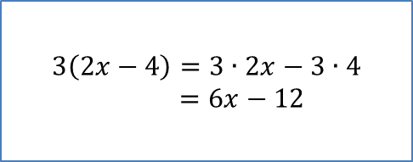
constXBinom
$$3\left(2x−4\right)=3∙2x−3∙4=6x−12$$

Slide 27
constXBinom
$$3\left(2x−4\right)=3∙2x−3∙4=6x−12$$

Slide 28

constXBinom1
$$3\left(2x−4y\right)=3∙2x−3∙4y=6x−12y$$

Slide 29
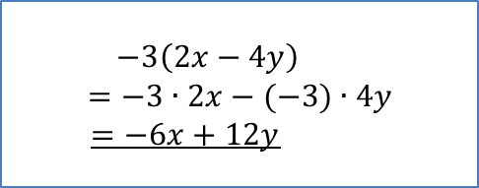
constXBinom2
$$−3\left(2x−4y\right)$$
$=−3∙2x−(−3)∙4y$
$=−6x+12y$

Slide 30
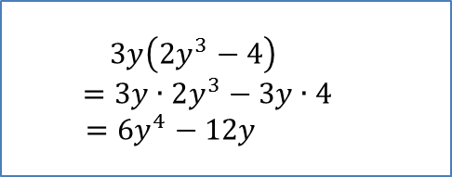
monomXBinom
$$3y\left(2y^{3}−4\right)$$
$=3y∙2y^{3}−3y∙4$
$=6y^{4}−12y$

Slide 31
monomXBinom1
$$3y\left(2y^{3}−4\right)$$
$=3y∙2y^{3}−3y∙4$
$=6y^{4}−12y$

Slide 32
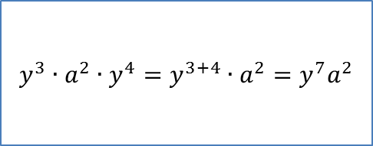
multiMonoms
$$y^{3}∙a^{2}∙y^{4}=y^{3+4}∙a^{2}=y^{7}a^{2}$$

Slide 33
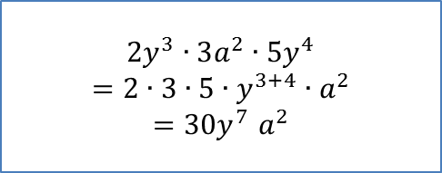
multiMonoms1
$${2y}^{3}∙3a^{2}∙5y^{4}={2∙3∙5∙y}^{3+4}{∙a}^{2}$$
$${=30y}^{7}a^{2}$$

Slide 34
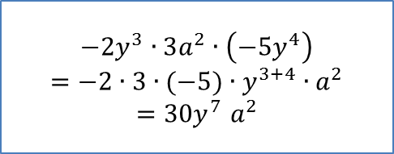
multiMonoms2
$${−2y}^{3}∙3a^{2}∙\left(−5y^{4}\right)=−{2∙3∙(−5)∙y}^{3+4}{∙a}^{2}$$
$${=30y}^{7}a^{2}$$

Slide 35
No help
Sorry!
There is no help for this level yet.

