Slide 1
Data Analytics and Machine Learning for Digital Loan Disbursement Analysis in NBFCs
Field Project
B.Sc. Data Science | 2026–2027
Student: __________________

Slide 2
What is the project?
RBI public digital-lending data
Python cleaning + visualisation
Machine learning for prediction, grouping and unusual-pattern detection

Slide 3
Dataset
305 cleaned NBFC-period observations
61 visible respondent IDs
Five reporting periods
Main variables: amount, loan count, average ticket

Slide 4
Python Workflow
Raw/cleaned data → Pandas → cleaning → feature engineering → visualisation → ML → evaluation → interpretation

Slide 5
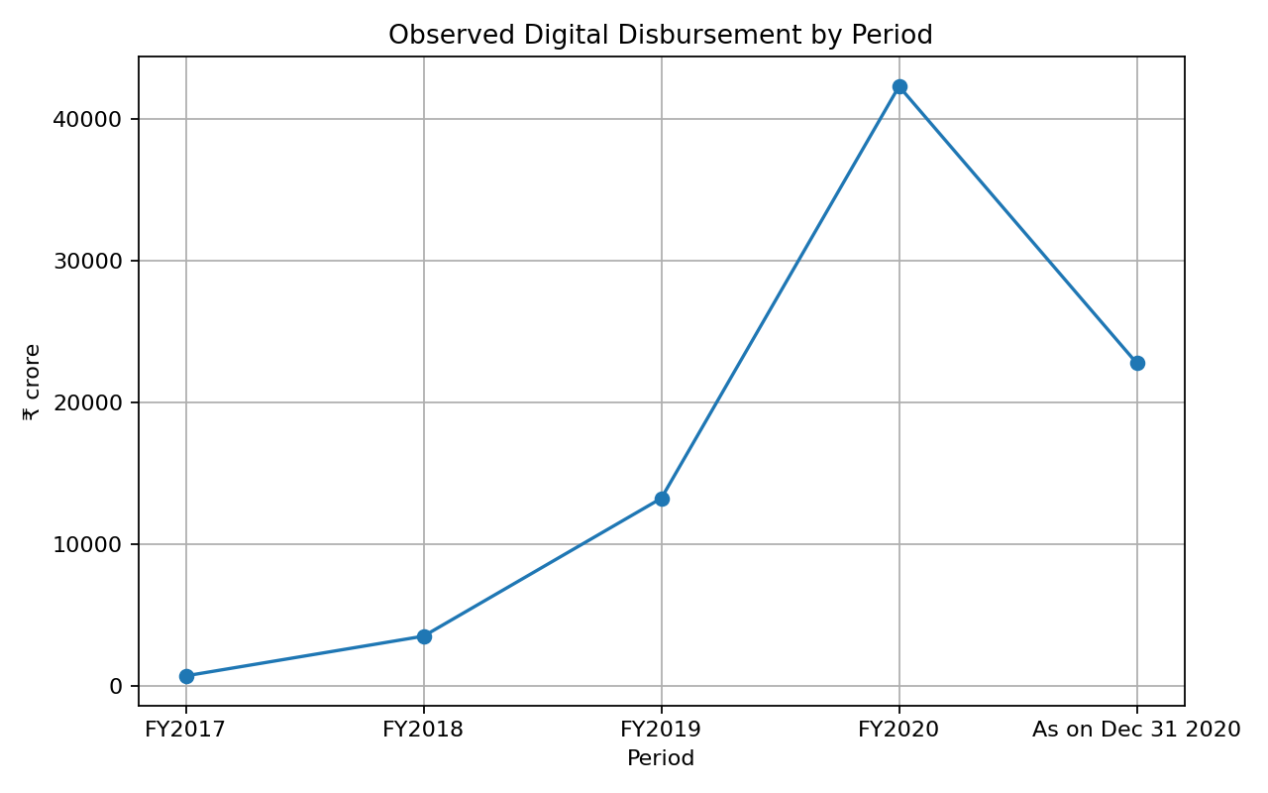
Digital Disbursement Trend
The graph shows the observed total digital disbursement across the reporting periods.

Slide 6
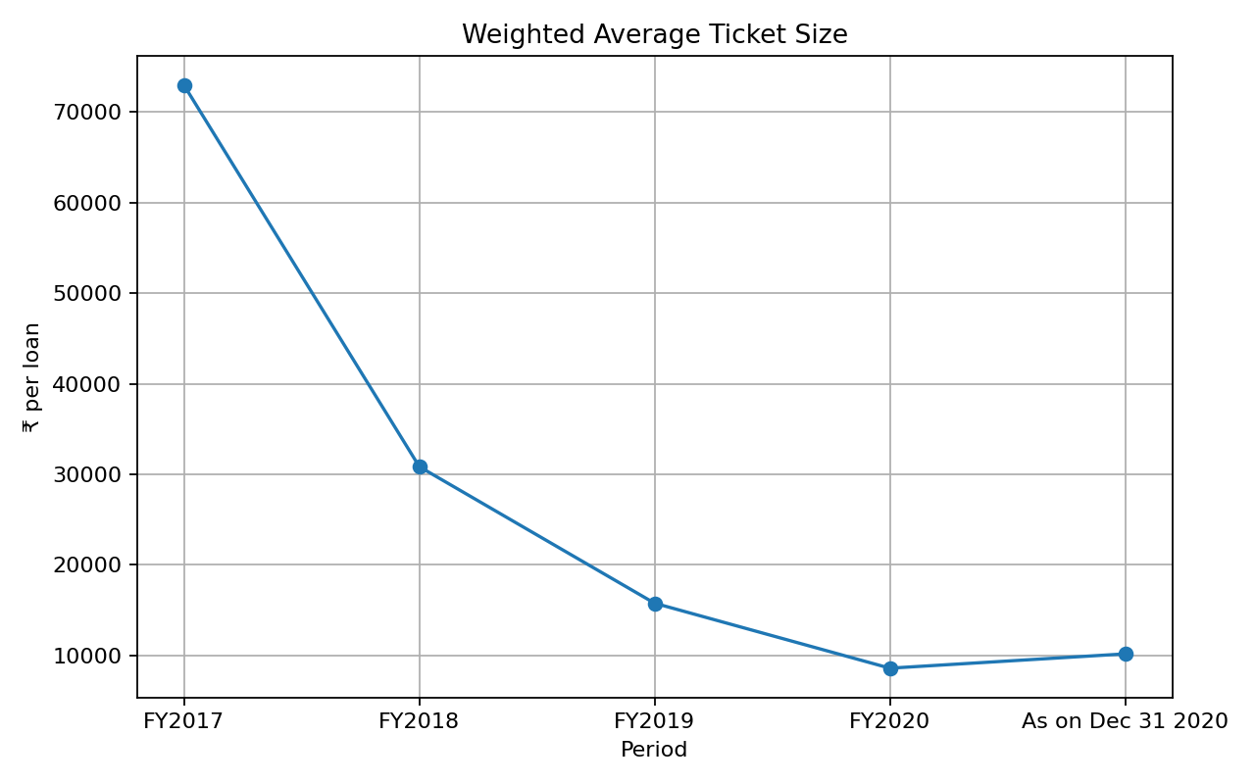
Loan Count and Average Ticket
Loan count and average ticket are analysed together to understand volume versus size.

Slide 7
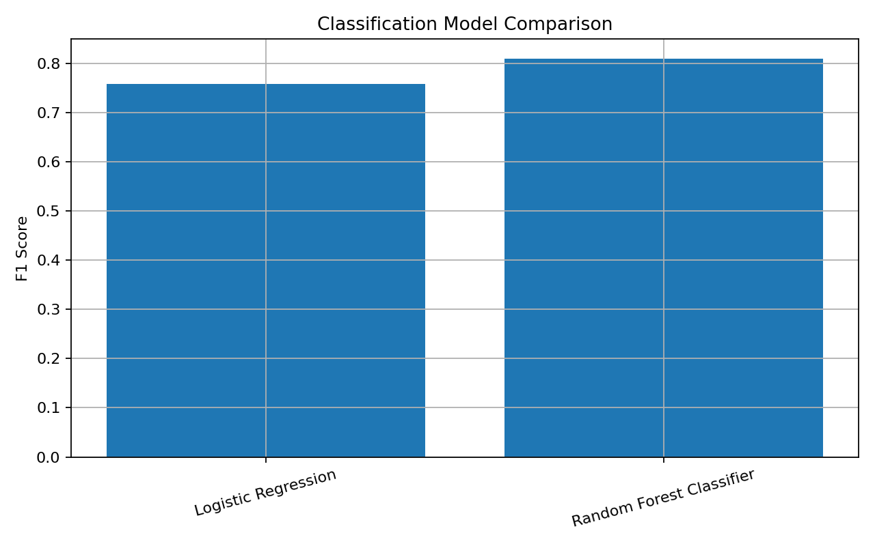
Classification
Question: will the next observed disbursement increase?
Best model: Random Forest Classifier
F1 score: 0.809

Slide 8
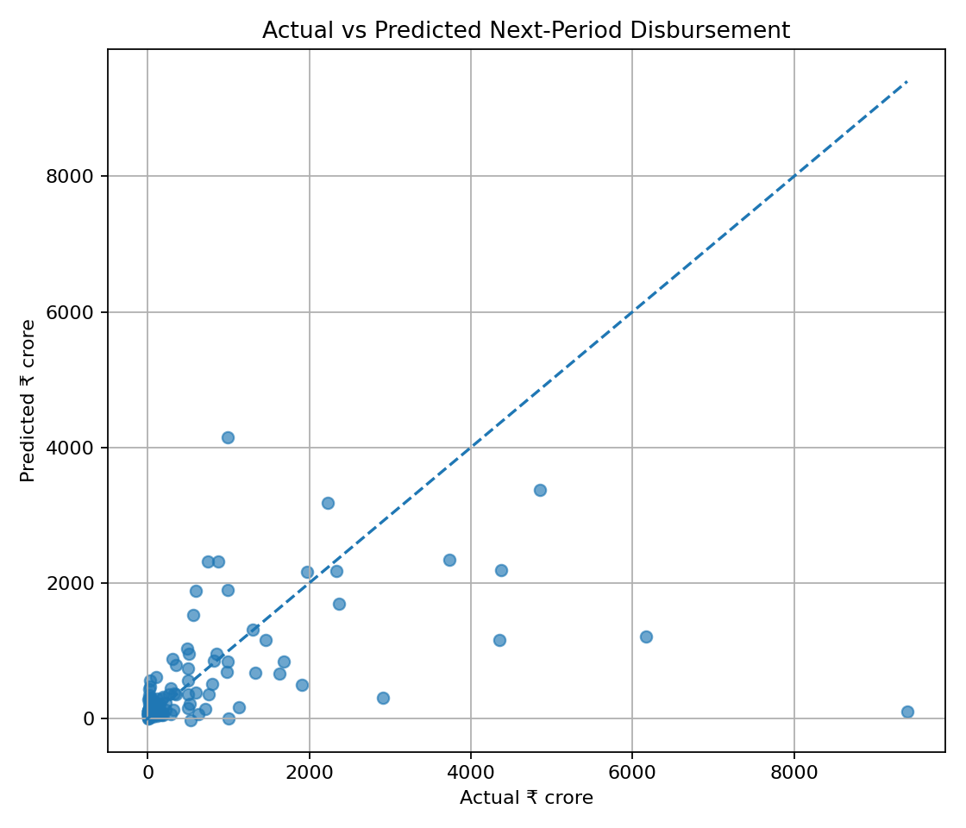
Regression
Best model by RMSE: Gradient Boosting Regressor
RMSE: ₹1112.69 crore
R²: 0.221

Slide 9
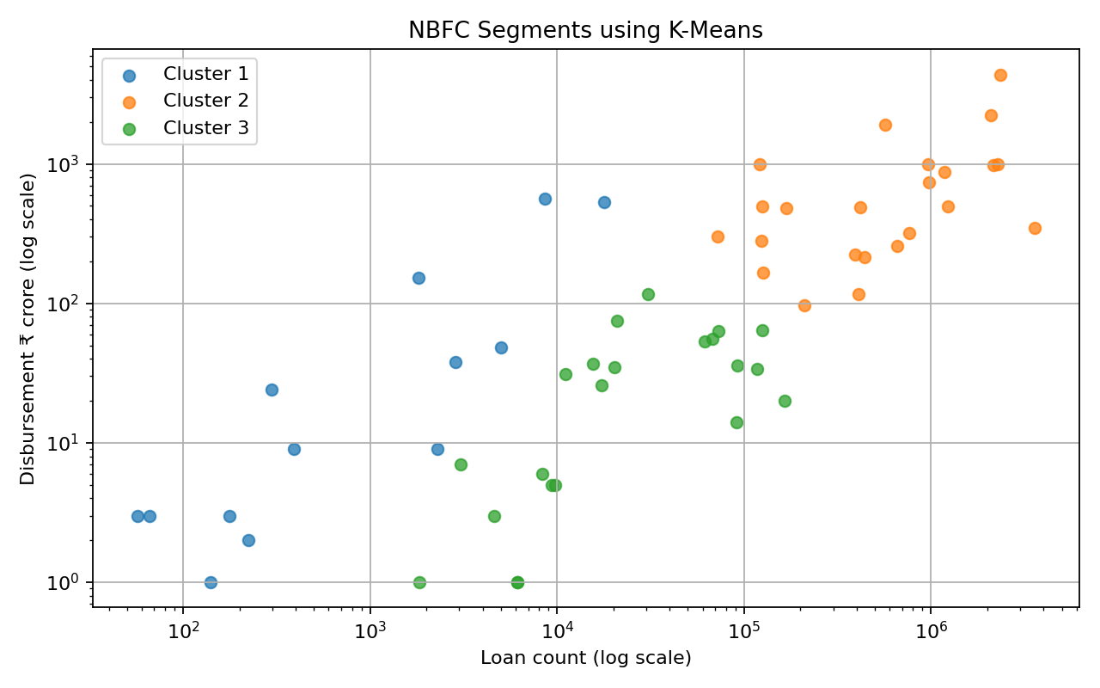
K-Means Segmentation
Three data-driven groups based on latest-period lending behaviour.

Slide 10
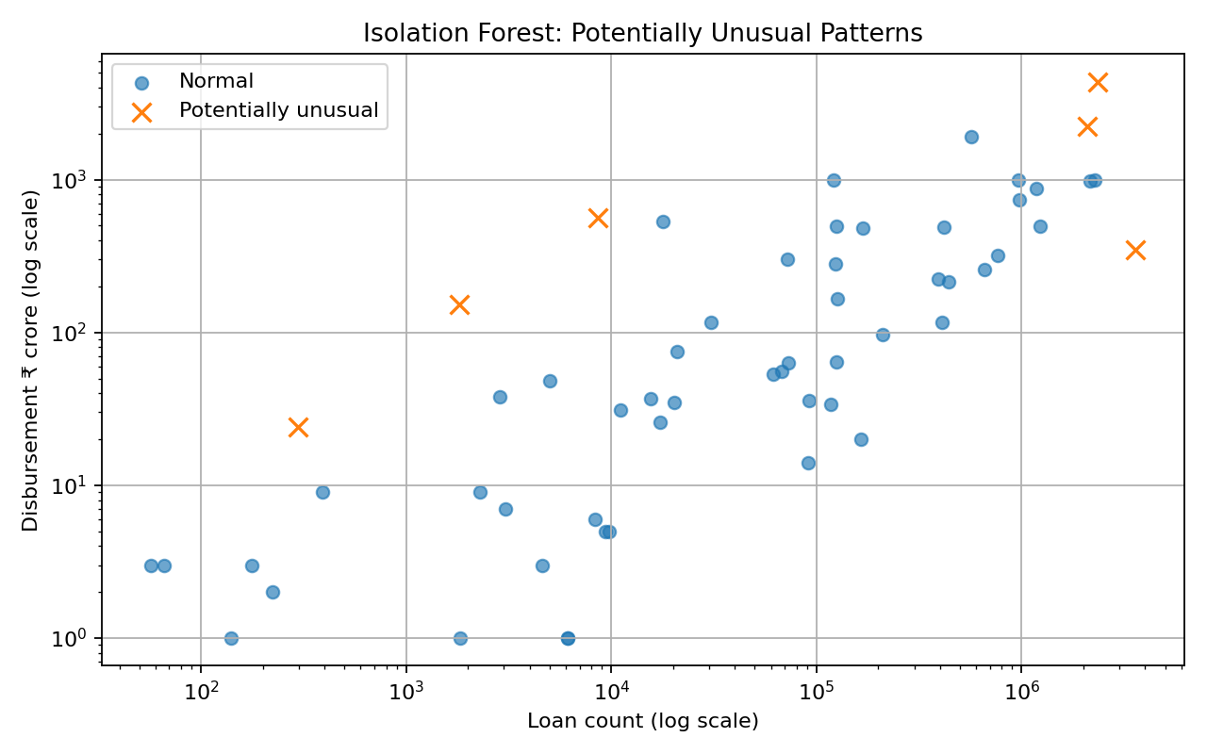
Anomaly Detection
Isolation Forest flagged 6 of 58 complete latest-period observations.
These are candidates for checking, not proof of errors or fraud.

Slide 11
Key Findings
ML can identify useful patterns, but predictions are imperfect.
Aggregate public data limits what can be concluded.
Python visualisation makes the data easier to understand.
The project demonstrates a complete data-science workflow.

Slide 12
Conclusion
The project combines financial data, Python analytics and machine learning.
It predicts observable lending patterns, groups NBFCs and flags unusual observations.
It does not prove that internal NBFC analytics caused lending changes.

Slide 13
Thank You
Questions?
Student: __________________
Roll No.: __________________

