Slide 1
Executive Summary for Product, Supplier, and Customer Insights
Actionable Recommendations for Improvement

Slide 2
Key Insights
1. Product Performance:
- Top Performers: Cameras, Computers, and Smartwatches
- Low Performers: Smartphones, Headphones, and Mice
2. Supplier Efficiency:
- Top Suppliers: TechSupply, GadgetWorks, and ElectroGoods
3. Customer Ratings:
- Lowest Rated Products: BoomBox Max, iTab Plus, ClickMate 200
- Immediate attention required for quality improvements

Slide 3
Actionable Recommendations
1. Product Strategy:
- Focus on High-Performing Categories
- Revamp Low-Performing Products
2. Supplier Management:
- Strengthen Key Supplier Relationships
- Diversify Supplier Base
3. Customer Satisfaction:
- Immediate Product Quality Improvements
- Implement Customer Feedback Loop
4. Marketing and Customer Engagement:
- Targeted Marketing Campaigns
- Improve Customer Communication

Slide 4
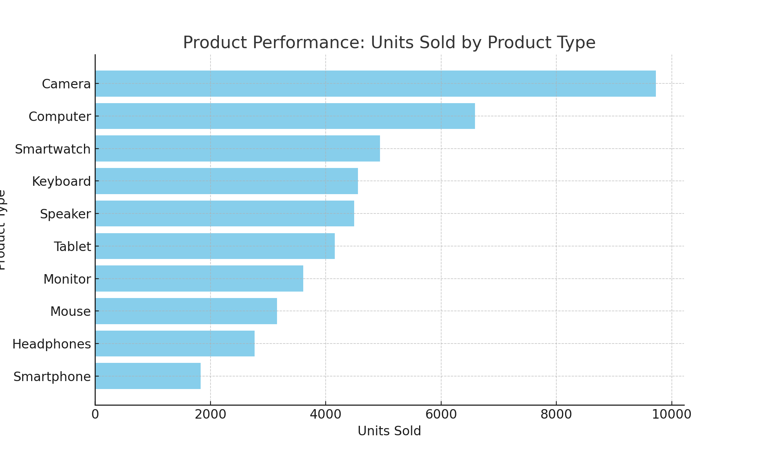
Product Performance by Product Type

Slide 5
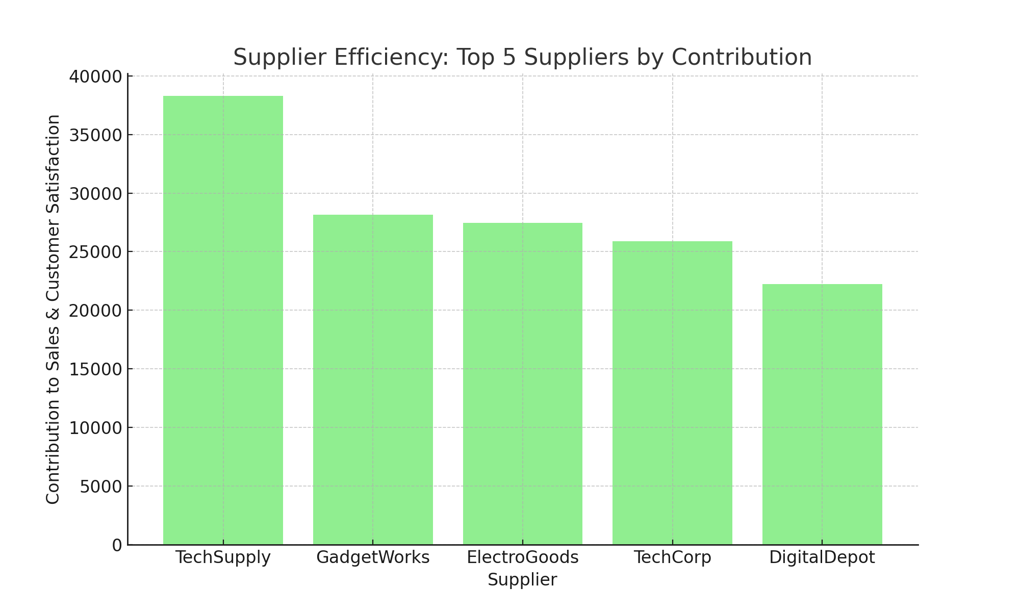
Top 5 Suppliers by Contribution

Slide 6
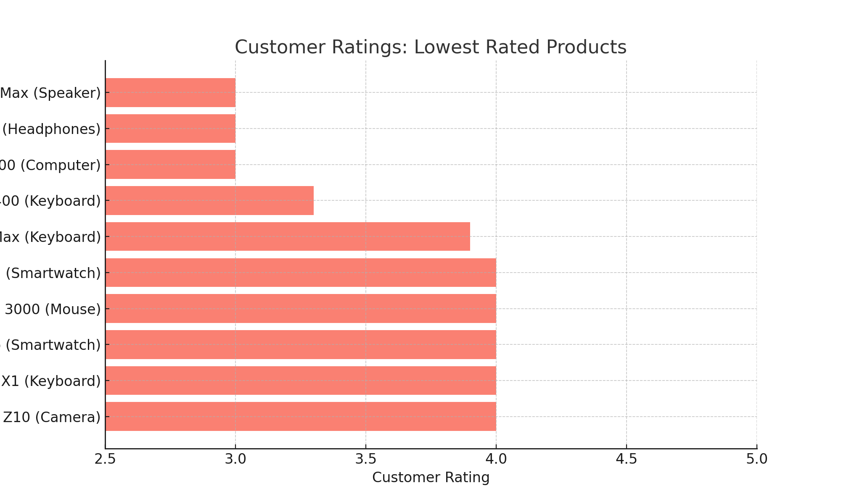
Lowest Rated Products

