Slide 1
KAFKA CONNECT

Slide 2

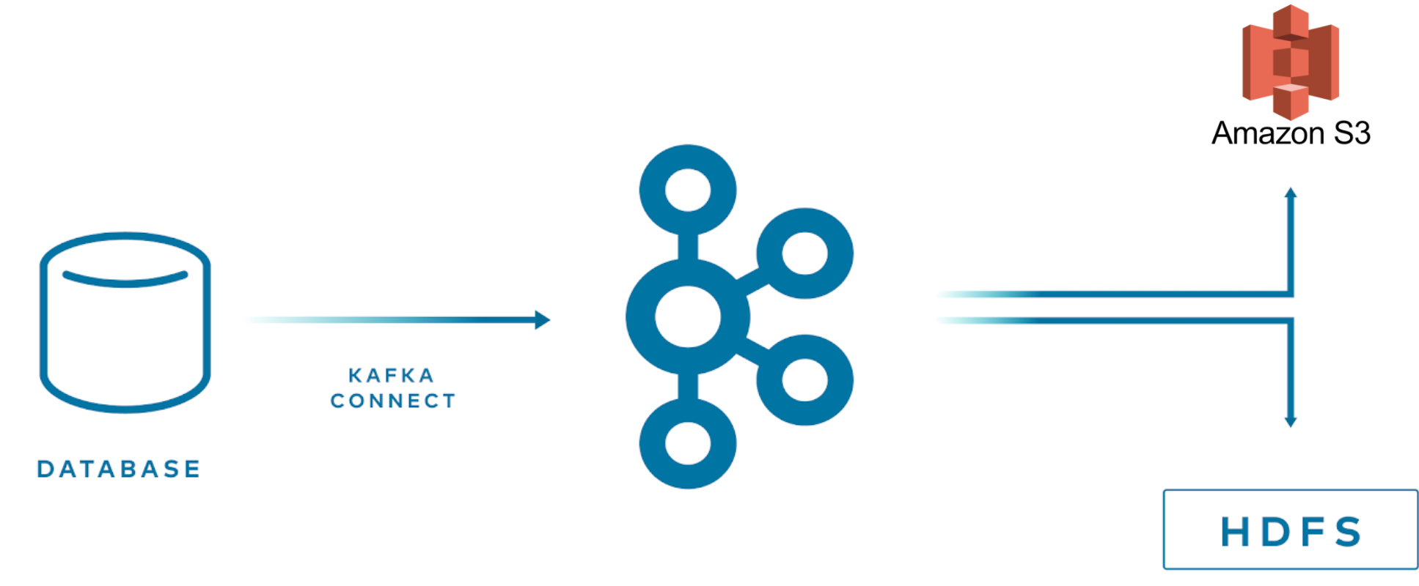
THINKPORT
KAFKA CONNECT
Use Cases
Streaming Data Pipelines
Pipe data from one or multiple source systems in real-time to different sink systems for:
different business requirements
make the same data available to different areas in a business that has their own systems in which to hold

Slide 3
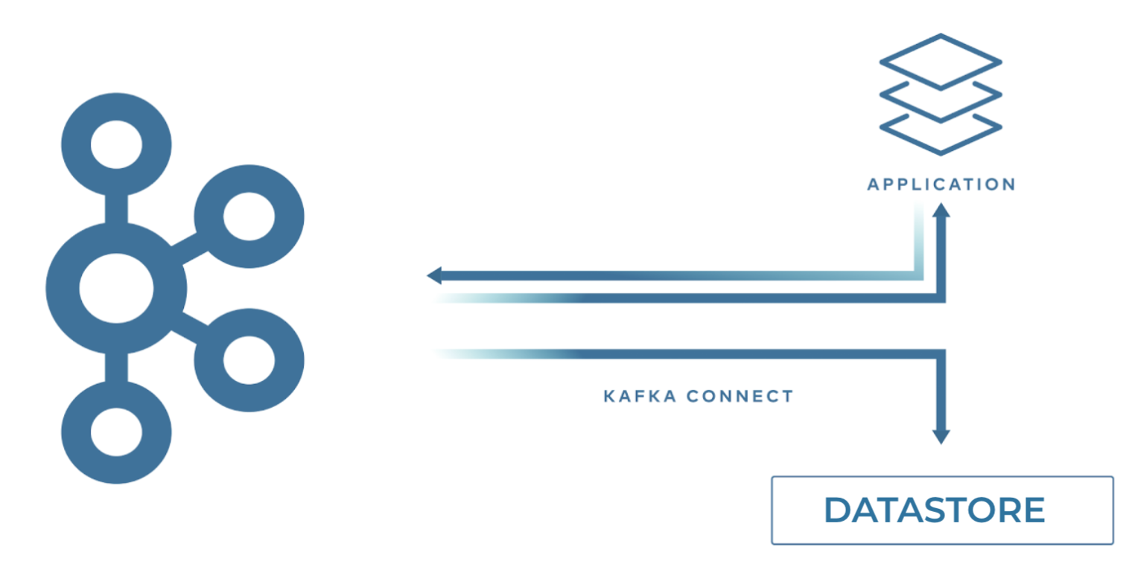
THINKPORT
KAFKA CONNECT
Use Cases
Writing to Datastores from an Application
You may create data that you want to write to a target system.
This could be a series of logging events to write to a document store or data to persist to a relational database.
By using Kafka Connect to take responsibility for writing that data to the target, you simplify the footprint or distribute the data to diffrent systems

Slide 4
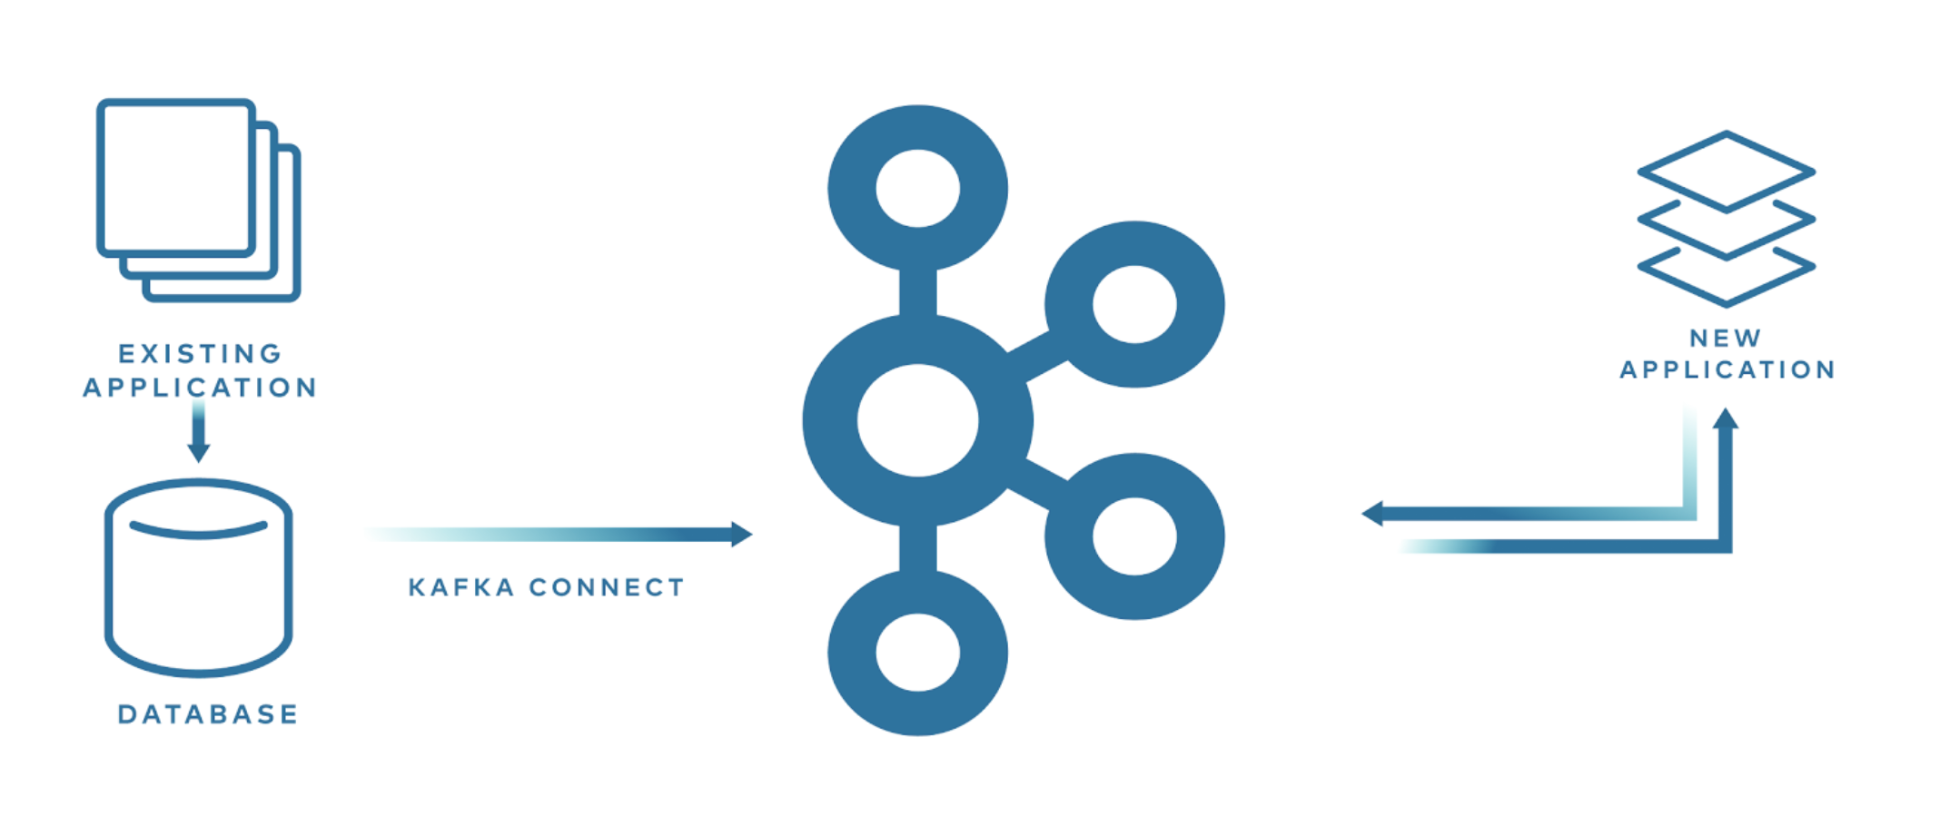
THINKPORT
KAFKA CONNECT
Use Cases
Evolve Processing from Old Systems to New
Relational databases (RDBMS) still stores a lot of critical data. Kafka Connect enables a directly low footprint data transfer between different systems .
By utilizing change data capture (CDC), it is possible to extract in near real time every INSERT, UPDATE, and even DELETE from a database into a stream of events in Kafka

Slide 5
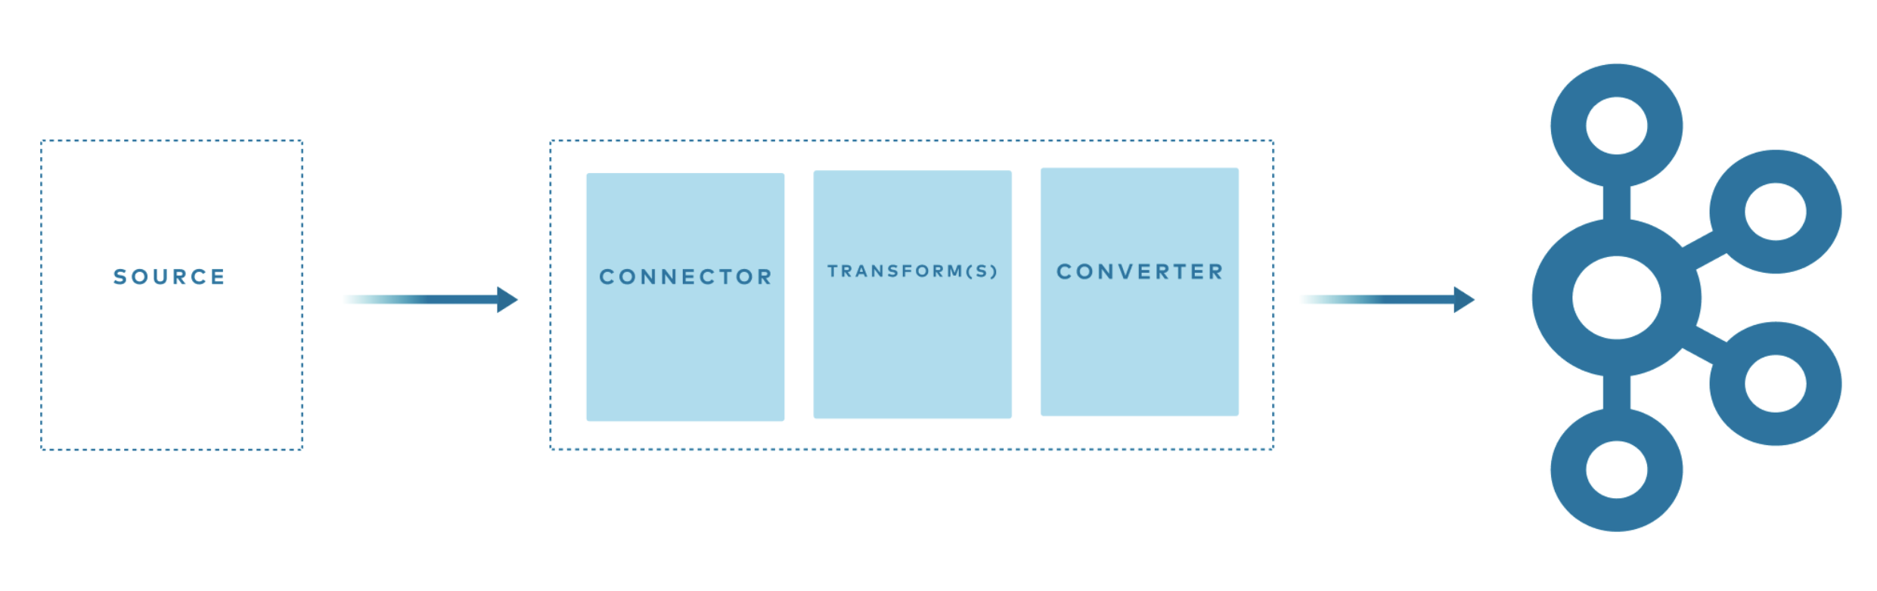
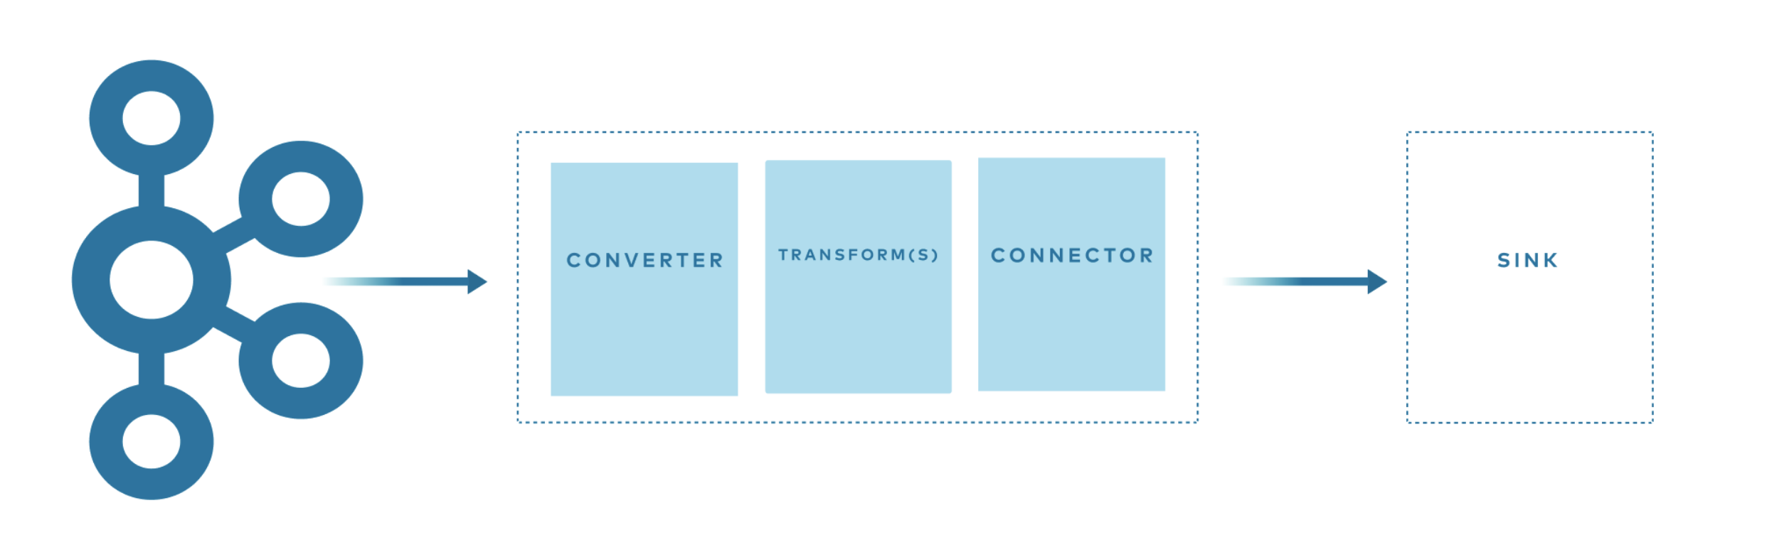


INSIDE KAFKA CONNECT
Connectors are responsible for the interaction between Kafka Connect and the external technology being integrated with
Converters handle the serialization and deserialization of data
Transformations can optionally apply one or more transformations to the data passing through the pipeline
Confluent
Kafka Connect
Confluent
Kafka Connect
Data source
Data target

Slide 6
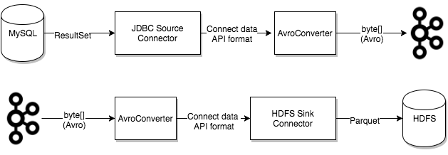
THINKPORT
KAKFA CONNECT
Use Cases

Slide 7
KAFKA CONNECT CONCEPT
Connectors → the high level abstraction that coordinates data streaming by managing tasks
Tasks → the implementation of how data is copied to or from Kafka
Workers → the running processes that execute connectors and tasks
Converters → the code used to translate data between Connect and the system sending or receiving data
Transforms → simple logic to alter each message produced by or sent to a connector
Dead Letter Queue → how Connect handles connector errors

Slide 8
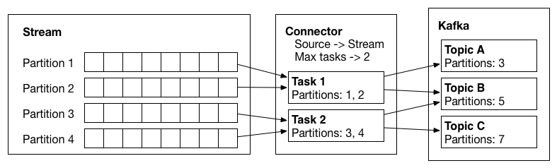
CONNECTORS AND TASKS
THINKPORT
CREATE A DATA
GENERATOR WITH
KAFKA CONNECT
SourceConnectors → import data from another system,
SinkConnectors → export data to another system
Configuration of the Connector class describes the set of data to be copied,
Connector is responsible for breaking that job into a set of Tasks that can be distributed to Kafka Connect workers
Two corresponding flavors:
SourceTask and
SinkTask
Quelle: https://docs.confluent.io/platform/current/connect/devguide.html#connectors-and-tasks

Slide 9
TASKS
THINKPORT
ABOUT
Each connector instance coordinates a set of tasks that actually copy the data.
Connector break a single job into many tasks,
Kafka Connect provides built-in support for parallelism and scalable data copying with very little configuration
These tasks have no state stored within them
Task state is stored in Kafka in special topics config.storage.topic and status.storage.topic and managed by the associated connector
Tasks may be started, stopped, or restarted at any time in order to provide a resilient, scalable data pipeline
Quelle: https://docs.confluent.io/platform/current/connect/concepts.html#tasks

Slide 10
TASK REBALANCING
THINKPORT
ABOUT
When a connector is first submitted to the cluster, the workers rebalance the full set of connectors in the cluster and their tasks so that each worker has approximately the same amount of work
Used also when connectors increase or decrease the number of tasks they require,
Or when a connector’s configuration is changed
When a worker fails, tasks are rebalanced across the active workers
Note: When a task fails, no rebalance is triggered (exceptional case)
Failed tasks should be restarted via the REST API.
Quelle: https://docs.confluent.io/platform/current/connect/concepts.html#task-rebalancing

