Slide 1
KAFKA SCHEMA REGISTRY

Slide 2
WHAT IS A SCHEMA?
Data set (record)
Schema
Name of the value | Data typ | Mandatory field
Alice;
42;
Frankfurt;
Burger with vegan Patty;
;
Name of service-staff | Text | No
Odering number | Number | Yes
Location | Text | Yes
Ordered product | Text | Yes
Additionally Ingredients | Text List | No
Note:
Data without a description of the content cannot be interpreted technically.
An abstract description of data enables a defined exchange of technical information.

Slide 3
THINKPORT
COMMON SERALIZATION PROTOCOLS
ABOUT
Extensive and complex structured data sets can be mapped
These data sets can be converted into an efficient binary format to optimize the exchange between components of a system
 | Avro | Protobuf | JSON | Parquet
Format | Binary | Binary | Non-Binary Human-readable | Binary
Use case | Transaction systems with high performance | Transaction systems with high performance | Transaction systems | Bulk data storage
Supported in schema registry | Yes | Yes | Yes | No

Slide 4

THINKPORT
SCHEMA – EXAMPLE AVRO
ABOUT
RECORD describes a collection of attributes
NAMESPACE in conjunction with NAME can be used to map a domain model to ensure uniqueness in schema administrations
FIELDS are the attributes
optional fields are defined by [null, string], default: null
Complex data types can be nested
SCHEMA
{ type : record,
namespace : digital.thinkport.kafkaworkshop,
name : order,
fields : [
{ name : bedienung, type : [null,string], default:null},
{ name : order-number, type : int },
{ name : location , type : int },
{ name : product , type : int } ,
{ name : additional_ingredient,
type :[null,
{type: array,
items:{ name : ingredient, type : string}
}],
default : null
}] }

Slide 5
SCHEMA EVOLUTION AT AVRO
Compatibility | Description | Possible modifications | Possible changes, Avro specific
Backward | Customized consumers can still process data with a new schema according to the old schema of unadapted producers | Delete fields Add optional fields | Sequence of fields, string can be converted to byte and byte to string, integer to long, float or double, long to float or duouble, float to double
Forward | Customized Producers with new schema can send to unadjusted Consumers. These ignore the changes. | Add fields Delete optional fields | Sequence of fields
Full | Producer or Consumer can be adjusted first. The schemas remain valid in any case. | Delete optinal fields Add optional fields | Sequence of fields
None | No restriction | No restriction

Slide 6
EXPLANATION TRANSITIVE COMPATIBILITY
Compatibility modus:
Forward / Backward / Full
Check compatibility
Schema Version 1
Schema Version 2
Schema Version 3
Schema Version 4
(current)
Check compatibility
Compatibility modus
Forward Transitive / Backward Transitive / Full Transitive

Slide 7
THINKPORT
SCHEMA REGISTRY IN PRODUCTION I/III
ABOUT
Schema Registry Cluster
(Space for 1GB heap memory)
The schemas are persisted on a Kafka broker in the _schemas topic. Thus a broker must be available
A central schema registry cluster can unify all clusters and their communication to each other.
Monitoring, access management, capacity planning and maintainability are simplified by a central SR.
By detaching brokers that process other messages, the schema registry detaches itself from performance fluctuations in other clusters.
Node
Node
Node
Broker
Broker
Broker
Write or read Schema
Schema Registry
Schema Registry
Schema Registry
Client
(Producer or Consumer)
Kafka Cluster (1..n)
Node
Node
Node
Broker
Broker
Broker
Write or read Messages

Slide 8
THINKPORT
SCHEMA REGISTRY IN PRODUCTION II/III
ABOUT
Schema Registry Cluster
(Space for 1GB heap memory)
Introduce default policy that all clients set auto.register.schemas parameter to false so that schemas can be managed centrally.
The configuration of the schema registry instances should be the same for all instances - with the exception of host.name: this parameter must be unique per instance.
It is recommended not to change the default topic for the _schemas and to provide them with a backup.
Node
Node
Node
Broker
Broker
Broker
Write or read Schema
Schema Registry
Schema Registry
Schema Registry
Client
(Producer or Consumer)
Kafka Cluster (1..n)
Node
Node
Node
Broker
Broker
Broker
Write or read Messages

Slide 9
THINKPORT
SCHEMA REGISTRY IN PRODUCTION III/III
ABOUT
Schema Registry Cluster
(Space for 1GB heap memory)
Securing the environment with SSL and certificate authentication is recommended.
The schema registry should be accessible through a fixed endpoint that does not change. This ensures that, for example, with dynamic addresses, all clients disconnect and have to be updated at once.
Node
Node
Node
Broker
Broker
Broker
Write or read Schema
Schema Registry
Schema Registry
Schema Registry
Client
(Producer or Consumer)
Kafka Cluster (1..n)
Node
Node
Node
Broker
Broker
Broker
Write or read Messages

Slide 10
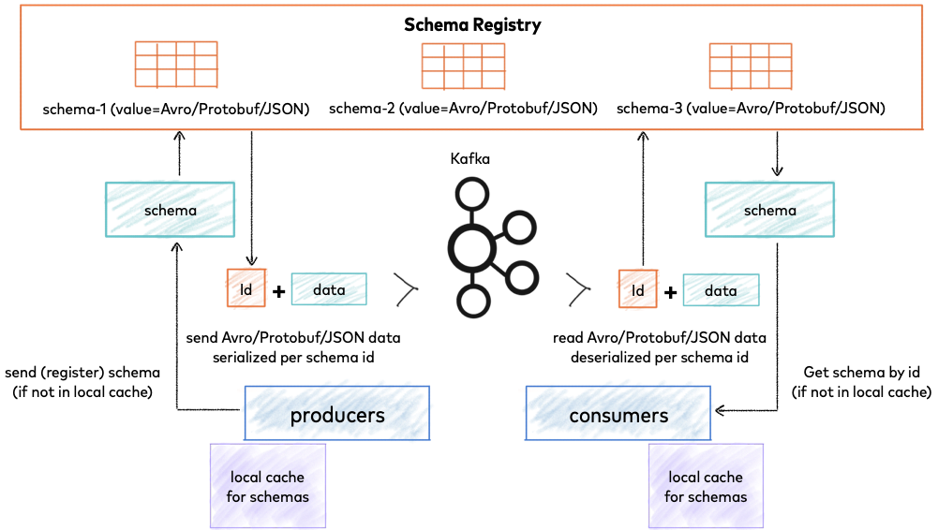
SCHEMA REGISTRY
Confluent provides a RESTful interface for schema registries
Avro, JSON Schema and Protobuff are available
Schema Registry lives outside of and separately from your Kafka brokers
No need to select a schema registry format

