Slide 1
Change of Measure II
Taorui Wang

Slide 2
Outline
1.Review of the change of measure formula
2. Martingale as the Radon Nikodym Theorem
3.Change of measure for Stochastic Process

Slide 3
Outline
1.Review of the change of measure formula
2. Martingale as the Radon Nikodym Theorem
3.Change of measure for Stochastic Process

Slide 4
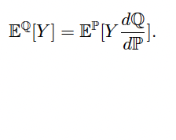
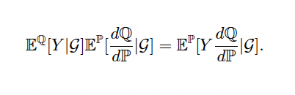
Review
Change of the measure for the expectation
Change of the measure for the conditional expectation

Slide 5
Outline
1.Review of the change of measure formula
2. Martingale as the Radon Nikodym Derivative
3.Change of measure for Stochastic Process

Slide 6
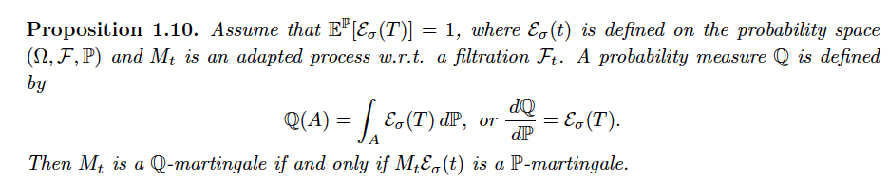
Radon Nikodym Derivative Process
We construct such process with the exponential martingale

Slide 7
Outline
1.Review of the change of measure formula
2. Martingale as the Radon Nikodym Theorem
3.Change of measure for Stochastic Process

Slide 8
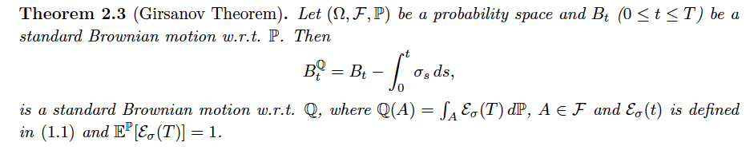
Girsanov Theorem

