Slide 1
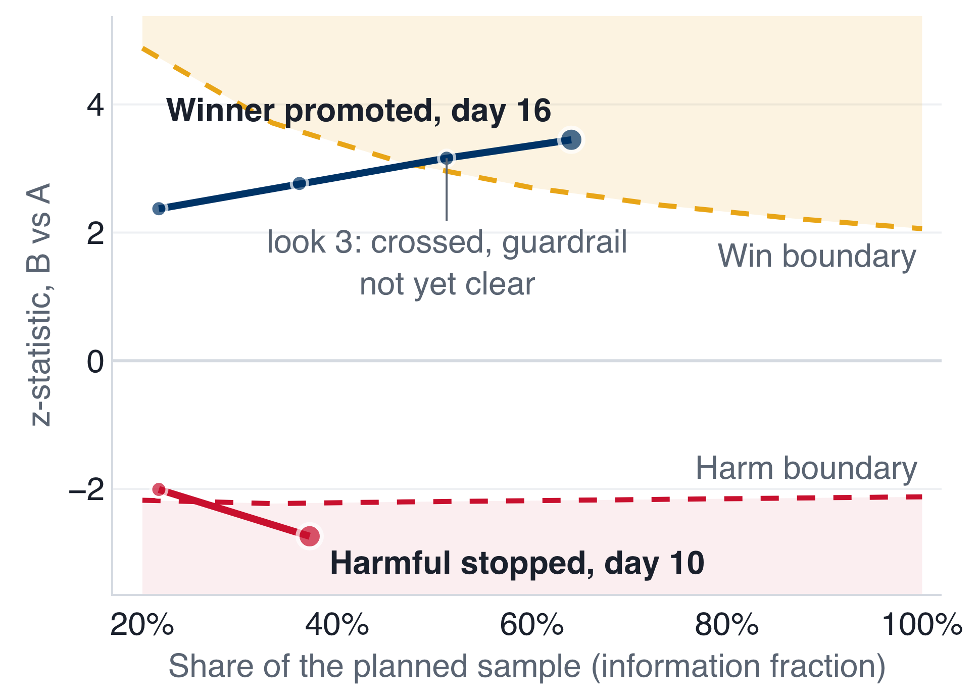
Vani Lab: prompt changes ship on evidence, not judgement
Winner promoted on day 16: ≈ +240 Meeting Fixed a week. Harmful variant stopped on day 10: ≈ 246 a week protected.
RESULT: TWO SIMULATED A/B RUNS
METHOD AND DECISION RULES
WORKFLOW
Unit: the lead, from its first answered call; stats per lead, never per call.
Route
Sticky hash buckets, 90%/10%
Achieved B 9.9%, 0 in both arms
Alpha spending: O'Brien-Fleming win (α 2.5%), no lucky early wins; Pocock harm (α 5%), fast stops; any number of looks.
Track
Exposures and calls per lead
At every look, in this order; the first match decides:
SRM halts: split off its 10% (χ² p < 0.001): results untrusted, all traffic to A.
Analyse
z, CIs, repeated CIs per look
1
Stop early: z ≤ harm boundary, or the call duration guardrail's repeated CI fully beyond +10%.
Decide
First match: SRM, harm, win
Else, at the last look: A stays
2
≈ +240 / week
Meeting Fixed gained
Promoted on day 16 (look 4)
≈ 246 / week
Meeting Fixed protected
Stopped on day 10 (look 2)
Promote: z ≥ win boundary and the guardrail's repeated CI inside +10%.
3
Roll out
Live allocation + audit log
Simulated traffic from historical Vani meeting calls, replayed with injected effects the engine never sees (true lift +24% / −29%; engine estimated +23% / −24%).
A/A check: 2.30% false wins in 2,000 no-effect runs. Weekly figures: engine estimate at 100% rollout. Sources: the store's decision log, reports/validation.md.

