Slide 1

Customer Segmentation
By Krishnakant Sonji

Slide 2
Understanding Our Customer Base
This presentation aims to:
uncover patterns within our customer base.
providing insights to enhance marketing strategies.
product development.
customer experience.
The analysis covers customer demographics, product usage, and segmentation to uncover hidden opportunities.

Slide 3
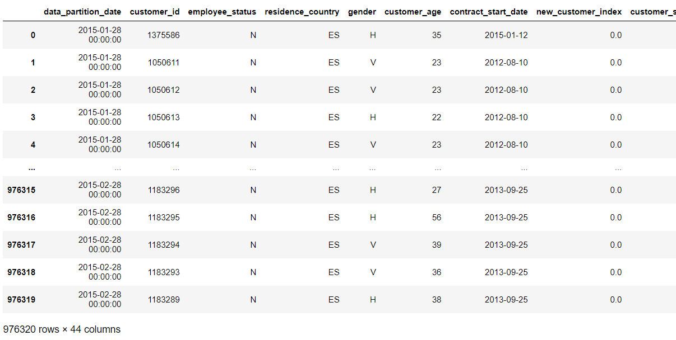
Data Overview
The dataset contains 976,320 customer records with 44 columns
Features: age, income, financial product usage, and customer status.

Slide 4
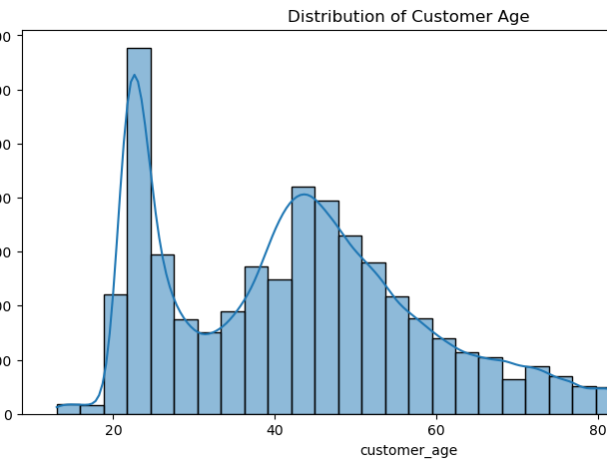
Age Demographics of Customers
The customer age distribution is bimodal, with prominent age groups around 20 and 40-50 years.
The first peak indicates a large presence of younger customers, while the second peak points to middle-aged customers.
Opportunity: Develop tailored offers and experiences to cater to the distinct age demographics.

Slide 5
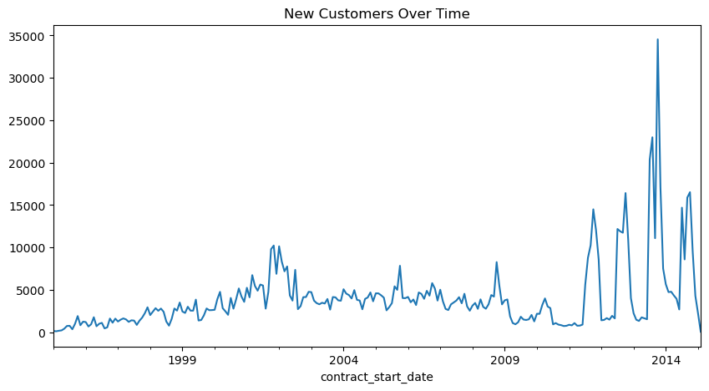
Customer Trends Over Time
New Customer Growth: Analyze how the number of new customers has evolved monthly or annually.
Age Trends: Explore changes in the age distribution of new vs. existing customers over time.
Income Changes: Monitor any shifts in the average household income of customers over various time periods.
Opportunity: Identifying growth periods or shifts in customer demographics can inform when to launch new products, campaigns, or retention efforts.

Slide 6
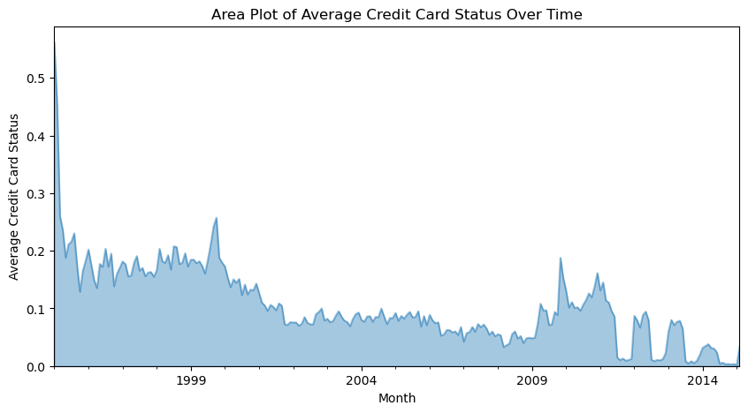
Trends in Credit Card Ownership Over Time
Growth in Credit Card Ownership: Track how the number of customers with credit card changes over time.
Seasonal/Monthly Variations: Identify any spikes or dips in credit card adoption during specific months (e.g., during holidays or sales seasons).
Income and Age Influence: Observe whether certain age groups or income levels show different trends in adopting credit cards over time.
Opportunity: Understanding these trends can help tailor campaigns during peak adoption periods and develop strategies to increase credit card ownership among specific customer segments.

Slide 7
Income Profile of Customers
The household income distribution is highly right-skewed, with the majority of customers in the low to moderate income range.
A small number of outliers represent very high-income households.
Opportunity: Segment customers by income to design differentiated product offerings.

Slide 8
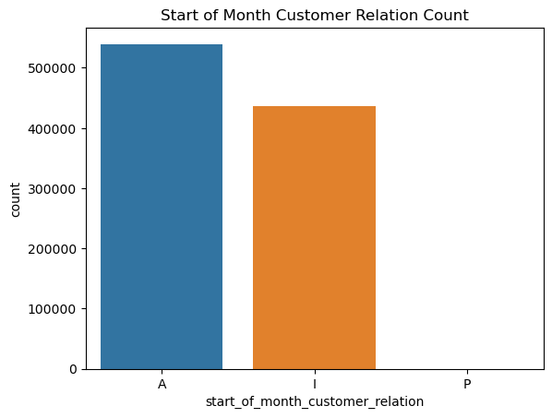
Length of Customer Relationship
Most customers have low seniority (<50 months), indicating a high proportion of recently acquired clients.
Seniority gradually decreases as tenure increases, with a smaller proportion of long-term customers.
Opportunity: Implement retention strategies to nurture these newer customers into long-term loyal clients.

Slide 9

Gender Breakdown
The gender distribution is balanced between male and female customers.
This balance enables gender-neutral product development and marketing strategies, ensuring inclusive targeting across all genders.

Slide 10
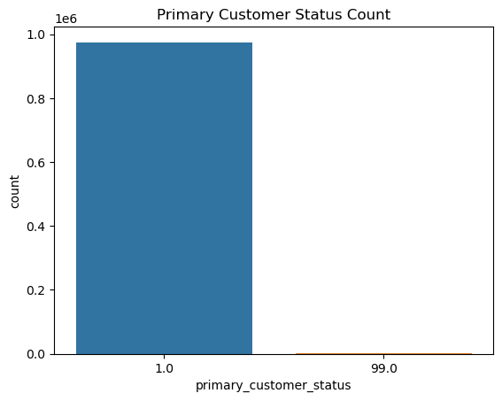
Primary Customer Status Overview
Nearly all customers are classified as 1.0, suggesting a uniform classification of active customers.
The minor category (99.0) is insignificant, which indicates either a special condition or potential data anomaly..

Slide 11

Current vs. Savings and Credit Accounts
Current account has the highest usage among customers, while saving account and credit cards are significantly underutilized.
Opportunity: Promote savings and credit accounts to diversify financial product engagement and increase revenue streams.

Slide 12
Segmenting Customers Based on Age, Income, and Seniority
Clustering analysis groups customers into distinct segments based on their age, income, and seniority.
This segmentation helps identify specific customer needs and preferences, enabling more focused marketing strategies.

Slide 13
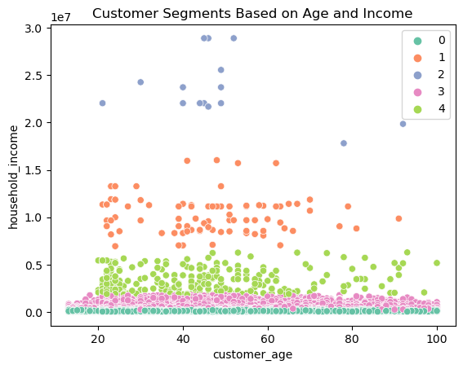
Visual Clusters of Customer Segments
Five customer segments are identified with unique combinations of age, income, and seniority.
The scatter plot reveals the visual distinction between these groups, indicating potential market segments to target.

Slide 14

Recap of EDA Insights
The customer base skews younger with mostly low to moderate income.
Heavy usage of current accounts; savings and credit products are underutilized.
Clear customer segments offer opportunities for targeted product offerings and marketing.
Takeaway: Strategies should focus on product diversification, tailored marketing for segments and retaining newer customers.

Slide 15

Actionable Next Steps

Slide 16
For Business Users
Boost Product Adoption: Create campaigns to promote savings and credit products.
Enhance Customer Retention: Develop loyalty programs to retain newly acquired customers.
Personalize Offers: Leverage customer segments to design personalized products and communication.

Slide 17
For Technical Users
Modeling Suggestions: Use KMeans for refined clustering; apply Logistic Regression or Decision Trees for product adoption prediction; use Random Forest/XGBoost for complex classification.
Handle Data Skewness: Transform skewed variables (e.g., income) for improved model performance.
Next Steps: Explore dimensionality reduction (PCA) and model tuning to enhance accuracy.

Slide 18

Thank You!

