Slide 1

Exploratory Data Analysis
Cab Investment
08 August 2024

Slide 2

Agenda
Executive Summary
Problem Statement
Approach
EDA
EDA Summary
Recommendations

Slide 3
Executive Summary
EDA Objectives: i) Perform an analysis of the operating data in order to identify the market share and customer favorites for the "Pink" and "Yellow" cab companies. ii) Identify key performance indicators to inform business strategies.
Key Findings: i) "Yellow Cab" is the dominant player, which is mostly popular among the young customers. ii) Key Demographic and peak usage time show the potential for targeted marketing and operational improvements.
Business Impact: i) Through these insights, investors will be able to make strategic decisions about which company to invest in.

Slide 4
Problem Statement
Business Challenge: Investors have to understand market dynamics and customer behavior in a world full of competition so as to take advantage of those factors and beat their competitors and make wise investment.
Importance of EDA: 1) Market Share and Performance: Analyze the competition standing and find out growth opportunities to move a business forwards. 2) Customer Insights: Detect preferences and demographics so as to devise targeted strategies. 3) Operational Efficiency: Recognize efficiencies and bottlenecks of operation.
Goal: Through these insights, investors will be able to make strategic decisions about which company to invest in.

Slide 5
Approach
Data Preprocessing: i) Data Cleaning: Handled the missing values, data inconsistences were also corrected and the irrelevant data were filtered out. ii) Data Transformation: Data Normalization was done and additional variables were calculated to obtain more profound insights for the analysis.
Statistical Methods: i) Descriptive Statistics: Used to summarize data features and derive early patterns.

Slide 6
Approach
Visualization Techniques: i) Trend Analysis: Services usage, as well as revenue trends, were tracked over time by sentences line graphs and time series plots. ii) Demographic Insights: Bar charts and Pie charts were used to show the varied information about the demographics and the liking of customers.

Slide 7
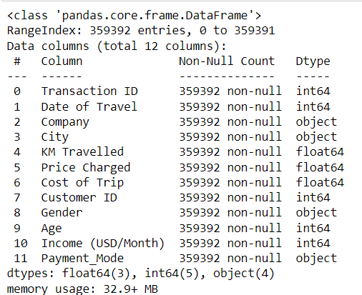
EDA - Data Overview
Data Structure: i) Data Types: Incorporates both categorical and numerical data reflecting various measures from trip records to customer feedback. ii) Records and Attributes: Deciphered 1 million records with features such as trip length, price, age of clients, and level of happiness. iii) Sources: Collected either from the operational databases or customer surveys.
Purpose: Embedding the basic comprehension of the data set to warrant valid and pertinent insights for strategic planning.

Slide 8
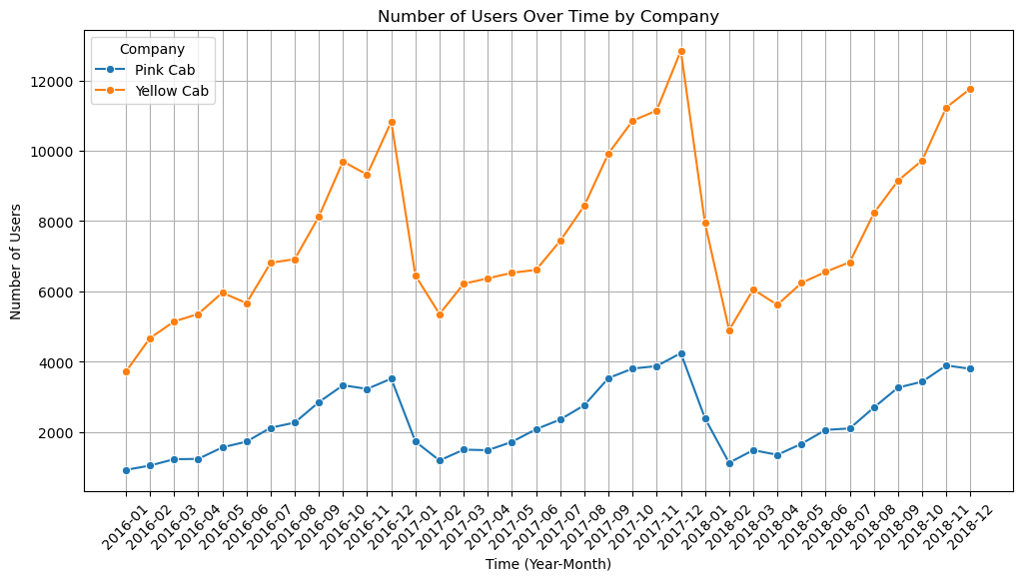
EDA - Usage Trends
Key Trends: i) Temporal Patterns: The research showed the daily, monthly, and yearly usage, thus revealing the peak periods and the seasonal differences. ii) Growth Trends: The long-term data exhibit market saturation points along with the growth passage.
Line graphs and area charts present the trends which have a clear view of the temporal dynamics that impact the cab companies.

Slide 9
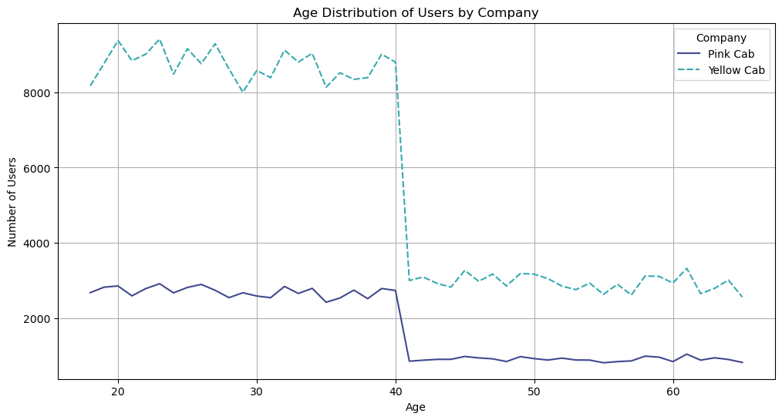
EDA -Customer Demographics
Demographic Insights: i) Age Distribution: "Yellow" is a favorite among younger people, but groups have their preferences too, which can be seen by the different ages. ii) Customer Loyalty: These are the frequencies and retention rates, sorted by demographics and service type.
The age-frequency and loyalty metrics of the student’s customers are displayed in bar charts providing a clear insight into their customers’’ main information.

Slide 10
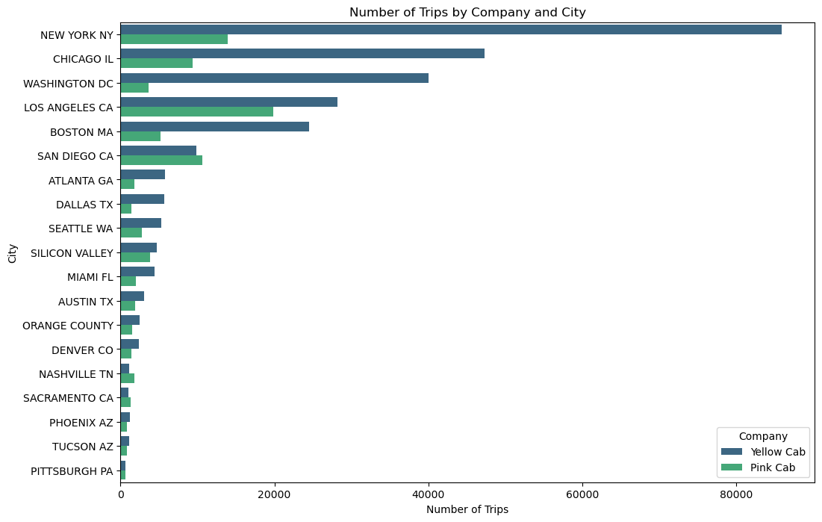
EDA - Market Comparison
Comparative Analysis: i) Trip Counts and Revenue: "Yellow" is frequently preferred in most cases, especially in high-demand areas. ii) Customer Ratings: A comparative evaluation of satisfaction ratings across various service aspects such as wait times and ride comfort.
Using dual-axis charts for financial comparison as well as star rating histograms for customer review excellence.

Slide 11
EDA SUMMARY
Key Insights: i) "Yellow Cab" is making it big when it comes to younger people and at the same time dominates over others in terms of market share and revenue. ii) "Pink Cab" lures to cost-saving customers but has a lower overall market share.
Strengths and Weaknesses: i) "Yellow Cab": Has Big Revenue but Also Big Operational Costs. ii) "Pink Cab": Attractive Prices but is Facing a Problem of Customer Loyalty.
Surprising Patterns: User Drop-off at Age 40: Both "Pink Cab" and "Yellow Cab" experience a sharp decline in users around age 40. After this age, user numbers stabilize but remain low, with "Yellow Cab" keeping a larger, yet reduced, user base compared to younger demographics.
Strategic adjustments will be necessary to optimize market positioning and improve service delivery based on these insights.

Slide 12
Recommendations
Investment Considerations:
"Yellow Cab": Invest for Growth: Capitalize on Yellow’s strong market share and revenue. Focus on expanding into new markets and improving operational efficiency.
"Pink Cab": Targeted Investments: Strengthen marketing to core demographics and invest in technology upgrades to enhance service efficiency and customer retention.
Risk Management: Market Dynamics: Be aware of the competitive landscape and regulatory changes that could impact profitability.
Strategy: Diversified Investments: Balance investments between both companies to mitigate risks and leverage their unique strengths.

Slide 13
Thank You

