Slide 1
Machine Learning
CS 4622
DengAI : Predicting Disease Spread
140042R - B. P. T. D. Ariyarathna
140205V - P. N. Harankahadeniya
140238A - S. I. Isthikar
140436E - C. M. N. D. Pathirana

Slide 2
Project Description
The "DrivenData Labs" has organized a competition named "DengAI: Predicting Disease Spread"
Main task is to predict the number of dengue cases weekly, based on varying environmental factors like temperature, precipitation, vegetation, and more

Slide 3
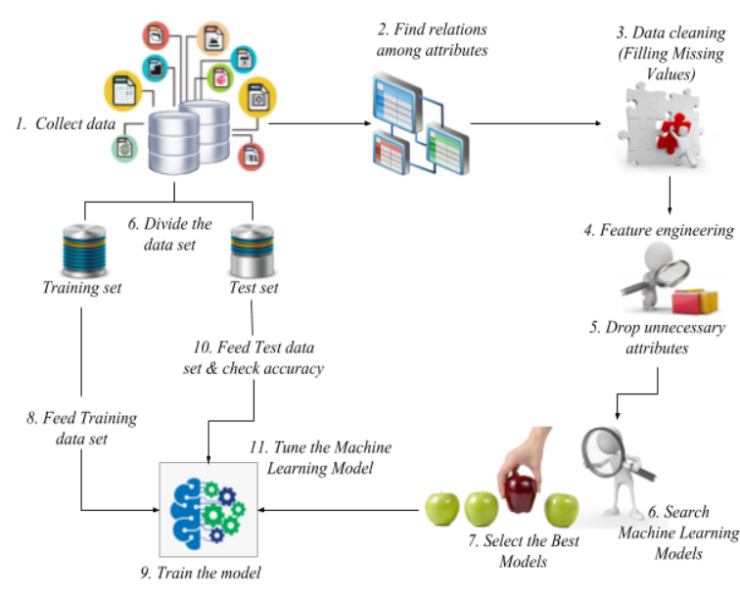
Methodology
Data Preprocessing
Feature Extraction
Feature Selection
Select the Best ML model
Tuning the Model
Evaluation

Slide 4
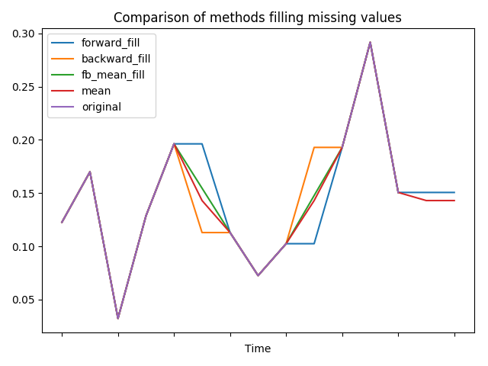
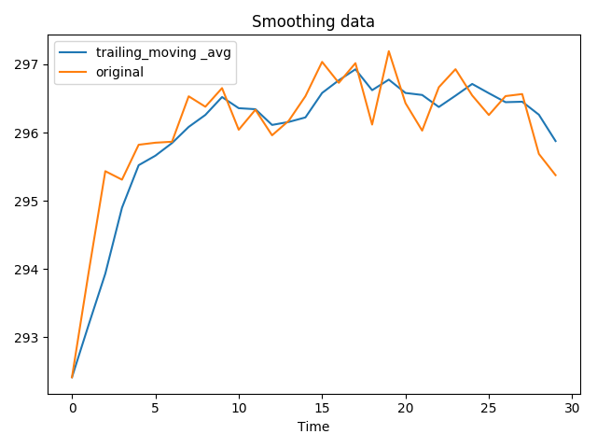
Data Preprocessing
Filling Missing values
Forward Fill
Backward Fill
Average Forward Backward Fill
Smoothing
Trailing Moving Average
Normalization
Z-Score

Slide 5
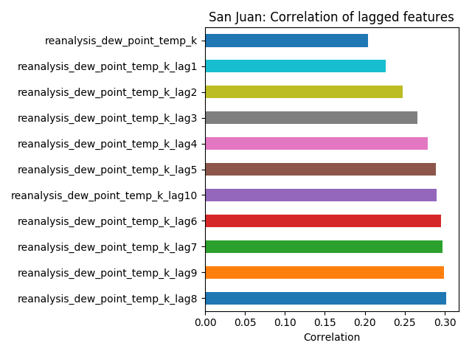
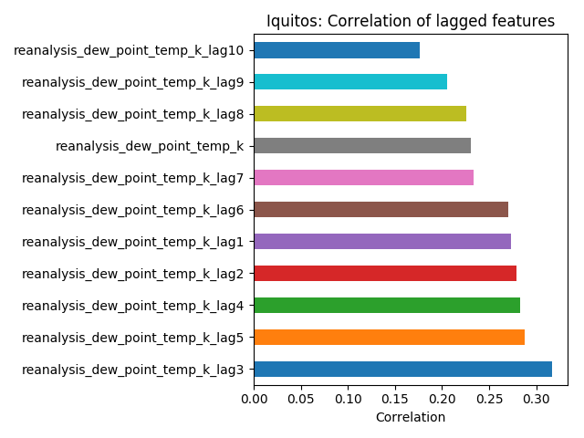
Feature Extraction
Feature Lag
The temperature of the week before may affect more to the breeding of the mosquito
Moving Window Average
Moving average is calculated and added as a new input feature
Window size which gave the least mean absolute error was used to calculate the values for the moving window average

Slide 6
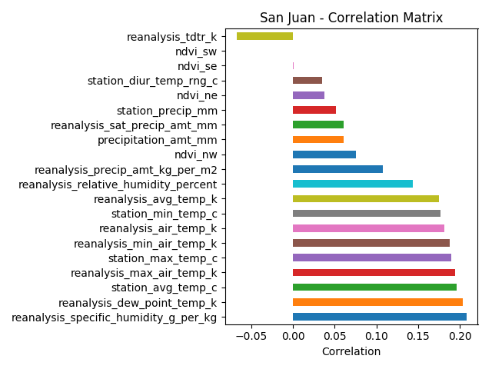
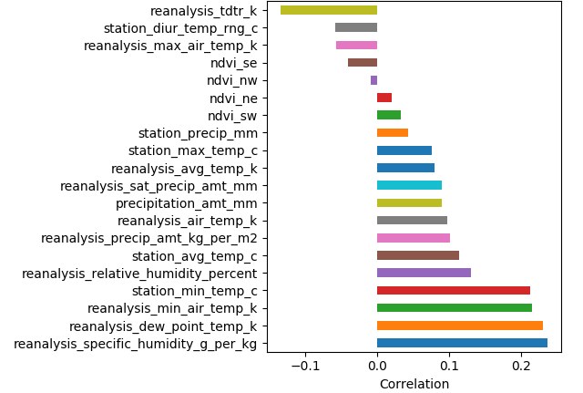
Feature Selection
Using Correlation Analysis
Correlation strengths of features in San Juan
Correlation strengths of features in Iquitos

Slide 7
ML Model Selection
Linear Regression
Regression analysis predicts trends and future values
Therefore the problem is a regression problem
Explain the relationship between one dependent variable and one or more independent variables

Slide 8
ML Model Selection (Cont.)
Random Forest Regression
Constructs a multitude of decision trees at training time and outputs the mean prediction (regression) of individual trees
Used grid search method to tune the model by finding the optimal values for the number of trees in the forest and the maximum depth of the tree

Slide 9
ML Model Selection (Cont.)
3. Gradient Boosting Regression
Ensemble of week prediction models
These weak learners might not be good for the entire dataset but good for some part of the dataset
So each model boots the performance of the ensemble

Slide 10
ML Model Selection (Cont.)
Ensemble
Ensemble of Gradient Boosting Regressor and Random Forest Regressor
Averaged the values predicted by two models
Changed the bias of averaging for tuning

Slide 11
Evaluation
The Evaluation score for the competition was MAE (Mean Absolute Error)
MAE = 𝞢 ⎜y i - x i⎟ / n = 𝞢 ⎜e i⎟ / n

Slide 12
Analysis
ML Model | Best Score from the Model (MAE)
Linear Regression | 21.9774
Random Forest Regressor | 20.3173
Gradient Boosting Regressor | 20.1659
Ensemble | 20.1563

Slide 13
Conclusion
Got a reasonably high score (Low MSE) by coming along the pipeline of preprocessing, feature engineering, model training and tuning and then evaluating.
Preprocessing - Filling missing values, smoothing, normalization
Feature Engineering - Extracted new features using rolling window and lagging features
ML model - Ensemble of Gradient Boosting Regressor and Random Forest Regressor by getting a biased average

Slide 14
Thank You

