Slide 1
NDDNUG 8/5/2015
Best Practices for Skunkworks RAD with MVC
0 to MVP in 90 Minutes

Slide 2
About Me – Sean Goodpasture
Been developing professionally since 1996
Started with Basic & Pascal, then Fortran
Then VB, Access, Java, Oracle
Saw the .NET light in late 2001
Been in the MSFT stack since then
Partner in Third Corner since 2010
Heavy focus in intranet application development for Oil & Gas and Healthcare markets

Slide 3
Tonight’s Goals
What is an MVP really?
Building an MVP in ~90 minutes
Hacking vs. Architectural Purity
MVP to get over blank sheet hurdle
MVP as a sales tool

Slide 4
Our Itch
A friend recently lost everything in a disaster
Didn’t have logs of belongings and is now trying to remember everything they own
We should build an app to track our possessions for insurance purposes!

Slide 5
What is the MVP?
List items in a database
Add items to the database
View an item
Edit an item
That’s it. “M” is for “Minimum”

Slide 6
How do we start?
Cookie Cutter Process:
Define the Model
Sketch the UI
Scaffold the project
List items
View Item
Add/Edit Item

Slide 7
Define the Model
Item
PK
Name
Manufacturer
Serial Number
Purchase Price
Date Acquired
Build the DB and the Table

Slide 8
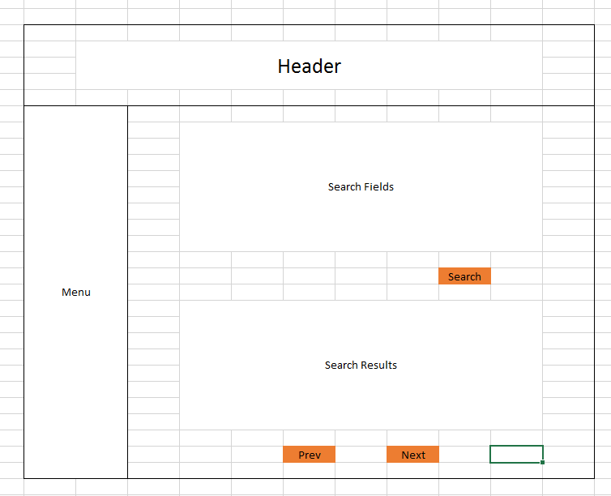
Sketch the UI
Use a fancy prototyping tool

Slide 9
Scaffold the Project
File => New Empty Web Project
Bring in Logging
Linq to SQL Model
Bring in ThirdCorner.Base & it’s components
BaseController
LoggedInUser
Layout
Controls
Samples
Scripts

Slide 10
Coding the App
Home Controller
Index.cshtml
Edit.cshtml
Convert to Paging/Sorting

Slide 11
What Next?
Use the application!
Add pictures
Item
Receipt
Delete items
Login/multi-tenant/Azure Hosting
API
Mobile App

