Slide 1


Face Image Detection
Present by - Thiri Than Myint

Slide 2
Content
1
Dataset overview
2
Data Processing
3
Model Design
3
4
Performance Evaluation
3
5
Visualizatin result
3
6
References

Slide 3
Dataset Overview
FairFace is a face image dataset which is race balanced. It contains 108,501 images and images were collected from the YFCC-100M Flickr dataset and labeled with race, gender, and age groups.
Age: Categorical (e.g., 0–2, 3–9, 10–19, etc.).
Gender: Binary (Male, Female).
Ethnicity: Seven classes (White, Black, Asian, Indian, Latino_Hispanic, Middle Eastern, Southeast Asian).

Slide 4
Data Processing
Normalization: Scale pixel values to [0, 1] for standardized inputs.
Augmentation: Random rotations, flips, and resizing to mitigate overfitting.
Dataset Split:
Training: 70%
Validation: 15%
Testing: 15%
Dataset Label Transformation
Transformed dataset with readable labels for gender and race.
Drop unused Columns: service_test column

Slide 5
Model Design
CNN Architecture:
Feature Extraction Layers:
Convolutional layers (filters: 32 to 256).
Flattening Layer:
Converts feature maps to 1D.
Fully Connected Layers:
Age: Multi-class classification with sigmoid function
Gender: Binary classification.
Race : Multi-class classification with softmax function
Loss Functions:
Age: Cross-Entropy Loss (multi-class).
Gender: Cross-Entropy Loss (binary).
Race: Cross-Entropy Loss (multi-class).
Optimizer: Adam with learning rate scheduler.
Batch Sizes: Experiment with 32,.
Epochs: Experiment with 10–20 epochs.

Slide 6
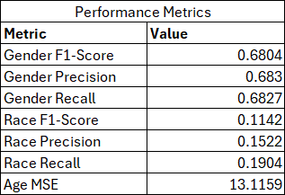
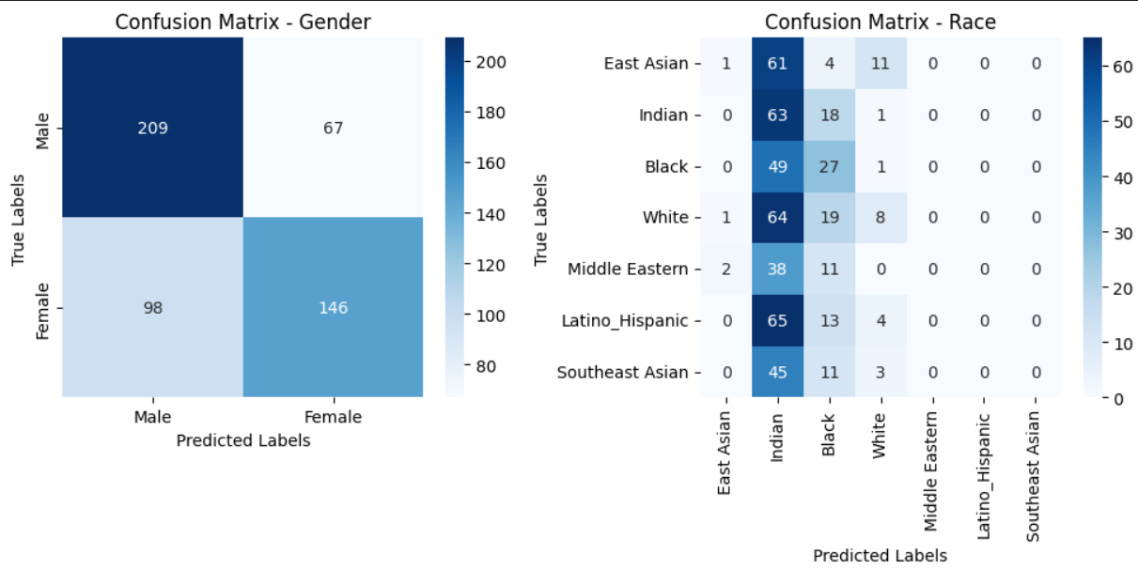
Performance Evaluation
Metrics:
Age: Mean Squre Error (MSE) and Accuracy.
Gender & Ethnicity: Accuracy, Precision, Recall, F1-score.

Slide 7
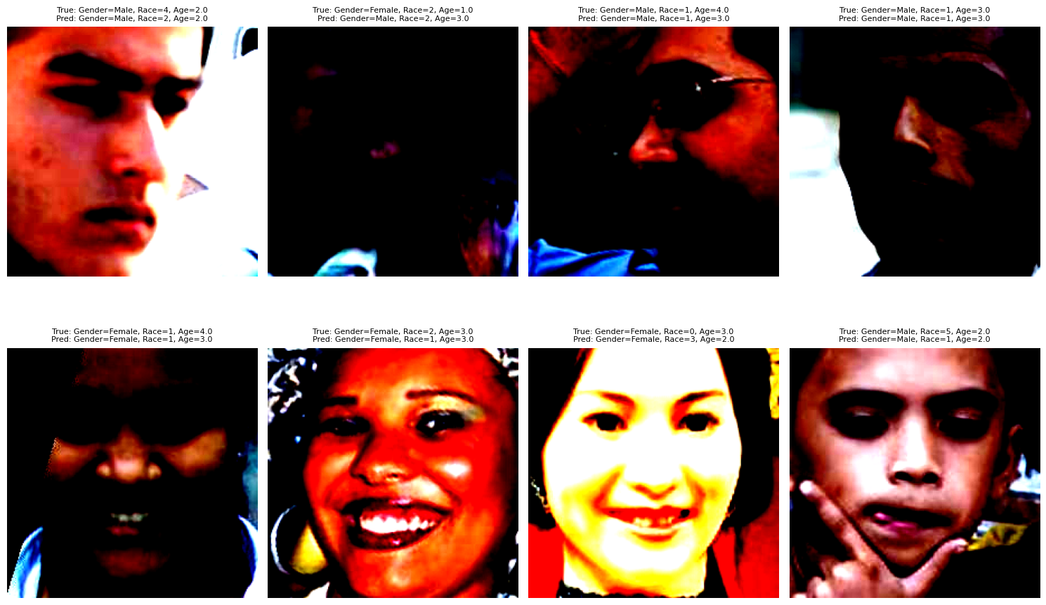
Visualization result
Challenges
Ambiguous Features:
facial features are not distinctly representative of a class, such as mixed-ethnicity individuals
Age Estimation:
Predicting age from facial features is inherently challenging due to subjective and overlapping age group boundaries. Errors in age classification (e.g., predicting 3 instead of 4) highlight this issue.
Extreme Variations:
Some images appear overly dark, saturated, or unclear, introducing noise that hinders accurate predictions.

Slide 8
References
https://paperswithcode.com/dataset/fairface
https://huggingface.co/datasets/HuggingFaceM4/FairFace/viewer

Slide 9
Thank you!

