Slide 1

AI-Based Fire Fighting Robot using ESP32
An autonomous, IoT-enabled robot designed to detect, navigate, and extinguish fires — with real-time WhatsApp alerts
Team
Department
Arun Kumar · Priya S · Karthik R · Divya M
Electronics & Communication Engineering
Institution
Anna University, Chennai

Slide 2


Introduction
The Problem
The Solution
Fire accidents cause thousands of casualties and billions in property damage annually. Traditional firefighting relies heavily on manual intervention — placing human lives at serious risk in unpredictable, high-heat environments.
Autonomous fire-fighting robots bridge this gap by combining embedded systems, sensor fusion, and IoT connectivity to detect and respond to fires faster — without putting humans at risk.
Delayed response time in large buildings
Firefighters exposed to toxic fumes and extreme heat
Manual systems lack real-time monitoring
Automation is no longer optional in fire safety — it is a necessity.

Slide 3




Project Objectives
Four core goals drive this project, from sensing to action to communication.
Detect Fire Automatically
Navigate Towards Fire
Use three flame sensors to triangulate fire position with high accuracy in real time.
Drive DC motors intelligently to steer the robot in the direction of the detected flame.
Extinguish the Fire
Send Real-Time Alert
Activate the water pump and servo motor to spray water precisely at the fire source.
Trigger a WhatsApp notification via WiFi API the moment fire is detected.

Slide 4






System Overview
The robot follows a closed-loop sense → decide → act → communicate pipeline.
ESP32 Processing
Flame Sensors
Motor Driver
Water Pump
WiFi Alert
The ESP32 microcontroller acts as the brain — reading sensor data, controlling actuators, and managing wireless communication simultaneously through its dual-core architecture.

Slide 5

Components Used
Microcontroller
Sensing
ESP32 DevKit V1 — dual-core, built-in WiFi & Bluetooth
3× Flame Sensors (analog IR-based, 60° detection angle each)
Actuation
Power
TT DC Motors + L298N Driver · SG90 Servo · 5V Water Pump + Relay
18650 Li-ion Batteries + LM2596 Buck Converter for regulated supply

Slide 6
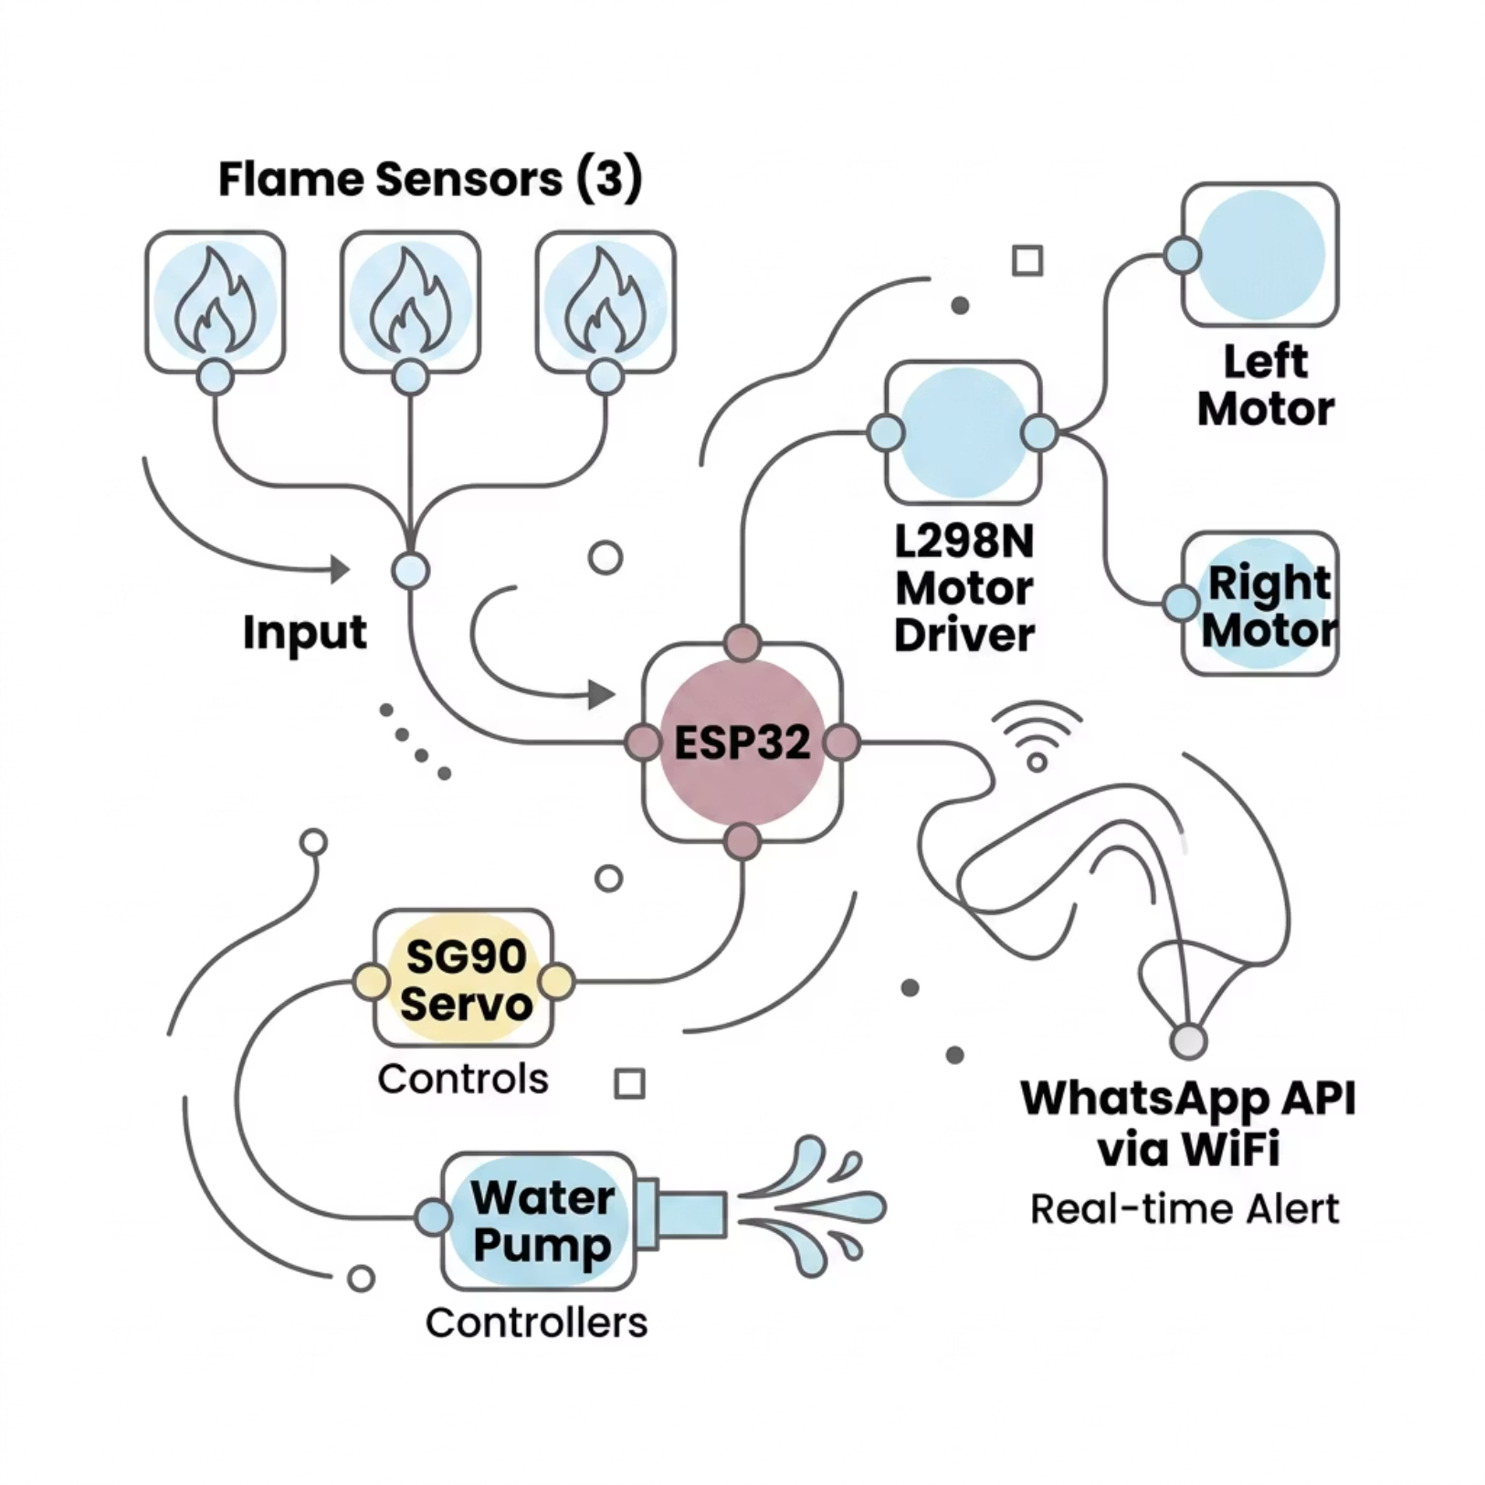


Block Diagram
Signal Flow Summary
Sensors → ESP32: Analog flame intensity values read on GPIO pins
ESP32 → L298N: PWM signals control motor speed and direction
ESP32 → Servo: PWM positions nozzle at fire source
ESP32 → Relay: Digital HIGH triggers the water pump
ESP32 → WiFi: HTTP GET request to CallMeBot WhatsApp API
All control logic runs on ESP32's core 0 while WiFi communication uses core 1 for non-blocking operation.

Slide 7
Working Principle
Flame Detection
1
Left, centre, and right sensors output analog values. Lower value = stronger flame signal in that direction.
2
Direction Logic
ESP32 compares sensor readings. Steers left, right, or straight based on which sensor registers the minimum value.
Fire Suppression
3
When centre sensor crosses the fire threshold, the relay activates the pump and servo sweeps to spread water.
4
Alert Dispatch
Simultaneously, ESP32 sends an HTTP request to the WhatsApp API — notifying the operator instantly over WiFi.
The robot continuously loops through this pipeline — stopping all actuators once all three sensors read above the safe threshold, confirming fire extinction.

Slide 8





Algorithm / Flowchart
Code Structure Highlights
01
Sensor Reading
Activate Response
analogRead() on GPIO 34, 35, 32 — sampled every 100 ms loop cycle
Move, pump, alert
02
Fire Detected?
Motor Control
Threshold comparison
digitalWrite() on IN1–IN4 pins of L298N; PWM via ledcWrite() for speed
Read Flame Sensors
03
analogRead on GPIOs
Fire Logic
Start
Threshold comparison (sensorVal < FIRE_THRESHOLD) triggers action
Initialize sensors and loop
04
WhatsApp Alert
HTTPClient sends GET request to CallMeBot API with encoded message

Slide 9

Results
<2s
Detection Time
Flame detected and response initiated within 2 seconds of exposure
~1m
Effective Range
Flame sensor reliably detects fire up to 1 metre in open conditions
360°
Servo Sweep
Servo rotates nozzle across full arc for maximum water coverage
5s
Alert Latency
WhatsApp notification delivered within 5 seconds on a stable network

Slide 10



Advantages, Limitations & Future Scope
Advantages & Applications
Limitations
Limited water tank capacity — suitable for small fires only
Battery life restricts continuous operation time
Performance degrades in complex terrain or poor WiFi coverage
Human Safety
Wide Applications
Future Scope
Eliminates need for manual intervention in dangerous environments
Homes, warehouses, industrial plants, small-scale forest monitoring
Integrate ESP32-CAM for real-time visual feedback
Add ML-based fire classification for improved accuracy
Replace WiFi with GSM (SIM800L) for network-independent alerts
Multi-robot coordination for large-scale environments
Low Cost
Built under ₹3,000 using off-the-shelf components

