Slide 1

RECOGNITION OF HERBAL FLORA
MANAKULA VINAYAGAR INSTITUTE OF TECHNOLOGY
Kalitheerthalkuppam Madagadipet, Puducherry – 605 107
Under the Guidance of
Mr.R.Raj Bharath
Asst.Prof.Dept of CSE
Presented by
Thirumurugan C
Vimalraji K
(II Year)

Slide 2
Project analysis slide 2
Agenda
ABOUT DOMAIN
ABSTRACT
PROJECT
PROBLEM STATEMENT
PROTOTYPE
LANGUAGE/TOOLS
REFERENCE

Slide 3
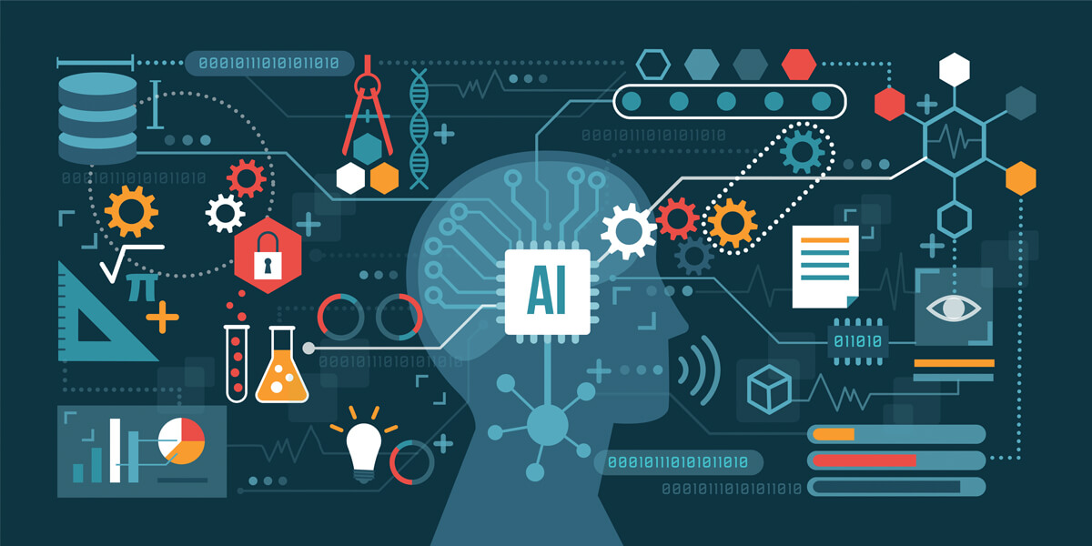
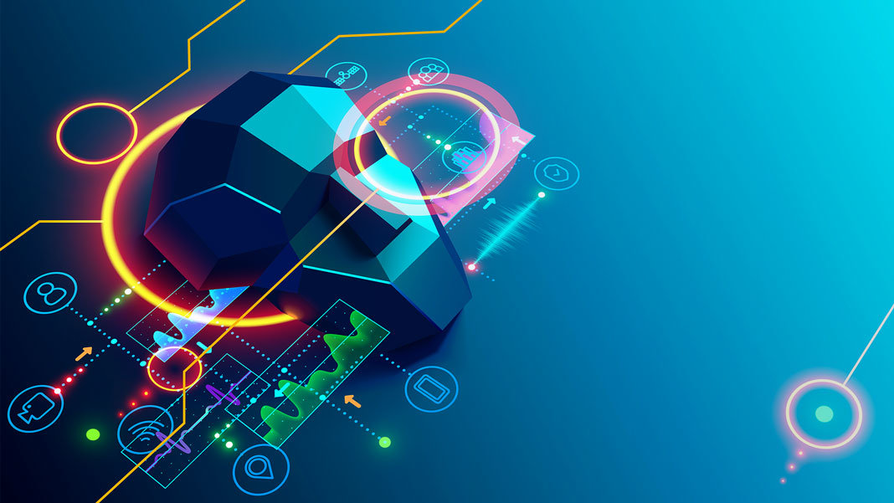
Project analysis slide 6
About Domain
Domain Name: Artificial Intelligence
Deep Learning is a sub category of AI, In our project we were going to use it for recognizing the herbal species.

Slide 4
Project analysis slide 6
Abstract
This is the Android app where the herbal plant species are recognized. If the particular herb is quite healthy, the user receives its name and its benefits. If the particular herb is unhealthy, the user receives its name, symptoms besides to the disease that the particular herbal plant species affected, and it shows the way to rectify the disease. This recognition of plants is done by clicking the particular herb species. This application software is designed by flutter and dart programming for Android development and python programming for deep learning under Artificial Intelligence for recognizing the herbal species

Slide 5
Project analysis slide 6
Problem Statement
To Know the Medicinal use of the Plants and Disease of the Plants:
We can know the medicinal uses of the plants and we were able to know for what disease it has to be used
We can also know if the plant is not good or not if it is affected by some disease then our app will give remedies to cure the plant from the disease
So that our App will give certain knowledge for the young farmers, gardeners and for common peoples

Slide 6
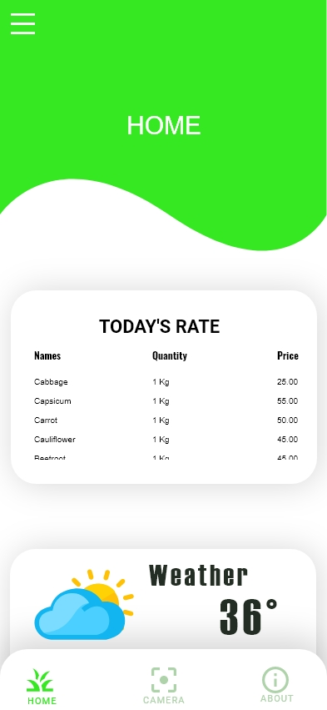
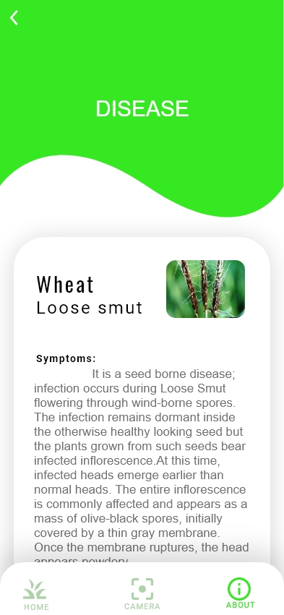
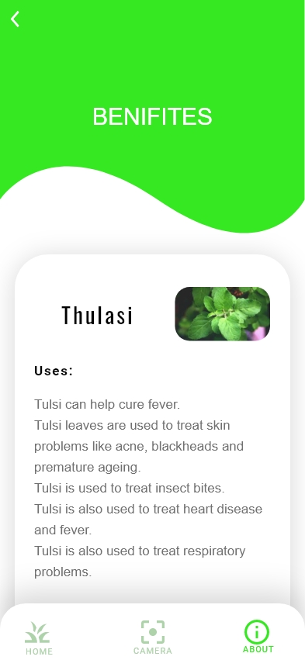

Project analysis slide 6
Prototype

Slide 7






Project analysis slide 6
Language/Tools
Languages : Flutter, Dart and Python
Software : Vs Code or Android Studio IntelliJ
Other Tools : Firebase

Slide 8



Project analysis slide 6
Reference
Dart : https://dart.dev/guides
Flutter : https://flutter.dev/docs
Python : https://www.python.org/doc/
Firebase: https://firebase.google.com/docs
Deep Learning: https://stackoverflow.com/, https://www.geeksforgeeks.org/,
https://towardsdatascience.com/, https://github.com ,

Slide 9
Thank You

