Slide 1
AWS EC2
Purusothaman S

Slide 2
Amazon EC2
• EC2 is one of the most popular of AWS’ offering
• EC2 = Elastic Compute Cloud = Infrastructure as a Service
• It mainly consists in the capability of :
• Renting virtual machines (EC2)
• Storing data on virtual drives (EBS)
• Distributing load across machines (ELB)
• Scaling the services using an auto-scaling group (ASG)
• Knowing EC2 is fundamental to understand how the Cloud works

Slide 3
EC2 sizing & configuration options
Operating System (OS): Linux, Windows or Mac OS
• How much compute power & cores (CPU)
• How much random-access memory (RAM)
• How much storage space:
• Network-attached (EBS & EFS)
• hardware (EC2 Instance Store)
• Network card: speed of the card, Public IP address
• Firewall rules: security group
• Bootstrap script (configure at first launch): EC2 User Data

Slide 4
EC2 User Data
It is possible to bootstrap our instances using an EC2 User data script.
• bootstrapping means launching commands when a machine starts
• That script is only run once at the instance first start
• EC2 user data is used to automate boot tasks such as:
• Installing updates
• Installing software
• Downloading common files from the internet
• Anything you can think of
• The EC2 User Data Script runs with the root user

Slide 5
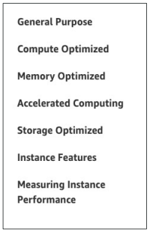
EC2 Instance Types - Overview
• You can use different types of EC2 instances that are optimised for different use cases (https://aws.amazon.com/ec2/instance-types/)
• AWS has the following naming convention:
m5.2xlarge
m: instance class
5: generation (AWS improves them over time)
2x: size within the instance class

Slide 6
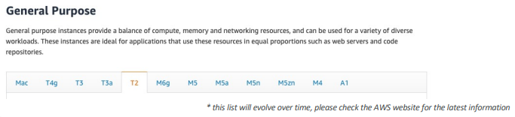
EC2 Instance Types – General Purpose
• Great for a diversity of workloads such as web servers or code repositories
• Balance between:
• Compute
• Memory
• Networking
• In the course, we will be using the t2.micro which is a General Purpose EC2 instance

Slide 7
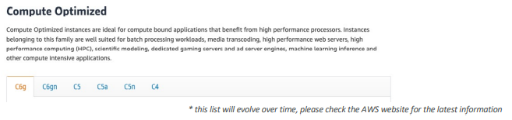
EC2 Instance Types – Compute Optimized
• Great for compute-intensive tasks that require high performance processors:
• Batch processing workloads
• Media transcoding
• High performance web servers
• High performance computing (HPC)
• Scientific modeling & machine learning
• Dedicated gaming servers

Slide 8
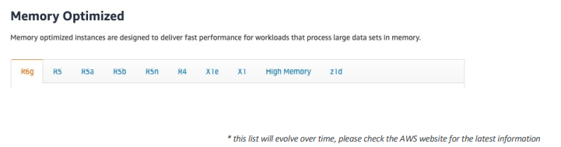
EC2 Instance Types – Memory Optimized
• Fast performance for workloads that process large data sets in memory
• Use cases:
• High performance, relational/non-relational databases
• Distributed web scale cache stores
• In-memory databases optimized for BI (business intelligence)
• Applications performing real-time processing of big unstructured data

Slide 9
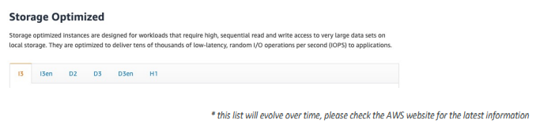
EC2 Instance Types – Storage Optimized
• Great for storage-intensive tasks that require high, sequential read and write access to large data sets on local storage
• Use cases:
• High frequency online transaction processing (OLTP) systems
• Relational & NoSQL databases
• Cache for in-memory databases (for example, Redis)
• Data warehousing applications
• Distributed file systems

Slide 10
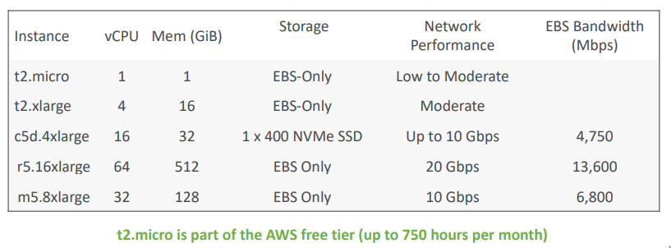
EC2 Instance Types: example
Great website: https://instances.vantage.s

Slide 11
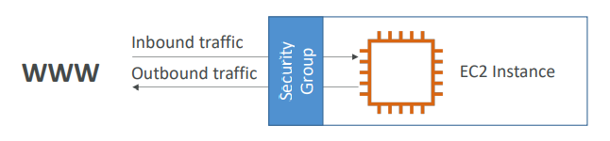
Introduction to Security Groups
• Security Groups are the fundamental of network security in AWS
• They control how traffic is allowed into or out of our EC2 Instances.
• Security groups only contain allow rules
• Security groups rules can reference by IP or by security group

Slide 12
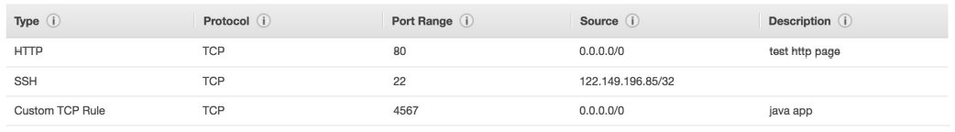
Security Groups Deeper Dive
• Security groups are acting as a “firewall” on EC2 instances
• They regulate:
• Access to Ports
• Authorised IP ranges – IPv4 and IPv6
• Control of inbound network (from other to the instance)
• Control of outbound network (from the instance to other

Slide 13
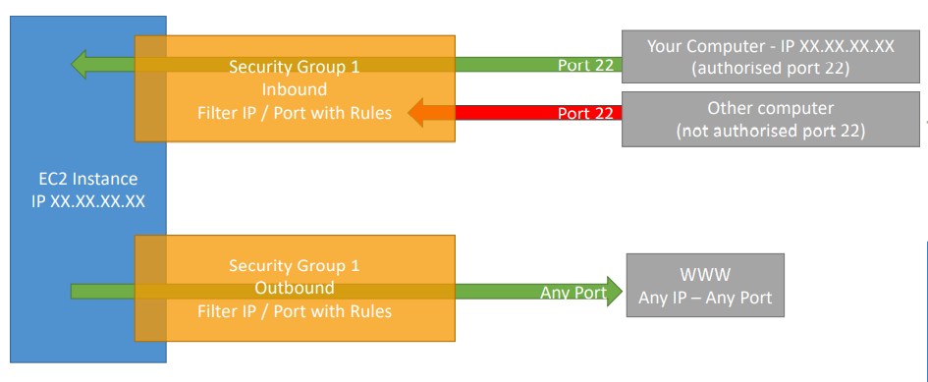
Security Groups Diagram

Slide 14
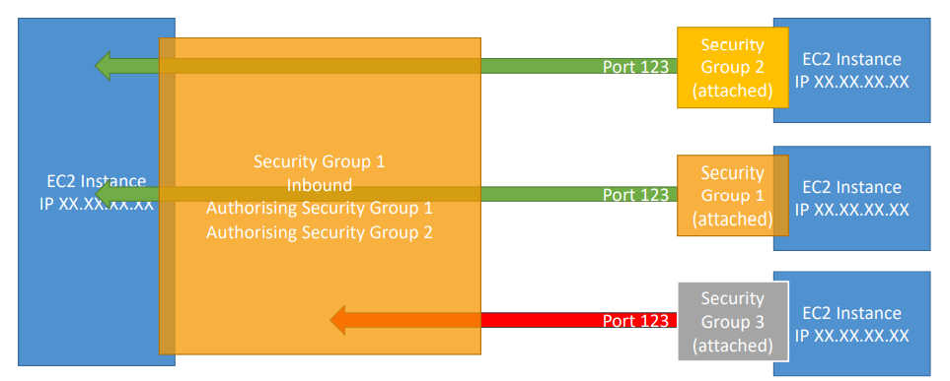
Referencing other security groups Diagram

Slide 15
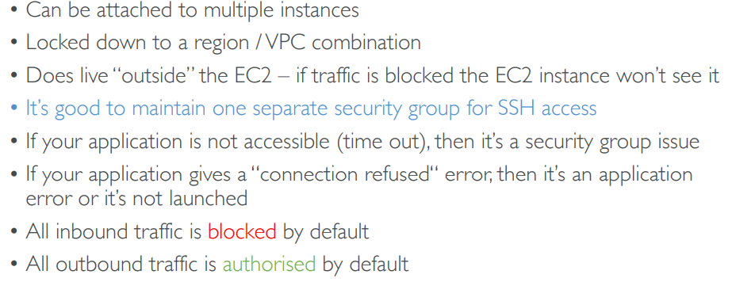
Security Groups Good to know

Slide 16
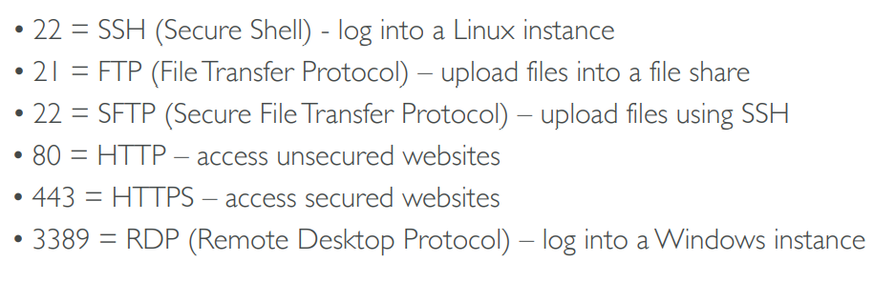
Classic Ports to know

Slide 17
EC2 Instances Purchasing Options
• On-Demand Instances: short workload, predictable pricing
• Reserved: (MINIMUM 1 year)
• Reserved Instances: long workloads
• Convertible Reserved Instances: long workloads with flexible instances
• Scheduled Reserved Instances: example – every Thursday between 3 and 6 pm
• Spot Instances: short workloads, cheap, can lose instances (less reliable)
• Dedicated Hosts: book an entire physical server, control instance placement
• Dedicated Instances: no other customers will share your hardware

Slide 18
EC2 On Demand
• Pay for what you use:
• Linux or Windows - billing per second, after the first minute
• All other operating systems - billing per hour
• Has the highest cost but no upfront payment
• No long-term commitment
• Recommended for short-term and un-interrupted workloads, where you can't predict how the application will behave

Slide 19
EC2 Reserved Instances
• Up to 72% discount compared to On-demand
• Reservation period: 1 year = + discount | 3 years = +++ discount
• Purchasing options: no upfront | partial upfront = + | All upfront = ++ discount
• Reserve a specific instance type
• Recommended for steady-state usage applications (think database)
Convertible Reserved Instance
• can change the EC2 instance type
• Up to 66% discount
Scheduled Reserved Instances
• launch within time window you reserve . • When you require a fraction of day / week / month

Slide 20
EC2 Spot Instances
• Can get a discount of up to 90% compared to On-demand
• Instances that you can “lose” at any point of time if your max price is less than the current spot price
• The MOST cost-efficient instances in AWS
• Useful for workloads that are resilient to failure
• Batch jobs
• Data analysis
• Image processing
• Any distributed workloads
• Workloads with a flexible start and end time
• Not suitable for critical jobs or databases

Slide 21
EC2 Dedicated Hosts
• An Amazon EC2 Dedicated Host is a physical server with EC2 instance capacity fully dedicated to your use. Dedicated Hosts can help you address compliance requirements and reduce costs by allowing you to use your existing server-bound software licenses.
• Allocated for your account for a 3-year period reservation
• More expensive
• Useful for software that have complicated licensing model (BYOL – Bring Your Own License)
• Or for companies that have strong regulatory or compliance needs

Slide 22
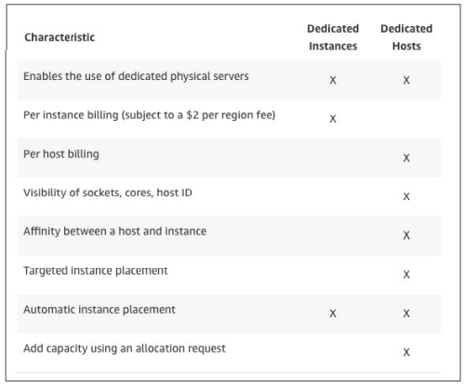
EC2 Dedicated Instances
• Instances running on hardware that’s dedicated to you
• May share hardware with other instances in same account
• No control over instance placement (can move hardware after Stop / Start)

Slide 23
EC2 Spot Instance Requests
• Can get a discount of up to 90% compared to On-demand
• Define max spot price and get the instance while current spot price < max
• The hourly spot price varies based on offer and capacity
• If the current spot price > your max price you can choose to stop or terminate your instance with a 2 minutes grace period.
• Other strategy: Spot Block
• “block” spot instance during a specified time frame (1 to 6 hours) without interruptions
• In rare situations, the instance may be reclaimed
• Used for batch jobs, data analysis, or workloads that are resilient to failures.
• Not great for critical jobs or databases

Slide 24

Which purchasing option is right for me?
• On demand: coming and staying in resort whenever we like, we pay the full price
• Reserved: like planning ahead and if we plan to stay for a long time, we may get a good discount.
• Spot instances: the hotel allows people to bid for the empty rooms and the highest bidder keeps the rooms. You can get kicked out at any time
• Dedicated Hosts: We book an entire building of the resort

