Slide 1


Fundamentals of Machine Learning
PREDICTIONS OF TESLA STOCK PRICE BASED ON LINEAR REGRESSION,SVM,RANDOM FOREST,LSTM AND ARIMA
Team Members:
1. SATHISH KUMAR R (210701515)
2. THIRUESWARAN V (210701290)
PROJECT CO-ORDINATOR:
V Karthick
Associate Professor
Department of CSE
Rajalakshmi Engineering college

Slide 2
AGENDA
ABSTRACT
INTRODUCTION
LITERATURE SURVEY
EXISTING SYSTEM
PROPOSED SYSTEM
PROPOSED METHODOLOGY
RESULTS AND DISCUSSION
OUTPUT
CONCLUSION AND FUTURE ENHANCEMENTS
REFERENCES

Slide 3
ABSTRACT
The stock market of a country is an important financial market. A booming stock market promotes the effective use of social capital, the prudent deployment of economic resources, and the expansion of the country's macroeconomics. Making more informed decisions as an investor is made possible by the development of trustworthy equity market models. A trading model allows market participants to select corporations that pay the highest dividend payments while lowering the risks associated with investing. However, batch processing methodologies make stock market research more challenging as a result of the strong connection between stock prices. The advent of technological achievements like universal digitization has elevated share market forecasting into a highly advanced age. Through the research and comparison of several methodologies, this article tries to discover the most accurate approach for predicting Tesla stock closing prices. Predictions are made using statistical approaches such as ARIMA and machine learning methods such as SVM , Linear Regression, Random Forests, and LSTM. Following a thorough examination of all approaches, it was discovered that the accuracy of machine learning methods in predicting stocks is higher than that of statistical methods and integrated algorithm technologies like Random Forest have excellent anti-interference and anti-overfitting characteristics, which are more suitable for evaluating highvolatility stocks like Tesla.
Keywords: Tesla; stock market; machine learning; future price prediction.

Slide 4
INTRODUCTION
The stock market is a group of stockbrokers and dealers who buy and trade stock shares. A stock exchange is where many large firms' shares are traded. This improves the stock's liquidity, making it more enticing to investors [1]. A vast number of investors put large sums of money into the stock market. However, it is risky since stock values may quickly rise or decrease [2]. Because of this, forecasting stock prices is a difficult subject on which many scholars are working.
To predict stock prices, a variety of approaches have been utilized. Because statistical methodologies are linear in nature, they perform poorly in the event of a rapid spike or decrease in stock prices. Because stock data is unpredictable, volatile, non-stationary, and dependent on a variety of technical characteristics, statistical techniques have been proven to be insufficiently accurate [3].
The open stock exchange trades stocks of publicly listed companies, whereas the private share exchange trades stocks of privately held businesses. Investments made through the mixed-ownership share trade are made in companies with ordinary shares that may only be exchanged publicly on rare occasions. Several countries, like the UK's London Stock Exchange and the US's New York Stock Exchange, have stock exchanges with mixed ownership [4-9].
Thus, all previous work has been centered on reducing some metric that leads to estimates near the true stock price. However, this does not indicate that these forecasts will be profitable.
The experiment first collects data from Kaggle. Reprocess the data to remove any null values in the time series. And transform and normalize the data to make it compatible with the input of the model. Then use Matlab to implement the Linear Regression model [10], SVM model [11, 12], Random Forest model [13, 14], LSTM model [15], and ARIMA model [16, 17]. Finally, compare the performance of different models and propose further work and project expansion.

Slide 5
LITERATURE SURVEY
SI.NO | NAME OF THE PAPER | AUTHOR | YEAR
1. | Deep Learning for Tesla’s Stock Prices Prediction | A. P. Kaul, V. Sharma, and N. Sharma | 2023
2. | An Analysis on Tesla’s Stock Price Forecasting Using ARIMA Model | S. Kumar, R. Jain | 2022
3. | Stock Prices Prediction Using Machine Learning. | S. Patel, M. Shah | 2021
4. | Tesla Stock Price Prediction using Machine Learning | A. Khlement | 2022
5. | A Fuzzy Multi-Criteria Evaluation System for Share Price Prediction: A Case Study of Tesla Inc. | R.Debnath, P. Srivastava | 2020

Slide 6
LITERATURE SURVEY
SI.NO | NAME OF THE PAPER | AUTHOR | YEAR
6. | Predictions of Tesla Stock Price Based on Machine Learning Model | N. M. Polanki, R. D. Kusuma, S. K. Basha, et al. | 2023
7. | Forecasting Tesla’s Stock Price Using Autoregression | B. Van Oost | 2020
8. | Tesla Stock Price Timeseries Analysis and Forecasting | J. Lee, H. Kim | 2022
9. | Comparative Study of Machine Learning Models for Stock Price Prediction | T. Zhang, A. Brown | 2022
10. | Stock Price Prediction using Machine Learning and Deep Learning | M. Tiwari, P. S. Chauhan | 2021

Slide 7
EXISTING SYSTEM
The existing system for predicting Tesla's stock price typically involves a combination of quantitative and qualitative methods. Quantitative approaches include statistical models and machine learning techniques that analyze historical price data, trading volumes, financial indicators, and macroeconomic variables. Common models used are time series analysis (like ARIMA), regression models, and more advanced neural networks such as Long Short-Term Memory (LSTM) networks and Convolutional Neural Networks (CNNs). These models can identify patterns and trends that might not be immediately obvious to human analysts.Integrating these approaches, sophisticated trading algorithms and prediction systems continuously update their forecasts based on new data. These systems may also factor in real-time events such as earnings reports, product launches, regulatory changes, and broader market movements. The goal is to create a dynamic and adaptive model that can provide accurate and timely predictions to inform investment strategies.

Slide 8
PROPOSED SYSTEM
The prediction of Tesla's stock price by including a variety of machine learning and statistical models offer an alluring avenue for in-depth investigation. To predict when Tesla's stock will rise price with accuracy and dependability, the suggested work intends to take advantage of the advantages of Linear Regression, Support Vector Machines (SVM), Random Forest, Long Short-Term Memory (LSTM) networks, and Autoregressive Integrated Moving Average (ARIMA) models.To guarantee data quality and consistency, the dataset containing past Tesla stock prices and pertinent predictors will first be gathered and preprocessed. Features engineering techniqes will be utilised to extract helpful featurs, which capture the basic mechanics of the changes in Tesla's stock price. For the purpose of preparing the data inputs for further modeling, this preprocessing phase is essential,with each of the selected algorithms.

Slide 9
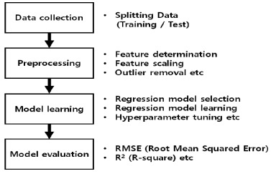
PROPOSED METHODOLOGY

Slide 10
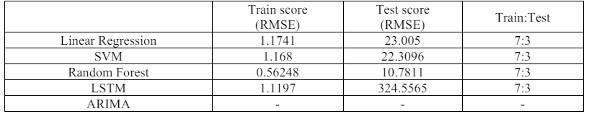
RESULTS AND DISCUSSIONS
The stock values of the firm Tesla Inc. are listed in the research's data. On June 29, 2010, Tesla began trading publicly. The business has raised US $226 million through its IPO. The original share price of the stock was $17.00 USD. In the eleven years since the stock became public, it has grown by over 4144%, and it is currently listed at roughly US$ 721 per share.

Slide 11

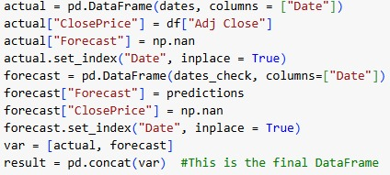

RESULTS AND DISCUSSION
The NASDAQ index lists Tesla's shares. Elon Musk, the richest man in the world at the time of its founding, has served as its CEO and has overseen operations in several nations. Since becoming the company's CEO in 2008, Musk has consistently surpassed expectations and overcome obstacles. The LSTM, SVM, Random Forest, and Linear Regression models' training outcomes are shown in Tables 1, 4, 7, and 10. The results show how reliable and strong the deep learning model is at predicting the current value based on the training data. Low forecast error rates are observed in Random Forest, as measured by the RMSE (0.56248).

Slide 12
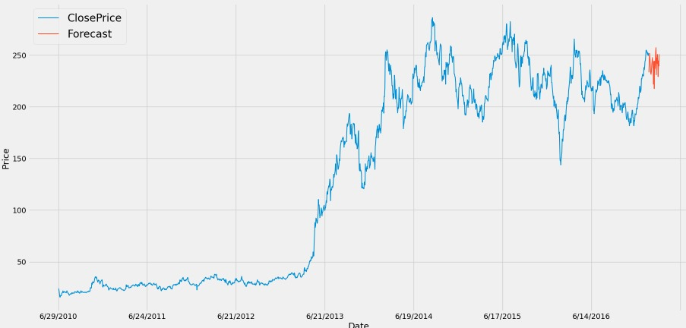
OUTPUT
The Tesla stock price prediction output is generated using a combination of historical data analysis, machine learning models, and sentiment analysis to forecast future price movements.

Slide 13
COMPARATIVE ANALYSIS
By using techniques such as Linear regression, Random Forest, and SVM algorithm, we can analyze the location of the Market, store type and predict future sales. From the proposed approach it was found that for the model evaluation SVM algorithm is more accurate than other models and gives the predicted outcomes.
ALGORITHM USED | EXISTING MODEL | PROPOSED MODEL
Linear Regression | 49.2 | 49.72
Random Forest Algorithm | 60.8 | 60
SVM algorithm | - | 81.71

Slide 14
CONCLUSION
To predict the Tesla share's closing price, this paper employed five different algorithms, including statistical and deep learning methods. It can be seen that the Random Forest prediction algorithm has the greatest forecast accuracy for the Tesla stock among machine learning algorithms. Because it's possible that changes in the share market don't often adhere to a recognizable pattern or a constant cycle. The existence and longevity of trends will differ based on the organizations and industries. Investment results will increase with an awareness of these cycles and trends. We shoulduse an integrated algorithm technique like Random Forest, which has excellent anti-interference and anti-over-fitting characteristics, to assess highly volatile equities like Tesla. Deep learning models that include news stories about the economy and monetary factors like income statements, trade volume, etc. can be constructed for future work to produce potentially better outcomes.

Slide 15
FUTURE ENHANCEMENT
The stock values of the firm Tesla Inc. are listed in the research's data. On June 29, 2010, Tesla began trading publicly. The NASDAQ index lists Tesla's shares. Elon Musk, the richest man in the world at the time of its founding, has served as its CEO and has overseen operations in several nations. This is demonstrated by the fact that there isn't a big discrepancy between the actual and anticipated figures. Because the Rsquare values of Linear Regression, SVM, and Random Forest are all quite high, and the RMSE values are all very low, they were ready to be tested throughout the training period. These figures demonstrate how the system is capable of achieving the set objectives Investors may trade their personal equities on the stock market with other traders using stock brokerages and computerized trading platforms. Traders try to acquire stocks with rising prices and sell stocks with dropping prices on the share market. Because of its potential advantages, it could make it possible to foresee the future with credibility, which is something that most economies and people have long wished for. Understanding how to predict price fluctuations may be helpful for forecasting stock market enthusiasts.

Slide 16
REFERENCES
[1] Dhankar R S. Stock Market Operations and Long-Run Reversal Effect in Capital Markets and Investment Decision Making India. Springer, 2019.
[2] Usmani M, et al. Ali Stock market prediction using machine learning techniques. 2016 3rd International Conference on Computer and Information Sciences (ICCOINS), 2016, 322 - 327.
[3] Grigoryan H. A stock market prediction method based on support vector machines (svm) and independent component analysis (ica). Database Systems Journal, 2016, 7 (1): 12 - 21.
[4] Nti I K, Adekoya A F, Weyori B A. A systematic review of fundamental and technical analysis of stock market predictions. Artif. Intell. Rev, 2019, 53: 3007 – 3057.
[5] Sengupta A, Sena V. Impact of open innovation on industries and firms—A dynamic complex systems view. Technol. Forecast. Soc, 2020, 159: 120199.
[6] Terwiesch C, Xu Y. Innovation Contests, Open Innovation, and Multiagent Problem Solving. Manag. Sci, 2008, 54: 1529 – 1543.
[7] Blohm I, et al. Idea evaluation mechanisms for collective intelligence in open innovation communities: Do traders outperform raters? In Proceedings of the 32nd International Conference on Information Systems, Cavtat, Croatia, 2010, 21 – 24.
[8] Del Giudice, et al. The human dimension of open innovation. Manag. Decis, 2018, 56: 1159 – 1166. [9] Daradkeh M. The Influence of Sentiment Orientation in Open Innovation Communities: Empirical Evidence from a Business Analytics Community. J. Inf. Knowl. Manag, 2021, 20: 2150031.

Slide 17
REFERENCES
[10] Seber G A F, Lee A J. Linear regression analysis. John Wiley & Sons, 2012, 329.
[11] Sunil Ray. Svm | support vector machine algorithm in machine learning [internet]. Available from:https://www.analyticsvidhya.com/blog/2017/09/understaing-support-vector-machine-examplecode/. Google Scholar. 2017.
[12] Henrique B M, Sobreiro V A, Kimura H. Stock price prediction using support vector regression on daily and up to the minute prices. J. Financ. Data Sci., 2018, 4 (3): 183 - 201.
[13] Liaw Andy, Matthew Wiener. Classification and regression by Random Forest. R news, 2002, 2 (3): 18 - 22.
[14] Kumar, Manish, Thenmozhi. Forecasting stock index movement: A comparison of support vector machines and random forest. In Indian institute of capital markets 9th capital markets conference paper, 2006.

Slide 18
THANK YOU

