Slide 1
Phishing Email Detection Using NLP & Machine Learning
A leakage-aware, recall-first comparison of four tuned classifiers on 82,486 real emails
The problem
82,486
emails in the raw corpus (52/48 balance)
Phishing is the most common way attacks enter an inbox, and nobody can review mail manually at scale. Given only an email's text, can a model catch the scams — and can we tell how much of its score is real signal versus dataset artefact?
4
models, tuned & compared under identical conditions
98.5%
of phishing caught by the best model (recall)
Thirugnanam V S · VIT Chennai · IICT Summer Internship on AI & ML, 2026 · Mentor: Dr. Ashok
Notes:
Good morning everyone. Project 2 of the IICT internship: detecting phishing emails from text alone. The question on the slide has two halves. The first is the obvious one — can a model catch scams. The second is the one this project takes seriously — how much of a high score is genuine phishing signal, and how much is the model recognising which archive an email came from. Three headline figures: about eighty-two thousand emails, four models required by the brief, all tuned and compared under identical conditions, and the winner catches 98.5 percent of phishing — recall is the metric I will keep coming back to, because a missed scam costs far more than a false alarm.

Slide 2
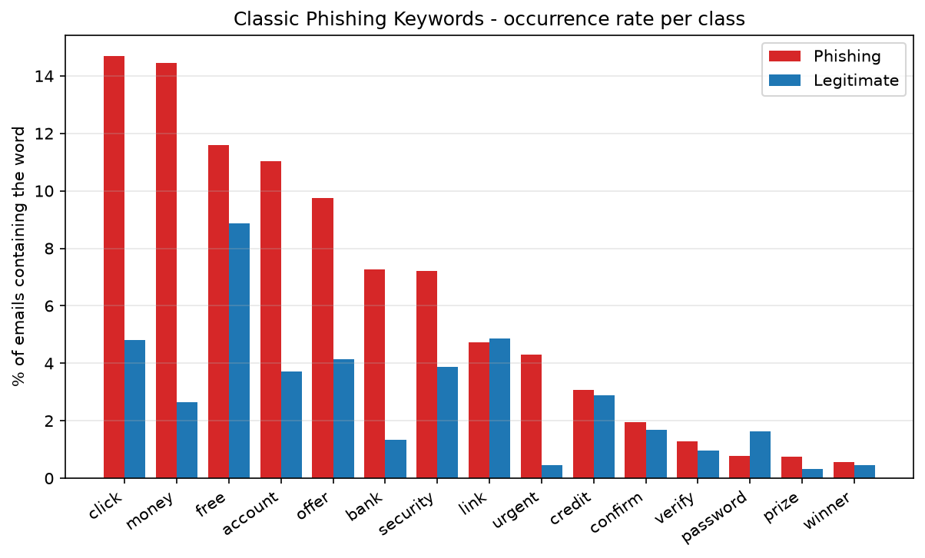
Dataset: 82k real emails, measured before trusted
1
Verified, not assumed
text arrives pre-normalised: 0.0% uppercase, 0.0% HTML — but 47.2% still carry URL tokens, so the pipeline still earns its place
2
Watermark measured & removed
'enron' in 18.2% of legitimate vs 0.0% of phishing → made a stop word
3
Outliers truncated first
longest email: 4,279,526 chars → capped at 20,000 (255 emails, 0.31%) before de-duplication
4
Clean corpus
15 classic scam words, fixed before looking at the data — all more frequent in phishing ('click': 14.7% vs 4.8%)
409 duplicates removed, 0 label conflicts → 82,075 emails (52.2% phishing)
Notes:
The corpus combines Enron-era business mail and mailing lists on the legitimate side with public scam archives on the phishing side — 52/48, so no resampling needed. The habit this project runs on: measure before you trust. The authors say the text is pre-normalised — I checked: zero percent uppercase, zero percent HTML, but nearly half the emails still carry URL tokens, so preprocessing still matters. The word 'enron' appears in eighteen percent of legitimate mail and zero percent of phishing — that is a label for where the ham was collected, not a scam signal, so it became a stop word. One subtle ordering bug worth mentioning: truncation runs before de-duplication, because two long emails that differ only beyond the cap become identical after it. And the chart: fifteen classic scam words chosen before looking at the data — every single one is more frequent in phishing, but none is universal, which is why we use five thousand word features, not a keyword rule.

Slide 3
Methodology: split first, measure every choice
1. Clean
2. Split
3. Vectorize
4. Tune & compare
truncate → dedupe → conflict check → normalise text ('enron' stop word)
stratified 80/20, seed 42 → 65,660 train / 16,415 test, 52.2% phishing both sides
fitted on training text only — 5,000 terms, no test-set statistics leak in
grid search where cheap; same features, test set and metrics for all four models
Representation decided by a pre-declared protocol
Representation | CV Accuracy | CV F1 (phishing) | Decision
CountVectorizer (5,000) | 0.9795 ± 0.0014 | 0.9805 ± 0.0013
TF-IDF (5,000) | 0.9792 ± 0.0010 | 0.9801 ± 0.0010 | SELECTED
Gap of 0.0003 — inside the 0.001 tie threshold declared before running. The tie rule picks TF-IDF (down-weights universal words; suggested by the brief). Same protocol chose CountVectorizer decisively in Project 1 — the default is not always the measured winner.
Notes:
One rule above all: split before fitting anything. The vectorizer only ever sees training text. For the representation I ran counts against TF-IDF with an identical logistic-regression probe under three-fold cross-validation — and got a statistical tie, a gap of three ten-thousandths, inside the tie threshold I declared before running the comparison. The pre-declared rule breaks ties toward TF-IDF, which down-weights near-universal words and is what the brief suggests. Why bother comparing at all, then? Because in Project 1 the identical protocol produced a decisive win for raw counts. Same method, different data, different answer — that is exactly the point of measuring instead of defaulting. The fourth card matters too: hyperparameters are grid-searched where the search is cheap and meaningful, and the scope of that search is written to a file rather than left implied.

Slide 4
Four models, tuned where it pays
Same cleaned data · same 5,000 TF-IDF features · same stratified split · same metrics (phishing class) · seed 42 everywhere
Logistic Regression
C grid-searched: 0.1 / 1 / 10 → 10
CV F1 0.9801 → 0.9827 after tuning
T
Multinomial Naive Bayes
alpha grid-searched: 0.1 / 0.5 / 1.0 → 0.1
beats the 1.0 default (CV F1 0.9605)
T
Random Forest
100 trees, fixed
forests are insensitive to more trees — budget went to grids that move the needle
F
MLP Neural Network
100 hidden units · Adam · early stopping
self-regularises by construction
F
T grid-search tuned (3-fold CV, training set only) F fixed with documented rationale — grids, candidates and winners saved to hyperparameter_tuning.csv
Notes:
The four models the brief requires, all on identical matrices and the identical test set — any difference comes from the algorithm, not the setup. The amber-T models are grid-search tuned: logistic regression's C, searched over point-one, one, and ten, landed on ten and lifted cross-validated F1 from 0.9801 to 0.9827. Naive Bayes's smoothing landed on point-one, beating the default. The navy-F models are fixed with the reasoning written down: forests barely change beyond a hundred trees, so the compute budget went where it moves the needle, and the early-stopped MLP regularises itself. Everything — grids, candidates, winners — is saved to a tuning CSV by the pipeline, so the scope of the search is visible rather than implied. All four trained models are saved with joblib.

Slide 5
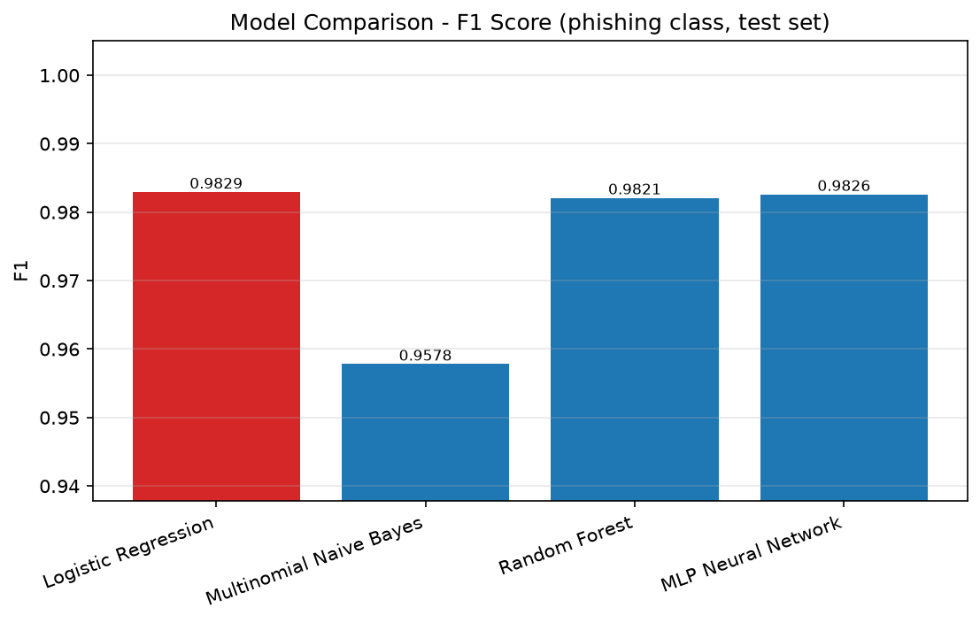
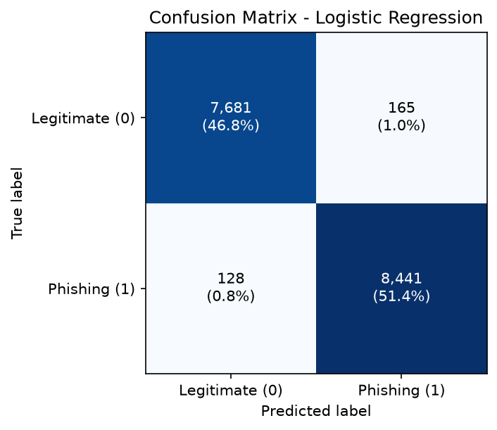
Results: linear wins, recall decides
Best model: Logistic Regression (C=10)
98.22% accuracy · F1 0.9829 · recall 0.9851 293 errors / 16,415 test emails — 165 false alarms, 128 missed phish (≈15 per 1,000) Top three within 0.0008 F1 · NB misses 498 phish (4× the winner) · 0.42 s vs MLP's 46.6 s training
Misses skew long: missed phishing averages 180 words vs 104 for phishing overall — short punchy scams are caught almost perfectly.
Notes:
Everything on one chart. Tuned logistic regression wins: 98.22 percent accuracy, F1 0.9829, and — the number I care most about — recall 0.9851. Out of sixteen and a half thousand test emails it makes 293 mistakes: 165 false alarms and 128 missed phish, roughly fifteen misses per thousand phishing emails. Three things to notice. The top three models sit within eight ten-thousandths of F1 — with vocabularies this disjoint the classes are nearly linearly separable, so the MLP's extra capacity re-draws the same boundary at a hundred times the training cost, and the forest trades recall for the best precision. Naive Bayes is the cautionary row: decent accuracy, but 498 missed phishing emails — four times the winner's — which is disqualifying in this domain. And the error pattern at the bottom: the misses skew towards long emails that blend business vocabulary; the short punchy scams are caught almost perfectly.

Slide 6
Conclusion
Measured, end to end
Future work
82,486 raw → 82,075 clean → tuned, saved model — one command, seed-reproducible
• Cross-archive evaluation
• Real URL & header features
• Calibrated probabilities
• Small transformer baseline
• Flask / Streamlit demo
Recall-first winner
Logistic Regression (C=10): 98.22% acc · F1 0.9829 · recall 0.9851 · 128 misses in 8,569
Tuning earned its keep
C=10 lifted CV F1 0.9801 → 0.9827; alpha=0.1 beat the NB default
The honest finding
top features include archive names — josemonkeyorg, spamassassin tokens, Enron first names — partly a phishing detector, partly an archive detector
Thank you — questions welcome. · Everything reproduces with python main.py (seed 42).
Notes:
To close: a pipeline where every decision has a measurement behind it — the pre-normalisation claim verified, the watermark quantified before removal, the representation chosen by a declared protocol, tuning scoped and recorded. Tuned logistic regression wins with the best F1 and the best recall — 128 misses out of eight and a half thousand phishing emails. The finding I would defend hardest is the last card. Reading the model's strongest weights: alongside genuine scam vocabulary like meds, replica and kindly, the single strongest phishing feature is josemonkeyorg — the hostname of a public phishing archive — and the legitimate side contains a SpamAssassin token and the first names of Enron executives. The model is partly a phishing detector and partly an archive detector. That is what near-perfect accuracy means on a combined corpus, and it is why cross-archive evaluation tops the future-work list. Thank you — happy to take questions.

