Slide 1
P&ID
C.R.Aadithya & Deepak.T

Slide 2
Scope of the project
To develop a solution in computer vision to detect the P&ID components from the given schematic diagram image files.
To annotate images with its respective class.
To extract the tag names associated with the components.
To create a master list (csv file) that contains all the components identified from the image.
Initially focussing on five components : Gate valve, Rotary valve, Flange, Diaphragm, Plug.

Slide 3
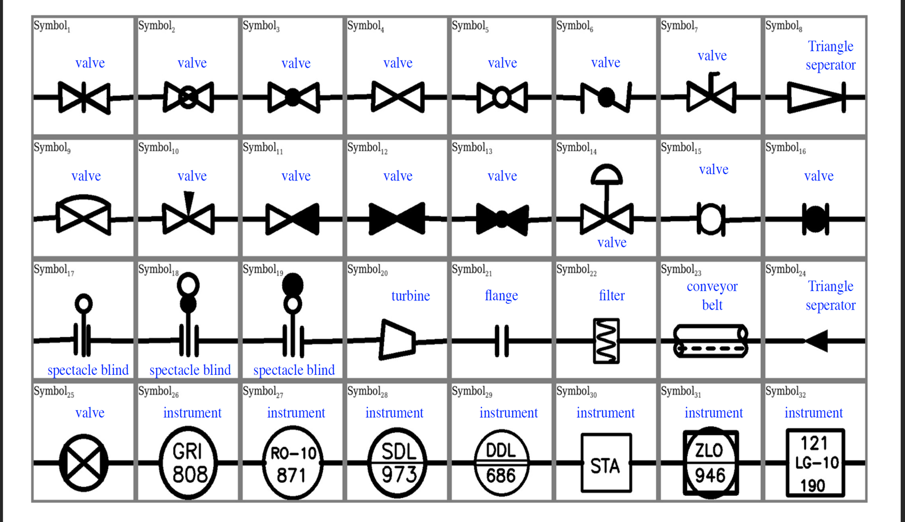
Dataset
Obtained 30000 images of schematic diagrams .
These 32 components are present in those images with various instances.
Link to dataset

Slide 4

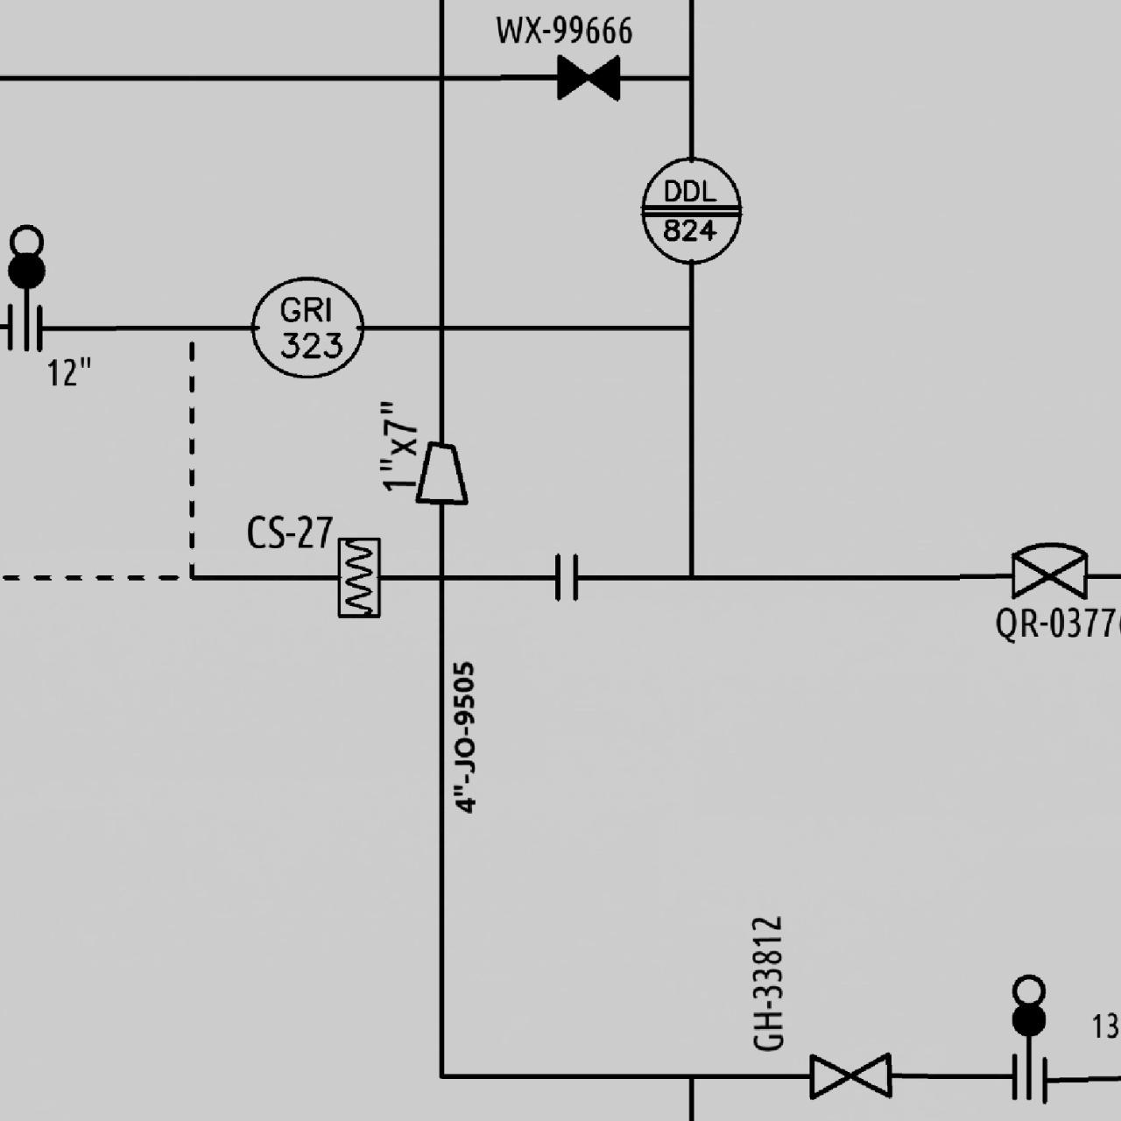

EDA
Good quality images.
Tag names for components are mentioned.
All images are of size – 640 x 640 pixels.

Slide 5
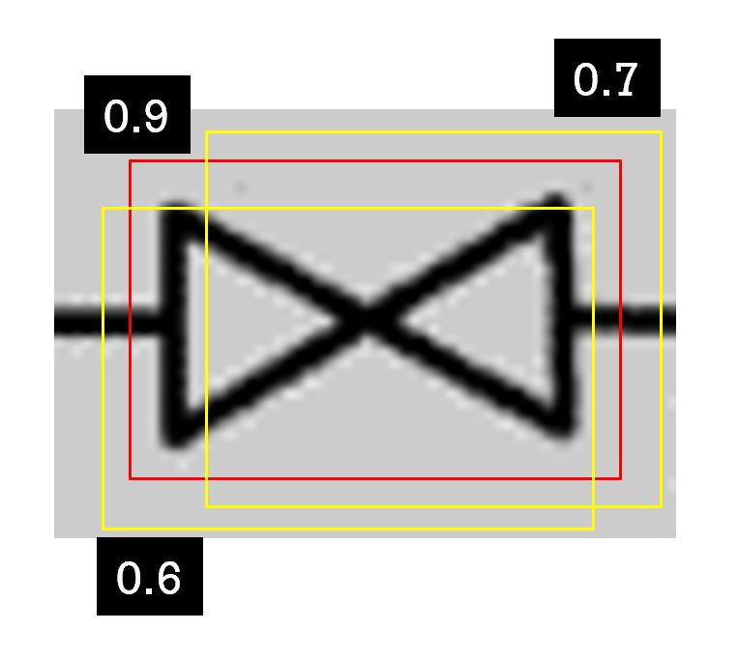
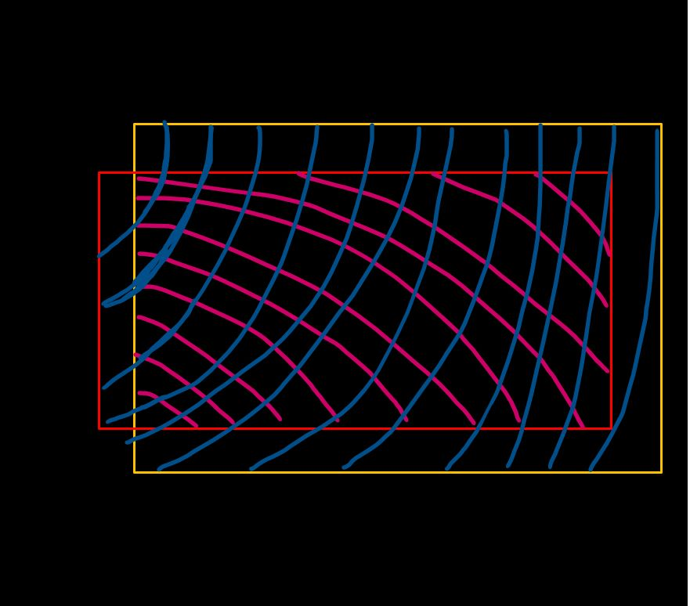
Model – Yolov8
YOLO (You Only Look Once) takes an input image and divides it into a grid, with each grid cell responsible for predicting bounding boxes and class probabilities.
For each grid cell, YOLO predicts multiple bounding boxes.
It selects the most confident bounding box based on the class probability and removes overlapping boxes that have high intersection over union (IOU) with the selected box.
We chose YOLOV8 because it was accurate, simple and faster than other models. It is the latest version of YOLO , being better than all its previous versions.
IOU= intersect area / union area

Slide 6
Initial - 30000 Schematic images
8222 schematic images taken
7509 individual images cropped out from it
8222 +7509= 15731 images
DATASET for Training 1
Flange : 2904
Plug : 1108 Diaphragm : 1163 Gate valve : 1174 Rotary valve : 1160

Slide 7
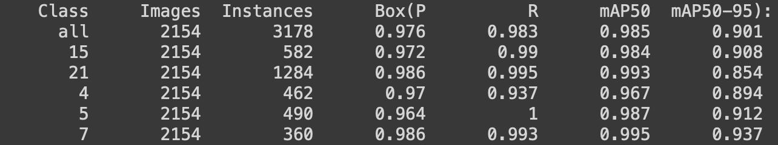
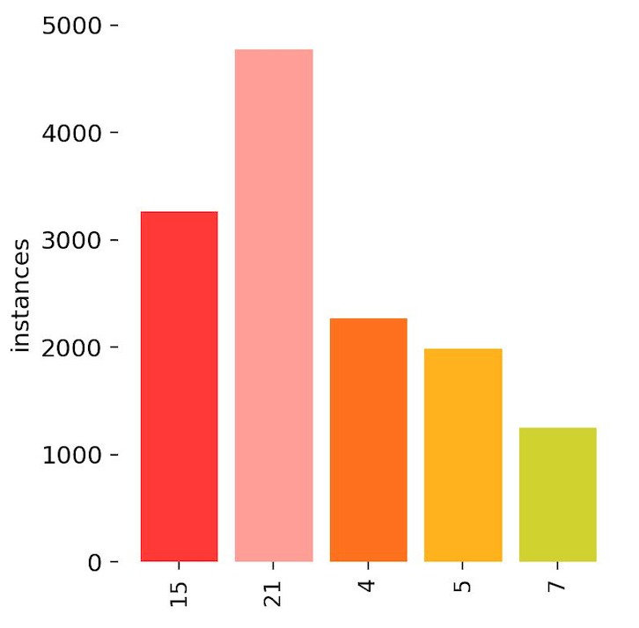
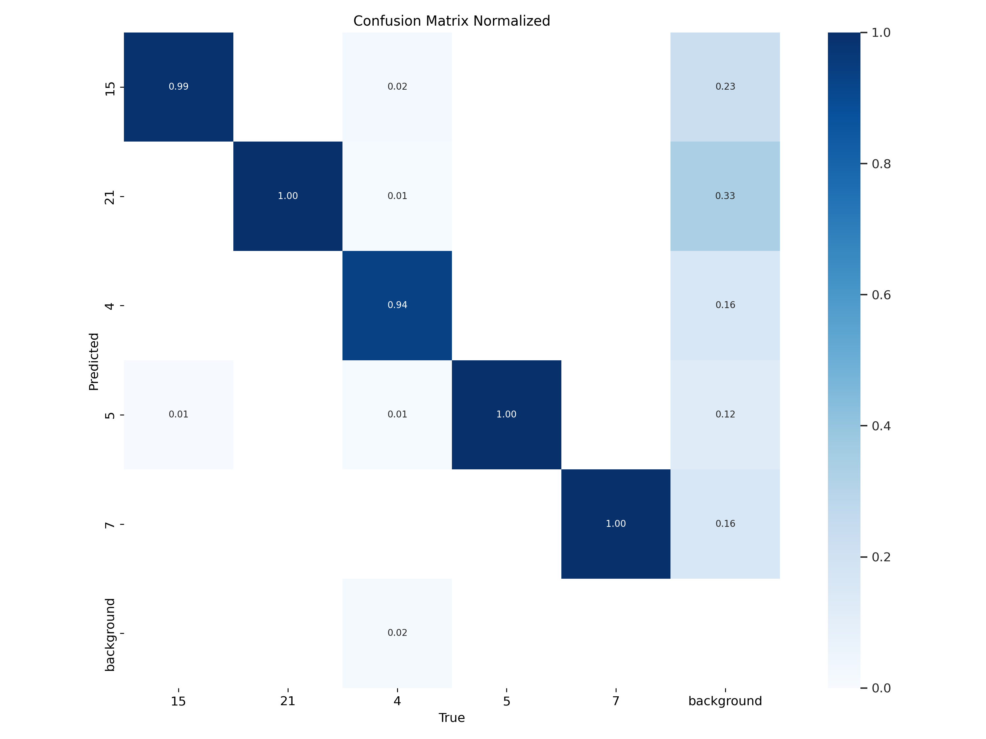
Training - 1
Flange
Ratio -
Train : Test: validation - 80 :10 :10
No augmentations applied.
Epoch - 20
Batch size - 8
R valve
G valve
Diaphragm
Plug

Slide 8
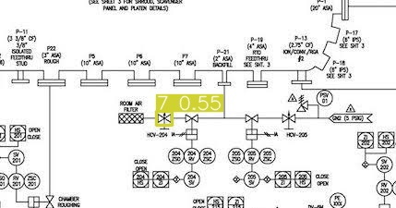
Challenges Faced
Some of the predictions were bad because of the individual images which were of bad quality.
When the input image was of bad quality, it wasn’t able to detect the components.
Model was not able to perform well when there were variations in the images. Augmentations were required.

Slide 9
Initial - 30000 Schematic images
16622 schematic images taken
Generated 43318 images with augmentations
DATASET
FOR
TRAINING 2

Slide 10

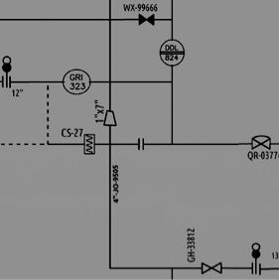

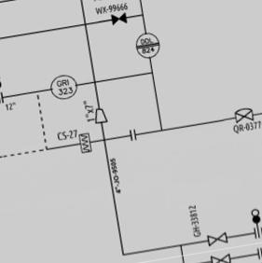
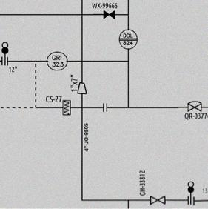
Augmentations
Rotation: Between -10° and +10°
- simulates variations in image orientations.
Brightness: Between -25% and +25%
- simulates variations in image lighting conditions.
Blur: Up to 2.5px
- simulates variations in image sharpness.
Bounding Box: Noise: Up to 5% of pixels
- simulates variations in accuracy and precision.
Brightness
Blur
Rotation
Noise

Slide 11
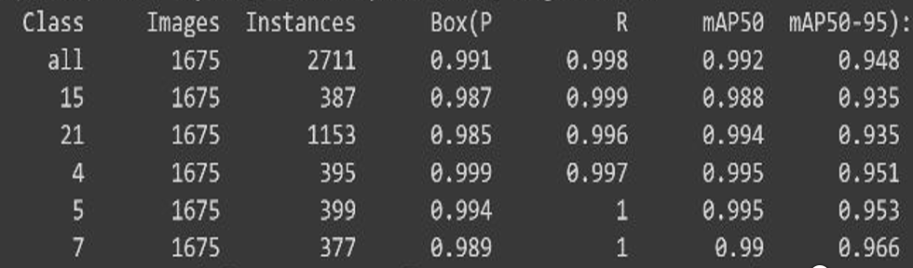
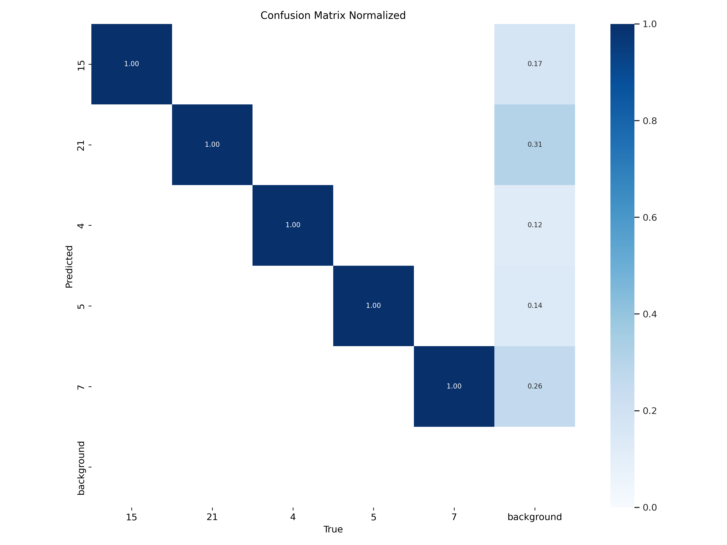
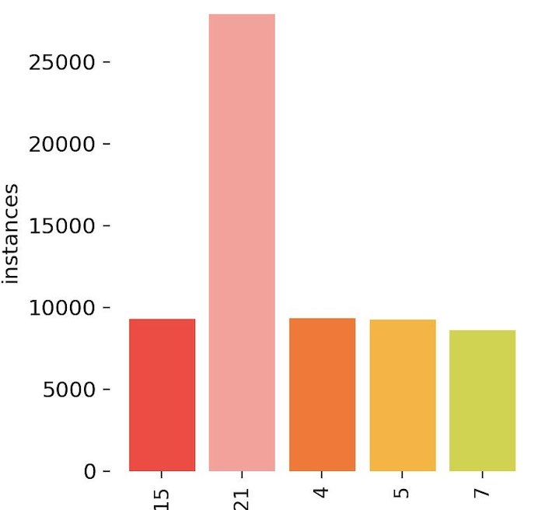
Training - 2
- Train : Test: validation (ratio) 80:10:10
- Epoch – 15 , batch size - 8
- Augmentations were applied
Flange
R valve
Diaphragm
G valve
Plug

Slide 12
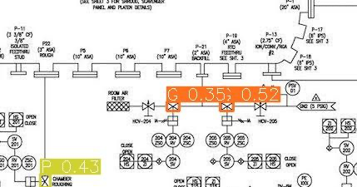
Post Augmentations

Slide 13
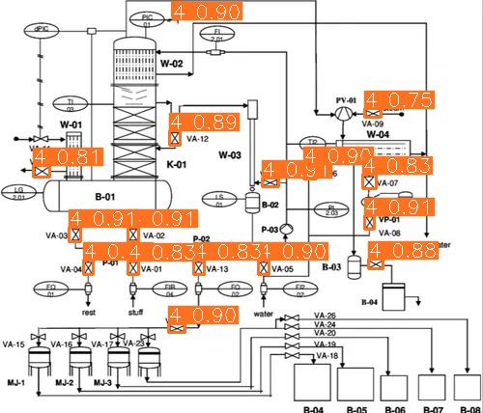
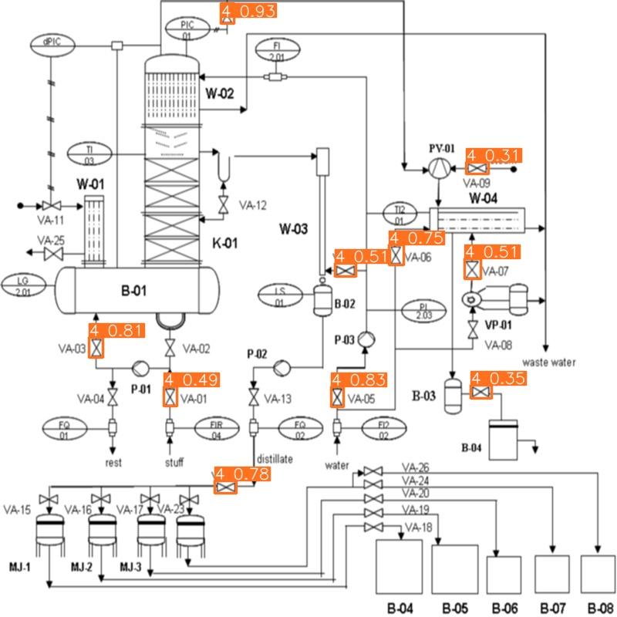
Steps to improve accuracy
Since P&ID components are small , we used the SAHI library .
The concept of sliced inference is basically; performing inference over smaller slices of the original image and then merging the sliced predictions on the original image.
The model detected more no. of components with a better confidence score
Before SAHI
After SAHI

Slide 14
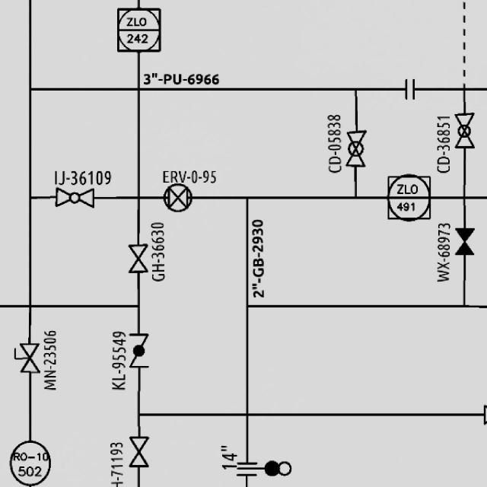
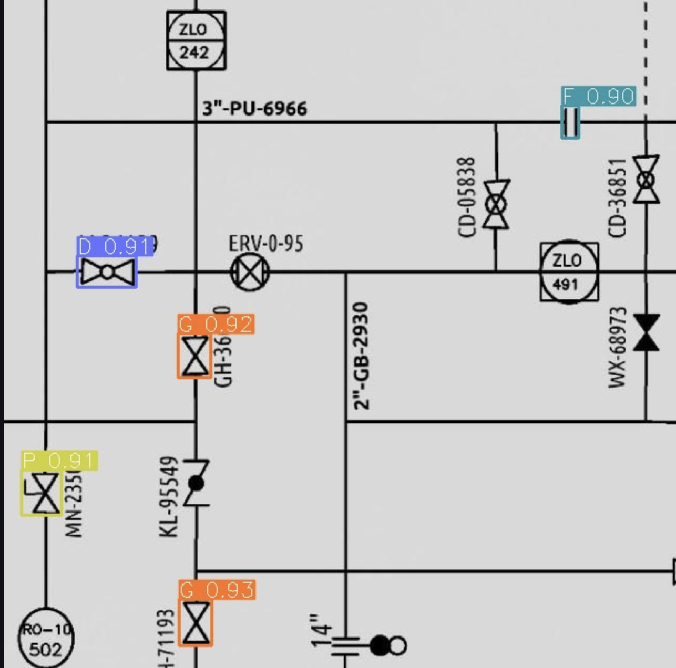
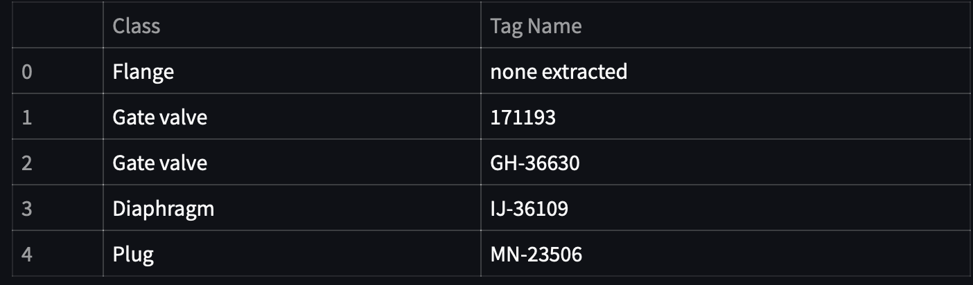
Tag name extraction
EasyOCR is a Python library that provides a simple and convenient way to perform Optical Character Recognition (OCR) on images.

Slide 15
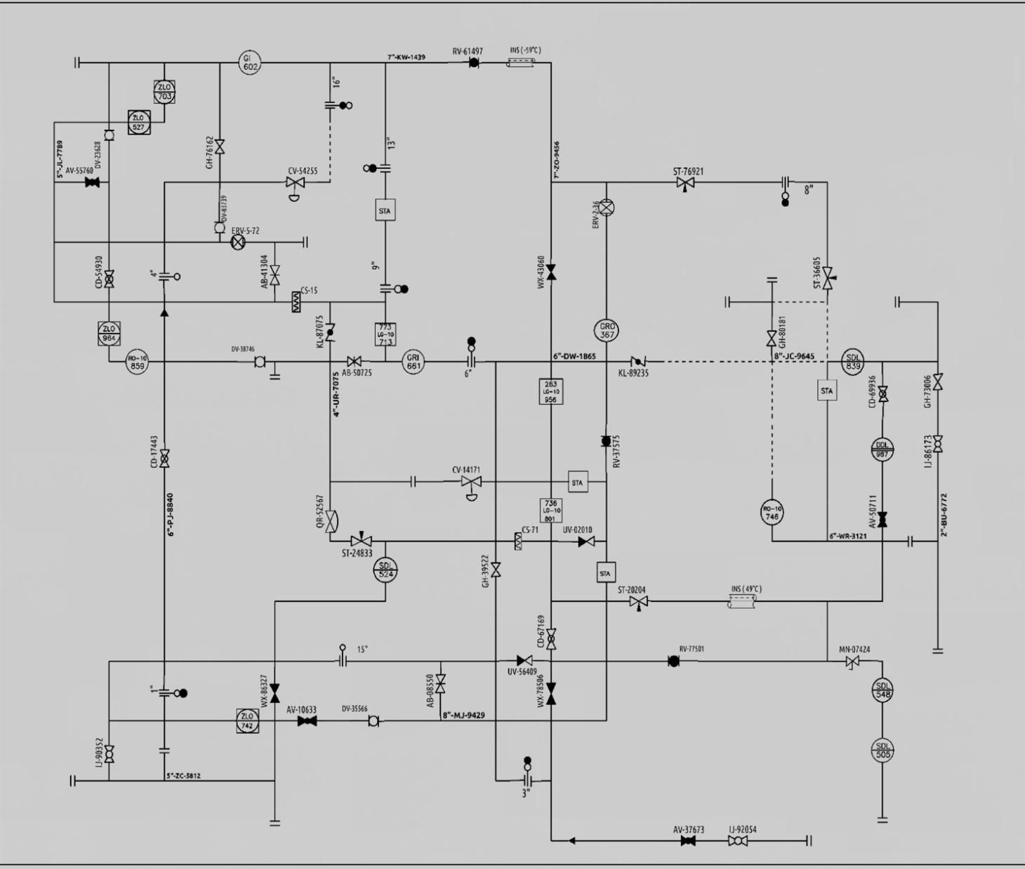
VALIDATION METRICS
 | Gate valve | Rotary valve | Flange | Plug | Diaphram
Actual components | 4 | 4 | 14 | 1 | 3
Predicted components | 4 | 4 | 15 | 3 | 3

Slide 16
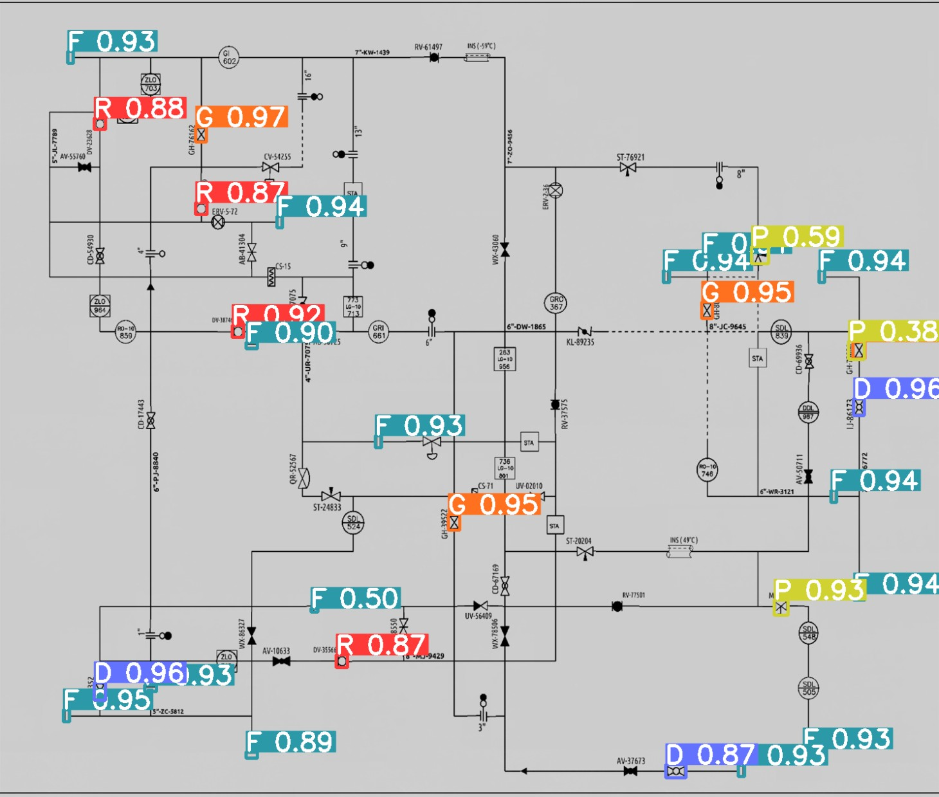
 | PRECISION | RECALL | F1-SCORE
Gate valve | 1.0 | 1.0 | 1.0
Rotary valve | 1.0 | 1.0 | 1.0
Flange | 0.933 | 1.0 | 0.965
Plug | 0.333 | 1.0 | 0.5
Diaphram | 1.0 | 1.0 | 1.0

