Slide 1


Analyzing Byju's Failures and Challenges
Byju's, India's leading edtech startup, has experienced significant setbacks and challenges in recent years. This presentation provides a data-driven analysis of the key issues facing the company, including financial mismanagement, unprofitable acquisitions, and operational hurdles.
by Thirupathi P

Slide 2
Introduction to Byju's:
Byju's (stylised as BYJU'S) is an Indian multinational educational technology company, headquartered in Bengaluru.[4] It was founded in 2011 by Byju Raveendran and Divya Gokulnath. As of October 2024, various media outlets reported that Byju's valuation has now plummeted to zero, down from its peak valuation of $22 billion in 2022.[5][6] In April 2023, the company claimed it had over 150 million registered students.
Rapid Expansion
Operational Challenges
Financial Strain
Byju's aggressive growth strategy led to a rapid expansion, including costly acquisitions and diversification into new verticals.
The company faced difficulties in integrating new businesses, streamlining operations, and maintaining high-quality customer service.
Byju's financial performance has been marked by mounting losses, cash flow issues, and concerns about its long-term sustainability.

Slide 3
Key Issues: Financial Mismanagement, Unprofitable Acquisitions, and Operational Hurdles
1
Financial Mismanagement
2
Unprofitable Acquisitions
3
Operational Hurdles
Byju's struggled to balance its revenue growth with effective cost control, leading to persistent losses and a weakened financial position.
The company's acquisition spree, including the purchases of WhiteHat Jr. and Aakash Educational Services, failed to deliver the expected returns.
Integration challenges, scalability issues, and difficulties in maintaining quality standards across its expanding portfolio of products and services.

Slide 4
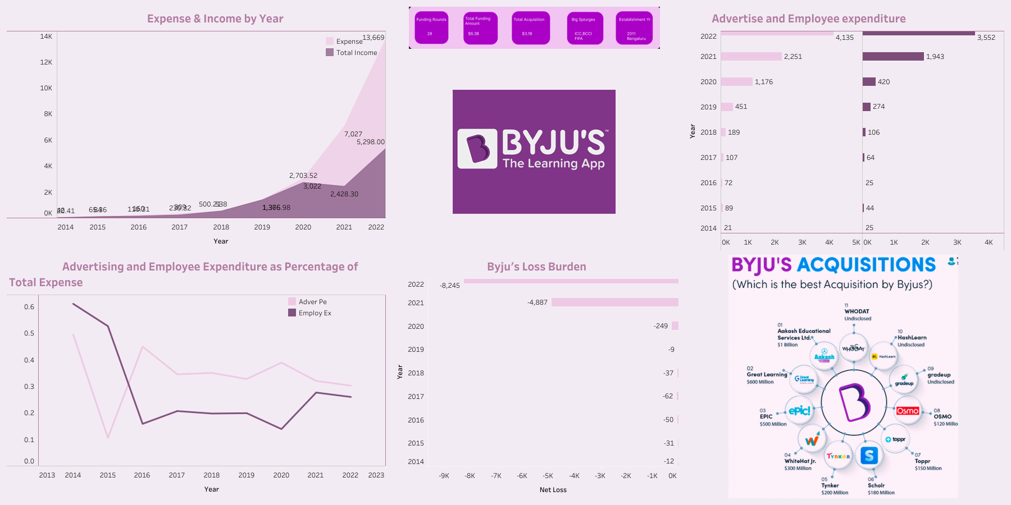
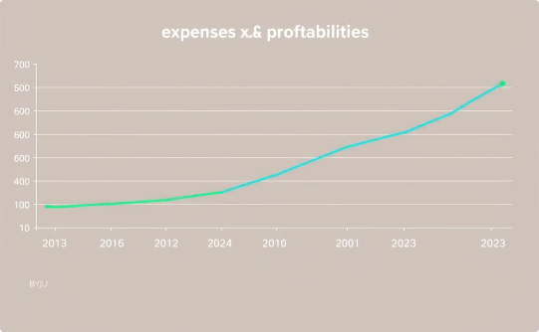
Tableau Dashboard: Visual Insights into Byju's Financial and Operational Metrics
Cost and Profitability
Customer Metrics
Evaluate Byju's ability to manage its expenses and maintain a sustainable profit margin.

Slide 5

Income vs. Expenses: Visualizing the Financial Imbalance and Its Impact
1
Revenue Growth
Byju's achieved impressive revenue growth, driven by its expanding user base and diversification into new product offerings.
2
Expense Escalation
However, the company's expenses grew at an even faster rate, driven by factors such as aggressive marketing, high customer acquisition costs, and inefficient operations.
3
Financial Imbalance
The widening gap between income and expenses resulted in mounting losses, putting strain on Byju's financial sustainability and long-term viability.

Slide 6
Recommendations: Lessons for Sustainable Growth and Profitability
Focus on Profitability:
Smart Acquisitions:
Avoid over-reliance on debt and unsustainable growth strategies.
Prioritize acquisitions that align with core business goals and ensure ROI.
Streamline Operations:
Transparent Communication:
Optimize costs and build a leaner, more efficient workforce.
Maintain trust with investors and employees through consistent and open communication.

Slide 7
Conclusion: Key Takeaways and Next Steps
Byju’s rapid growth came at the cost of long-term sustainability. This analysis highlights the importance of balancing ambition with financial discipline and operational efficiency. Learning from Byju’s challenges, other companies can build sustainable growth models that focus on profitability, operational stability, and stakeholder trust.
Thank you

