Slide 1
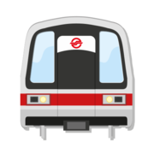
Track My MRT

Slide 2
What Does Our app do?
Tracks your MRT’s arrival time and fare.
Locate your boarding and destination station and current location.
Share your current location via SMS.
Share the timings, fare and other details by sending screen shot via Airdrop, WhatsApp and so on.
MRT guide map for quick reference.

Slide 3
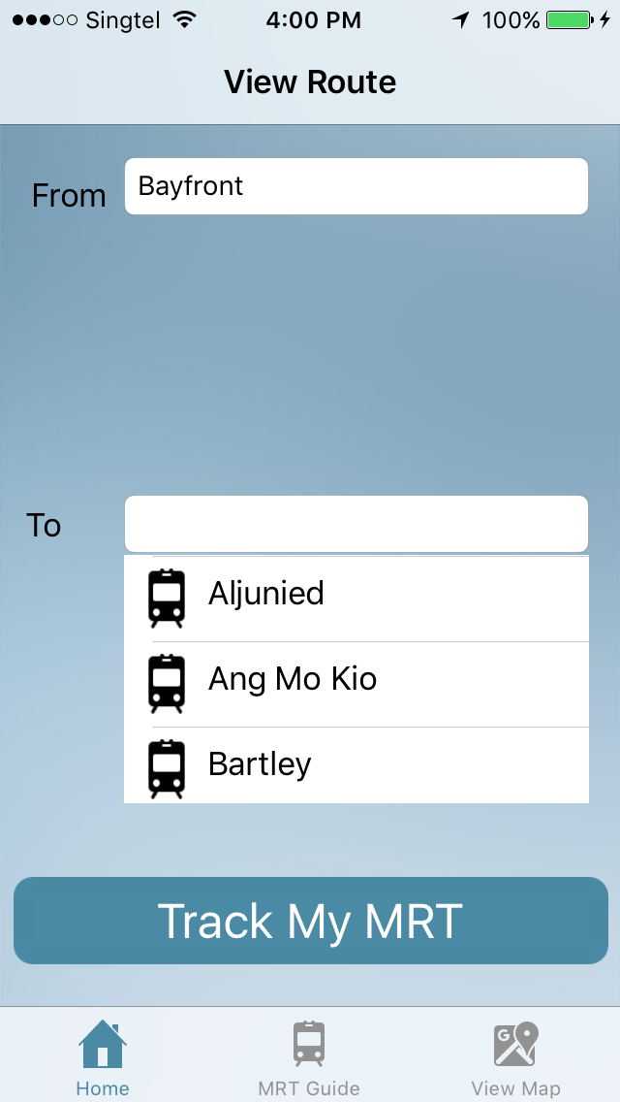
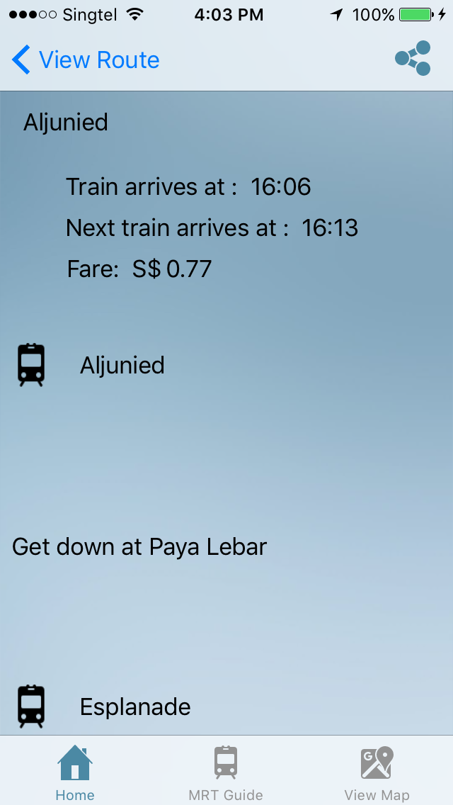

Home Screen

Slide 4
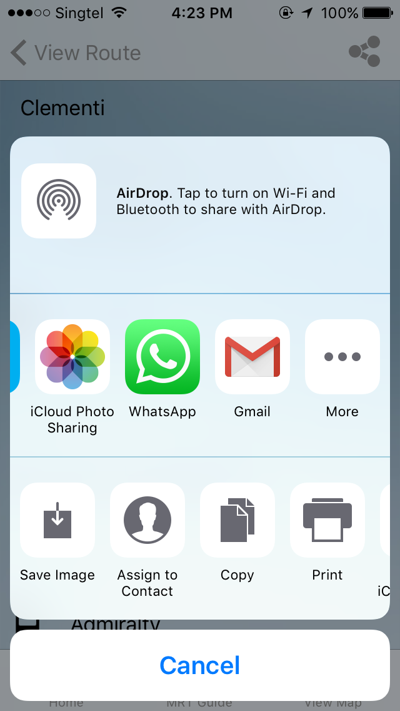
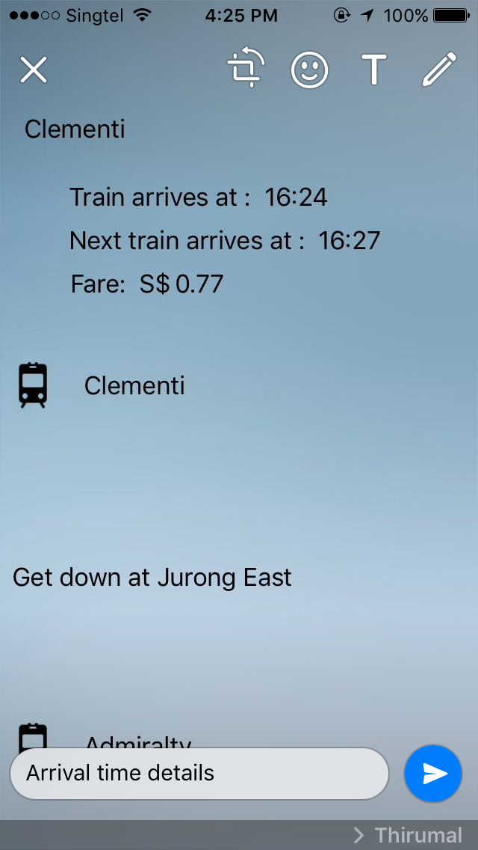
SHARING

Slide 5
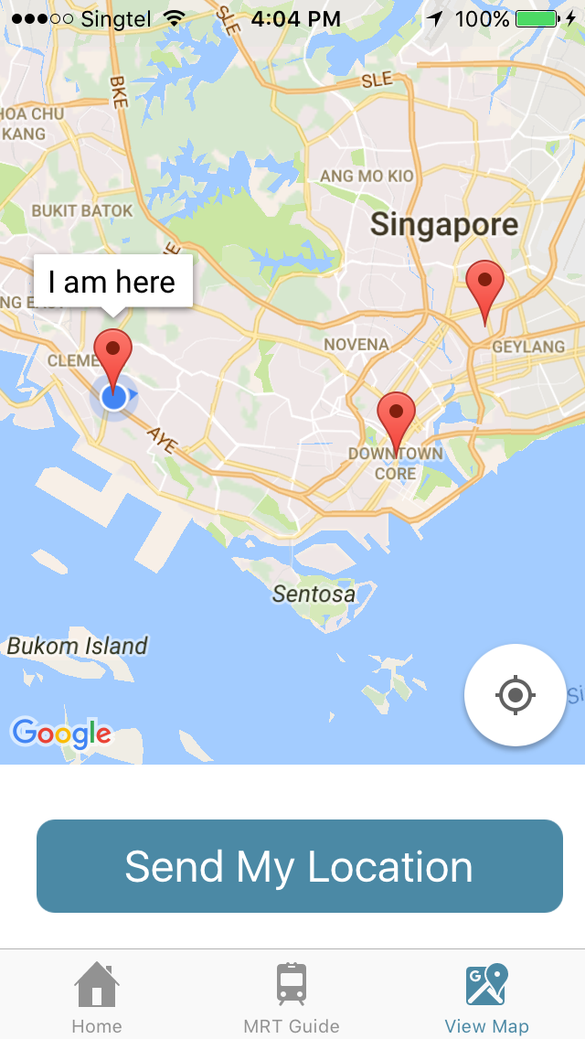
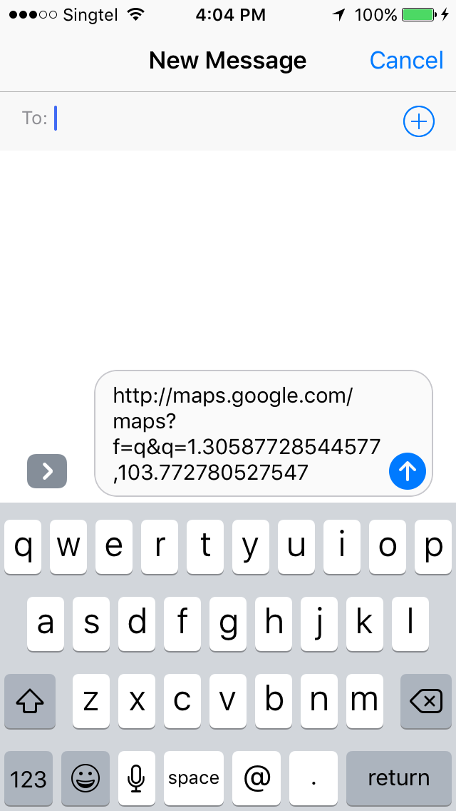
Location

Slide 6
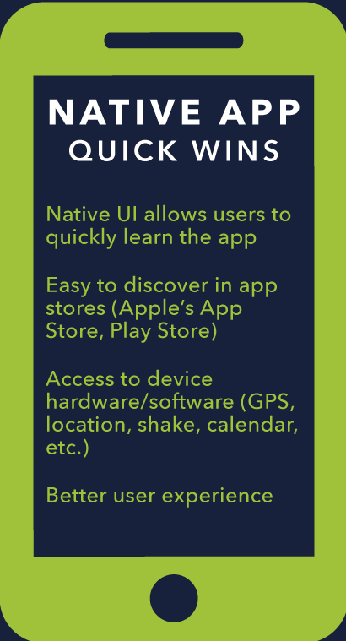
We chose Native over hybrid---WHY???
Users expect your app to launch faster than a website,
are very concerned with mobile app performance,
and if they have a poor user experience,
they will most likely stop using your app and switch to a competitor’s app
Native Apps have easier access to device sensors (GPS, accelerometer, etc.)
Better user experience.

Slide 7
Thank you

