Slide 1
Hadoop Distributed File System(HDFS)
Features
Write Once Read Many
Fault tolerance by default
Data replication happens all the time
Runs on commodity Hardware
Moves code to where data resides

Slide 2
HDFS Architecture
Master-Slave Architecture:
One NameNode per cluster(Master)
has meta data about cluster
allocates work to data node
manage cluster
One DataNode per node(Slaves)
storage
read –write operations

Slide 3
WHAT IS MAP AND REDUCE?
Map
A function
Works on 1 line of the file at a time
Output is keys and values
Reduce
Works on one key at a time
Output is key and values

Slide 4
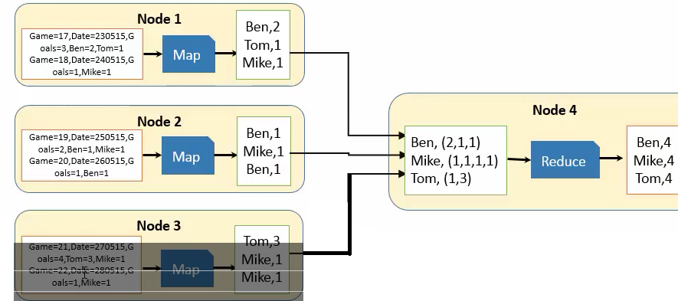
MapReduce

Slide 5
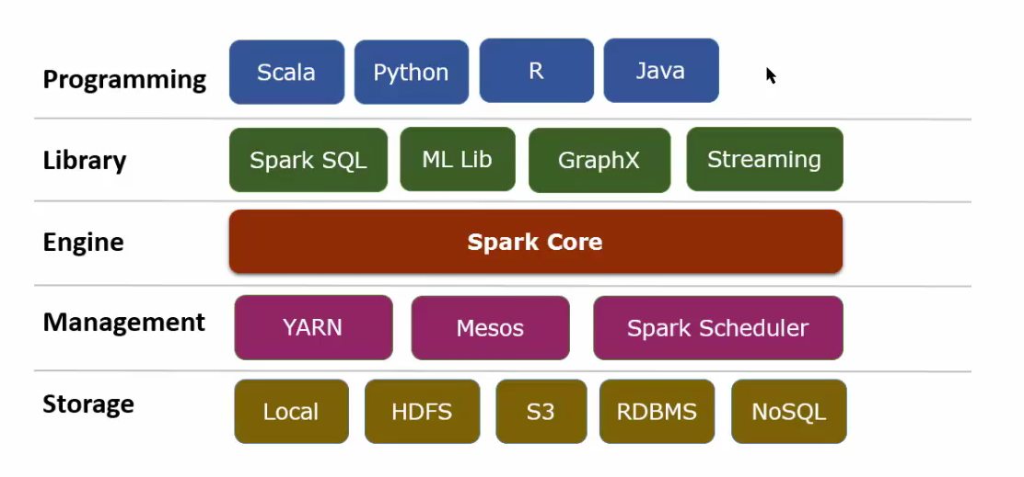
Spark Framework

Slide 6
Resilient Distributed Datasets(RDD)
Spark is built around RDDs. You create, transform, analyze and store RDDs in Spark program
The Dataset contains a collection of elements of any type
String, Lines, rows, objects, collections
The Dataset can be partitioned and distributed across multiple nodes
RDDs are immutable. They can’t be changed
They can be cached and persisted
Transformations act on RDDs to create a new RDD

Slide 7
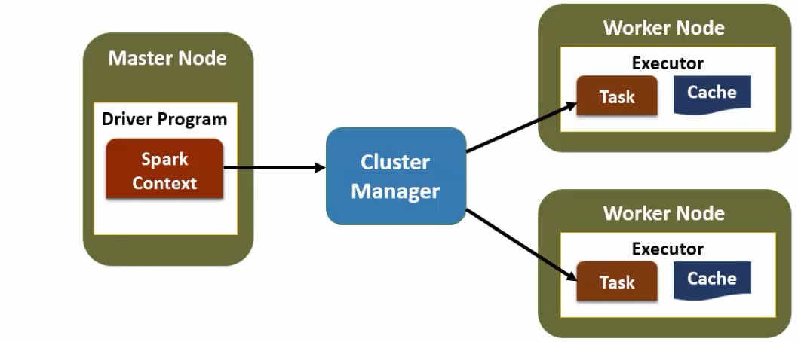
Spark Architecture

Slide 8
Overview
Perform operation on one RDD and create a new RDD
Operate on one element at a time
Lazy Evaluation
Can be distributed across multiple nodes based on partition they act upon

Slide 9
Map
newRdd=rdd.map(function)
Works similar to the Map Reduce “Map”
Act upon each element and perform some operation
Element level computation or transformation
Result RDD may have the same number of elements as original RDD
Result can be of different type
Can pass functions to this operation to perform complex task

Slide 10
flatMap
newRdd=rdd.flatMap(function)
Works the same way as map
Can return more elements than the original map
Use to break up elements in the original map and create a new map
Split strings in the original map
Extract child elements from a nested json string

Slide 11
Filter
newRdd=rdd.filter(function)
Filter a RDD to select elements that match a condition
Result RDD smaller than the original RDD
A function can be passed as a condition to perform complex filtering
Returns a true/false

Slide 12
Set Operations
Set Operations are performed on two RDDs
Union-Return a new dataset that contains the union of two elements in the source dataset and the argument.
unionRDD=firstRDD.union(secondRDD)

Slide 13
Introduction to actions
Act on a RDD and product a result(not a RDD)
Lazy evaluation-Spark does not act until it sees an action
Simple actions
collect-return all elements in the RDD as an array. Use to trigger execution or print values
count-count the number of elements in the RDD
first- returns the first element in the RDD
take(n)-returns the first n elements

Slide 14
reduce
Perform an operation across all the elements of an RDD
sum,count etc.
The operation is a function that takes as input two values
The functions is called for every element in the RDD
inputRDD-[a,b,c,d,e] and the function is func(x,y)
Func(func(func(func(a,b),c),d),e)
Example
vals=[3,5,2,4,1]
sum(x,y) { return x+y }
sum( sum( sum( sum(3,5), 2) ,4) ,1)=15

