Slide 1
Internship Details
About our Internship

Slide 2
Introduction
Company Name : Onebill Softwares Pvt. Ltd.
Location : Bangalore
Internship Period : 3 Months

Slide 3
Technologies We Learned
Core-Java
Git and Github
SQL
Servlet and JSP
Spring-Core
Hibernate with JPA
HTML and CSS
Java Script

Slide 4

Uses:
Standalone applications
OOPS concepts (Data Abstraction, Encapsulation, Inheritance, Polymorphism)
Basic Java constructs like loops and data types.
String handling.
Collection framework.
Multithreading.
Exception handling.
Generics.
Synchronisation
Serialisation & De-serialisation

Slide 5
Features of Core java and advanced Java
For developing any advanced java application, one must have a good grasp over the concepts of Core java
Core java covers some topics like data types, OOP, operators exception handling, swing, threading and collections
Where Advanced java covers the topics like web services, database connectivity, jsp, servlets and EJB, etc.
Core java used to create a standalone application---A standalone application is an application that runs locally on the device and doesn't require anything else to be functional. All the logic is built into the app, so it doesn't need an internet connection nor any other services installed.

Slide 6

Spring Core
Dependency Injection
Inversion of Control
Aspect Oriented Programming
Model-View-Controller

Slide 7
Spring Framework
Advantages:
Predefined Templates for JDBC, Hibernate, JPA
Loose Coupling
Easy to Test
Light Weight – It does not force the programmer to inherit any class or implement any interface.

Slide 8
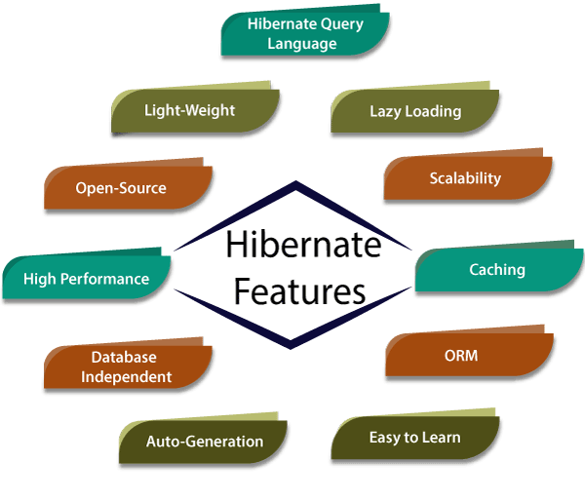
Hibernate

Slide 9
Hibernate
Hibernate is a Java framework that simplifies the development of Java application to interact with the database.
Hibernate's primary feature is mapping from Java classes to database tables, and mapping from Java data types to SQL data types. Hibernate also provides data query and retrieval facilities. It generates SQL calls and relieves the developer from the manual handling and object conversion of the result set
Following are the advantages of hibernate framework:
1) Open Source and Lightweight. Hibernate framework is open source under the LGPL license and lightweight.
2) Fast Performance. ...
3) Database Independent Query. ...
4) Automatic Table Creation. ...
5) Simplifies Complex Join. ...
6) Provides Query Statistics and Database Status.

Slide 10
Design patterns
Factory Design pattern
Singleton Design pattern
Prototype Design pattern
Template Design pattern

Slide 11
